Slide 1
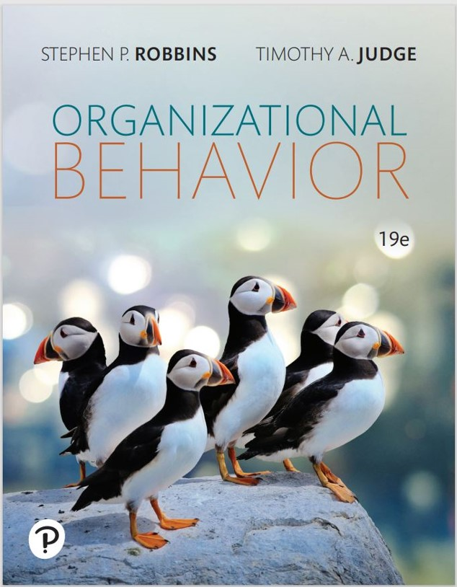

Organizational Behavior
Nineteenth Edition
Chapter 16
Organizational Culture and Change
Copyright © 2023, 2019, 2017 Pearson Education, Inc. All Rights Reserved
Notes:
If this PowerPoint presentation contains mathematical equations, you may need to check that your computer has the following installed:
1) MathType Plugin
2) Math Player (free versions available)
3) NVDA Reader (free versions available)
Welcome to this Organizational Behavior course that uses the 19th edition of the textbook, Organizational Behavior by Robbins and Judge. This is considered among the most widely used OB textbooks in the world. Robbins and Judge are recognized as definitive aggregators of OB concepts, applications, and practices. The course and this book will provide you with a resource that will benefit you throughout your degree program and your professional life.

Slide 2
Learning Objectives (1 of 2)
16.1 Describe the common characteristics of organizational culture.
16.2 Show how culture is transmitted to employees.
16.3 Identify the factors that create and sustain an organization’s culture.
16.4 Compare the functional and dysfunctional effects of organizational culture on people and the organization.
Notes:
After studying this chapter, you should be able to:
Describe the common characteristics of organizational culture.
Show how culture is transmitted to employees.
Identify the factors that create and sustain an organization’s culture.
Compare the functional and dysfunctional effects of organizational culture on people and the organization.

Slide 3
Learning Objectives (2 of 2)
16.5 Describe the similarities and differences in creating positive, ethical, and innovative cultures.
16.6 Discuss how change operates both within and outside organizations.
16.7 Compare the four main approaches to managing organizational change.
Notes:
After studying this chapter, you should be able to:
Describe the common characteristics of organizational culture.
Show how culture is transmitted to employees.
Identify the factors that create and sustain an organization’s culture.
Compare the functional and dysfunctional effects of organizational culture on people and the organization.

Slide 4
Common Characteristics of Organizational Culture (1 of 6)
A Definition of Organizational Culture
Organizational culture refers to a system of shared meaning held by members that distinguishes the organization from other organizations.
Values
Beliefs
Assumptions
Notes:
Organizational culture refers to a system of shared meaning held by members that distinguishes the organization from other organizations.

Slide 5
Common Characteristics of Organizational Culture (2 of 6)
Shared values, beliefs, and assumptions:
Filter what employees pay attention to.
Are physically manifested as material symbols and stories.
Form the foundation for shared meaning among members of an organization.
Notes:
The values, beliefs, and assumptions, when put into practice, (1) filter what employees pay attention to, (2) are physically manifested as material symbols (for example, uniforms, statues, etc.) and stories, and (3) form the foundation for shared meaning among members of an organization.

Slide 6
Common Characteristics of Organizational Culture (3 of 6)
Culture as a Descriptive Term
Organizational culture is concerned with employees’ perceptions of the characteristics of the culture, not whether they like them.
Does it encourage teamwork?
Does it reward innovation?
Does it stifle initiative?
It differs from job satisfaction:
Job satisfaction is evaluative.
Organizational culture is descriptive.
Notes:
Organizational culture is concerned with employees’ perceptions of the characteristics of the culture, not whether they like them. Research has sought to measure how employees see their organization by asking questions like “Does it encourage teamwork? ,” “Does it reward innovation? ,” and “Does it stifle initiative?” Organizational culture differs from job satisfaction in that job satisfaction is evaluative while organizational culture is descriptive.

Slide 7
Common Characteristics of Organizational Culture (4 of 6)
Exhibit 16.2 The Effect of Culture on Organizational Outcomes
Culture | Attitudes & Performance | Innovation | Quality & Efficiency | Customer Satisfaction | Profitability & Revenue Growth
Clan | +* | +* | 0 | +*
Adhocracy | +* | + | +* |  | 0
Market | 0 | + | +* | +* | 0
Hierarchy | +* |  | +* | 0 | +*
Note: + corresponds with a positive effect on the outcome, - corresponds with a negative effect on the outcome, 0 corresponds with no effect on the outcome, * suggests the culture is strongly related to the outcome.
Source: Based on findings from C. A. Hartnell, A. Y. Ou, A. J. Kinicki, D. Choi, and E. P. Karam, “A Meta-Analytic Test of Organizational Culture’s Association With Elements of an Organization’s System and Its Relative Predictive Validity on Organizational Outcomes,” Journal of Applied Psychology 104, no. 6 (2019): 832–50.
Notes:
A common culture framework groups organizations into one of four types, each which has its own assumptions, beliefs, values, artifacts, and even criteria for effectiveness:
1. “The Clan.” A culture which is based on human affiliation. Employees value attachment, collaboration, trust, and support.
2. “The Adhocracy.” A culture which is based on change. Employees value growth, variety, attention to detail, stimulation, and autonomy.
3. “The Market.” A culture which is based on achievement. Employees value communication, competence, and competition.
4. “The Hierarchy.” A culture which is based on stability. Employees value communication, formalization, and routine.
The differences between these cultures are reflected in their internal vs. external focus and their flexibility and stability.
As shown in Exhibit 16.2, the various cultures differ regarding how they influence organizational outcomes.

Slide 8
Common Characteristics of Organizational Culture (5 of 6)
Do Organizations Have Uniform Cultures?
Most organizations have a dominant culture and numerous sets of subcultures.
The dominant culture expresses the core values a majority of members share and that give the organization distinct personality.
Subcultures tend to develop in large organizations to reflect common problems, situations, or experiences that members face.
Notes:
Most organizations have a dominant culture and numerous sets of subcultures. The dominant culture expresses the core values that are shared by a majority of the organization’s members. Subcultures tend to develop in large organizations to reflect common problems, situations, or experiences that members face.
If organizations were composed only of numerous subcultures, organizational culture as an independent variable would be significantly less powerful. It is the “shared meaning” aspect of culture that makes it such a potent device for guiding and shaping behavior.

Slide 9
Common Characteristics of Organizational Culture (6 of 6)
Strong Versus Weak Cultures
Strong culture: core values are intensely held and widely shared.
The more members who accept the core values and the greater their commitment, the stronger the culture and the greater its influence on member behavior.
Notes:
In a strong culture, core values are intensely held and widely shared. Moreover, the more members accept the core values, and the greater their commitment to those values, the stronger the culture is. The unanimity of purpose builds cohesiveness, loyalty, and organizational commitment, and in doing so, reduces employee turnover. High formalization creates predictability, orderliness, and consistency.
A strong culture should more directly affect organizational outcomes because it demonstrates high agreement about what the organization represents. Such unanimity of purpose builds cohesiveness, loyalty, meaning, and organizational commitment.

Slide 10
How Is Culture Transmitted to Employees?
How employees learn culture
Stories
Ford Motor Company
Nike
Rituals
Symbols
Material symbols
Language
Notes:
Culture is transmitted in several forms, the most potent being stories, rituals, material symbols, and language.
Stories. When Henry Ford II was chair of Ford Motor Company, you would have been hard-pressed to find a manager who had not heard how he reminded his executives, when they got too arrogant, “It’s my name that’s on the building.” The message was clear: Henry Ford II ran the company. As another example, several senior Nike executives spend much of their time serving as corporate storytellers. When they tell how cofounder (and Oregon track coach) Bill Bowerman went to his workshop and poured rubber into a waffle iron to create a better running shoe, they are talking about Nike’s spirit of innovation.
Rituals are repetitive sequences of activities that express and reinforce the key values of the organization—what goals are most important and/or which people are important versus which are expendable.
Symbols. The layout of corporate headquarters, the types of automobiles top executives are given, and the presence or absence of corporate aircraft are a few examples of material symbols, sometimes also known as artifacts.
Language. Many organizations and subunits within them use language to help members identify with the culture, attest to their acceptance of it, and help preserve it. Unique terms describe equipment, officers, key individuals, suppliers, customers, or products related to the business.

Slide 11
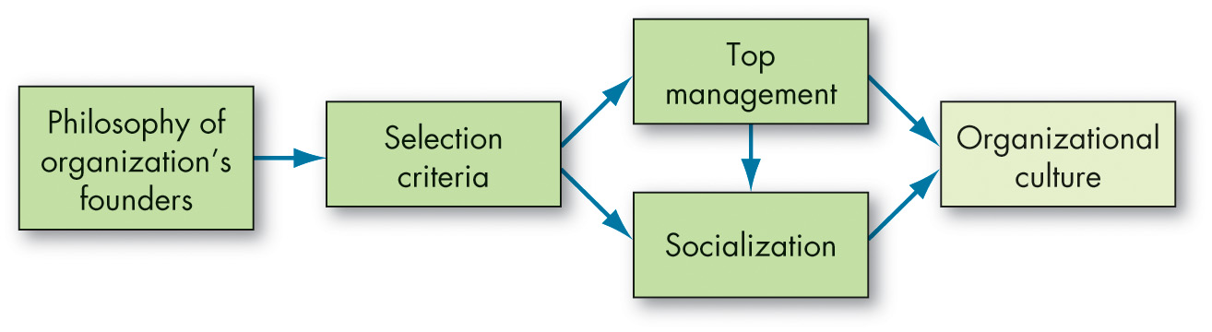
Creating and Sustaining Culture (1 of 7)
Exhibit 16.3 How Organizational Cultures Form
Notes:
So, how does a culture begin? The ultimate source of an organization’s culture is its founders. Founders have the vision of what the organization should be.
Exhibit 16.3 summarizes how an organization’s culture is established and sustained. The original culture derives from the founder’s philosophy and strongly influences hiring criteria as the firm grows. The success of socialization depends on the deliberateness of matching new employees’ values to those of the organization in the selection process and on top management’s commitment to socialization programs. Top managers’ actions set the general climate, including what is acceptable behavior and what is not, and employees sustain and perpetuate the culture. The culture then becomes linked and entrenched within the organizational structures and systems and is perpetuated by leadership.
Long Description:
the flowchart starts with the Philosophy of organization's founders, which points to Selection Criteria. The selection criteria points to two more components: Top Management and Socialization. An arrow also points from the Top management to Socialization. Finally, Top management and Socialization together lead to last step Organizational culture.

Slide 12
Creating and Sustaining Culture (2 of 7)
Culture creation occurs in three ways:
Founders hire employees who think and feel the way they do.
Employees are indoctrinated and socialized into the founders’ way of thinking.
Founders’ own behavior encourages employees to identify with them and internalize their beliefs, values, and assumptions.
Notes:
Culture creation occurs in three ways. First is when founders hire employees who think and feel the way they do. Second, employees are indoctrinated and socialized into the founders’ way of thinking. And third, the founders’ themselves act as role models, encouraging employees to identify with them and internalize their beliefs, values, and assumptions through their own behaviors.

Slide 13
Creating and Sustaining Culture (3 of 7)
Keeping a Culture Alive
Selection
Identify and hire individuals with the knowledge, skills, and abilities to perform successfully.
Two-way street.
Top Management
Establish norms of behavior.
Socialization
A process which enables new employees to acquire the social knowledge and necessary skills in order to adapt to the organization’s culture.
Notes:
So how can cultures be sustained? The first way is in the selection of employees. The explicit goal of the selection process is to identify and hire individuals with the knowledge, skills, and abilities to perform successfully. The final decision, because it’s significantly influenced by the decision maker’s judgment of how well the candidates will fit into the organization, identifies people whose values are essentially consistent with at least a good portion of the organization’s.
Selection also provides information to applicants. Those who perceive a conflict between their values and those of the organization can remove themselves from the applicant pool. Selection thus becomes a two-way street, allowing employer or applicant to avoid a mismatch and sustaining an organization’s culture by selecting out those who might attack or undermine its core values.
The actions of top management also have a major impact on the organization’s culture. Through words and behavior, senior executives establish norms that filter through the organization about, for instance, whether risk-taking is desirable, how much freedom managers give employees, what is appropriate dress, and what actions earn pay raises, promotions, and other rewards.
Third, no matter how good a job the organization does in recruitment and selection, new employees need help adapting to the prevailing culture. This help comes in the form of socialization.

Slide 14
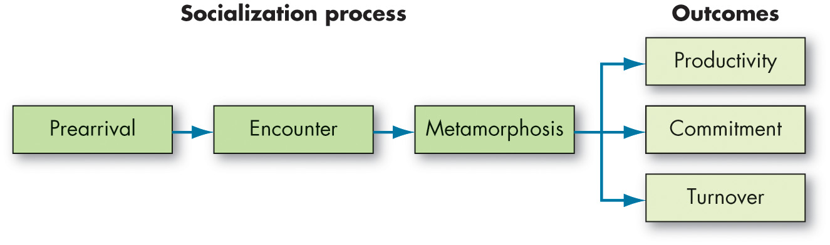
Creating and Sustaining Culture (4 of 7)
Exhibit 16.4 A Socialization Model
Notes:
The socialization component of sustaining a culture is shown in Exhibit 16.4. Socialization is the process of helping new employees adapt to the organization’s culture. The socialization model is a three-stage process.
The first stage is prearrival, which explicitly recognizes that each individual arrives with a set of values, attitudes, and expectations. One way to capitalize on prehire characteristics in socialization is to use the selection process to inform prospective employees about the organization as a whole. The selection process ensures the inclusion of the “right type”—those who will fit in.
The second stage is encounter, in which the individual confronts the possible dichotomy between expectations and reality. If expectations were fairly accurate, the encounter stage merely cements earlier perceptions. However, this is often not the case. At the extreme, a new member may become disillusioned enough to resign. Proper recruiting and selection should significantly reduce that outcome, along with encouraging friendship ties in the organization—newcomers are more committed when friends and coworkers help them “learn the ropes.”
Finally, to work out any problems discovered during the encounter stage, the new member changes or goes through the metamorphosis stage.
Long Description:
The model has two parts : Socialization Process and Outcomes. The Socialization process shows three steps, each pointing to the next: Prearrival, Encounter, Metamorphosis.
The Socialization process points to three outcomes which are labeled as: Productivity, Commitment, and Turnover.

Slide 15
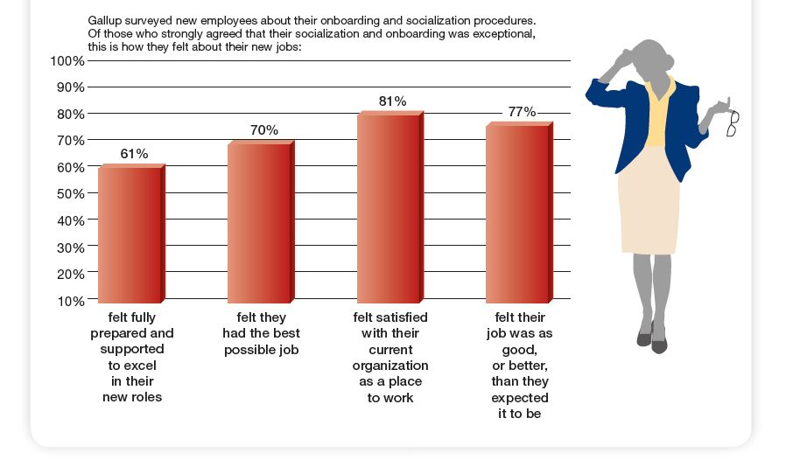
Creating and Sustaining Culture (5 of 7)
OB POLL Exceptional Socialization Shapes Employee Expectations
Source: Based on Gallup, Creating an Exceptional Onboarding Journey for New Employees (Washington, DC: Gallup, 2019).
Notes:
Socialization can help alleviate the problem many employees report that their new jobs are different than expected (see OB Poll).
Long Description:
The horizontal axis is marked with the satisfaction levels. The vertical axis is marked with the percentage and ranges from 10 percent to 100 percent in increments of 10. The data from the graph is as follows. Felt fully prepared and supported to excel in their new roles: 61 percent. Felt they had the best possible job: 70 percent. Felt satisfied with their current organization as a place to work: 81 percent. Felt their job was as good, or better, than they expected it to be: 77 percent.
Notes above the graph reads: Gallup surveyed new employees about their onboarding and socialization procedures. Of those who strongly agreed that their socialization and onboarding was exceptional, this is how they felt about their new jobs.

Slide 16
Creating and Sustaining Culture (6 of 7)
Exhibit 16.5 Socialization Practices
Formal vs. Informal The more a new employee is segregated from the ongoing work setting and differentiated in some way to make explicit their newcomer’s role, the more socialization is formal. Specific orientation and training programs are examples. Informal socialization puts the new employee directly into the job, with little or no special attention.
Individual vs. Collective New members can be socialized individually. This describes how it is done in many professional offices. They can also be grouped together and processed through an identical set of experiences, as in military boot camp.
Fixed vs. Variable This refers to the time schedule in which newcomers make the transition from outsider to insider. A fixed schedule establishes standardized stages of transition. This characterizes rotational training programs. It also includes probationary periods, such as the 8- to 10-year “associate” status used by accounting and law firms before deciding on whether or not a candidate is made a partner. Variable schedules give no advance notice of their transition timetable. Variable schedules describe the typical promotion system, in which one is not advanced to the next stage until one is “ready.”
Notes:
The options presented in Exhibit 16.5 are alternatives designed to bring about metamorphosis.

Slide 17
Creating and Sustaining Culture (7 of 7)
Exhibit 16.5 Socialization Practices
Serial vs. Random Serial socialization is characterized by the use of role models who train and encourage the newcomer. Apprenticeship and mentoring programs are examples. In random socialization, role models are deliberately withheld. New employees are left on their own to figure things out.
Investiture vs. Divestiture Investiture socialization assumes that the newcomer’s qualities and qualifications are the necessary ingredients for job success, so these qualities and qualifications are confirmed and supported. Divestiture socialization tries to strip away certain characteristics of the recruit. Fraternity and sorority “pledges” go through divestiture socialization to shape them into the proper role.
Notes:
The options presented in Exhibit 16.5 are alternatives designed to bring about metamorphosis.

Slide 18
What Do Cultures Do? (1 of 8)
The Functions of Culture
Boundary-defining role.
Conveys a sense of identity for members.
Facilitates the generation of commitment.
Enhances the stability of the social system.
Serves as a sense-making and control mechanism.
Notes:
What role does culture perform? Cultures can be positive or negative for organizations. Culture is a boundary-defining role; it conveys a sense of identity for members; it facilitates the generation of commitment; it enhances the stability of the social system; and culture serves as a sense-making and control mechanism to guide and shape the attitudes and behavior of employees. In essence, culture defines the rules of the game.

Slide 19
What Do Cultures Do? (2 of 8)
Culture Creates Climate
Organizational climate is shared perceptions about the organization and work environment.
Team spirit at the organizational level.
Climates can interact with one another to produce behavior.
Climate also influences the habits people adopt.
Notes:
Organizational climate refers to the shared perceptions organizational members have about their organization and work environment. This aspect of culture is like team spirit at the organizational level. When everyone has the same general feelings about what’s important or how well things are working, the effect of these attitudes will be more than the sum of the individual parts. A positive overall workplace climate has been linked to higher customer satisfaction and financial performance.
Climates can interact with one another to produce behavior. For example, a positive climate for worker empowerment can lead to higher levels of performance in organizations that also have a climate for personal accountability.
Climate also influences the habits people adopt. If the climate for safety is positive, for example, everyone wears safety gear and follows safety procedures even if individually they wouldn’t normally think very often about being safe. Indeed, many studies have shown that a positive safety climate decreases the number of documented injuries on the job.

Slide 20
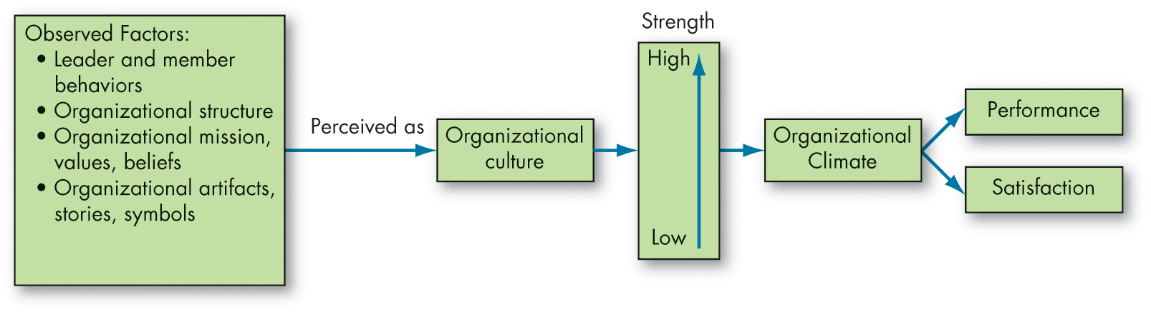
What Do Cultures Do? (3 of 8)
Exhibit 16.6 How Organizational Cultures Have an Impact on Employee Performance and Satisfaction
Notes:
Exhibit 16.6 depicts the impact of organizational culture.
Long Description:
The observed factors are perceived as organizational culture which points to strength that ranges from low to high represented by an upward facing arrow. The strength points to organizational climate which then branches to performance and satisfaction.

Slide 21
What Do Cultures Do? (4 of 8)
Culture as an Asset
Culture can significantly contribute to an organization’s bottom line in many ways.
Notes:
Culture can also significantly contribute to an organization’s bottom-line in many ways.

Slide 22
What Do Cultures Do? (5 of 8)
The Ethical Dimension of Culture
Organizational cultures are not neutral in their ethical orientation, even when they are not openly pursuing ethical goals.
Over time, the ethical culture, or the shared concept of right and wrong behavior in that workplace, develops as part of the organizational climate.
The ethical climate reflects the true values of the organization and shapes the ethical decision making of its members.
Notes:
Organizational cultures are not neutral in their ethical orientation, even when they are not openly pursuing ethical goals. Over time, the ethical culture, or the shared concept of right and wrong behavior in that workplace, develops as part of the organizational climate. The ethical climate reflects the true values of the organization and shapes the ethical decision making of its members.

Slide 23
What Do Cultures Do? (6 of 8)
Sustainability: practices that can be maintained over very long periods of time because the tools or structures that support the practices are not damaged by the processes.
Social sustainability practices.
Sustainable management doesn’t need to be purely altruistic.
To create a truly sustainable business, an organization must develop a long-term culture and put its values into practice.
Like other cultural practices we’ve discussed, sustainability needs time and nurturing to grow.
Notes:
As the name implies, sustainability refers to practices that can be maintained over very long periods of time because the tools or structures that support the practices are not damaged by the processes.
One survey found that a great majority of executives saw sustainability as an important part of future success.
Social sustainability practices address the ways social systems are affected by an organization’s actions over time, and in turn, how changing social systems may affect the organization. For example, farmers in Australia have been working collectively to increase water use efficiency, minimize soil erosion, and implement tilling and harvesting methods that ensure long-term viability for their farm businesses. In a very different context, 3M has an innovative pollution-prevention program rooted in cultural principles of conserving resources, creating products that have minimal effects on the environment, and collaborating with regulatory agencies to improve environmental effects.
Sustainable management doesn’t need to be purely altruistic. To create a truly sustainable business, an organization must develop a long-term culture and put its values into practice. In other words, there needs to be a sustainable system for creating sustainability! In one workplace study, a company seeking to reduce energy consumption found that soliciting group feedback reduced energy use significantly more than simply issuing reading materials about the importance of conservation. In other words, talking about energy conservation and building the value into the organizational culture resulted in positive employee behavioral changes.
Like other cultural practices we’ve discussed, sustainability needs time and nurturing to grow.

Slide 24
What Do Cultures Do? (7 of 8)
Culture and Innovation
The most innovative companies have open, unconventional, collaborative, vision-driven, and accelerating cultures.
Startup firms often have innovative cultures.
They are usually small, agile, and focused on solving problems in order to survive and grow.
Notes:
The most innovative companies are often characterized by their open, unconventional, collaborative, vision-driven, and accelerating cultures. Startup firms often have innovative cultures by definition because they are usually small, agile, and focused on solving problems in order to survive and grow.

Slide 25
What Do Cultures Do? (8 of 8)
Culture as a Liability
Stagnation and entrenchment
Uniformity and rigidity
Toxicity and dysfunctions
Cultural clashes
Notes:
While culture can certainly enhance an organization, it can also be a liability. Four major factors that signal a negative organizational culture are stagnation and entrenchment, uniformity and rigidity, toxicity and dysfunctions, and cultural clashes.

Slide 26
Influencing an Organizational Culture (1 of 3)
There is a trend today for organizations to attempt to create a positive organizational culture:
Emphasizes building on employee strengths.
Rewards more than it punishes.
Emphasizes individual vitality growth.
Positive culture is not a cure-all.
Toxic positivity
Notes:
There is a trend today for organizations to attempt to create a positive organizational culture, one that emphasizes building on employee strengths, rewards more than it punishes, and emphasizes individual vitality growth. Keep in mind though, that a positive culture is not a cure-all. There may be benefits to establishing a positive culture, but an organization also needs to be objective and not pursue it past the point of effectiveness. Positivity that has been taken to the extreme is referred to as toxic positivity— an approach that imposes unrealistic and psychologically damaging effects on employees who are pressured to be perfect and pure while actively avoiding perfectly natural negative states and conditions.

Slide 27
Influencing an Organizational Culture (2 of 3)
Developing an Ethical Culture:
Be a visible role model.
Communicate ethical expectations.
Provide ethics training.
Visibly reward ethical acts and punish unethical ones.
Provide protective mechanisms.
Notes:
Management can create a more ethical culture by following a few simple principles. First, be a visible role model: employees look to top management behavior as a benchmark. Second, communicate ethical expectations: a code of ethics can minimize ethical ambiguities. Third, provide ethical training: training sessions should reinforce standards of conduct and clarify permissible practices. Fourth, visibly reward ethical acts and punish unethical ones: performance appraisal of managers should include analysis of behavior against code of ethics. Finally, provide protective mechanisms: create a support network of ethical counselors, ombudsmen, or ethics officers.

Slide 28
Influencing an Organizational Culture (3 of 3)
Developing an Innovative Culture
Sources of innovation
Context and innovation
Idea champions and innovation
Idea champion: individuals who take an innovation and actively and enthusiastically promote the idea, build support, overcome resistance, and ensure that the idea is implemented.
Notes:
How can an organization become more innovative?
Sources of innovation. Organic structures positively influence innovation; contingent rewards positively influence innovation; innovation is nurtured when there are slack resources; and interunit communication is high in innovative organizations.
Context and innovation. Innovative organizations tend to have similar contextual features. First, they encourage experimentation, reward both successes and failures, and celebrate mistakes. Second, they tend to share a common vision as well as underlying goals. Third, they also tend to be cohesive, mutually supportive, and encouraging of innovation. Fourth, they leverage human resources (HR) systems to promote innovation.
Idea champions and innovation. Once a new idea has been developed, idea champions actively and enthusiastically promote it, build support, overcome resistance, and ensure it is implemented.

Slide 29
How Change Operates Within and Outside Organizations (1 of 6)
Exhibit 16.7 Forces for Change
Force | Examples
Nature of the workforce | More cultural diversity Aging population Increased immigration and outsourcing
Technology | Faster, cheaper, and more mobile computers and handheld devices Emergence and growth of social networking sites Deciphering of the human genetic code
Economic shocks | Rise and fall of global housing market Financial sector collapse Global recession
Competition | Global competitors Mergers and consolidations Increased government regulation of commerce
Notes:
Exhibit 16.7 shows examples of forces behind organizational change.

Slide 30
How Change Operates Within and Outside Organizations (2 of 6)
Force | Examples
Social trends | Increased environmental awareness Liberalization of attitudes toward gay, lesbian, and transgender employees More multitasking and connectivity
World politics | Rising health care costs Negative social attitudes toward business and executives Opening of new markets worldwide

Slide 31
How Change Operates Within and Outside Organizations (3 of 6)
The Nature of Change
Change: when things become different than the way they were.
Planned change: change activities that are proactive, intentional, and goal-oriented.
Change agents: people who act as catalysts and assume the responsibility for managing change activities.
Notes:
Change is simply when things become different than the way they were. When changes are implemented, it leads to a natural redistribution of values, priorities, and resources that reverberate throughout the organization and transform employees interactions.
Planned change refers to change activities that are proactive, intentional, and goal-oriented. Change agents are people who act as catalysts and assume the responsibility for managing change activities.

Slide 32
How Change Operates Within and Outside Organizations (4 of 6)
Exhibit 16.8 Sources of Resistance to Change
Individual Sources
Habit—To cope with life’s complexities, we rely on habits or programmed responses. But when confronted with change, this tendency to respond in our accustomed ways becomes a source of resistance.
Security—People with a high need for security are likely to resist change because it threatens their feelings of safety.
Economic factors—Changes in job tasks or established work routines can arouse economic fears if people are concerned that they will not be able to perform the new tasks or routines to their previous standards, especially when pay is closely tied to productivity.
Fear of the unknown—Change substitutes ambiguity and uncertainty for the unknown.
Selective information processing—Individuals are guilty of selectively processing information in order to keep their perceptions intact. They hear what they want to hear, and they ignore information that challenges the world they have created.
Notes:
We often see change as threatening. Employees and managers alike who feel negatively toward a change cope by not thinking about it or even leaving the organization. These reactions can sap the organization of vital energy when it is most needed. Indeed, resisting change can be emotionally exhausting for employees. Exhibit 16.8 summarizes major forces for resistance to change, categorized by their sources.

Slide 33
How Change Operates Within and Outside Organizations (5 of 6)
Exhibit 16.8 Sources of Resistance to Change
Organizational Sources
Structural inertia—Organizations have built-in mechanisms—such as their selection processes and formalized regulations—to produce stability. When an organization is confronted with change, this structural inertia acts as a counterbalance to sustain stability.
Limited focus of change—Organizations consist of a number of interdependent subsystems. One cannot be changed without affecting the others. So limited changes in subsystems tend to be nullified by the larger system
Group inertia—Even if individuals want to change their behavior, group norms may act as a constraint.
Threat to expertise—Changes in organizational patterns may threaten the expertise of specialized groups.
Threat to established power relationships—Any redistribution of decision-making authority can threaten long-established power relationships within the organization.
Notes:
We often see change as threatening. Employees and managers alike who feel negatively toward a change cope by not thinking about it or even leaving the organization. These reactions can sap the organization of vital energy when it is most needed. Indeed, resisting change can be emotionally exhausting for employees. Exhibit 16.8 summarizes major forces for resistance to change, categorized by their sources.

Slide 34
How Change Operates Within and Outside Organizations (6 of 6)
How Can Managers Overcome Resistance to Change?
Communication
Participation
Building support and commitment
Developing positive relationships
Implementing changes fairly
Manipulation and cooptation
Selecting people who accept change
Coercion
Notes:
Eight tactics can help change agents deal with resistance to change:
Communication
Participation
Building support and commitment
Developing positive relationships
Implementing changes fairly
Manipulation and cooptation
Selecting people who accept change
Coercion
No discussion of resistance would be complete without a brief mention of the politics of change. Because change invariably threatens the status quo, it inherently implies political activity. The impetus for change is more likely to come from outside change agents, employees new to the organization (who have less invested in the status quo), or managers slightly removed from the main power structure. Managers who have spent a long time with an organization and who have achieved a senior position in the hierarchy are often major impediments to change.

Slide 35
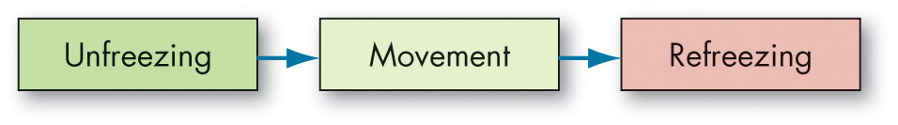
Comparing the Four Main Approaches to Managing Change (1 of 6)
Exhibit 16.9 Lewin’s Three-Step Change Model
Notes:
As shown in Exhibit 16.9, Kurt Lewin argued that successful change in organizations should follow three steps: unfreezing the status quo, movement to a desired end state, and refreezing the new change to make it permanent.

Slide 36
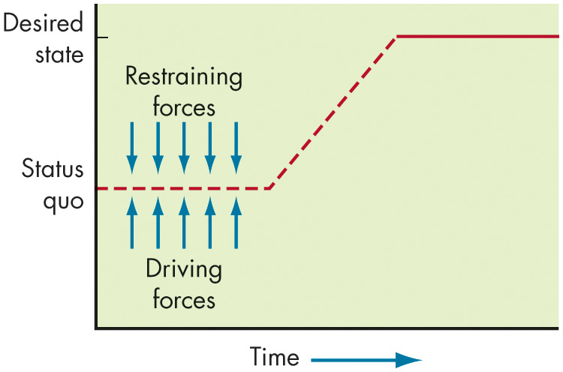
Comparing the Four Main Approaches to Managing Change (2 of 6)
Exhibit 16.10 Unfreezing the Status Quo
Notes:
By definition, status quo is an equilibrium state. To move from equilibrium—to overcome the pressures of both individual resistance and group conformity—unfreezing must happen in one of three ways (see Exhibit 16.10).
Long Description:
The graph shows horizontal axis labeled as time. The vertical axis is labeled as status quo in the middle and desired state at the top. A dotted line starting from status quo has restraining forces, represented with downward arrows, and driving forces represented with upward arrows, applying equal and opposite force on the line. As time passes, the line follows an upward step pattern and reaches the desired state as a straight line.

Slide 37
Comparing the Four Main Approaches to Managing Change (3 of 6)
Exhibit 16.11 Kotter’s Eight-Step Plan for Implementing Change
Establish a sense of urgency by creating a compelling reason for why change is needed.
Form a coalition with enough power to lead the change.
Create a new vision to direct the change and strategies for achieving the vision.
Communicate the vision throughout the organization.
Empower others to act on the vision by removing barriers to change and encouraging risk taking and creative problem solving.
Plan for, create, and reward short-term “wins” that move the organization toward the new vision.
Consolidate improvements, reassess changes, and make necessary adjustments in the new programs.
Reinforce the changes by demonstrating the relationship between new behaviors and organizational success.
Notes:
John Kotter built on Lewin’s three-step model to create a more detailed approach for implementing change. Kotter began by listing common mistakes managers make when trying to initiate change. They may fail to create a sense of urgency about the need for change, a coalition for managing the change process, or a vision for change. They also may fail to communicate effectively about it and/or anchor the changes to the organization’s culture. Moreover, they could also fail to remove obstacles impeding the vision’s achievement and/or provide short-term and achievable goals. Finally, they may declare victory too soon. Addressing these impediments to change, Kotter established eight sequential steps to overcome these problems. They are listed in Exhibit 16.11.

Slide 38
Comparing the Four Main Approaches to Managing Change (4 of 6)
Action research:
A change process based on the systematic collection of data and selection of a change action based on what the analyzed data indicate.
Diagnosis
Analysis
Feedback
Action
Evaluation
Notes:
Action research is a change process based on the systematic collection of data and selection of a change action based on what the analyzed data indicate. Its value is in providing a scientific methodology for managing planned change. Action research consists of five steps (note how they closely parallel the scientific method): diagnosis, analysis, feedback, action, and evaluation.
The change agent, often an outside consultant in action research, begins by gathering information about problems, concerns, and needed changes from members of the organization. Diagnosis is followed by analysis. The third step—feedback—requires sharing with employees what has been found from the first and second steps. Now the action part of action research is set in motion. The employees and the change agent carry out the specific actions they have identified to address the problem together. The final step, consistent with the scientific underpinnings of action research, is evaluation of the action plan’s effectiveness, using the initial data gathered as a benchmark.

Slide 39
Comparing the Four Main Approaches to Managing Change (5 of 6)
Organizational development (O D) is a collection of change methods that try to improve organizational effectiveness and employee well-being.
Process consultation
Team building
Intergroup development
Appreciative inquiry
Notes:
Organizational development (OD) is a collection of change methods that try to improve organizational effectiveness and employee well-being.
OD techniques or interventions for bringing about change:
Process consultation: a meeting in which a consultant assists a client in understanding process events with which they must deal and identifying processes that need improvement.
Team building: high interaction among team members to increase trust and openness.
Intergroup development: organizational development (OD) efforts to change the attitudes, stereotypes, and perceptions that groups have of each other.
Appreciative inquiry: an approach that seeks to identify the unique qualities and special strengths of an organization, which can then be built on to improve performance.

Slide 40
Comparing the Four Main Approaches to Managing Change (6 of 6)
The Change Paradox
Paradox theory: the theory that the key paradox in management is that there is no final optimal status for an organization.
Notes:
Managers can learn a few lessons from paradox theory, which states that the key paradox in management is that there is no final optimal status for an organization. In a paradox situation, we are required to balance tensions across various courses of action, which are caused by resource scarcity. There is a constant process of finding a balancing point, a dynamic equilibrium, among shifting priorities over time.

Slide 41
Implications for Managers (1 of 5)
Realize that an organization’s culture is relatively fixed in the short term. To effect change, involve top management and strategize a long-term plan.
Although every culture is unique in its own way, researchers have uncovered four competing values that tend to have reliably similar effects on organizational outcomes. For innovation, try to build a clan culture. For customer satisfaction and quality, try to build a market culture. For employee attitudes and performance, try to build an adhocracy. Finally, if profitability and revenue are most important, try to build a hierarchy culture.
Notes:
Realize that an organization’s culture is relatively fixed in the short term. To effect change, involve top management and strategize a long-term plan.
Although every culture is unique in its own way, researchers have uncovered four competing values that tend to have reliably similar effects on organizational outcomes. For innovation, try to build a clan culture. For customer satisfaction and quality, try to build a market culture. For employee attitudes and performance, try to build an adhocracy. Finally, if profitability and revenue are most important, try to build a hierarchy culture.

Slide 42
Implications for Managers (2 of 5)
Although you may think you have a strong, dominant culture, looks can be deceptive. You may be surprised to find that there are subcultures in departments, teams, or other work units. If you encounter these subcultures, try to determine what caused them to splinter off in the first place and decide what you can do to meet the needs of these employees.
Stories, rituals, material symbols, and language are powerful mechanisms you can leverage to build and maintain culture.
Notes:
Although you may think you have a strong, dominant culture, looks can be deceptive. You may be surprised to find that there are subcultures in departments, teams, or other work units. If you encounter these subcultures, try to determine what caused them to splinter off in the first place and decide what you can do to meet the needs of these employees.
Stories, rituals, material symbols, and language are powerful mechanisms you can leverage to build and maintain culture.

Slide 43
Implications for Managers (3 of 5)
Starting a new company is a tall order—the decisions you make set the tone and foundation for the entire culture of your organization. Careful planning and strategizing are paramount to building positive, ethical, sustainable, innovative cultures.
Several H R processes perpetuate culture: selection, top management, and socialization (onboarding) all play a role in transmitting culture. If you are looking to transform culture, start with these processes.
Although values, beliefs, and underlying assumptions are relatively fixed aspects of culture, leaders can build organizational climates that realize these values.
Notes:
Starting a new company is a tall order—the decisions you make set the tone and foundation for the entire culture of your organization. Careful planning and strategizing are paramount to building positive, ethical, sustainable, innovative cultures.
Several HR processes perpetuate culture: selection, top management, and socialization (onboarding) all play a role in transmitting culture. If you are looking to transform culture, start with these processes.
Although values, beliefs, and underlying assumptions are relatively fixed aspects of culture, leaders can build organizational climates that realize these values.

Slide 44
Implications for Managers (4 of 5)
Managers would do wise to avoid culture traps. Stagnation, entrenchment, uniformity, rigidity, toxicity, and other dysfunctions can cause organizations to fail if they do not adapt and change.
To build a positive culture, seek to develop employee strengths, reward more than punish, and encourage growth and vitality, but recognize that some negativity is perfectly natural, and positivity does not mean perfectionism.
To build an ethical culture, be a visible role model for appropriate behavior, communicate ethical expectations, provide ethics training, reward (and punish) (un)ethical behavior, and protect whistleblowers.
Notes:
Managers would do wise to avoid culture traps. Stagnation, entrenchment, uniformity, rigidity, toxicity, and other dysfunctions can cause organizations to fail if they do not adapt and change.
To build a positive culture, seek to develop employee strengths, reward more than punish, and encourage growth and vitality, but recognize that some negativity is perfectly natural, and positivity does not mean perfectionism.
To build an ethical culture, be a visible role model for appropriate behavior, communicate ethical expectations, provide ethics training, reward (and punish) (un)ethical behavior, and protect whistleblowers.

Slide 45
Implications for Managers (5 of 5)
To build an innovative culture, focus on creating structures and contexts that nurture innovation, and ensure leaders “champion” their ideas to others so they catch on.
To inspire organizational change, recognize that the process is extremely difficult and there is a high likelihood for failure. (That does not mean that the effort is not worthwhile, however.)
Depending upon the nature of what you are trying to change, there are a variety of mechanisms and tools available (such as those provided by the field of organizational development) to facilitate change.
Notes:
To build an innovative culture, focus on creating structures and contexts that nurture innovation, and ensure leaders “champion” their ideas to others so they catch on.
To inspire organizational change, recognize that the process is extremely difficult and there is a high likelihood for failure. (That does not mean that the effort is not worthwhile, however.)
Depending upon the nature of what you are trying to change, there are a variety of mechanisms and tools available (such as those provided by the field of organizational development) to facilitate change.

Slide 46
Discussion Questions
Choose a company with a distinctive organizational culture, for example Virgin Group or Google. How is the culture of the organization reflected in the image the company presents and the strategy it follows?
Consider companies such as R E I or Patagonia that emphasize sustainability. Using the framework presented in the text, explain how the culture of these companies is an asset.
C O V I D-19 has forced many companies to change internally and externally. Using Exhibit 16.7 as a reference, think about the nature of this change and what it means for companies and their employees.

Slide 47

Copyright
This work is protected by United States copyright laws and is provided solely for the use of instructors in teaching their courses and assessing student learning. Dissemination or sale of any part of this work (including on the World Wide Web) will destroy the integrity of the work and is not permitted. The work and materials from it should never be made available to students except by instructors using the accompanying text in their classes. All recipients of this work are expected to abide by these restrictions and to honor the intended pedagogical purposes and the needs of other instructors who rely on these materials.

