Slide 1


Organizational Behavior
Nineteenth Edition
Chapter 17
Human Resource Systems and Practices
Copyright © 2023, 2019, 2017 Pearson Education, Inc. All Rights Reserved
Notes:
If this PowerPoint presentation contains mathematical equations, you may need to check that your computer has the following installed:
1) MathType Plugin
2) Math Player (free versions available)
3) NVDA Reader (free versions available)
Welcome to this Organizational Behavior course that uses the 19th edition of the textbook, Organizational Behavior by Robbins and Judge. This is considered among the most widely used OB textbooks in the world. Robbins and Judge are recognized as definitive aggregators of OB concepts, applications, and practices. The course and this book will provide you with a resource that will benefit you throughout your degree program and your professional life.

Slide 2
Learning Objectives
17.1 Describe the value of recruitment methods.
17.2 Specify initial selection methods.
17.3 Identify the most useful substantive selection methods.
17.4 Compare the main types of training.
17.5 List the methods of performance evaluation.
17.6 Discuss how reasonable accommodations make accessible workplaces.
17.7 Describe the leadership role of human resources (H R) in organizations.
Notes:
After studying this chapter, should be able to:
Describe the value of recruitment methods.
Specify initial selection methods.
Identify the most useful substantive selection methods.
Compare the main types of training.
List the methods of performance evaluation.
Discuss how reasonable accommodations make accessible workplaces.
Describe the leadership role of human resources (HR) in organizations.

Slide 3
Describe the Value of Recruitment Methods (1 of 3)
Applicant Attraction:
The degree to which an individual is drawn toward an organization, intends to apply for a job at that organization, and would accept a job offer if given one.
Referral Hiring:
When a hiring manager decides to hire a job-seeker based on their own previous experiences with that individual, or a recommendation from a referrer.
Notes:
The first stage in any HR program is recruiting, closely followed by selection. A selection system can only be as good as the individuals who apply in the first place.
Strategic recruiting has become a cornerstone for many companies, in which recruiting practices are developed in alignment with long-term strategic goals. As for defining “success” in recruiting, most research suggests that the best system attracts candidates who are highly knowledgeable about the job and the organization. Such candidates are likely to have a better fit between their skills and job requirements, and to be more satisfied in the jobs they take.
The primary recruitment outcome of interest in OB is applicant attraction, or the degree to which an individual is drawn toward an organization, intends to apply for a job at that organization, and would accept a job offer if given one.
Many organizations actively encourage this practice of referral hiring, or when a hiring manager decides to hire a job seeker based on their own previous experiences with that individual or a recommendation from a referrer (e.g., a previous coworker, a friend from college).

Slide 4
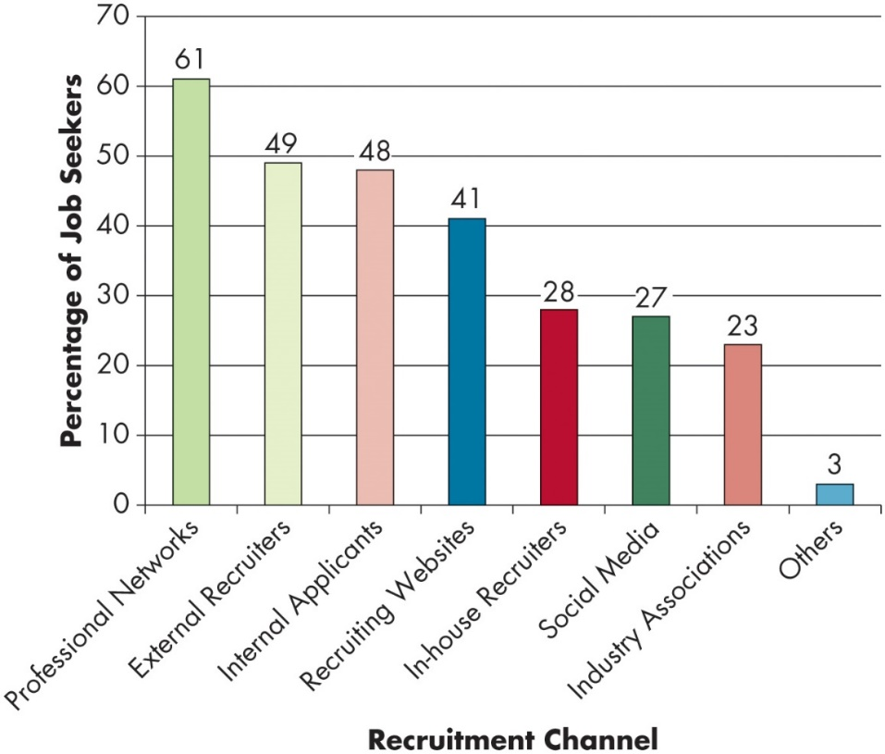
Describe the Value of Recruitment Methods (2 of 3)
OB POLL How Are Job-Seeking Managers Recruited?*
*Note: Based on a survey of 1,641 H R managers from different firms.
Source: Based on Society for Human Resource Management, S H R M Customized Talent Acquisition Benchmarking Report (Alexandria, VA: SHRM, 2017).
Notes:
This OB Poll demonstrates that most hiring managers and HR professionals responsible for hiring source their applicants through their professional networks (61 percent).
Long Description:
The horizontal axis is labeled recruitment channel. The vertical axis is labeled percentage of job seekers and ranges from 0 to 70 in increments of 10. The data from the graph in the format recruitment channel: percentage is as follows. Professional networks: 61 percent. External recruiters: 49 percent. Internal applicants: 48 percent. Recruiting websites: 41 percent. In-house recruiters: 28 percent. Social media: 27 percent. Industry associations: 23 percent. Others: 3 percent.

Slide 5
Describe the Value of Recruitment Methods (3 of 3)
Role of Recruiters
The most effective recruiters—internal or external—are well informed about the job, are efficient in communicating with potential recruits, and treat recruits with consideration and respect. They also use a variety of online tools, including job boards and social media.
Realistic Job Previews
A job tryout given to demonstrate to job seekers what they would be doing on the job if they were hired.
Notes:
The most effective recruiters—internal or external—are well informed about the job, are efficient in communicating with potential recruits, and treat recruits with consideration and respect. They also use a variety of online tools, including job boards and social media, to bring in applications.
Employers are increasingly using recruitment methods beyond signaling values and attracting job seekers into the realm of previewing the actual work performed and evaluated. These are sometimes known as realistic job previews or job tryouts. They are given to demonstrate to job seekers what they would be doing on the job. Realistic job previews help to clarify and manage applicant expectations.

Slide 6
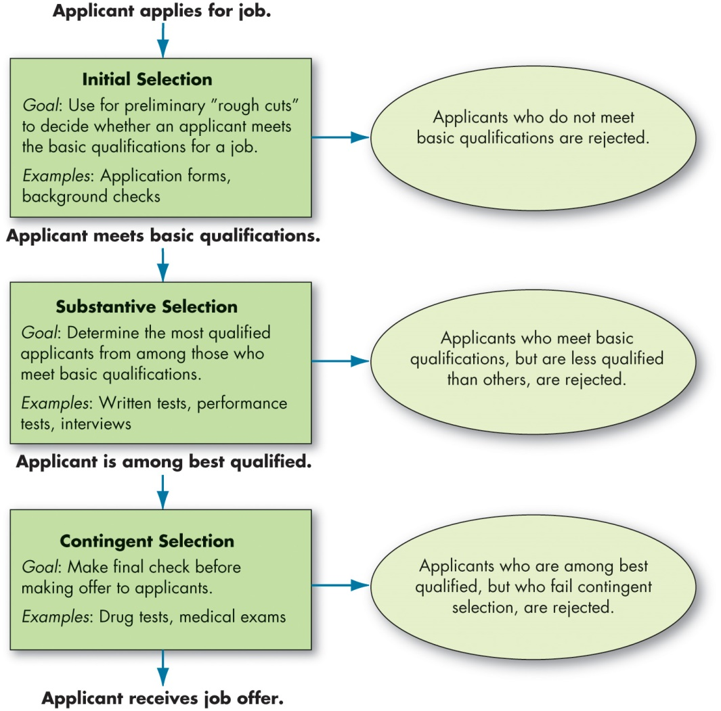
Specify Initial Selection Methods
Exhibit 17.1 Model of Selection Process in Organizations
Notes:
One of the most important HR functions is hiring the right people. When companies hire the right people, they increase their human capital resources. Human capital resources are the capacities available to an organization through its employees. The resources include specialized skills, collective knowledge, abilities, and other resources available through an organization’s workforce.
The goal of the selection process is to match individual characteristics with the job—in other words, finding the right person for the job. Exhibit 17.1 shows that new job applicants go through several sections stages: initial selection, substantive selection, and contingent selection.
Initial selection devices are used for preliminary rough cuts to decide whether the applicant meets the basic qualifications for a job. The initial selection stage usually requires an application form. While these are not a good predictor of performance, they are a good initial screen. Most applications today begin online. Care should be exercised on the questions included in an application to avoid conflict with legal and ethical limitations. During this initial stage, the application may undergo background checks such as checking credit histories or criminal records. Letters of recommendation are a form of background check. Many employers perform a general Internet search or a targeted search of social networking sites to “find” background information on a candidate.
Next, we will discuss substantive and contingent selection.
Long Description:
The flowchart begins when the Applicant applies for job and progresses through three selection processes as follows:
1. Initial Selection:
Goal: Use for preliminary rough cuts to decide whether an applicant meets the basic qualifications for a job. Examples: Application forms, background checks.
Applicants who don‘t meet basic qualifications are rejected and the applicant who meets basic qualifications undergoes next step of selection.
2. Substantive selection:
Goal: Determine the most qualified applicants from among those who meet basic qualifications.
Examples: Written tests, performance tests, interviews.
Applicants who meet basic qualifications, but are less qualified than others, are rejected.
The applicants who are among the best qualified undergo last process of selection as follows:
3. Contingent selection:
Goal: Make final check before making an offer to applicants.
Examples: Drug tests and medical exams.
Applicants who are among best qualified, but who fail contingent selection, are rejected. Applicant who succeeds contingent selection receives a job offer.

Slide 7
Identify the Most Useful Substantive Selection Methods (1 of 5)
Substantive Selection
Written tests
Performance simulation tests
Interviews
Notes:
Substantive selection is at the heart of the selection process and is used after the applicant passes initial screening. It includes written tests, performance simulation tests, and interviews. Let’s look at each one in more detail.

Slide 8
Identify the Most Useful Substantive Selection Methods (2 of 5)
Written Tests
Typically tests of intelligence or cognitive ability, personality, and integrity.
Intelligence tests are particularly good predictors for jobs that require cognitive complexity.
Evidence shows that these tests are good predictors, but care should be taken to use the “right” test.
Notes:
Long popular as selection devices, written employment tests—called “paper-and-pencil” tests, though most are now available online—declined in use between the late 1960s and mid-1980s, especially in the United States. They were frequently characterized as discriminatory, and many organizations had not validated them as job-related. Since then, however, there has been a resurgence, and today most organizations have at least considered using one or more tests. Managers recognize that valid tests can help predict who will be successful on the job. Applicants, however, tend to view written tests as less valid and fair than interviews or performance tests. Typical tests include (1) intelligence or cognitive ability tests, (2) personality tests, and (3) integrity tests.
Intelligence tests are particularly good predictors for jobs that require cognitive complexity. Tests in intellectual ability, spatial and mechanical ability, perceptual accuracy, and motor ability have shown to be moderately valid predictors for many semiskilled and unskilled operative jobs. Personality tests are inexpensive and simple to administer. Their use has grown in recent years.
As ethical problems have increased in organizations, integrity tests have gained popularity. These paper-and-pencil tests that measure dependability, carefulness, responsibility, and honesty. While these tests are powerful predictors of performance, care should be taken that the test actually measures criteria matched to the job responsibilities.

Slide 9
Identify the Most Useful Substantive Selection Methods (3 of 5)
Performance-Simulation Tests
Have higher face validity and their popularity has increased.
Work sample tests: hands-on simulations of part or all of the job that must be performed by applicants.
Assessment centers: evaluate managerial potential.
Situational judgment tests
Notes:
Although they are more complicated to develop and administer than written tests, performance-simulation tests have higher face validity, which measures whether applicants perceive the measures to be accurate, and their popularity has increased. The three best-known performance simulation tests are work samples, assessment centers, and situational judgment tests.
Work sample tests are hands-on simulations of part or all of the job that must be performed by applicants. Work samples are based on job analysis data, and each element is matched with a corresponding job performance element. Work samples yield valid data superior to written aptitude and personality tests.
Assessment centers use a more elaborate set of performance simulation tests designed to evaluate a candidate’s managerial potential. Line executives, supervisors, and/or trained psychologists evaluate candidates as they go through one to several days of exercises that simulate real problems. Assessment centers have consistently demonstrated results that predict later job performance in managerial positions.
Situational judgment tests ask applicants how they would perform in a variety of job situations and compare their answers to those of high-performing employees.

Slide 10
Identify the Most Useful Substantive Selection Methods (4 of 5)
Interviews
A frequently used selection device.
Carry a great deal of weight.
Unstructured interviews are not as effective as structured ones, particularly behavioral structured interviews.
Notes:
The interview continues to be standard practice and carries a great deal of weight. The candidate who performs poorly in the employment interview is likely to be cut, regardless of his/her experience, test scores, or letters of recommendation, and vice versa. This is important because of the unstructured form of most selection interviews.
The unstructured interview—short in duration, casual, and made up of random questions—is an ineffective selection device.
In contrast, structured interviews are planned interviews designed to gather job-related information.

Slide 11
Identify the Most Useful Substantive Selection Methods (5 of 5)
Contingent Selection
Applicants that pass the substantive selection process are ready to be hired, contingent on final checks.
A common contingent method is a drug test.
Drug testing is controversial.
Under the Americans with Disabilities Act, firms may not require employees to pass a medical exam before a job offer is made.
Notes:
Once an applicant has passed substantive selection such as background checks, interviews, and so on, the individual is ready to be hired subject to a final check.
One common, but controversial, contingent method is a drug test. Many applicants think testing without reasonable suspicion is invasive or unfair and say they should be tested on job performance factors, not lifestyle choices that may not be relevant. Employers might counter that drug use and abuse are extremely costly, not just in financial terms but also in terms of people’s safety. They have the law on their side: the U.S. Supreme Court has concluded that drug tests are “minimally invasive” selection procedures that as a rule, do not violate individuals’ rights.
Under the Americans with Disabilities Act, firms may not require employees to pass a medical exam before a job offer is made. They can conduct medical exams after making a contingent offer, to determine whether an applicant is physically or mentally able to do the job.

Slide 12
Compare the Main Types of Training (1 of 4)
Transfer of training: utilizing the knowledge, skills, and abilities learned from training on the job.
On-the-job training
Cross-training
Off-the-job training
Training Content
Basic skills
Technical skills
Soft skills
Ethics training
Notes:
Corporations in the United States spend over $70 billion annually on training.
The number one goal of training is for it to transfer. This transfer of training refers to utilizing the knowledge, skills, and abilities learned from training on the job.
What does training look like? On-the-job training methods include job rotation, apprenticeships, and understudy assignments. U.S. companies have been increasingly using longer-term job rotations to cross-train employees and to foster collaboration. Organizations also invest in off-the-job training.
Training is concerned with building skills, developing abilities, and even acquiring competencies like adaptability, emotional competence, and leadership.
Most training that organizations offer are focused on technical skills or soft skills. One area of soft skills that is particularly important in the workplace is ethics training, which focuses on recognizing moral issues, regulating moral emotions, considering different perspectives, and acting ethically by treating others with respect and civility.

Slide 13
Compare the Main Types of Training (2 of 4)
Training Methods
Historically, training meant “formal training”.
Organizations are increasingly relying on informal training.
Unstructured, unplanned, and easily adapted to situations and individuals.
Notes:
Historically, training meant “formal training,” or something that is planned in advance and has a structured format. However, organizations are increasingly relying on informal training, which is unstructured, unplanned, and easily adapted to situations and individuals. Most informal training is nothing other than employees helping each other out. They share information and solve work-related problems with one another.

Slide 14
Compare the Main Types of Training (3 of 4)
Instructional System Design
Analyze
Design
Develop
Implement
Evaluation
Active Learning
Inactive Learning
E-Learning
Notes:
The instructional system design (ISD) approach views training very formally and primarily centers on the role of the training developer and trainer in facilitating employee learning. The ISD approach generally follows the following procedure, also known as the ADDIE model:
Analyze: Establish what skills, abilities, or other characteristics needs to be trained. Establish what goals should be accomplished by the training. Define who the trainees would be and what they would need to be successful.
Design: Establish what training success and failure would look like. Select instructional strategies to meet learning objectives and decide how trainees receive feedback on their performance.
Develop: Establish where training will occur and what will be needed (e.g., media, applications, other resources) to ensure its success.
Implement: Engage trainees in the training session or program. Provide opportunities for transfer and encourage transfer following training.
Evaluation: Determine whether the system is successful in the context of the organization (e.g., how much money saved or gained, accidents avoided; how many people trained). Use the information to inform revisions of the training session or program.
Active learning primarily consists of three basic tenets: (1) encouraging exploration and reflection, (2) normalizing errors and mistakes, and (3) controlling emotions.
Interactive learning builds upon active learning to suggest that learning is a social construction created from interacting people (e.g., trainers–trainees, trainees–trainees).
The fastest-growing training method is computer-based training, or e-training or e-learning. E-learning systems emphasize learner control over the pace and content of instruction, allow e-learners to interact through online communities, and incorporate other techniques such as simulations and group discussions.
Therefore, e-learning approaches seek to emphasize the best elements of active and interactive learning in a boundless, electronic environment. Computer-based training that lets learners actively participate in exercises and quizzes can be more effective than traditional classroom instruction.

Slide 15
Compare the Main Types of Training (4 of 4)
Evaluating Effectiveness
The effectiveness of a training program can refer to the level of student satisfaction, the amount students learn, the extent to which they transfer the material from training to their jobs, or the financial return on investments in training.
Rigorous measurement of multiple training outcomes should be part of every training effort.
Notes:
The effectiveness of a training program can refer to the level of student satisfaction, the amount students learn, the extent to which they transfer the material from training to their jobs, or the financial return on investments in training.
Rigorous measurement of multiple training outcomes should be part of every training effort.

Slide 16
List the Methods of Performance Evaluation (1 of 6)
Purposes of Performance Evaluation
Make general human resource decisions.
Identify training and development needs.
Pinpoint employee skills and competencies needing development.
Provide feedback to employees.
Can be the basis for reward allocations.
Notes:
Performance management should be a continuous process where HR managers identify, measure, and develop both individual and team performance that is aligned with the strategic goals of the organization. In essence, performance management focuses on three primary areas: job performance, organizational citizenship behavior (OCB), and counterproductive work behavior (CWB). Most managers believe that good performance means doing well on the first two dimensions and avoiding the third.
Management uses evaluations for general human resource decisions, such as promotions, transfers, and terminations. Evaluations also identify training and development needs, as they pinpoint employee skills and competencies needing development and can provide criterion against which selection and development programs are validated.
Evaluations also provide feedback to employees on how the organization views their performance and are often the basis for reward allocations including merit pay increases.

Slide 17
List the Methods of Performance Evaluation (2 of 6)
What Do We Evaluate?
Individual task outcomes
Behaviors
Traits
Who Should Do the Evaluating?
Traditionally, the manager, but today that is changing.
Now peers, subordinates, and the employee can be involved.
Notes:
What do we evaluate? The criteria or criterion used to evaluate performance has a major influence on performance. The three most popular sets of criteria are individual task outcomes, behaviors, and traits. If ends count, rather than means, then management should evaluate an employee’s task outcomes. It is difficult to attribute specific outcomes to the actions of employees in advisory or support positions or employees whose work assignments are part of a group effort; we may readily evaluate the group’s performance, but if it is hard to identify the contribution of each group member, management will often evaluate the employee’s behavior. The weakest set of criteria is individual traits because they are farthest removed from the actual performance of the job itself. Traits may or may not be highly correlated with positive task outcomes, but only the naive would ignore the reality that such traits are frequently used in organizations for assessing performance.
Who should do the evaluating? Traditionally, the task has fallen to managers, because they are held responsible for their employees’ performance, but others may do the job better. With many of today’s organizations using self-managed teams, telecommuting, and other organizing devices that distance bosses from employees, the immediate superior may not be the most reliable judge of an employee’s performance. More and more, peers and even subordinates are being asked to take part in the process, and employees are participating in their own evaluation. A recent survey found about half of executives and 53% of employees now have input into their performance evaluations.
As you might expect, self-evaluations often suffer from over-inflated assessment and self-serving bias, and they seldom agree with superiors’ ratings. So they are probably better suited to developmental than evaluative purposes and should be combined with other sources of information to reduce rating errors. In most situations, in fact, it is highly advisable to use multiple sources of ratings. Any individual performance rating may say as much about the rater as about the person being evaluated. By averaging across raters, we can obtain a more reliable, unbiased, and accurate performance evaluation.

Slide 18
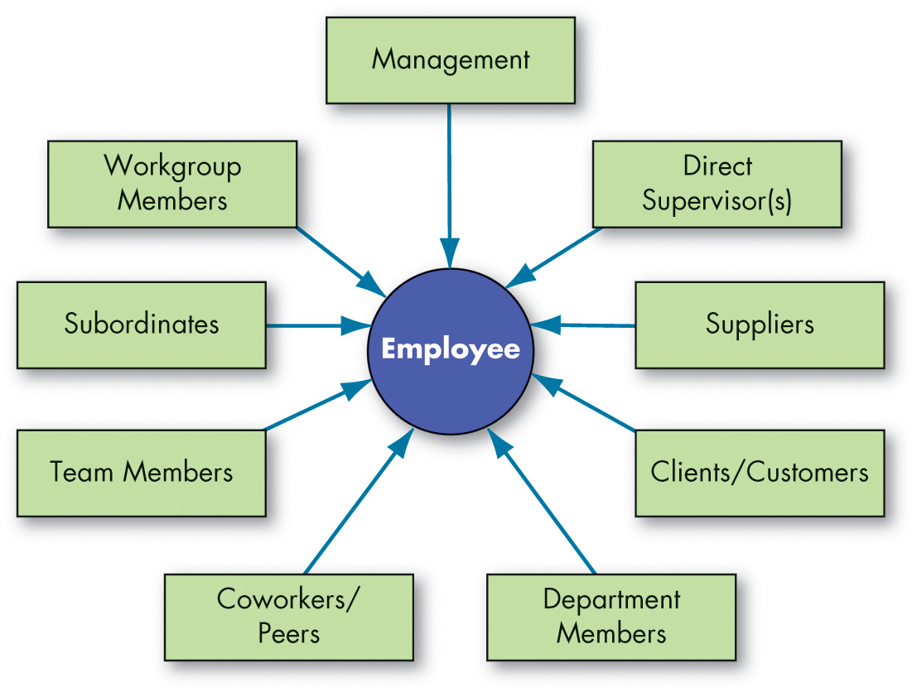
List the Methods of Performance Evaluation (3 of 6)
Exhibit 17.2 360-Degree Evaluation
Notes:
Another approach to performance evaluation is 360-degree evaluations. As shown in Exhibit 17.2, 360-degree evaluations provide performance feedback from the employee’s full circle of daily contacts, from mailroom workers to customers to bosses to peers. The number of appraisals can be as few as 3 or 4 or as many as 25; most organizations collect 5 to 10 per employee.
Evidence on the effectiveness of the 360-degree evaluation is mixed. It provides employees with a wider perspective on their performance, but many organizations don’t spend the time to train evaluators in giving constructive criticism.
Long Description:
The factors on the basis of which 360-degree evaluation of an employee are Management, Direct Supervisor(s), Suppliers, Clients or Customers, Department Members, Coworkers or Peers, Team members, Subordinates, and Workgroup members.

Slide 19
List the Methods of Performance Evaluation (4 of 6)
Methods of Performance Evaluation
Written comments
Critical incidents
Graphic ratings scales
Behaviorally anchored rating scales (B A R S)
Electronic performance monitoring (E P M)
Forced comparisons
Group order ranking
Individual ranking
Notes:
There are several different methods to evaluate an employee’s performance.
First, written comments are the simplest method of evaluation. It involves writing a narrative describing an employee’s strengths, weaknesses, past performance, potential, and suggestions for improvement. No complex forms or extensive training is required, but the results often reflect the ability of the writer.
Second is critical incidents. These focus on those behaviors that are key in making the difference between executing a job effectively and executing it ineffectively. The appraiser writes down anecdotes that describe what the employee did that was especially effective or ineffective. A list of critical incidents provides a rich set of examples to discuss with the employee.
Third is graphic ratings scales, based on a set of performance factors, such as quantity and quality of work, depth of knowledge, cooperation, loyalty, attendance, honesty, and initiative. The evaluator then goes down the list and rates each on incremental scales. They are popular because they are less time-consuming to develop and administer, and allow for quantitative analysis and comparison.
Fourth is behaviorally anchored rating scales, or BARS, which combine major elements from the critical incident and graphic rating scale approaches. The appraiser rates the employees based on items along a continuum, but the points are examples of actual behavior. To develop the BARS, participants first contribute specific illustrations of effective and ineffective behavior, which are translated into a set of performance dimensions with varying levels of quality.
Fifth, some organizations utilize electronic performance monitoring (EPM) to capture objective indicators of employees’ performance while on the job. This captures attentional metrics, such as how long employees stay logged into collaboration programs, how many reports they file, and whether they “cyberloaf.”
Finally, forced comparisons evaluate one individual’s performance against the performance of one or more. So, it’s a relative rather than an absolute measuring device. The two most popular are group order ranking and individual ranking. The group order ranking requires the evaluator to place employees into a particular classification, such as top one-fifth or second one-fifth. The individual ranking approach rank-orders employees from best to worst.

Slide 20
List the Methods of Performance Evaluation (5 of 6)
Improving Performance Evaluations:
Use multiple evaluators.
Evaluate selectively.
Train evaluators.
Provide employees with due process.
Three features of due process.
Post appraisals online.
Notes:
The performance evaluation process is a potential minefield. Evaluators can unconsciously inflate evaluations (positive leniency), understate performance (negative leniency), or allow the assessment of one characteristic to unduly influence the assessment of others (the halo error). Some appraisers bias their evaluations by unconsciously favoring people who have qualities and traits similar to their own (the similarity error). And, of course, some evaluators see the evaluation process as a political opportunity to overtly reward or punish employees they like or dislike.
Some suggestions for methods to improve evaluation processes and outcomes start with the use of multiple evaluators. As the number of evaluators increases, the probability of attaining more accurate information increases. If a set of evaluators judges a performance, the highest and lowest scores are dropped, and the final performance evaluation is made up from the cumulative scores of those remaining.
Second is to evaluate selectively. Evaluate only those areas in which you have some expertise. Appraisers should be as close as possible, in terms of organizational level, to the individual being evaluated.
Third is to train evaluators. There is substantial evidence that training evaluators can make them more accurate raters. Most rater training courses emphasize changing the raters’ frame of reference by teaching them what to look for, so everyone in the organization defines good performance in the same way.
Fourth is to provide employees with due process. The concept of due process increases the perception that employees are treated fairly.
Three features characterize due process systems: individuals are provided with adequate notice of what is expected of them; all relevant evidence is aired in a fair hearing so individuals affected can respond; and the final decision is based on the evidence and is free from bias. One technique organizations might consider to enhance due process is posting appraisals online so employees can see their own performance scores exactly as the supervisor enters them.

Slide 21
List the Methods of Performance Evaluation (6 of 6)
Providing Performance Feedback
Managers are often uncomfortable discussing weaknesses with employees.
In fact, unless pressured by organizational policies and controls, managers are likely to ignore this responsibility.
The solution to the problem is not to ignore it but to train managers to conduct constructive feedback sessions.
Notes:
Providing performance feedback is a key method to improve evaluation, but managers are often uncomfortable discussing weaknesses with employees. In fact, unless pressured by organizational policies and controls, managers are likely to ignore this responsibility.
The solution to the problem is not to ignore it but to train managers to conduct constructive feedback sessions. An effective review—in which the employee perceives the appraisal as fair, the manager as sincere, and the climate as constructive—can leave the employee feeling upbeat, informed about areas needing improvement, and determined to correct them. Appraisals should also be as specific as possible.

Slide 22
Accommodations to Make Accessible Workplaces
Accommodations for Physical Disabilities
Managers need to be attuned to the true requirements of each job and match the skills of the individual to them, providing accommodations when needed.
Accommodations for Hidden Disabilities
U.S. organizations must accommodate employees with a broad range of disabilities. However, employees must disclose their conditions to their employers in order to be eligible for workplace accommodations and employment protection.
Notes:
Workplace policies, both official and circumstantial, regarding individuals with physical or mental disabilities vary from country to country but matter for all HR processes, including recruitment, selection, training, and performance management.
The EEOC classifies a person as having a disability who has any physical or mental disability that substantially limits one or more major life activities.
The recognition of the talents and abilities of individuals with disabilities has made a positive impact. In addition, technology and workplace advancements have greatly increased the scope of available jobs for those with all types of disabilities. Managers need to be attuned to the true requirements of each job and match the skills of the individual to them, providing accommodations when needed.
Unless an individual decides to disclose a disability that is not easily observable, it can remain hidden at the discretion of the employee. These are called hidden disabilities. Research suggests that disclosure generally helps all— the individual, others, and organizations. Disclosure may increase the job satisfaction and well-being of the individual, help others understand and assist the individual to succeed in the workplace, and allow the organization to accommodate the situation so that the employee and the organization achieve top performance.

Slide 23
Describe the Leadership Role of H R in Organizations (1 of 2)
High-performance work system (H P W S): a group of human resources practices that work together and reinforce one another to improve organizational outcomes.
Communicating H R Practices
Leadership by H R begins with informing employees about H R practices and explaining the implications of decisions that might be made around these practices.
It is not enough to simply have a practice in place; H R needs to let employees know about it.
Notes:
Companies have only recently begun to recognize the potential for HR to influence employee performance. Researchers have been examining the effects of a high-performance work system (HPWS), a group of human resources practices that some organizations have been implementing. These practices work together and reinforce one another to accomplish the organization’s strategy and improve organizational outcomes over time.
Leadership by HR begins with informing employees about HR practices and explaining the implications of decisions that might be made around these practices. It is not enough to simply have a practice in place; HR needs to let employees know about it. When a company successfully communicates how the whole system of HR practices has been developed and what function this system serves, employees feel they can control and manage what they get out of work.
The evidence supporting the contribution of communication and perception to HR effectiveness is considerable. For example, one study of different business units within a large food-service organization found that employee perceptions of HR practices, rated at the workgroup level, were significant predictors of OCB, commitment, and intention to remain with the company, but the HR practices led to these positive outcomes only if employees were aware they were in place.
The effectiveness of HR practices also depends on employee attitudes. One review found that HR practices were more likely to lead to positive outcomes when employees felt motivated.

Slide 24
Describe the Leadership Role of H R in Organizations (2 of 2)
Drafting and Enforcing Employment Policies
Employment policies that are informed by current laws but go beyond minimum requirements will help define a positive organizational culture and set high standards for performance.
Policies differ from benefits in that they provide the guidelines for behavior, not just the working conditions.
Any policy must have enforcement to be effective.
Notes:
Employment policies that are informed by current laws but go beyond minimum requirements will help define a positive organizational culture and set high standards for performance. Policies differ from benefits in that they provide the guidelines for behavior, not just the working conditions.
Any policy must have enforcement to be effective. Human resource managers are responsible for setting the organizational consequences of infractions, and often for enforcing the policies as well. Sometimes, human resource managers will need to take action even when the employee’s direct manager may not agree, especially if compliance with the law is at issue.

Slide 25
Implications for Managers (1 of 5)
Managers should increase applicant attraction by managing their impressions with potential job seekers. To do so, recruiters should be trained to build positive relationships with job seekers; the recruitment and selection systems should be fair, just, and clear; and the company brand should communicate its core values and safeguard its reputation.
Although referral hiring is an extremely common practice, there is mixed evidence for whether it is effective. In some ways, it can enrich workplace relationships—in other ways, job seekers and current employees may see the practice as unfair.
Notes:
Managers should increase applicant attraction by managing their impressions with potential job seekers. To do so, recruiters should be trained to build positive relationships with job seekers; the recruitment and selection systems should be fair, just, and clear; and the company brand should communicate its core values and safeguard its reputation.
Although referral hiring is an extremely common practice, there is mixed evidence for whether it is effective. In some ways, it can enrich workplace relationships—in other ways, job seekers and current employees may see the practice as unfair.

Slide 26
Implications for Managers (2 of 5)
Realistic job previews are one way to manage job seekers and applicant expectations of what it is like to work at a company. The realistic job preview is becoming increasingly accessible to managers. Many companies post realistic job preview videos, simulations, and games on their websites.
The hiring process is extremely complex, and managers should carefully consider the methods they use in initial, substantive, and contingent selection. Above all, managers should make sure that each piece of the selection puzzle positively contributes to the decision, does not introduce bias, complies with laws and regulations, and does not treat people from underrepresented groups unfairly. Moreover, some of the most common methods (e.g., unstructured interviews, applications, cover letters) are the least informative.
Notes:
In addition,
Realistic job previews are one way to manage job seekers and applicant expectations of what it is like to work at a company. The realistic job preview is becoming increasingly accessible to managers. Many companies post realistic job preview videos, simulations, and games on their websites.
The hiring process is extremely complex, and managers should carefully consider the methods they use in initial, substantive, and contingent selection. Above all, managers should make sure that each piece of the selection puzzle positively contributes to the decision, does not introduce bias, complies with laws and regulations, and does not treat people from underrepresented groups unfairly. Moreover, some of the most common methods (e.g., unstructured interviews, applications, cover letters) are the least informative.

Slide 27
Implications for Managers (3 of 5)
Managers should build systems that keep track of training needs and skills gaps, design (online and in-person) programs that meet these needs, and continuously evaluate their effectiveness. Formal and informal training have their place, and managers should take a three-pronged approach that focuses on building structure, fostering trainee engagement, and nurturing positive learning interactions between people.
Notes:
Managers should build systems that keep track of training needs and skills gaps, design (online and in-person) programs that meet these needs, and continuously evaluate their effectiveness. Formal and informal training have their place, and managers should take a three-pronged approach that focuses on building structure, fostering trainee engagement, and nurturing positive learning interactions between people.

Slide 28
Implications for Managers (4 of 5)
Performance management is done poorly more often than not. Managers should consider ditching the traditional approach of annual performance appraisals for termination, promotion, and pay increase decisions. Instead, managers could develop performance management systems that are conducted continuously, focus on concrete behaviors, obtain feedback from multiple trained employees well acquainted with the target individual, and serve developmental purposes (e.g., providing feedback that identifies professional growth and development gaps).
Notes:
Performance management is done poorly more often than not. Managers should consider ditching the traditional approach of annual performance appraisals for termination, promotion, and pay increase decisions. Instead, managers could develop performance management systems that are conducted continuously, focus on concrete behaviors, obtain feedback from multiple trained employees well acquainted with the target individual, and serve developmental purposes (e.g., providing feedback that identifies professional growth and development gaps).

Slide 29
Implications for Managers (5 of 5)
Managers are required to provide reasonable accommodation for disclosed, recognized disabilities under the A D A. Beyond this, however, managers should actively work with employees with disabilities to consider their needs, learn more about their disabilities so that they can better understand their situations, and foster an inclusive and accommodating environment.
Leadership plays a critical role in establishing, communicating, and enforcing high-performance work practices. With executive and manager support and championing, many organizational initiatives could fall flat.
Notes:
Managers are required to provide reasonable accommodation for disclosed, recognized disabilities under the ADA. Beyond this, however, managers should actively work with employees with disabilities to consider their needs, learn more about their disabilities so that they can better understand their situations, and foster an inclusive and accommodating environment.
Leadership plays a critical role in establishing, communicating, and enforcing high-performance work practices. With executive and manager support and championing, many organizational initiatives could fall flat.

Slide 30
Discussion Questions
Congratulations! You’ve earned your college degree! Now, it’s time to find a job! Knowing how companies go about recruiting new employees, how can you best position yourself to find your first post-graduate position?
Will professional networks be important?
Do you expect to work with a professional recruiter?
What role will social media play in your job search?
What should you expect during the selection process?
Will resumes and cover letters be part of your job application?
Do you anticipate taking any tests as part of your application? Explain.
What type of interview should you anticipate and how can you prepare for it?

Slide 31

Copyright
This work is protected by United States copyright laws and is provided solely for the use of instructors in teaching their courses and assessing student learning. Dissemination or sale of any part of this work (including on the World Wide Web) will destroy the integrity of the work and is not permitted. The work and materials from it should never be made available to students except by instructors using the accompanying text in their classes. All recipients of this work are expected to abide by these restrictions and to honor the intended pedagogical purposes and the needs of other instructors who rely on these materials.

