Slide 1

Organizational Behavior
Nineteenth Edition
Chapter 18
Stress and Health in Organizations
Copyright © 2023, 2019, 2017 Pearson Education, Inc. All Rights Reserved
Notes:
If this PowerPoint presentation contains mathematical equations, you may need to check that your computer has the following installed:
1) MathType Plugin
2) Math Player (free versions available)
3) NVDA Reader (free versions available)
Welcome to this Organizational Behavior course that uses the 19th edition of the textbook, Organizational Behavior by Robbins and Judge. This is considered among the most widely used OB textbooks in the world. Robbins and Judge are recognized as definitive aggregators of OB concepts, applications, and practices. The course and this book will provide you with a resource that will benefit you throughout your degree program and your professional life.

Slide 2
Learning Objectives
18.1 Describe how the stress process unfolds in the workplace.
18.2 Discuss how sleep, illness, and injury affect physical health at work.
18.3 Recognize how maladaptive mental health conditions can manifest as a consequence of stressors at work.
18.4 Compare the four major stress and health theories.
18.5 Differentiate between work–life conflict and work–life enrichment.
18.6 Describe individual and organizational approaches to managing stress at work.
Notes:
Describe how the stress process unfolds in the workplace.
Discuss how sleep, illness, and injury affect physical health at work.
Recognize how maladaptive mental health conditions can manifest as a consequence of stressors at work.
Compare the four major stress and health theories.
Differentiate between work–life conflict and work–life enrichment.
Describe individual and organizational approaches to managing stress at work.

Slide 3
How the Stress Process Unfolds In The Workplace (1 of 5)
Exhibit 18.1 Work Is One of the Top Sources of Stress for Young Adults (ages 18–23)
What area of your life causes you the most stress?
Area | Causes Most Stress
Money | 78%
Work | 64%
Housing costs | 52%
Job stability | 51%
The economy | 44%
Source: Based on American Psychological Association, Stress in American 2019 (Washington, D C: A P A, November 2019):
https://www.apa.org/news/press/releases/stress/2019/stress-america-2019.pdf
Notes:
Do you feel stressed? If so, join the crowd. As Exhibit 18.1 shows, work is a major source of stress in the lives of young adults (ages 18–23). Everyone experiences stress in some way, shape, or form. Stress emerges from many sources at work.

Slide 4
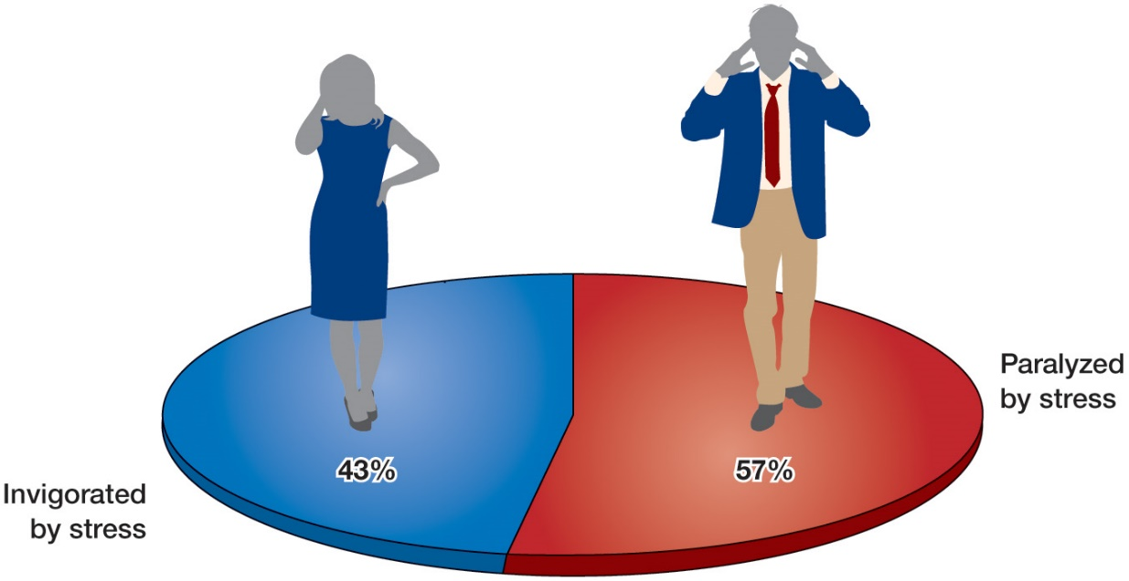
How the Stress Process Unfolds In The Workplace (2 of 5)
O B POLL Paralyzed or Invigorated by Stress?
Source: Based on M. Connolly and M. Slade, “The United States of Stress 2019,” Everyday Health , May 7, 2019,
https://www.everydayhealth.com/wellness/united-states-of-stress/
Notes:
Some people are invigorated by stress as shown in this OB Poll.

Slide 5
How the Stress Process Unfolds In The Workplace (3 of 5)
Stress: a generally unpleasant perception and appraisal of stressors.
Stressor: conditions or events that an individual perceives as challenging or threatening.
Challenge stressors
Hindrance stressors
Strain: the psychological, physiological, and behavioral consequences of stress.
Notes:
In this chapter, we distinguish between stressors, stress, and strain.
First, you are probably most familiar with stress, which we define as a generally unpleasant perception and appraisal of stressors. What, then, are stressors?
Stressors refer to conditions or events that an individual perceives as challenging or threatening. In essence, stressors are the antecedents to the experience of stress. An upcoming project deadline can be perceived as a challenging or threatening stressor to employees.
Then, as a result of stress, an individual experiences strain, or the psychological, physiological, and behavioral consequences of stress.
We tend to distinguish between two types of stressors: challenge and hindrance stressors. Challenge stressors—or stressors associated with workload, pressure to complete tasks, and time urgency—operate quite differently from hindrance stressors—or stressors that keep you from reaching your goals.

Slide 6
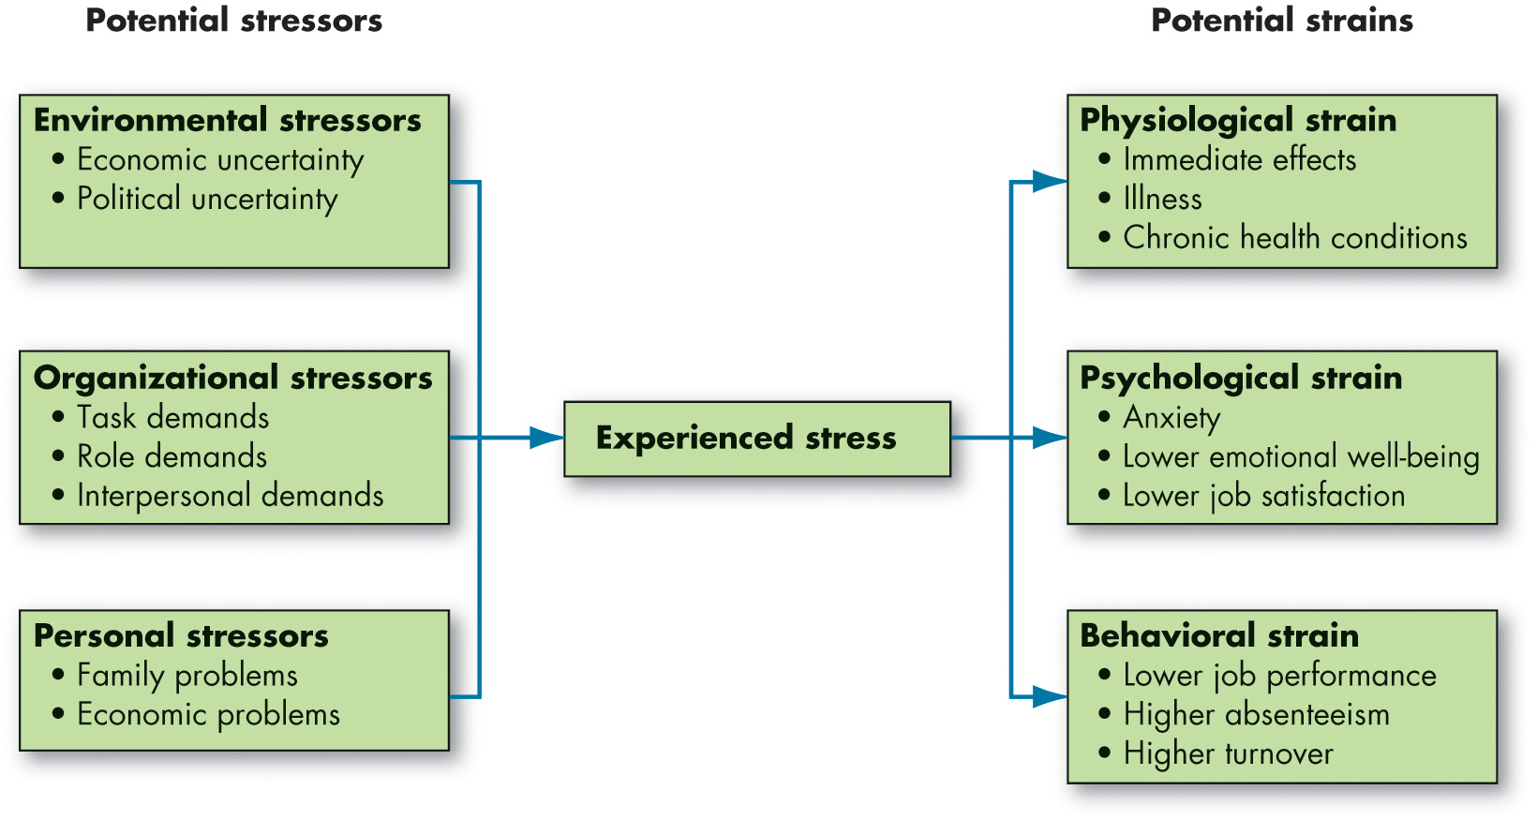
How the Stress Process Unfolds In The Workplace (4 of 5)
Exhibit 18.2 A Model of Stress
Notes:
Exhibit 18.2 suggests that stressors can come from environmental, organizational, or personal sources.
Long Description:
The three potential stressors and their subtypes are as follows:
Environmental stressors, and its sub types are economic uncertainty and political uncertainty.
Organizational stressors, and its sub types are task demands, role demands, and interpersonal demands.
Personal stressors, and its sub types are family problems and economic problems.
The three potential strains and their subtypes are as follows:
Physiological strain and its sub types are immediate effects, illness, and chronic health conditions.
Psychological strain and its sub types are anxiety, lower emotional well-being, and lower job satisfaction.
Behavioral strain and its sub types are lower job performance, higher absenteeism, and higher turnover.

Slide 7
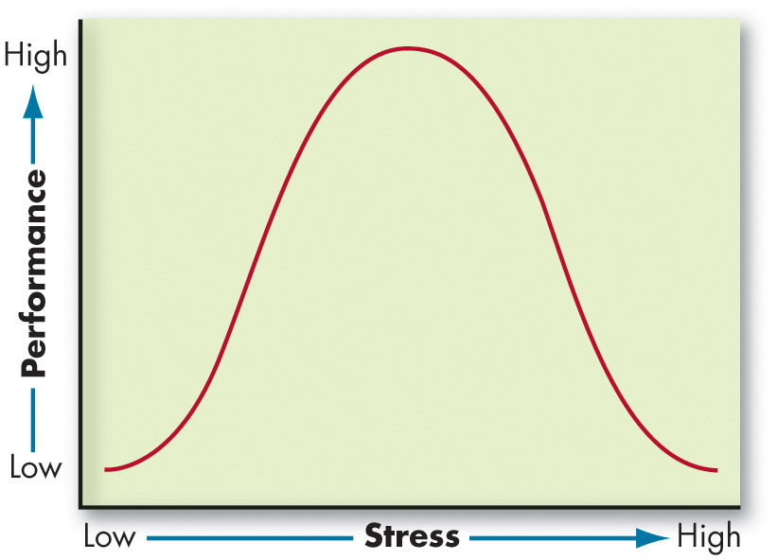
How the Stress Process Unfolds In The Workplace (5 of 5)
Exhibit 18.3 The Proposed Inverted-U Relationship Between Stress and Job Performance
Notes:
Although stress is typically discussed in a negative context, it also has a positive purpose. This form of stress has been labeled as eustress, or a healthy, positive, and constructive appraisal of stressors.
A significant amount of research has investigated the positive aspects of stress. One proposed pattern of this relationship is the inverted U shown in Exhibit 18.3. The logic underlying the figure is that low to moderate stress levels stimulate the body and increase its ability to react. Individuals may perform tasks better, more intensely, or more rapidly. But too much stress places impossible demands on a person that results in lower performance. Despite its popularity and intuitive appeal, the inverted-U model has not earned a lot of empirical support.
Long Description:
The X-axis shows Stress from low to high. The Y-axis shows Performance from low to high. A bell-shaped curve is depicted with its peak in the middle of the stress levels.

Slide 8
How Sleep, Illness, and Injury Affect Physical Health
Sleep
Sleep deprivation has a substantial impact on memory, cognitive task performance, and more general job outcomes for both managers and employees, like task performance, attendance, safety behavior, and counterproductive work behaviors.
Illness and Injury
Presenteeism: the act of working while ill or injured.
Notes:
Although the link between various physiological systems and behavior in the workplace is emerging, we focus on two areas that have been subject to quite a bit of attention in recent years: (1) sleep and (2) illness and injury.
Clearly, going into work while sick is not optimal for obvious reasons.
First and foremost, working close to others while sick with a contagious disease increases the risk that other team members will also become ill.
Second, people are not as effective at doing their jobs when ill or injured and can slow work processes. This effect will be even greater if the illness is spread to other members of the team, who then experience the same decrements. OB professionals refer to working while ill or injured as presenteeism.
Sleep. Various work-related stressors have been shown to impair sleep quality; such stressors include unfinished work tasks, social stressors, poor leadership, perceived discrimination, and role conflict. These stressors tend to have a compounding effect. Compounding job demands (and poor stress management) can lead to a steady decrease in sleep quality over the workweek, leaving you drained by the end of the week.

Slide 9
Mental Health at Work
Job insecurity: the perception that one’s job is at risk or that one’s employment is not stable.
Especially salient for gig workers
Workaholism: a maladaptive mental state characterized by feeling compelled to work due to internal pressures, thinking about work even when not working, and going above and beyond what is reasonably expected (to one’s own detriment).
Psychological Distress at Work
Burnout
Depression
Notes:
Just as workplace stress can affect physical health through increases in risky, unhealthy behavior, so, too, does workplace stress affect mental health at work.
Employees experience job insecurity when they perceive that their jobs are at risk or that their employment is not stable. Job insecurity is a highly emotional perception that greatly affects employees’ mental health, affecting sleep, depressive symptoms, and burnout. Interestingly, job insecurity is an especially salient stressor for gig workers.
One possible response to job insecurity is workaholism. Workaholism involves feeling compelled to work due to internal pressures, thinking about work even when not working, and going above and beyond what is reasonably expected.
Some employees encounter psychologically traumatic experiences in their jobs. Many employees at some point in their careers experience burnout, a work-related mental health syndrome characterized by emotional exhaustion, depersonalization, and reduced personal accomplishment.
Despite a large degree of attention, some researchers suggest that burnout is very similar in many ways to depression, a mental health disorder characterized by sadness, loss of interest, despondency, and dejection. Depressive symptoms such as these often co-occur with other negative emotions such as anxiety and anger. Of all mental health conditions, depression is the most common mental health condition.

Slide 10
Compare the Four Major Stress and Health Theories (1 of 4)
Conservation of Resources
Employees strive to obtain, foster, retain, and protect the resources and things they value.
Resources: factors within an individual’s control that can be expended toward fulfilling desires, attaining goals, or meeting task demands.
Notes:
Conservation of resources (COR) theory suggests that employees strive to obtain, foster, retain, and protect the resources and things they value. Resources are factors within an individual’s control that can be expended toward fulfilling desires, attaining goals, or meeting task demands.
Employees must invest time and energy to gain resources and protect or replenish resources from loss. Concerning stress, employees are more aware of resource losses than resource gains. In other words, a missed opportunity is not as concerning as a loss of a cherished resource. However, when resources have been lost, employees become motivated to replace what was lost. Moreover, when people are overextended or exhausted, they become desperate, defensive, aggressive, and irrational in their pursuit of regaining or replenishing what was lost.

Slide 11
Compare the Four Major Stress and Health Theories (2 of 4)
Effort-Reward Imbalance Model
Employees will experience strain when they put in a great deal of effort for little reward.
Employees are motivated to resolve this discrepancy by:
Putting in less effort.
Working to maximize or increase the reward.
Notes:
Although falling out of favor in recent years, the effort-reward imbalance (ERI) suggests that employees will experience strain when they put in a great deal of effort for little reward. In turn, employees are motivated to resolve this discrepancy by either (1) putting in less effort or (2) working to maximize or increase the reward.

Slide 12
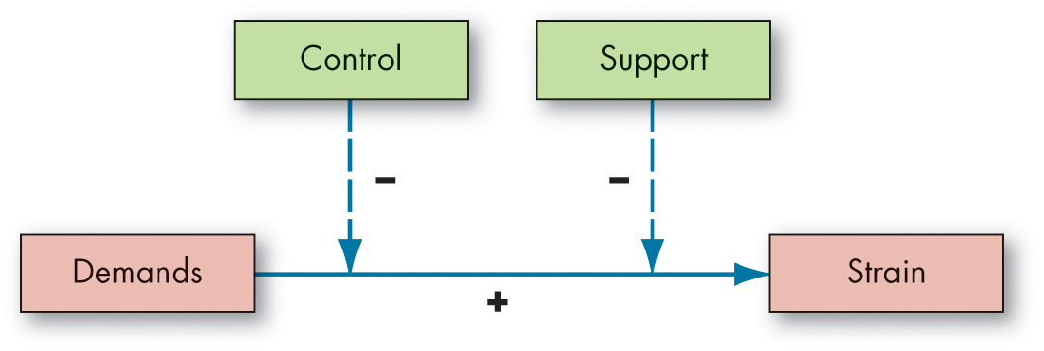
Compare the Four Major Stress and Health Theories (3 of 4)
Exhibit 18.4 The Job Demand-Control-Support Model
Notes:
An upcoming project deadline at work is not so bad when you have support from coworkers and supervisors, along with control over how you attain it. The job demand-control-support (JDCS) model suggests strain is a function of three factors: demands, control, and support.
Demands are the responsibilities, pressures, obligations, and uncertainties that individuals face in the workplace.
Control, similar to autonomy discussed in previous chapters, refers to the degree to which employees have discretion over how to do their jobs.
Support is essentially perceptions of assistance provided by the organization, supervisor, and coworkers.
The main tenant behind the JDCS model is that any negative effects of demands on strain can be offset or buffered by control and support, as shown in Exhibit 18.4.

Slide 13
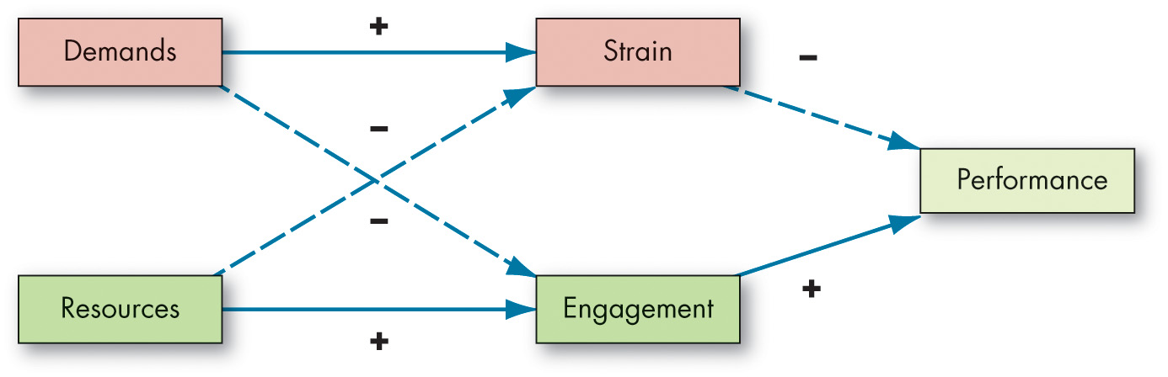
Compare the Four Major Stress and Health Theories (4 of 4)
Exhibit 18.5 The Job Demands-Resources Model
Based on A. B. Bakker and E. Demerouti, “Job Demands-Resources Theory: Taking Stock and Looking Forward,” Journal of Occupational Health Psychology 22, no. 3 (2017): 273–85.
Notes:
The job demands-resources (JDR) model depicted in Exhibit 18.5 combines elements of COR theory and the JDCS to suggest that demands and resources both contribute to performance through their distinctive effects on strain (e.g., burnout) and engagement.
The JDR is one of the most popular stress and health theories to date, and research tends to support its utility.
The discussion so far may give you the impression that individuals seek a steady state in which demands match resources perfectly. While early research emphasized such a homeostatic, or balanced, equilibrium perspective, it has now become clear that no single ideal state exists. Instead, it is more accurate to talk about allostatic models where demands shift, resources shift, and systems of addressing imbalances shift. By allostasis, we work to find stability by changing our behaviors and attitudes. It all depends on the allostatic load, or the cumulative effect of stressors on us, given the resources we draw upon.
Long Description:
The flow diagram shows that demands add to strain when resources are subtracted from it, which in turn leads to decreased performance. Resources add to engagement when demands are subtracted from it, which in turn leads to increased performance.

Slide 14
Work–Life Conflict Versus Work–Life Enrichment (1 of 7)
The State of Work–Life Balance: A New Normal?
Before the pandemic, employees viewed work–life balance as a unicorn or a life goal to aspire toward.
Current thinking may be shifting toward considering it as a continuously balancing process.
During this process, we remain self-aware, prioritize, and shuffle our demands and commitments in a way that meets our needs and that works for us.
Notes:
Next, we describe the nature of work–life balance in organizations while recognizing that we do not mean “balance” as a state of equilibrium— more like a “balancing act.”
Before the pandemic, employees viewed work–life balance as a unicorn or a life goal to aspire toward—now, many are considering this old perspective to be problematic. Instead, many think of it as something much more flexible, enigmatic, and nebulous. From a view that work–life balance is like an achievement to aspire toward (enjoyed by the select few corner-office executives in the upper echelons), current thinking may be shifting toward considering it as a continuously balancing process.
During this process, we remain self-aware, prioritize, and shuffle our demands and commitments in a way that meets our needs and that works for us.

Slide 15
Work–Life Conflict Versus Work–Life Enrichment (2 of 7)
Exhibit 18.6 Boundary Management Tactic Examples
Tactic | Form | Example
Physical Tactics | Establishing time boundaries Marking work spaces Facilitating boundary transitions | I always leave work at 5 p.m. to be home in time for dinner. I will always work in the second bedroom, and if the door is shut, do not come in. I bought a house a five-minute bike ride away from where I work.
Psychological Tactics | Prioritizing and goalsetting Making compromises | When the clients are in town this week, I will spend more time building relationships with them. I will make my working late all week up to the rest of my family by going to the movies with them on Friday.
Behavioral Tactics | Setting expectations Negotiating resources | Please respect my time by not calling me on vacation unless it is an emergency. I will ask my coworkers if they want to come to a family event with me this weekend, where we can discuss the new project.
Based on T. D. Allen, E. Cho, and L. L. Meier, “Work-Family Boundary Dynamics,” Annual Review of Organizational Psychology and Organizational Behavior 1 (2014): 99–121.
Notes:
Work–life boundaries refer to the lines that demarcate our lives. We move and transition between these domains both physically and/or psychologically, and people, things, and communications from some domains can move across boundaries and serve as interruptions in our daily lives.
When employees engage in boundary management, they enact strategies or tactics to negotiate the time, space, and roles they play in each of the domains. These tactics can come in one of three forms: physical, behavioral, and psychological (examples are shown in Exhibit 18.6).

Slide 16
Work–Life Conflict Versus Work–Life Enrichment (3 of 7)
Work-Life Spillover:
Occurs when our psychological responses to one domain are carried over into another domain and impact it in some way.
Work-life conflict
Work-life enrichment
Notes:
In the prior section, we described how people set boundaries between their work and nonwork lives. Sometimes, elements from one domain will directly impact the domain we are currently in. However, sometimes the impact of one domain on another may be more subtle and psychological. For instance, work–life spillover occurs when our psychological responses to one domain are carried over into another domain and impact it in some way.

Slide 17
Work–Life Conflict Versus Work–Life Enrichment (4 of 7)
Exhibit 18.7 Work–Life Initiatives
Time-based strategies | Flextime Job sharing Leave for new parents Telecommuting Paid time off | Management consulting firm A. T. Kearney’s Success with Flex program allows for schedule adjusments, telecommuting, and “hybird” positions. At biopharmaceutical firm AbbVie, 98% of employees use a flextime schedule. Cisco provides job-sharing and videoconferencing facilities to minimize needs for travel away from family. Deloitte offers employees 3−6 months sabbatical at 40% salary, and they have 40 paid days off per year.
Information-based strategies | Work–life support Relocation assistance Elder care resources Counseling services | Blue Cross Blue Shield of North Carolina provides networking opportunities to remote workers. Hallmark offers employees monthly meetings to talk about career management for women. Johnson and Johnson promotes weekends free of e-mail. Hewlett-Packard offers counselors, mentors, and $5,000 annual tuition aid.
Notes:
Time pressures are not the primary problem underlying work–life conflicts. The psychological incursion of work into the family domain—and vice versa—leaves people worrying about personal problems at work and thinking about work problems at home, creating conflict. This suggests organizations should spend less effort helping employees with time management issues and more effort helping them segment their lives, navigate boundary transitions, and facilitate enrichment between both domains. Flexible and supportive policies, such as keeping workloads reasonable, reducing work-related travel, and offering onsite high-quality child care, are examples of practices that can help in this endeavor.
Exhibit 18.7 lists some other initiatives over the past decade that have helped employees reduce work–life conflicts, many of which have been described in-depth in the chapter on motivation application.

Slide 18
Work–Life Conflict Versus Work–Life Enrichment (5 of 7)
Money-based strategies | Insurance subsidies Flexible benefits Adoption assistance Discounts for child care tuition Direct financial assistance Domestic partner benefits Scholarships, tuition reimbursement | Accenture offers a $5,000 adoption assistance benefit. Carlson offers employees scholarships of up to $20,000 to attend the University of Minnesota’s Carlson School of Management. Citi employees can save up to $5,000 per year in pretax dependent care accounts, with a match of up to 30% from the company. Colgate-Palmolive provides up to $10,000 per year in annual tuition aid for job-related courses. Prudential employees who are caregivers can use 100 hours of dependent backup care and six hours of geriatric care management services annually.
Notes:
Time pressures are not the primary problem underlying work–life conflicts. The psychological incursion of work into the family domain—and vice versa— leaves people worrying about personal problems at work and thinking about work problems at home, creating conflict. This suggests organizations should spend less effort helping employees with time management issues and more effort helping them segment their lives, navigate boundary transitions, and facilitate enrichment between both domains. Flexible and supportive policies, such as keeping workloads reasonable, reducing work-related travel, and offering onsite high-quality child care, are examples of practices that can help in this endeavor.
Exhibit 18.7 lists some other initiatives over the past decade that have helped employees reduce work–life conflicts, many of which have been described in-depth in the chapter on motivation application.

Slide 19
Work–Life Conflict Versus Work–Life Enrichment (6 of 7)
Direct services | Onsite child care Fitness center Summer child care Onsite conveniences Concierge services Free or discounted company products | Abbott provides a child-care center that serves 800 and discounts for 2,800 day care facilities. Companies like A O L and Verizon have onsite fitness centers and discounts at gyms nationwide. Bristol-Myers Squibb offers full-time, part-time, and backup care for kids up to age 5, and summer camps for older children. Turner Broadcasting offers a caregiver concierge to arrange babysitting, dog walking, and elder companions. R E I employees can participate in a program that offers large discounts on company products.
Notes:
Time pressures are not the primary problem underlying work–life conflicts. The psychological incursion of work into the family domain—and vice versa— leaves people worrying about personal problems at work and thinking about work problems at home, creating conflict. This suggests organizations should spend less effort helping employees with time management issues and more effort helping them segment their lives, navigate boundary transitions, and facilitate enrichment between both domains. Flexible and supportive policies, such as keeping workloads reasonable, reducing work-related travel, and offering onsite high-quality child care, are examples of practices that can help in this endeavor.
Exhibit 18.7 lists some other initiatives over the past decade that have helped employees reduce work–life conflicts, many of which have been described in-depth in the chapter on motivation application.

Slide 20
Work–Life Conflict Versus Work–Life Enrichment (7 of 7)
Culture-change strategies | Establishing work–life balanced culture; training managers to help employees deal with work–life conflicts Tie manager pay to employee satisfaction Focus on employees’ actual performance, not face time | At American Express, employee networks have been established to address issues directly. At business communication company Slack, employees are encouraged to “work hard and go home.” “W. L. Gore & Associates company slogan reads, “We do not manage people, we expect people to manage themselves.” Pearson developed a Flexible Work Options Accountability Guide that trains managers in the use of flextime for their employees.
Sources: Based on “2014 100 Best Companies,” Working Mother,
http://www.workingmother.com/best-company-list/156592, accessed July 21, 2015;
“100 Best Companies to Work For,” CNNMoney,
http://www.money.cnn.com
accessed June 18, 2013.
Notes:
Time pressures are not the primary problem underlying work–life conflicts. The psychological incursion of work into the family domain—and vice versa— leaves people worrying about personal problems at work and thinking about work problems at home, creating conflict. This suggests organizations should spend less effort helping employees with time management issues and more effort helping them segment their lives, navigate boundary transitions, and facilitate enrichment between both domains. Flexible and supportive policies, such as keeping workloads reasonable, reducing work-related travel, and offering onsite high-quality child care, are examples of practices that can help in this endeavor.
Exhibit 18.7 lists some other initiatives over the past decade that have helped employees reduce work–life conflicts, many of which have been described in-depth in the chapter on motivation application.

Slide 21
Managing Stress at Work (1 of 2)
Individual Approaches
Developing time management skills
Focusing on mental wellness and physical fitness
Building resilience
Resilience: resistance to the adverse effects of stress and strain.
Practicing relaxation and mindfulness
Mindfulness: reception, attention, and awareness of the present moment, events, and experiences.
Seeking social support
Notes:
What should we do about stress? Should we do anything? Because low to moderate amounts of challenging stressors can be functional and lead to higher performance, management may not be concerned when employees experience them; however, employees are likely to perceive even low levels of stress as undesirable.
An employee can effectively take personal responsibility for managing their health and stress levels through coping practices and recovery experiences.
Developing Time Management Skills - Many people manage their time poorly. The well-organized employee may very well accomplish twice as much as the person who is poorly organized.
Focusing on Mental Wellness and Physical Fitness - Physicians have recommended noncompetitive physical exercise, such as aerobics, walking, jogging, swimming, and riding a bicycle, to deal with excessive stress levels and promote physical and mental health.
Building Resilience - Resilience involves resistance to the adverse effects of stress and strain.
Practicing Relaxation and Mindfulness - Employees can teach themselves to reduce tension through relaxation techniques such as meditation, mindfulness, and deep breathing.
Seeking Social Support -As we have noted, friends, family, or work colleagues can provide an outlet when stress levels become excessive.

Slide 22
Managing Stress at Work (2 of 2)
Organizational Approaches
(Re)designing jobs
Enabling a remote work option
Offering recovery experiences
Wellness programs
Wellness program: organizationally supported programs that focus on the employees’ total physical and mental condition.
Notes:
Several organizational factors that cause stress—particularly task and role demands—are controlled by management. Strategies worth considering include job (re)design, ensuring recovery experiences, and wellness programs.
(Re)designing Jobs - Redesigning jobs to give employees more responsibility, more meaningful work, more autonomy, and increased feedback can reduce strain. Why? These factors give employees greater control over work activities, lessen their dependence on others, and demonstrate that the organization and its leadership care about employee well-being.
Enabling a Remote Work Option - As we noted earlier, the COVID-19 pandemic has led dozens of companies to permanently go virtual or partially. Indeed, most employees indicated that they would prefer to work from home at least part of the time.
Offering Recovery Experiences - All employees need an occasional escape from the frenetic pace of their work to recover from these experiences.
Wellness Programs - Our final suggestion is organizationally supported employee assistance programs (EAPs), work–life programs, or wellness programs.

Slide 23
Implications for Managers (1 of 4)
Both stress and health have substantial legal, financial, and effectiveness implications—managers would do well to have a stress and health management strategy.
Resist the temptation to consider stress as uniformly a challenging, productive, “good” feeling.
Encourage employees to proactively and constructively manage their health by getting enough good quality sleep and staying home and resting when they have contagious illnesses (or if their performance could be affected).
Notes:
Both stress and health have substantial legal, financial, and effectiveness implications—managers would do well to have a stress and health management strategy.
Resist the temptation to consider stress as uniformly a challenging, productive, “good” feeling.
Encourage employees to proactively and constructively manage their health by getting enough good quality sleep and staying home and resting when they have contagious illnesses (or if their performance could be affected).

Slide 24
Implications for Managers (2 of 4)
Although job insecurity cannot be avoided, recognize its effect on employees as a stressor. Drastic cost-cutting measures like downsizing can reduce morale through its effect on job insecurity.
To reduce burnout and other psychological distress, discourage workaholism and encourage employees to focus on their health and safety as major priorities.
When addressing health issues in your organization, consider the effects that demands and resources have on the experience of strain and engagement, along with the factors that can help (e.g., control, support).
Notes:
Although job insecurity cannot be avoided, recognize its effect on employees as a stressor. Drastic cost-cutting measures like downsizing can reduce morale through its effect on job insecurity.
To reduce burnout and other psychological distress, discourage workaholism and encourage employees to focus on their health and safety as major priorities.
When addressing health issues in your organization, consider the effects that demands and resources have on the experience of strain and engagement, along with the factors that can help (e.g., control, support).

Slide 25
Implications for Managers (3 of 4)
Although no one knows how work–life balance will be treated in the future, it is clear that boundaries, segmentation, integration, spillover, and crossover have major implications in the workplace. The best thing managers can do would be to provide flexibility, enrichment (when desired), and boundary management support to employees as much as they can.
Notes:
Although no one knows how work–life balance will be treated in the future, it is clear that boundaries, segmentation, integration, spillover, and crossover have major implications in the workplace. The best thing managers can do would be to provide flexibility, enrichment (when desired), and boundary management support to employees as much as they can.

Slide 26
Implications for Managers (4 of 4)
Although there are several stress management approaches at organizational levels (e.g., job redesign and recovery provision), leaders and managers can play a role at all levels by establishing support systems, programs, and training that encourages employees to manage their stress levels through individual-level approaches.
Notes:
Although there are several stress management approaches at organizational levels (e.g., job redesign and recovery provision), leaders and managers can play a role at all levels by establishing support systems, programs, and training that encourages employees to manage their stress levels through individual-level approaches.

Slide 27
Discussion Questions
As a student, the classroom is your workplace. How do you manage stress at work? How has your university (organization) supported you in managing stress over the past two years?
Think about work–life balance. What is important to you? How will your views influence your choice of employer? How important is it that your employer provide flexibility, enrichment, and boundary management support? Explain.
Do you experience work–life spillover? What steps do you take to proactively manage your health?

Slide 28

Copyright
This work is protected by United States copyright laws and is provided solely for the use of instructors in teaching their courses and assessing student learning. Dissemination or sale of any part of this work (including on the World Wide Web) will destroy the integrity of the work and is not permitted. The work and materials from it should never be made available to students except by instructors using the accompanying text in their classes. All recipients of this work are expected to abide by these restrictions and to honor the intended pedagogical purposes and the needs of other instructors who rely on these materials.

