Slide 1

Ethics in Information Technology, Second Edition
Chapter 3
Computer and Internet Crime

Slide 2
Objectives
What key trade-offs and ethical issues are associated with the safeguarding of data and information systems?
Why has there been a dramatic increase in the number of computer-related security incidents in recent years?
What are the most common types of computer security attacks?
Ethics in Information Technology, Second Edition

Slide 3
Objectives (continued)
What are some characteristics of common computer criminals, including their objectives, available resources, willingness to accept risk, and frequency of attack?
What are the key elements of a multilayer process for managing security vulnerabilities, based on the concept of reasonable assurance?
What actions must be taken in response to a security incident?
Ethics in Information Technology, Second Edition

Slide 4
IT Security Incidents: A Worsening Problem
Security of information technology is of utmost importance
  Protect confidential data
    Safeguard private customer and employee data
  Protect against malicious acts of theft or disruption
  Must be balanced against other business needs and issues
Number of IT-related security incidents is increasing around the world
Ethics in Information Technology, Second Edition

Slide 5
IT Security Incidents: A Worsening Problem (continued)
Computer Emergency Response Team Coordination Center (CERT/CC)
  Established in 1988 at the Software Engineering Institute (SEI)
  Charged with
    Coordinating communication among experts during computer security emergencies
    Helping to prevent future incidents
Ethics in Information Technology, Second Edition

Slide 6
Increasing Complexity Increases Vulnerability
Computing environment is enormously complex
  Continues to increase in complexity
  Number of possible entry points to a network expands continuously
Ethics in Information Technology, Second Edition

Slide 7
Higher Computer User Expectations
Computer help desks
  Under intense pressure to provide fast responses to users’ questions
  Sometimes forget to
    Verify users’ identities
    Check whether users are authorized to perform the requested action
Computer users share login IDs and passwords
Ethics in Information Technology, Second Edition

Slide 8
Expanding and Changing Systems Introduce New Risks
Network era
  Personal computers connect to networks with millions of other computers
  All capable of sharing information
Information technology
  Ubiquitous
  Necessary tool for organizations to achieve goals
  Increasingly difficult to keep up with the pace of technological change
Ethics in Information Technology, Second Edition

Slide 9
Increased Reliance on Commercial Software with Known Vulnerabilities
Exploit
  Attack on information system
  Takes advantage of a particular system vulnerability
  Due to poor system design or implementation
Patch
  “Fix” to eliminate the problem
  Users are responsible for obtaining and installing patches
  Delays in installing patches expose users to security breaches
Ethics in Information Technology, Second Edition

Slide 10
Increased Reliance on Commercial Software with Known Vulnerabilities (continued)
Zero-day attack
  Takes place before a vulnerability is discovered or fixed
U.S. companies rely on commercial software with known vulnerabilities
Ethics in Information Technology, Second Edition

Slide 11
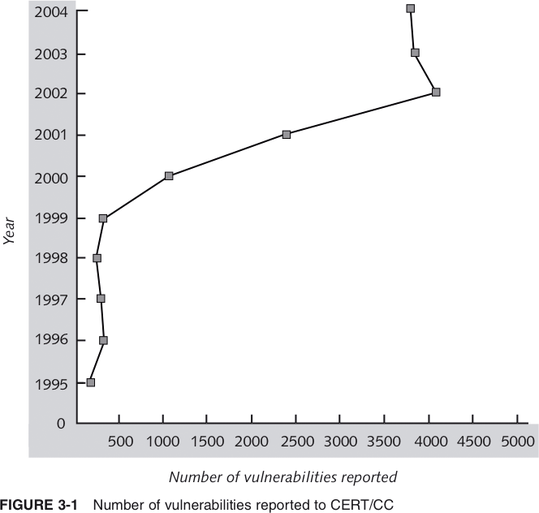
Number of Vulnerabilities Reported to CERT/CC
Ethics in Information Technology, Second Edition

Slide 12
Types of Attacks
Most frequent attack is on a networked computer from an outside source
Types of attacks
  Virus
  Worm
  Trojan horse
  Denial of service
Ethics in Information Technology, Second Edition

Slide 13
Viruses
Pieces of programming code
Usually disguised as something else
Cause unexpected and usually undesirable events
Often attached to files
Deliver a “payload”
Ethics in Information Technology, Second Edition

Slide 14
Viruses (continued)
Does not spread itself from computer to computer
  Must be passed on to other users through
    Infected e-mail document attachments
    Programs on diskettes
    Shared files
Macro viruses
  Most common and easily created viruses
  Created in an application macro language
  Infect documents and templates
Ethics in Information Technology, Second Edition

Slide 15
Worms
Harmful programs
  Reside in active memory of a computer
Duplicate themselves
  Can propagate without human intervention
Negative impact of virus or worm attack
  Lost data and programs
  Lost productivity
  Effort for IT workers
Ethics in Information Technology, Second Edition

Slide 16
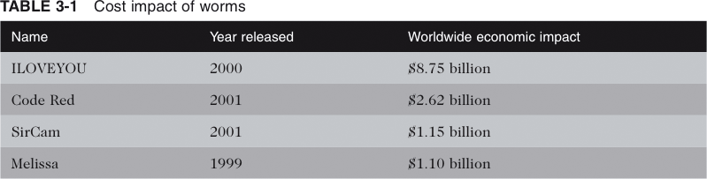
Cost Impact of Worms
Ethics in Information Technology, Second Edition

Slide 17
Trojan Horses
Program that a hacker secretly installs
Users are tricked into installing it
Logic bomb
  Executes under specific conditions
Ethics in Information Technology, Second Edition

Slide 18
Denial-of-Service (DoS) Attacks
Malicious hacker takes over computers on the Internet and causes them to flood a target site with demands for data and other small tasks
  The computers that are taken over are called zombies
Does not involve a break-in at the target computer
  Target machine is busy responding to a stream of automated requests
  Legitimate users cannot get in
Spoofing generates a false return address on packets
Ethics in Information Technology, Second Edition

Slide 19
Denial-of-Service (DoS) Attacks (continued)
Don't let anything out with a source IP address not belonging to the ISP
Don't let anything in with a source IP address belonging to the ISP
Ethics in Information Technology, Second Edition

Slide 20
Perpetrators
Motives are the same as other criminals
Different objectives and access to varying resources
Different levels of risk to accomplish an objective
Ethics in Information Technology, Second Edition

Slide 21
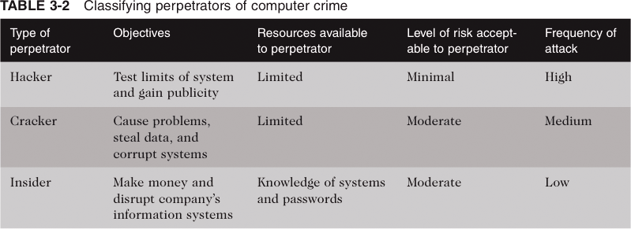
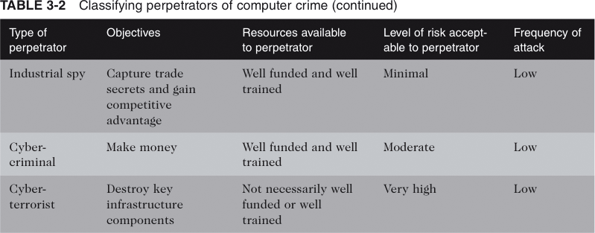
Classifying Perpetrators of Computer Crime
Ethics in Information Technology, Second Edition

Slide 22
Hackers and Crackers
Hackers
  Test limitations of systems out of intellectual curiosity
Crackers
  Cracking is a form of hacking
  Clearly criminal activity
Ethics in Information Technology, Second Edition

Slide 23
Malicious Insiders
Top security concern for companies
Estimated 85 percent of all fraud is committed by employees
Usually due to weaknesses in internal control procedures
Collusion is cooperation between an employee and an outsider
Insiders are not necessarily employees
  Can also be consultants and contractors
Extremely difficult to detect or stop
  Authorized to access the very systems they abuse
Ethics in Information Technology, Second Edition

Slide 24
Industrial Spies
Illegally obtain trade secrets from competitors
Trade secrets are protected by the Economic Espionage Act of 1996
Competitive intelligence
  Uses legal techniques
  Gathers information available to the public
Industrial espionage
  Uses illegal means
  Obtains information not available to the public
Ethics in Information Technology, Second Edition

Slide 25
Cybercriminals
Hack into corporate computers and steal
Engage in all forms of computer fraud
Chargebacks are disputed transactions
Loss of customer trust has more impact than fraud
To reduce the potential for online credit card fraud sites:
  Use encryption technology
  Verify the address submitted online against the issuing bank
  Request a card verification value (CVV)
  Use transaction-risk scoring software
Ethics in Information Technology, Second Edition

Slide 26
Cybercriminals (continued)
Smart cards
  Contain a memory chip
  Are updated with encrypted data every time the card is used
  Used widely in Europe
  Not widely used in the U.S.
Ethics in Information Technology, Second Edition

Slide 27
Cyberterrorists
Intimidate or coerce governments to advance political or social objectives
Launch computer-based attacks
Seek to cause harm
  Rather than gather information
Many experts believe terrorist groups pose only a limited threat to information systems
Ethics in Information Technology, Second Edition

Slide 28
Reducing Vulnerabilities
Security
  Combination of technology, policy, and people
  Requires a wide range of activities to be effective
Assess threats to an organization’s computers and network
Identify actions that address the most serious vulnerabilities
Educate users
Monitor to detect a possible intrusion
Create a clear reaction plan
Ethics in Information Technology, Second Edition

Slide 29
Risk Assessment
Organization’s review of:
  Potential threats to computers and network
  Probability of threats occurring
Identify investments that can best protect an organization from the most likely and serious threats
Reasonable assurance
Improve security in areas with:
  Highest estimated cost
  Poorest level of protection
Ethics in Information Technology, Second Edition

Slide 30
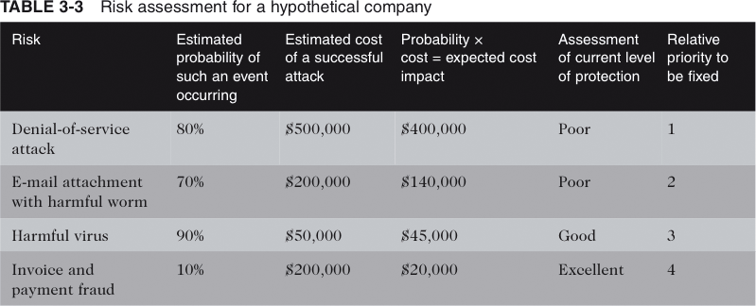
Risk Assessment for a Hypothetical Company
Ethics in Information Technology, Second Edition

Slide 31
Establishing a Security Policy
A security policy defines
  Organization’s security requirements
  Controls and sanctions needed to meet the requirements
Delineates responsibilities and expected behavior
Outlines what needs to be done
  Not how to do it
Automated system policies should mirror written policies
Ethics in Information Technology, Second Edition

Slide 32
Establishing a Security Policy (continued)
Trade-off between
  Ease of use
  Increased security
Areas of concern
  E-mail attachments
  Wireless devices
VPN uses the Internet to relay communications but maintains privacy through security features
Additional security includes encrypting originating and receiving network addresses
Ethics in Information Technology, Second Edition

Slide 33
Educating Employees, Contractors, and Part-Time Workers
Educate users about the importance of security
  Motivate them to understand and follow security policy
Discuss recent security incidents that affected the organization
Help protect information systems by:
  Guarding passwords
  Not allowing others to use passwords
  Applying strict access controls to protect data
  Reporting all unusual activity
Ethics in Information Technology, Second Edition

Slide 34
Prevention
Implement a layered security solution
  Make computer break-ins harder
Firewall
  Limits network access
Antivirus software
  Scans for a specific sequence of bytes
    Known as the virus signature
  Norton Antivirus
  Dr. Solomon’s Antivirus from McAfee
Ethics in Information Technology, Second Edition

Slide 35
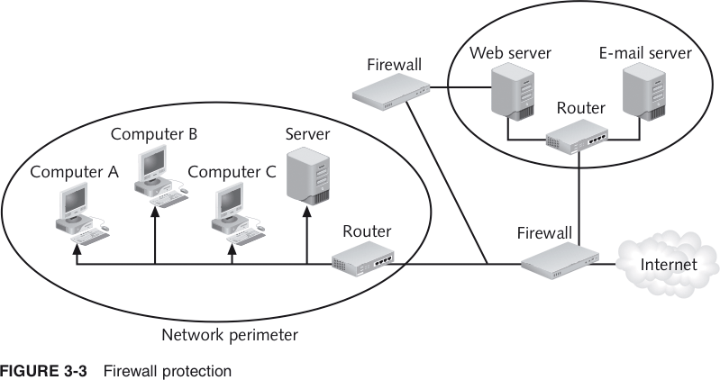
Firewall Protection
Ethics in Information Technology, Second Edition

Slide 36
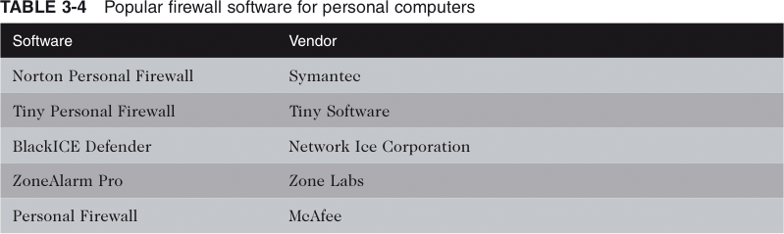
Popular Firewall Software for Personal Computers
Ethics in Information Technology, Second Edition

Slide 37
Prevention (continued)
Antivirus software
  Continually updated with the latest virus detection information
    Called definitions
Departing employees
  Promptly delete computer accounts, login IDs, and passwords
Carefully define employee roles
Create roles and user accounts
Ethics in Information Technology, Second Edition

Slide 38
Prevention (continued)
Keep track of well-known vulnerabilities
  SANS (System Administration, Networking, and Security) Institute
  CERT/CC
Back up critical applications and data regularly
Perform a security audit
Ethics in Information Technology, Second Edition

Slide 39
Detection
Detection systems
  Catch intruders in the act
Intrusion detection system
  Monitors system and network resources and activities
  Notifies the proper authority when it identifies
    Possible intrusions from outside the organization
    Misuse from within the organization
  Knowledge-based approach
  Behavior-based approach
Ethics in Information Technology, Second Edition

Slide 40
Detection (continued)
Intrusion prevention systems (IPSs)
  Prevent attacks by blocking
    Viruses
    Malformed packets
    Other threats
  Sits directly behind the firewall
Ethics in Information Technology, Second Edition

Slide 41
Detection (continued)
Honeypot
  Provides would-be hackers with fake information about the network
  Decoy server
  Well-isolated from the rest of the network
  Can extensively log activities of intruders
Ethics in Information Technology, Second Edition

Slide 42
Response
Response plan
  Develop well in advance of any incident
  Approved by
    Legal department
    Senior management
Primary goals
  Regain control
  Limit damage
Ethics in Information Technology, Second Edition

Slide 43
Response (continued)
Incident notification defines
  Who to notify
  Who not to notify
Security experts recommend against releasing specific information about a security compromise in public forums
Document all details of a security incident
  All system events
  Specific actions taken
  All external conversations
Ethics in Information Technology, Second Edition

Slide 44
Response (continued)
Act quickly to contain an attack
Eradication effort
  Collect and log all possible criminal evidence from the system
  Verify necessary backups are current and complete
  Create new backups
Follow-up
  Determine how security was compromised
    Prevent it from happening again
Ethics in Information Technology, Second Edition

Slide 45
Response (continued)
Review
  Determine exactly what happened
  Evaluate how the organization responded
Capture the perpetrator
Consider the potential for negative publicity
Legal precedent
  Hold organizations accountable for their own IT security weaknesses
Ethics in Information Technology, Second Edition

Slide 46
Summary
Ethical decisions regarding IT security include determining which information systems and data most need protection
65-fold increase in the number of reported IT security incidents from 1997 to 2003
Most incidents involve a:
  Virus
  Worm
  Trojan horse
  Denial-of-service
Ethics in Information Technology, Second Edition

Slide 47
Summary (continued)
Perpetrators include:
  Hackers
  Crackers
  Industrial spies
  Cybercriminals
  Cyberterrorists
Ethics in Information Technology, Second Edition

Slide 48
Summary (continued)
Key elements of a multilayer process for managing security vulnerabilities include:
  Assessment
  User education
  Response plan
Ethics in Information Technology, Second Edition

