Slide 1

OpenSource from inside
Alexander Makarov
Yii core team, Skyeng

Slide 2


About me
Indonesia Developer Summit 2017
Working on Yii and other OpenSource for more than 8 years.
Working on commecial projects as well.
PHP-FIG (source of PSR standards) participant.
Author of several books and http://en.rmcreative.ru/ blog.

Slide 3

What is Yii?
Indonesia Developer Summit 2017
Fullstack PHP MVC framework
Powers lots of cool projects. See http://yiipowered.com/
Makes building things fast
Is one of the most popular PHP frameworks:

Slide 4
What is OpenSource?
Indonesia Developer Summit 2017

Slide 5
My perception of OpenSource changed
Indonesia Developer Summit 2017
Before.
After.

Slide 6
Perception before
Indonesia Developer Summit 2017
I don’t have to pay for it! Yay!

Slide 7
How it sucked me in
Indonesia Developer Summit 2017
In 2005 I worked for Siemens.
In 2007 I've outsourced and used Java.
Private projects weren't convenient to deploy with Java...
So I've used PHP. CodeIgniter.

Slide 8
Yii
Indonesia Developer Summit 2017
At some point I was disappointed about CodeIgniter.
Tried ZF, Symfony, CakePHP and more.
Visited Yii website by accident. Site was awful.
Read docs and docs made sense.
Launched yiiframework.ru (2009).
Started to contribute actively.
Was invited to core team (2010).

Slide 9
Perception after
Indonesia Developer Summit 2017
Collective work where every participant benefit.
Free to use but isn't free to create.

Slide 10
What for?
Indonesia Developer Summit 2017
Together you can build better product.
More testing that you'll ever be able to do alone.
Can learn from others.
New faces.
Can learn to work remotely and improve your English.
Profit?!

Slide 11
Problems
Indonesia Developer Summit 2017
Time.
Energy.
Money.
Expectations.
Popularity.

Slide 12
Time
Indonesia Developer Summit 2017
There's not enough time for everything.
Hero syndrome and a cult of being busy.

Slide 13
Energy
Indonesia Developer Summit 2017
Burnout.
Emotional drain.

Slide 14
Some examples
Indonesia Developer Summit 2017
Every year there is the same topic at Linux conferences: "Is Linus happy?".
In Yii community burnouts happen and aren't that rare.
There were cases in the core team.
Example from Doctrine.

Slide 15
Money
Indonesia Developer Summit 2017
Where are money in OpenSource?!

Slide 16
Not Yii cases
Indonesia Developer Summit 2017
Selling licenses (MariaDB).
Consulting. Not so good... (Sphinx).
Paid learning materials (Laravel).
Complimentary SAAS with recurrent payments (Laravel).

Slide 17
What about Yii?
Indonesia Developer Summit 2017
No money. At least for now...

Slide 18
?!
Indonesia Developer Summit 2017
Yes, I've worked on Yii for 8 years for free.
Yes, the rest of the core team as well.

Slide 19
And it's not bad
Indonesia Developer Summit 2017
Consulting (not much but still there's some).
Cool jobs (CleverTech, Stay.com, Skyeng).
Conferences.
Gifts (hello, JetBrains).

Slide 20
Patreon
Indonesia Developer Summit 2017
A service to finance a project or a person with recurrent payments.
Launched a campaign there.
Was surprised by response.
Got enough to dedicate almost a year to Yii and personal projects.
Good motivation.

Slide 21
Expectations
Indonesia Developer Summit 2017
Many people do think that Yii is commercial company and that core team are employees.

Slide 22
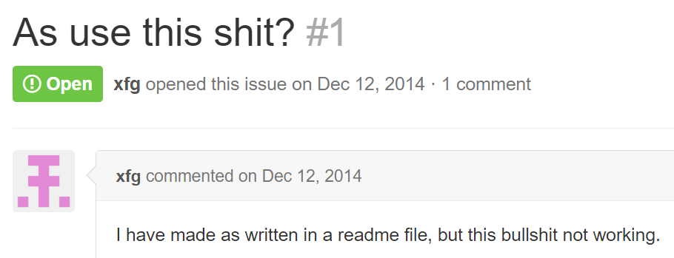
Indonesia Developer Summit 2017

Slide 23
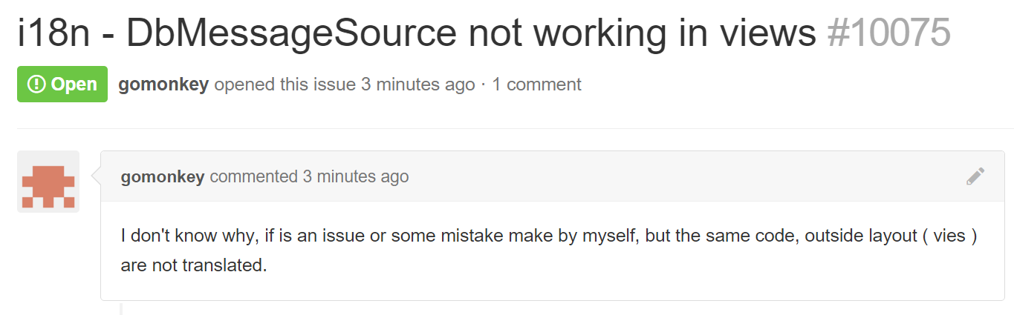
Indonesia Developer Summit 2017

Slide 24
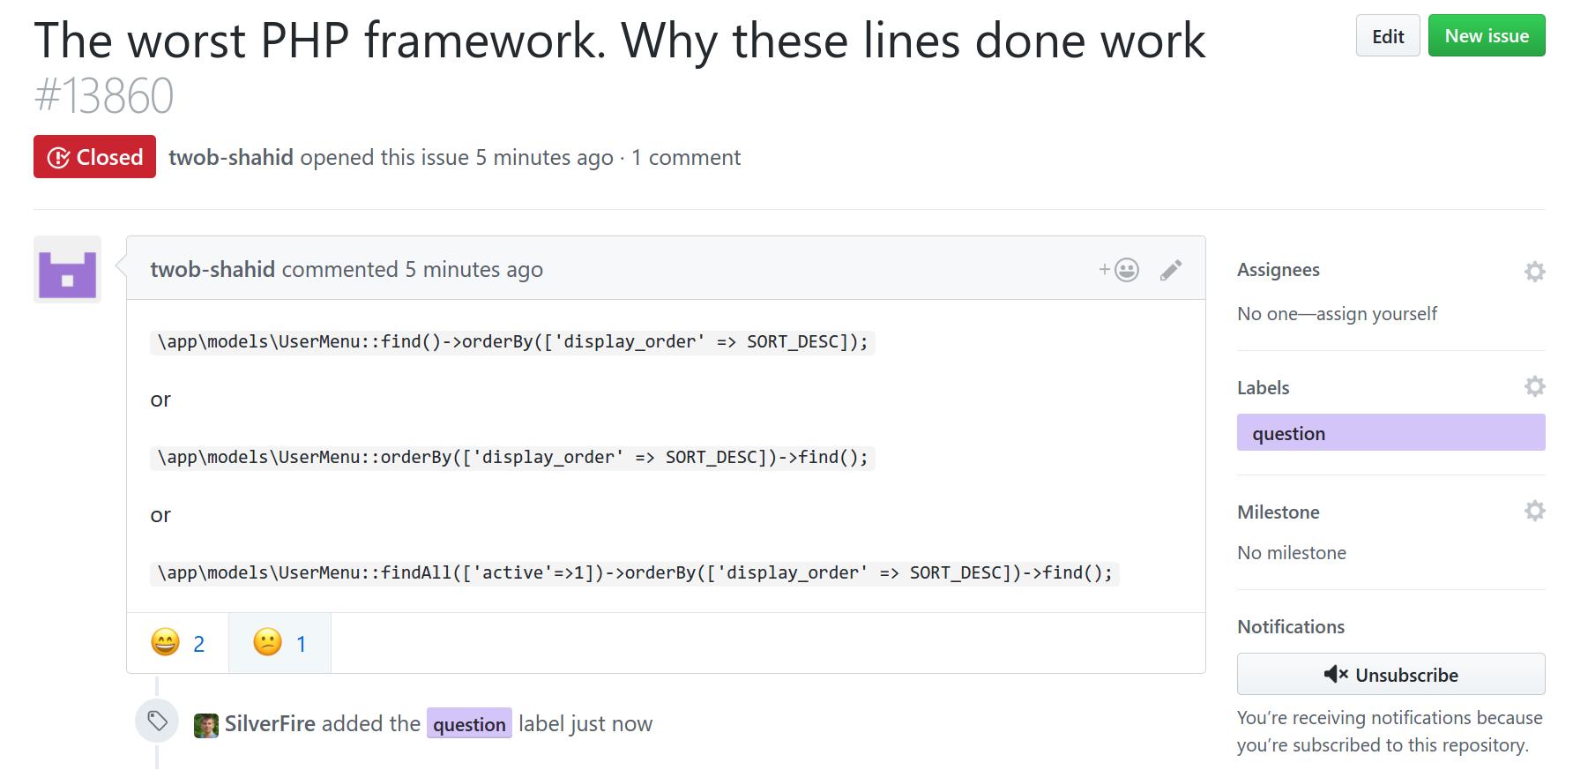
Indonesia Developer Summit 2017

Slide 25
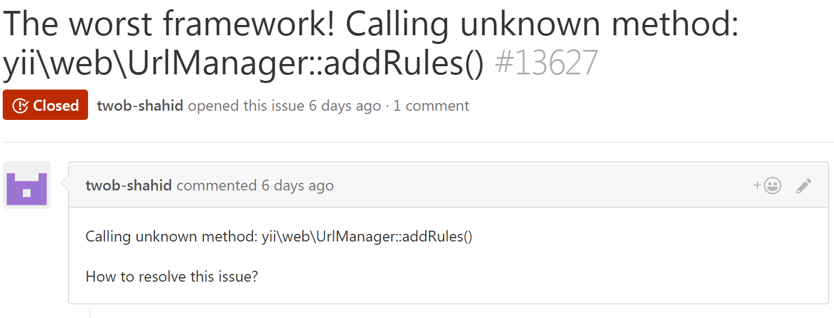
Indonesia Developer Summit 2017

Slide 26
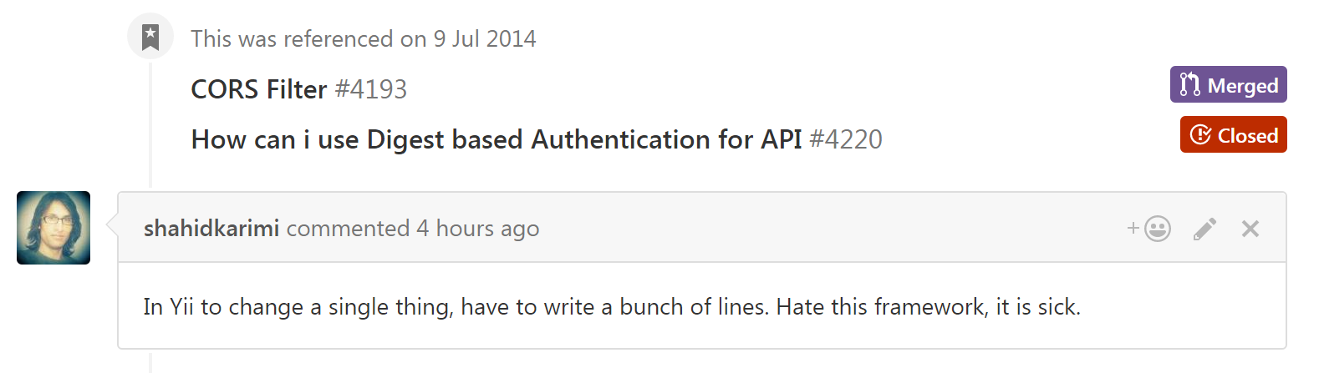
Indonesia Developer Summit 2017

Slide 27
OpenSource is about doing it together.
Indonesia Developer Summit 2017

Slide 28
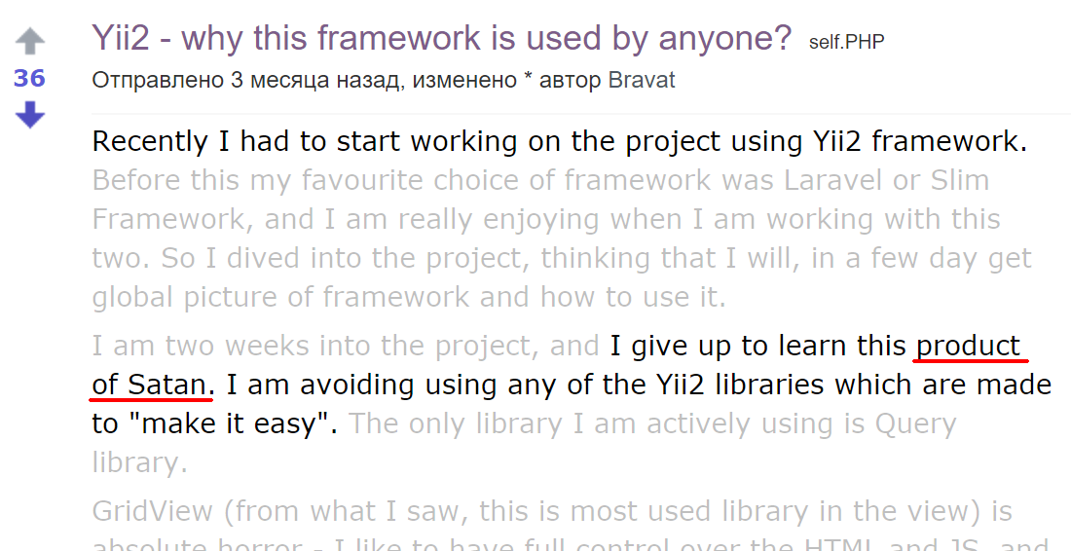
Popularity
Indonesia Developer Summit 2017
Agenda 1
Agenda 2
Sub Agenda 1
Sub Agenda 2
Agenda 3
……..
……..

Slide 29
Indonesia Developer Summit 2017
New issue and pull requests are created continuously.
Different feedback. Negative is voiced often. Positive is voiced rare.

Slide 30
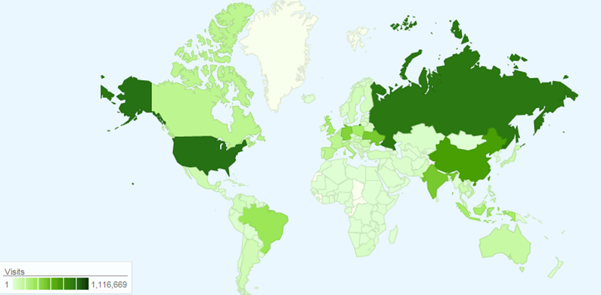
What to do with all that?!
Indonesia Developer Summit 2017
The project is definitely needed.
We want to enjoy life.
Time is finite.

Slide 31
Indonesia Developer Summit 2017
Enjoy positive part of it.
Constructive critics and haters aren't the same.
Do not try to do many things at the same time (if possible).
Do not try to do more than you can.

Slide 32
Useful part
Indonesia Developer Summit 2017
That you can actually apply...

Slide 33

Checklist
Indonesia Developer Summit 2017
+10 to attractiveness of your project.

Slide 34
Main points
Indonesia Developer Summit 2017
Short description: what it is and what is it for.
English!
Documentation.
phpdoc (jsdoc, javadoc).
Tests and CI.
Put more attention into readme.
Screenshots and logo.

Slide 35
Main points
Indonesia Developer Summit 2017
Coding standard (PSR or any other).
Handle issues for real.
Announce it everywhere (Facebook, YiiFeed, forums, reddit).
Choose a good license.
Choose versioning policy and follow it.
packagist (npm, bower).

Slide 36
These are important as well
Indonesia Developer Summit 2017
Support website.
Website and repo should be cross-linked.
Turn off wiki and projects if these aren't used.
Fill GitHub tags.
CONTRIBUTING.md.
Announce releases.

Slide 37
Some links
Indonesia Developer Summit 2017
http://en.rmcreative.ru
https://www.patreon.com/samdark
http://www.yiiframework.com/
Starting an Open Source Project

Slide 38
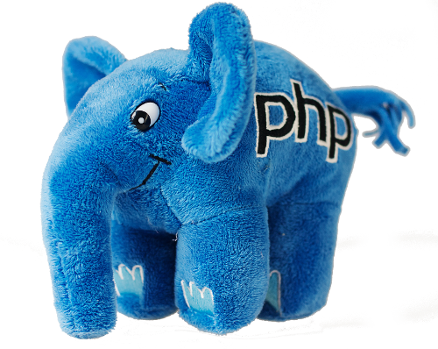
Questions time
Indonesia Developer Summit 2017
Ask me anything:
OpenSource
Yii
PHP
PSRs
…
Yii Slack, @samdark
sam@rmcreative.ru

