Slide 1
Yii, frameworks and where PHP is heading to
Alexander Makarov
Yii core team, Stay.com

Slide 2

Is PHP still there?
Developers are migrating to
Ruby
Python
Java
C++
Developers are migrating…
Because… PHP sucks?!

Slide 3
Well, it sucks a bit. Not that much!
Very good choice for web development.
Will be there for a long time.
Programming language is just a tool… one of the tools.
With a good framework bad parts aren’t that visible.

Slide 4

PHP is good for business
It’s web-focused.
Lots of ready to use stuff.
PHP makes everything easy.
Easy to find and replace
developers.
Less risky.
Project costs less.

Slide 5
Good choice for business → Good choice for developer.

Slide 6
PHP itself is heading towards simplicity and usability
Password hashing API.
Generators.
More consistency.
Built-in webserver.
More performance.
Better syntax.
etc.

Slide 7
And that’s the way to go!

Slide 8
What about frameworks?

Slide 9

Good things first
github = standard for hosting cool PHP stuff.
PSR-0 = interoperable & faster class loading.
At least some stable frameworks are there and definitely ready for business: BC and maintained.

Slide 10
Now not that good things…

Slide 11
“Enterprise”
ZF 2 and Symfony2 are very “enterprise”.
Much more “enterprise” than ZF1 and symfony were.

Slide 12


Slide 13
This “enterprise” shit is too complex

Slide 14
“ZF2 is too "scientific". You can write a thesis about ZF2 and its design. Don't get me wrong, I love best practices, standards, design patterns etc., but ZF2 devs dive too deep into "science".
Symfony2 is better but not enough.”

Slide 15
But why becoming complex instead of being simple?

Slide 16
Why ZF2 is what it is
Zend is the PHP company, they’ll have enough customers no matter what they’ll release.
Main customers are of enterprise type.
Not really interested in 80% projects out there.
Consulting isn’t profitable if product isn’t complex enough ;)
Heading into J2EE direction they have a chance to get former EE-companies on board.

Slide 17
It works for Zend very well.

Slide 18
What about Symfony2?
Personally I think they’re trying to be “enterpise” (=complex) as well.
Sensio labs is a commercial company earning for framework support and consulting.
http://fabien.potencier.org/article/65/why-symfony
Good thing is that framework is a bit more practical than ZF2.
Still very complex.

Slide 19
What’s bad in these “enterprise” things?
Design-patterns oriented instead of practically oriented. Emphasizing on patterns.
Easier to unit-test, harder to develop and learn.
Almost impossible to delegate routine work to less competent developers w/o spending lots of time teaching them first.
High risk for project owner.

Slide 20
That reminds me… Java past
“Their main thesis to support that complexity is… hold your breath… fasten your seatbelts: if it were easier, more stupid people would be using it!. Ta-da!!”
“J2EE is no way simple. However the reality is simple: for J2EE to survive - we have to make it simple to build, deploy and manage”

Slide 21
Java is simpler now compared to what it was
Play
Apache Wicket
Even Spring is much more usable and simple than what it was before

Slide 22
So are SF2 and ZF2 evil?

Slide 23
Not really. Just a different niche.

Slide 24
Enterprise isn’t only complexity
Stable API.
Well-tested code.
Backwards-compatible regular releases.
Guarantee that vendor will support product for at least X years.
Well-documented.
Commercial support, trainings.
And more…

Slide 25
So what’s left for practical fellows?

Slide 26
Practical frameworks
Development should be straightforward. We’re not doing complex stuff for webapps most of the time.
Easy learning.
Less magic.
Less configuration.
As simple API as possible.

Slide 27
If good parts of enterprise are still there it will be perfect

Slide 28
Yii — a practical framework

Slide 29



Slide 30
Let’s bust some myths first

Slide 31
Framework myths
If framework reinvented the wheel, it's a bad one.
If there is DI container and design patterns all over the place, it's a good one.
If framework X implemented feature Y first, it's better.
Loosely coupled framework is always a good choice.
If there’s no feature X it’s a bad one.

Slide 32
What’s really important
Easy to learn.
Easy to debug and fix.
Doesn’t mess with your code or any good third-party code.
Friendly active community.
BC and stable.
No roadblocks when trying to extend or customize it.
Feels good ;)

Slide 33









*
*
*
☺
*
2004
2005
2006
2007
2008
2011
Prado, с 2004 → Yii 1.0, 2008 → Yii 1.1, 2010

Slide 34
What is Yii?
PHP5 MVC.
Nice API.
DAO, AR, migrations.
Form builder.
Themes.
Test framework.
Well documented.
Friendly community.
Powerful cache.
RBAC, auth framework.
Console.
error handler, log.
Gii.
CLDR based I18n.
Widgets.
BSD license.

Slide 35
Still stays the fastest modern PHP framework (excluding some microframeworks and PECL ones).

Slide 36
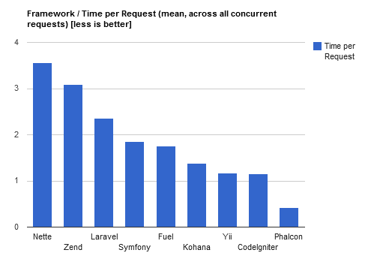
That's not ours benchmark. http://docs.phalconphp.com/en/latest/reference/benchmark/hello-world.html

Slide 37
Getting even faster and less memory-hungry thanks to our GitHub community.

Slide 38
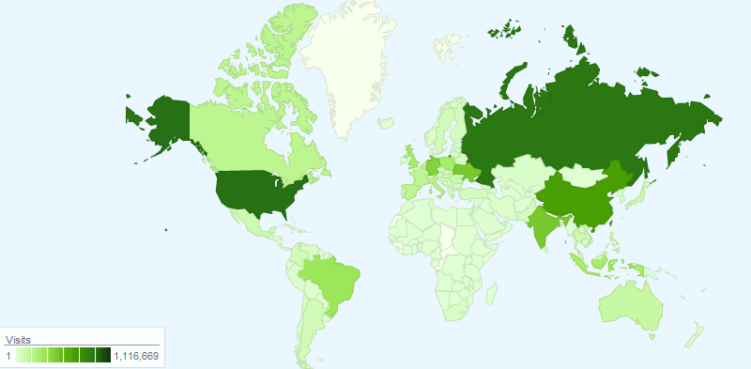

Slide 39












*intranet

Slide 40















Slide 41





2
2

Slide 42
Balanced
Stable
Flexible
Well-documented
Doesn’t mess with your stuff

Slide 43

Balance isn’t easy to achieve
Theoretically correct architecture or practical experience?
20% or 80%
Features or core?

Slide 44

Stable API and BC = good & evil

Slide 45
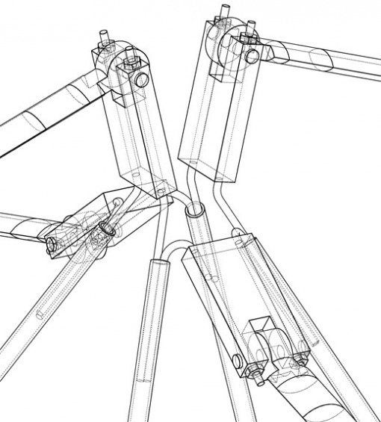
Flexibility should not mess with simplicity
As less abstraction as possible.
It’s simple to make things complex. Making things simple isn’t.
Conventions.
Hide complexity.

Slide 46
There’s not a single setMyCoolFactoryDependencyInjectionContainer() in Yii

Slide 47
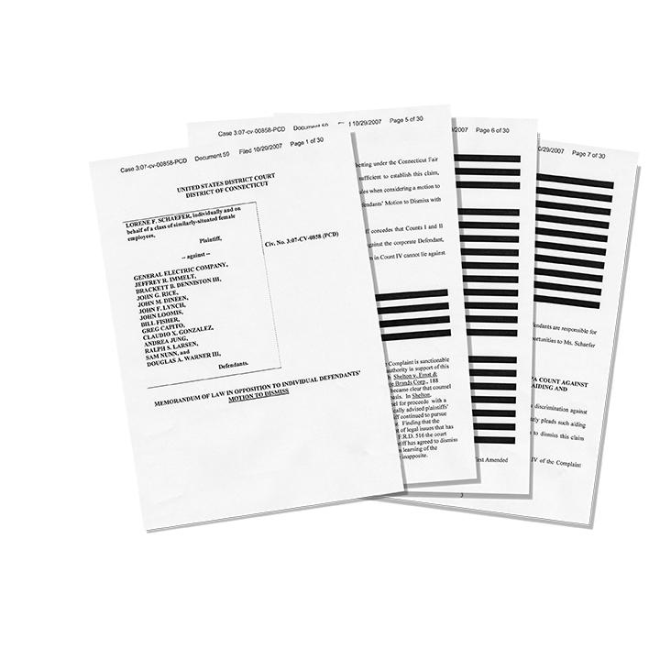
Docs are very important
We’re documenting as soon as writing code.
Definitive guide and blog tutorial translated into 16 languages.
phpdoc.
Examples.
Great books.

Slide 48
Yii can work with components from Symfony 2 and ZF2. That's what these are for, right? ;)

Slide 49
Yii is practice oriented framework

Slide 50
The end?
Questions?
Suggestions?
sam@rmcreative.ru
@sam_dark
http://yiiframework.com/

Slide 51
I knew you would ask about it ;)

Slide 52
PHP 5.3.8+
Namespaced classes
PSR-0
Better structured
Less entities
All the good things are still there
v2

Slide 53
Yii2: base
New aliases @yii/base/Component
CComponent → Object + Component
SPL instead of custom collections
Killed CFormModel. Model should be used instead.
Better rules and scenarios.
class MyComponent extends \yii\base\Object
{
public $x;
public function __construct($a, $b)
{
//…
}
}
$component = MyComponent::newInstance(
array('x'=>10),
'a', 'b'
);

Slide 54
Yii2: View Object
render(), widget(), beginCache() → viewObject
View: $owner = class that called render
$this = View.
No need for renderers.
Can be used in console.
CHtml is still there.

Slide 55
Yii2: events
$post->on('add', function($event) { ... });
$post->trigger('add', new Event($this));
$post->off('add', $callback);
$handlers = $post->getEventHandlers('add');
No need to declare
jQuery-like syntax
Behaviors instead of filters

Slide 56
Yii2: Query object
// Query object
$query = new Query;
$query->select('id')->from('tbl_customer')->limit(10);
$command = $db->createCommand($query);
$this->assertEquals("SELECT `id` FROM `tbl_customer` LIMIT 10", $command->sql);
// array
$command = $db->createCommand(array(
'select' => 'name',
'from' => 'tbl_customer',
));

Slide 57
Yii2: Even better ActiveRecord
$customer = Customer::find(2)
->active()
->one();
$customer->name = 'Qiang';
$customer->save();
$customers = Customer::find()
->order('id')
->asArray(true)
->all();
Finder / Model
Can create your own finder
::model()
Autoquotes.
Method chains.
Dirty attributes.
Less memory.
Can get arrays from AR.

Slide 58
Yii2: AR
$postFinder = Post::find()
->where(array(
'active' => true
));
if($isPrivate) {
$postFinder->addWhere(array(
'createdBy' => $userId,
));
}
$posts = $postFinder
->mergeWith($anotherFinder)
->all();
Criteria
You can merge finders
You can add conditions on the fly

Slide 59
Yii2: AR
tableName(), relations(), scopes() = static.
HAS_ONE, HAS_MANY relations.
link = FKs
via = through
Scopes via anonymous functions.
"@." and "?" tokens. Automatic alias. Own table. Foreign table.
class Customer extends ActiveRecord {
const STATUS_ACTIVE = 1;
public static function tableName() {
return 'tbl_customer';
}
public static function relations() {
return array(
'orders:Order[]' => array(
'link' => array('customer_id' => 'id'),
),
);
}
public static function scopes() {
return array(
'active' => function($q) {
return $q->andWhere('@.`status` = ' . self::STATUS_ACTIVE);
},
);
}
}

Slide 60
Yii2: AR
$customers = Customer::find()-> asArray()->all();
foreach (Customer::find() as $customer)
$count = Customer::count()
->value();
$customers = Customer::find()->active()
->all();
$customers = Customer::find()
->where('name like :name', array(
':name' => '%customer%'
))->order('id')->all();

Slide 61
TODO (if there will be enough time)
HTTP (CURL) wrapper
Package manager
Mailer
Twitter Bootstrap
Debug toolbar
Console requirements
More helpers
jQueryUI-based widgets (not just jQueryUI widgets)
Commercial support (most probably not by Yii core team members)

Slide 62
1 or 2?
Work with the stable one. 1.1 will be
supported till December 31, 2015.

Slide 63
When?
Before we’ll push alpha code to github repo we need to finish at least →
i18n
Controller + webapp
A solid base for widgets
URL manager

Slide 64

The end (really)
Questions?
Suggestions?
sam@rmcreative.ru
@sam_dark
http://yiiframework.com/

