Slide 1

Yii² What’s new?
Alexander Makarov,
Yii core team

Slide 2


Slide 3
Some statistics

Slide 4
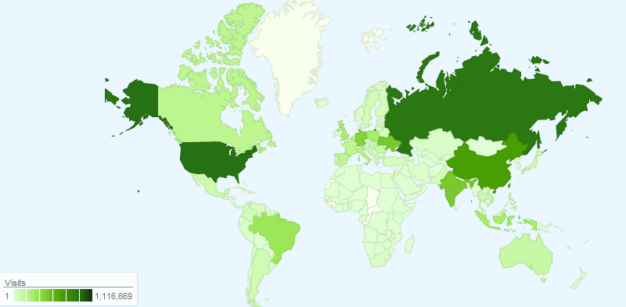

Slide 5
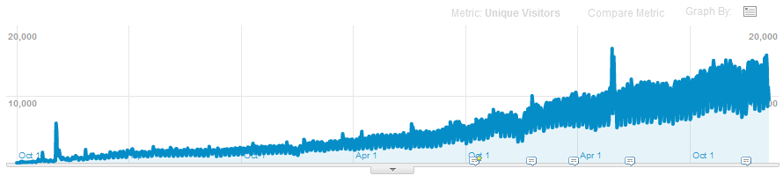
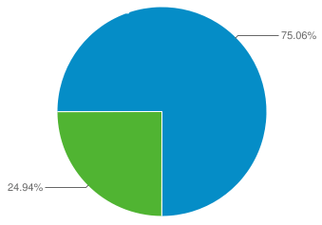

Slide 6
Who uses Yii?

Slide 7











*intranet

Slide 8















Slide 9





2
2

Slide 10
Why?

Slide 11
Well-balanced
Stable
Flexible
Well-documented

Slide 12
2011 — beginning of 2012 events

Slide 13
What happened?
5 stable Yii 1.1 releases
Yii 1.1 Application Development Cookbook
Yii for Eclipse PDT, CodeLobster
Yii → GitHub
Events:
Yii beer party
YiiTalk
YiiConf

Slide 14



Slide 15
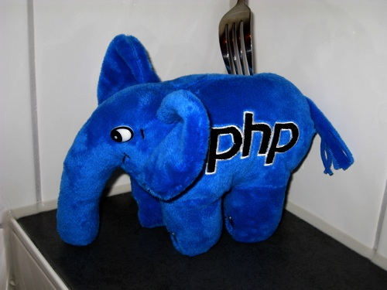
First two days
348 watches
61 forks

Slide 16
Now
1134 watches
240 forks

Slide 17
Yii 1.1.11 will be quite interesting release ;)

Slide 18
What’s bad in Yii 1.1?
AR (finder and record are the same object, some API).
Some classes are in strange places.
More small things.
BC
The biggest issue is

Slide 19









*
*
*
☺
*
2004
2005
2006
2007
2008
2011
Prado, from 2004 → Yii 1.0, 2008 → Yii 1.1, 2010

Slide 20
Yii 2 team
3 active core developers: qiang, samdark, mdomba.
github.

Slide 21
PHP 5.3.8+
All classes are namespaced (\yii) and w/o prefix
PSR-0
Better structure
Less entities
Keep good ideas
v2

Slide 22
Documentation
Larry Ullman, author of 22 excellent IT-books and a great article series about Yii will write a book about Yii2 + will participate in official documentation writing.
API docs will be at least same quality as 1.1.
Code style guide.
There’s a plan to release documentation tool to the public.

Slide 23
Yii2: base
Aliases in form of @yii/base/Component
CComponent → Object + Component
SPL replaced most of collections
Removed CFormModel. Now you can use Model directly.
class MyComponent extends \yii\base\Object
{
public $x;
public function __construct($a, $b)
{
//…
}
}
$component = MyComponent::newInstance(
array('x'=>10),
'a', 'b'
);

Slide 24
Yii2: View Object
render(), widget(), beginCache() → viewObject
In a View: $owner = class that uses view
$this = View.
No need for renderer.
Can be used in console applications.
CHtml is still there.

Slide 25
Yii2: events
$post->on('add', function($event) { ... });
$post->trigger('add', new Event($this));
$post->off('add', $callback);
$handlers = $post->getEventHandlers('add');
No need to explicitly declare before raising
jQuery-like syntax
Behaviors instead of filters

Slide 26
Yii2: Query object
// Query object
$query = new Query;
$query->select('id')->from('tbl_customer')->limit(10);
$command = $db->createCommand($query);
$this->assertEquals("SELECT `id` FROM `tbl_customer` LIMIT 10", $command->sql);
// array
$command = $db->createCommand(array(
'select' => 'name',
'from' => 'tbl_customer',
));

Slide 27
Yii2: AR
$customer = Customer::find(2)
->active()
->one();
$customer->name = 'Qiang';
$customer->save();
$customers = Customer::find()
->order('id')
->asArray(true)
->all();
Finder / Model
Can create your own finder
::model()
Auto quoting.
Method chains.

Slide 28
Yii2: AR
$postFinder = Post::find()
->where(array(
'active' => true
));
if($isPrivate) {
$postFinder->addWhere(array(
'createdBy' => $userId,
));
}
$posts = $postFinder
->mergeWith($anotherFinder)
->all();
Criteria
Can merge two finders
Can add conditions on the fly

Slide 29
Yii2: AR
tableName(), relations(), scopes() = static.
Relations are HAS_ONE, HAS_MANY.
link = FKs
via = through
Anonymous functions for scopes.
"@." and "?" tokens: own table, external table.
class Customer extends ActiveRecord {
const STATUS_ACTIVE = 1;
public static function tableName() {
return 'tbl_customer';
}
public static function relations() {
return array(
'orders:Order[]' => array(
'link' => array('customer_id' => 'id'),
),
);
}
public static function scopes() {
return array(
'active' => function($q) {
return $q->andWhere('@.`status` = ' . self::STATUS_ACTIVE);
},
);
}
}

Slide 30
Yii2: AR
$customers = Customer::find()-> asArray()->all();
foreach (Customer::find() as $customer)
$count = Customer::count()
->value();
$customers = Customer::find()->active()
->all();
$customers = Customer::find()
->where('name like :name', array(
':name' => '%customer%‘
))->order('id')->all();

Slide 31
TODO (if there will be enough time)
HTTP (CURL) wrapper
Package manager
Mailer
Twitter Bootstrap
Debug toolbar
Console requirements
More helpers
jQueryUI-based widgets
Commercial support

Slide 32
1 or 2?
Don’t wait. Work with stable one.

Slide 33
When?
Before alpha code will be put into public github repository we need to finish at least these things→
Base for caching
Base for i18n
Controller + webapp
Base for widgets
URL manager

Slide 34
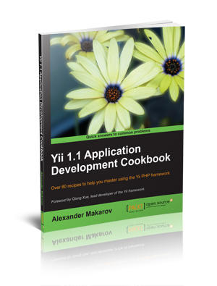
Want more info?
http://www.yiiframework.com/forum/index.php/forum/42-design-discussions-for-yii-20/

Slide 35

Questions?
yiiframework.com
yiiframework.ru
rmcreative.ru

