Slide 1
Perception and Visual Design
Project SAAB
Sumanth Pinnaka
Sameer Mishra

Slide 2
Design Ideologies
Colors
Monochromatic schema for the main content
Some prominent colors for certain icons
Visibility of bold black system can be very useful over a colorful map
Future possibility of having a translucent background

Slide 3
Fine structure
Using the current system shapes and ideas
Minimal changes to the system for the ease of use
Icons with clear meaning in layman
Freedom for all areas to carry information

Slide 4
Grouping
Groups formed correspond to meaningful aspects of the data
Proving some visual cues to the user in the groups
Ease of having similar icons under one category

Slide 5
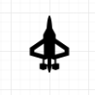
Initial state or Zero state
Depicted by a plane.
There are two possibilities
1- Single Right mouse click to open the selection menu
And Single left mouse click to open the selected options
2. Single and Double Left mouse clicks.

Slide 6
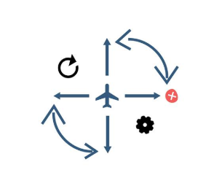
The Left Click
Single left click using the mouse on the plane icon will open the frequently required HAS function.
On selection the plane color changes into a shade of dark blue.
Other icons reload, settings and close.

Slide 7
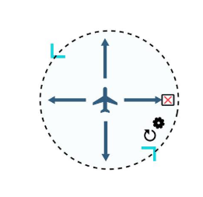
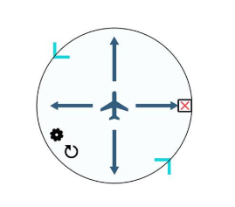
Other design ideas

Slide 8
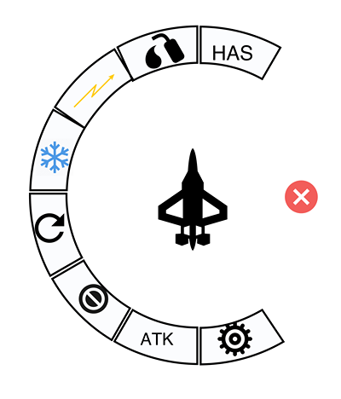
Second Click
Second left or right click?
Opening of a new world with more options
-HAS
-Refuel
-Reload
-Malfunction
Defaults included

Slide 9
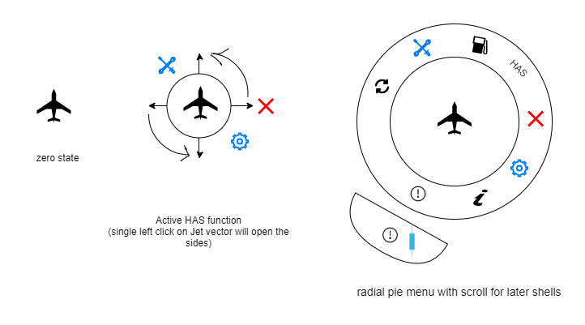
Developing Idea : third level with a scroll feature

Slide 10
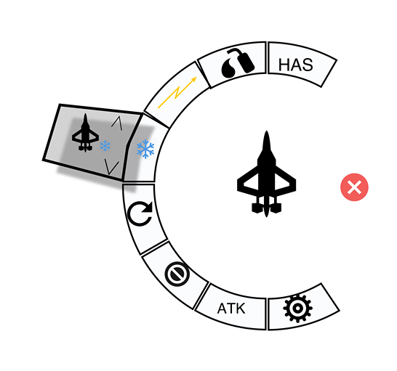
The “Third” level
For ease of access
Grouping of similar entities
For malfunction
Various freeze options
Settings options

Slide 11
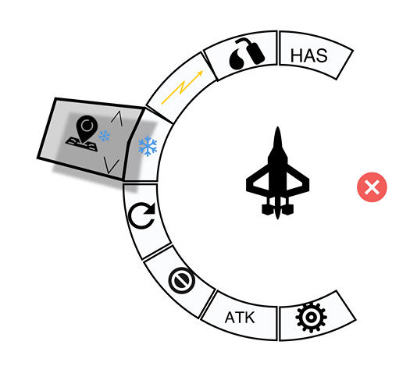
Final design idea

Slide 12
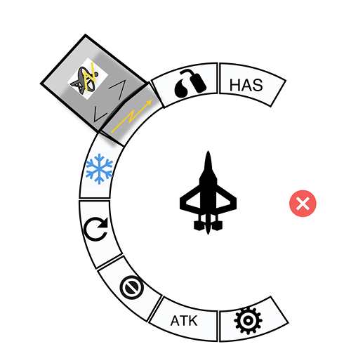

Slide 13
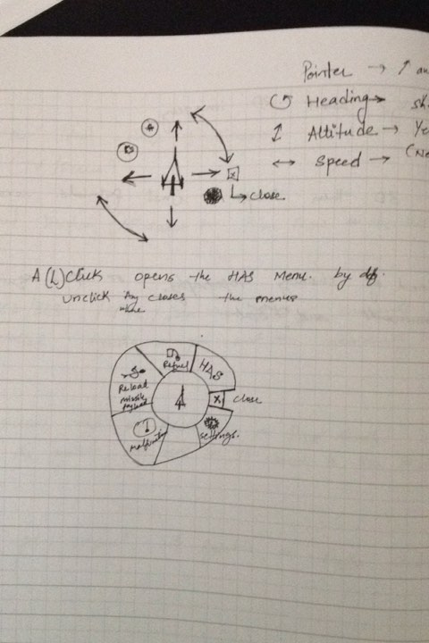
Initial Icon Ideas: paper model

Slide 14
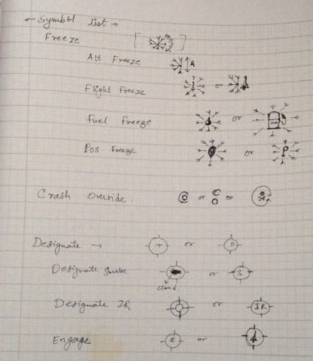

Slide 15
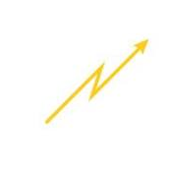
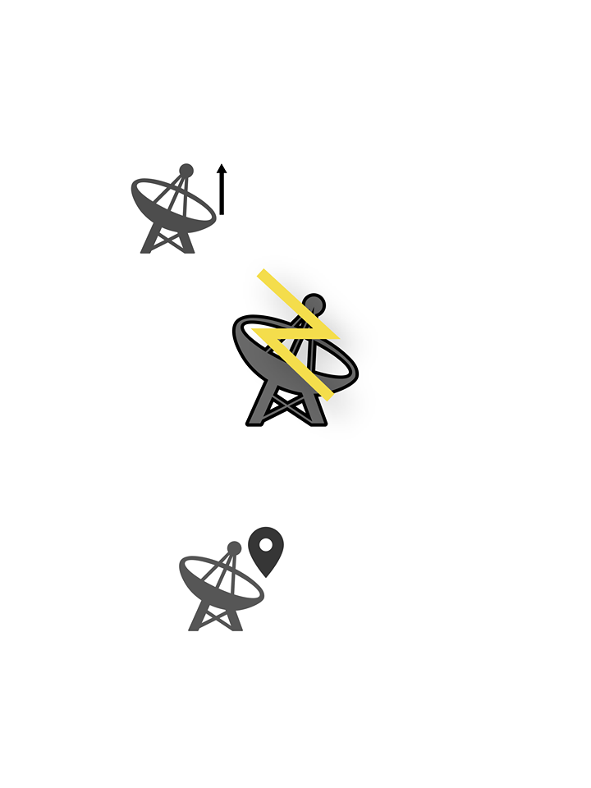
Icon List
Electronic Warfare
Spike
JAM
Spot

Slide 16
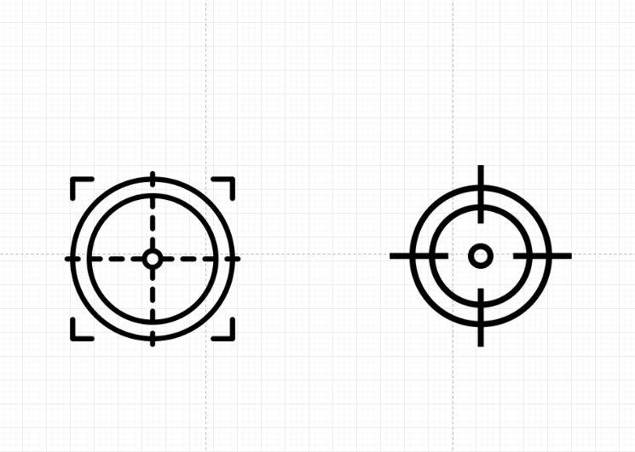
Attack
Engage Designate

Slide 17


Freeze
Location Freeze
Flight Freeze
Fuel Freeze

Slide 18
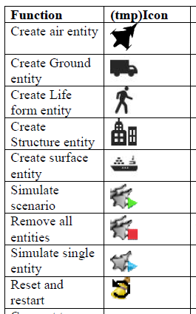
Functions in Settings: no changes made

Slide 19
Any Questions?
Thankyou :)

