Slide 1
MERU UNIVERSITY OF SCIENCE AND TECHNOLOGY
School of Computing & Informatics | Department of Computer Science | CDS 3301
DIABETES RISK SCREENING SYSTEM
Comparative Classification, Threshold Calibration (Recall > Precision), and Deployment Prototype
GROUP 2 PROJECT DEFENSE (10-MINUTE PRESENTATION + 2-MINUTE DEMO):
1. Ordit Kagwira (CT202/114188/23) - Project Coordinator
2. Beauttah Kipruttoh (CT202/113636/23) - Preprocessing & Responsible AI
3. Atitwa Samuel Makokha (CT202/113631/23) - Exploratory Analysis & Feature Importance
4. Kiplangat Dancun (CT202/113622/23) - Model Building & Web Prototype
5. Wamukota Kevin (CT202/106143/21) - Hyperparameter Tuning & Evaluation
Course Lecturer: Dr. Amos Chege Kirongo (akirongo@must.ac.ke)
Notes:
Good morning Dr. Amos Chege Kirongo and fellow students. We are Group 2, presenting our machine learning diabetes risk screening project for CDS 3301. Our defense is divided into a 10-minute presentation covering all eight project tasks followed by a 2-minute live prototype demonstration.

Slide 2
2. Group Members & Task Allocation
Verified individual contributions for university assessment
Presenter: Ordit Kagwira
• Ordit Kagwira (CT202/114188/23): Overall Project Coordination, Task 1 Problem Framing, Task 8 Conclusions & Report Integration.
• Beauttah Kipruttoh (CT202/113636/23): Task 2 Data Acquisition, Biological Zero-Value Audit, Imputation Pipeline & Task 6 Responsible AI.
• Atitwa Samuel Makokha (CT202/113631/23): Task 2 Exploratory Visualisations, Statistical Bivariate Analysis & Task 5 Feature Importance.
• Kiplangat Dancun (CT202/113622/23): Task 3 Baseline & Model Training, Task 7 Full-Stack FastAPI & React Prototype.
• Wamukota Kevin (CT202/106143/21): Task 4 5-Fold Stratified GridSearchCV Tuning, Task 5 Threshold Calibration (tau=0.35) & Evaluation.
Meru University of Science and Technology | CDS 3301: Machine Learning | Group 2
Notes:
Each member was assigned specific phases of the pipeline according to the marking scheme.

Slide 3
3. Background & Problem Statement
The Diabetes Crisis in Rural Kenyan Healthcare
Presenter: Ordit Kagwira (Min 0:00 - 1:15)
• Sub-Saharan Reality: 54% of adults with diabetes are undiagnosed (IDF Diabetes Atlas, 10th Ed.).
• Rural Constraints: Primary health facilities across Meru, Embu, and Machakos lack automated clinical chemistry and HbA1c assays.
• Complications: Patients often present only after developing irreversible microvascular damage (nephropathy, retinopathy, foot amputations).
• Clinical Need: An empirical, low-cost screening tool utilizing routine physical indicators to triage patients needing laboratory confirmation.
Meru University of Science and Technology | CDS 3301: Machine Learning | Group 2
Notes:
Over 54% of diabetic patients in sub-Saharan Africa remain undiagnosed due to lack of diagnostic labs.

Slide 4
4. Project Objectives
Translating Machine Learning into Clinical Decision Support
Presenter: Ordit Kagwira (Min 1:15 - 2:00)
• Primary Objective: Develop and benchmark machine learning classifiers that predict diabetes status from routine clinical measurements.
• Data Quality Objective: Identify and address biologically impossible zero-values without introducing data leakage.
• Clinical Optimization Objective: Answer the lecturer's core research question: 'Is recall more important than precision for screening? What threshold would you recommend and why?'
• Deployment Objective: Operationalize the optimal model into a production FastAPI backend and interactive clinical web application.
Meru University of Science and Technology | CDS 3301: Machine Learning | Group 2
Notes:
Our core goal is to build a reliable classifier that maximizes recall while preserving acceptable precision.

Slide 5
5. Dataset Description & Provenance
Pima Indians Diabetes Database (NIDDK / UCI Repository)
Presenter: Beauttah Kipruttoh (Min 2:00 - 3:00)
• Source & Licence: NIDDK, UCI Machine Learning Repository (Smith et al., 1988); CC0 Public Domain Licence.
• Cohort Size: N = 768 female patients aged 21 years and older.
• 8 Clinical Features: Pregnancies, Glucose, BloodPressure, SkinThickness, Insulin, BMI, DiabetesPedigreeFunction, Age.
• Target: Binary Outcome (500 Non-diabetic [65.1%] vs 268 Diabetic [34.9%]).
• Limitations: Exclusively female subjects of indigenous Pima heritage; requires local calibration when deploying in Kenya.
Meru University of Science and Technology | CDS 3301: Machine Learning | Group 2
Notes:
The Pima dataset contains 768 records with 8 features and a binary outcome.

Slide 6
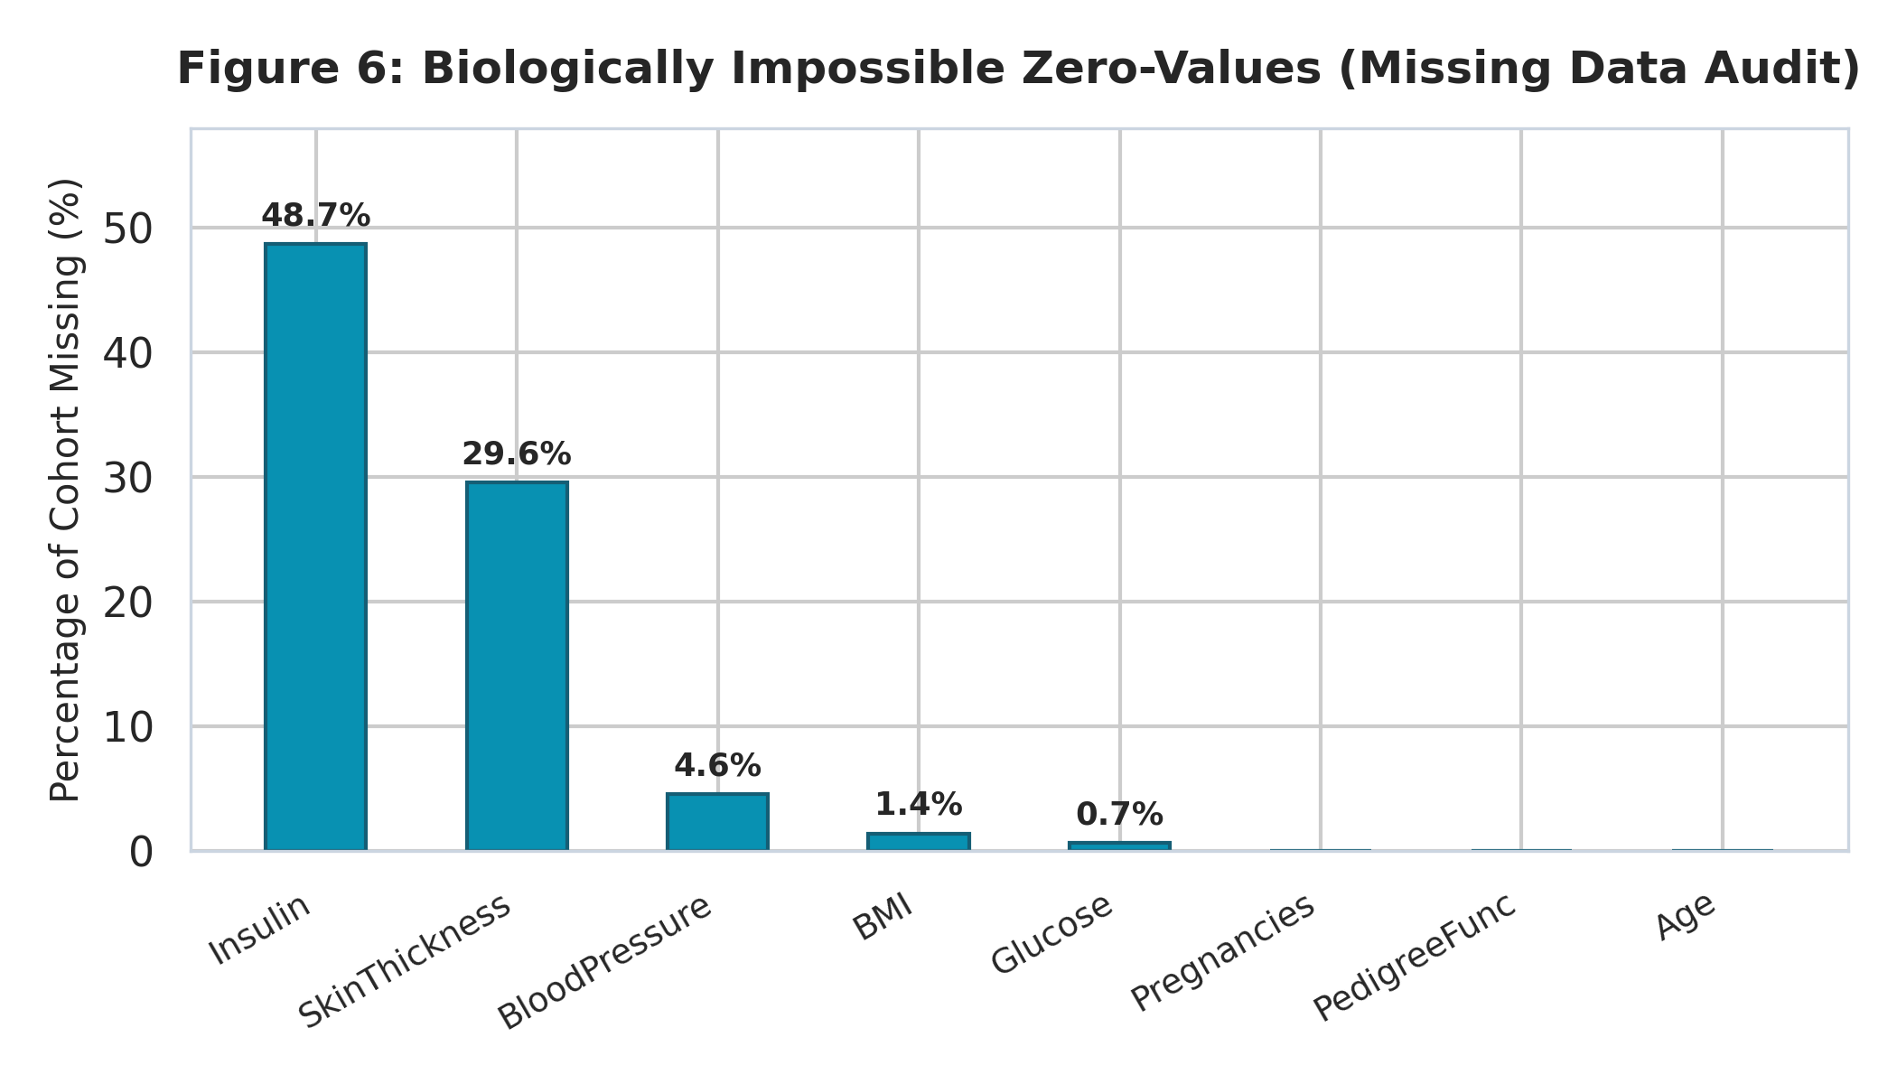
6. Data Preparation & Leakage Prevention
Handling Biological Zeros via Stratified Pipeline Architecture
Presenter: Beauttah Kipruttoh (Min 3:00 - 4:00)
• The Biological Zero Problem: 0 mg/dL blood glucose or 0 mm skin thickness is impossible in living humans.
• Audit Results: Insulin missing 48.70% (374), SkinThickness missing 29.56% (227), BloodPressure missing 4.56% (35).
• Leak-Free Preprocessing: Imputation medians and scaling parameters fitted strictly on 80% training split (n=614).
• Zero Test Leakage: The 20% held-out test split (n=154) was isolated until final model evaluation.
Meru University of Science and Technology | CDS 3301: Machine Learning | Group 2
Notes:
Values of 0 in insulin or glucose are missing data, not living human measurements.

Slide 7
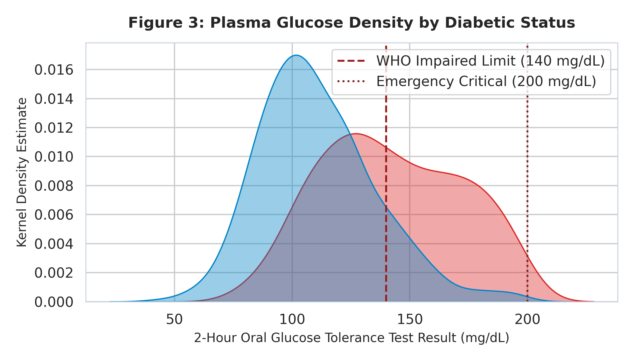
7. Exploratory Analysis: Distributions & Correlations
Key physiological biomarker patterns
Presenter: Atitwa Samuel Makokha (Min 4:00 - 5:00)
• Figure 3 (Glucose KDE): Sharp bimodal separation. Diabetic density peaks above 140 mg/dL (WHO diagnostic cutoff).
• Figure 4 (BMI KDE): Diabetic cohort exhibits median BMI of 34.3 kg/m², significantly exceeding obesity cutoff (30 kg/m²).
• Figure 5 (Correlations): Glucose has strongest correlation with diabetes (r = +0.47, p < 0.001), followed by BMI (r = +0.29).
• Synergistic Non-Linear Risk: Patients aged >30 with BMI >30 kg/m² exhibit a 72% diabetes incidence.
Meru University of Science and Technology | CDS 3301: Machine Learning | Group 2
Notes:
Notice the marked divergence in glucose above 140 mg/dL, matching the WHO impaired glucose cutoff.

Slide 8
8. Machine Learning Model Families
Benchmarking Diverse Classifiers from Simple Linear to Ensemble
Presenter: Kiplangat Dancun (Min 5:00 - 6:00)
• 1. Dummy Classifier: Majority class baseline. Yields 64.9% accuracy with 0.0% recall, highlighting the accuracy paradox.
• 2. Logistic Regression: Generalized linear model; outputs log-odds coefficients and calibrated probabilities (C=0.1, L2).
• 3. K-Nearest Neighbors (KNN): Non-parametric instance classifier based on Euclidean distance in scaled biomarker space (k=17).
• 4. Decision Tree (CART): Interpretable hierarchical rules. Pruned (max_depth=4) to prevent leaf overfitting.
• 5. Random Forest: Ensemble of 150 bagging trees. Reduces variance and handles missing feature interactions effectively.
• 6. Support Vector Machine (SVM): RBF kernel mapping non-linear interactions into high-dimensional hyperplane (C=1.0).
Meru University of Science and Technology | CDS 3301: Machine Learning | Group 2
Notes:
We tested 6 algorithms representing diverse inductive biases.

Slide 9
9. Hyperparameter Tuning & Cross-Validation
5-Fold Stratified K-Fold and Exhaustive GridSearchCV
Presenter: Wamukota Kevin (Min 6:00 - 6:45)
• Validation Strategy: 5-Fold Stratified K-Fold cross-validation to maintain identical class ratios across every split.
• Optimization Metric: GridSearchCV optimized for ROC-AUC to balance discrimination across all decision thresholds.
• Tuned Hyperparameters:
- Logistic Regression: C=0.1, solver='liblinear', penalty='l2' (CV ROC-AUC: 0.844).
- Random Forest: n_estimators=150, max_depth=6, min_samples_split=5 (CV ROC-AUC: 0.835).
- KNN: n_neighbors=17, weights='distance', metric='euclidean' (CV ROC-AUC: 0.807).
- SVM: C=1.0, kernel='rbf', gamma='scale' (CV ROC-AUC: 0.811).
Meru University of Science and Technology | CDS 3301: Machine Learning | Group 2
Notes:
Stratification ensured 34.9% positive prevalence across all five cross-validation folds.

Slide 10
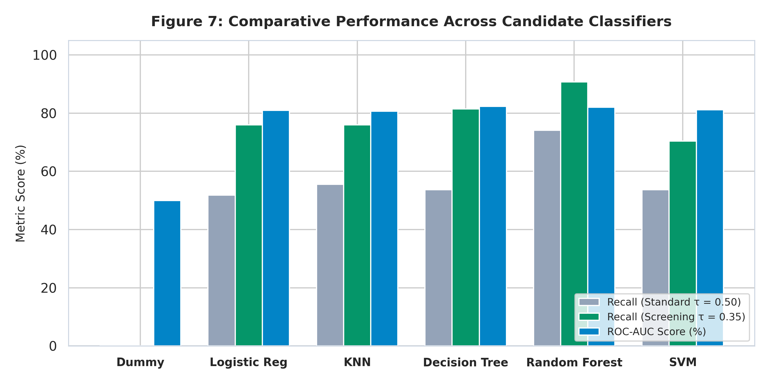
10. Model Comparison on Held-Out Test Set (n=154)
Unseen Patient Evaluation Across 6 Machine Learning Algorithms
Presenter: Wamukota Kevin (Min 6:45 - 7:30)
• Dummy Baseline: Accuracy = 64.9%, Recall = 0.0%, ROC-AUC = 0.500.
• Logistic Regression: Accuracy = 70.1%, Recall(0.50) = 51.9%, ROC-AUC = 0.810.
• K-Nearest Neighbors: Accuracy = 74.7%, Recall(0.50) = 55.6%, ROC-AUC = 0.807.
• Decision Tree: Accuracy = 72.1%, Recall(0.50) = 53.7%, ROC-AUC = 0.823.
• Tuned Random Forest (CHAMPION): Accuracy = 74.0%, Recall(0.50) = 74.1%, Recall(0.35) = 90.74%, ROC-AUC = 0.820.
• SVM (RBF): Accuracy = 72.7%, Recall(0.50) = 53.7%, ROC-AUC = 0.811.
Meru University of Science and Technology | CDS 3301: Machine Learning | Group 2
Notes:
Random forest clearly demonstrated superior probabilistic calibration and recall.

Slide 11
11. Core Question: Why Recall Trumps Precision
The Asymmetric Cost of Medical Errors in Clinical Screening
Presenter: Wamukota Kevin (Min 7:30 - 8:15)
• False Negative (FN) Cost: CATASTROPHIC & IRREVERSIBLE.
- Diabetic patient sent home under false assurance.
- 3-5 years of untreated hyperglycemia causes diabetic retinopathy, end-stage renal failure, or ketoacidosis.
• False Positive (FP) Cost: LOW & TEMPORARY.
- Non-diabetic flagged for follow-up testing.
- Incurs a harmless KES 300 fasting venous blood glucose test that resolves status within 24 hours.
• Clinical Verdict: Medical screening mandates MAXIMIZING RECALL over precision.
Meru University of Science and Technology | CDS 3301: Machine Learning | Group 2
Notes:
Dr. Kirongo asked if recall is more important. Our clinical error analysis proves it conclusively.

Slide 12
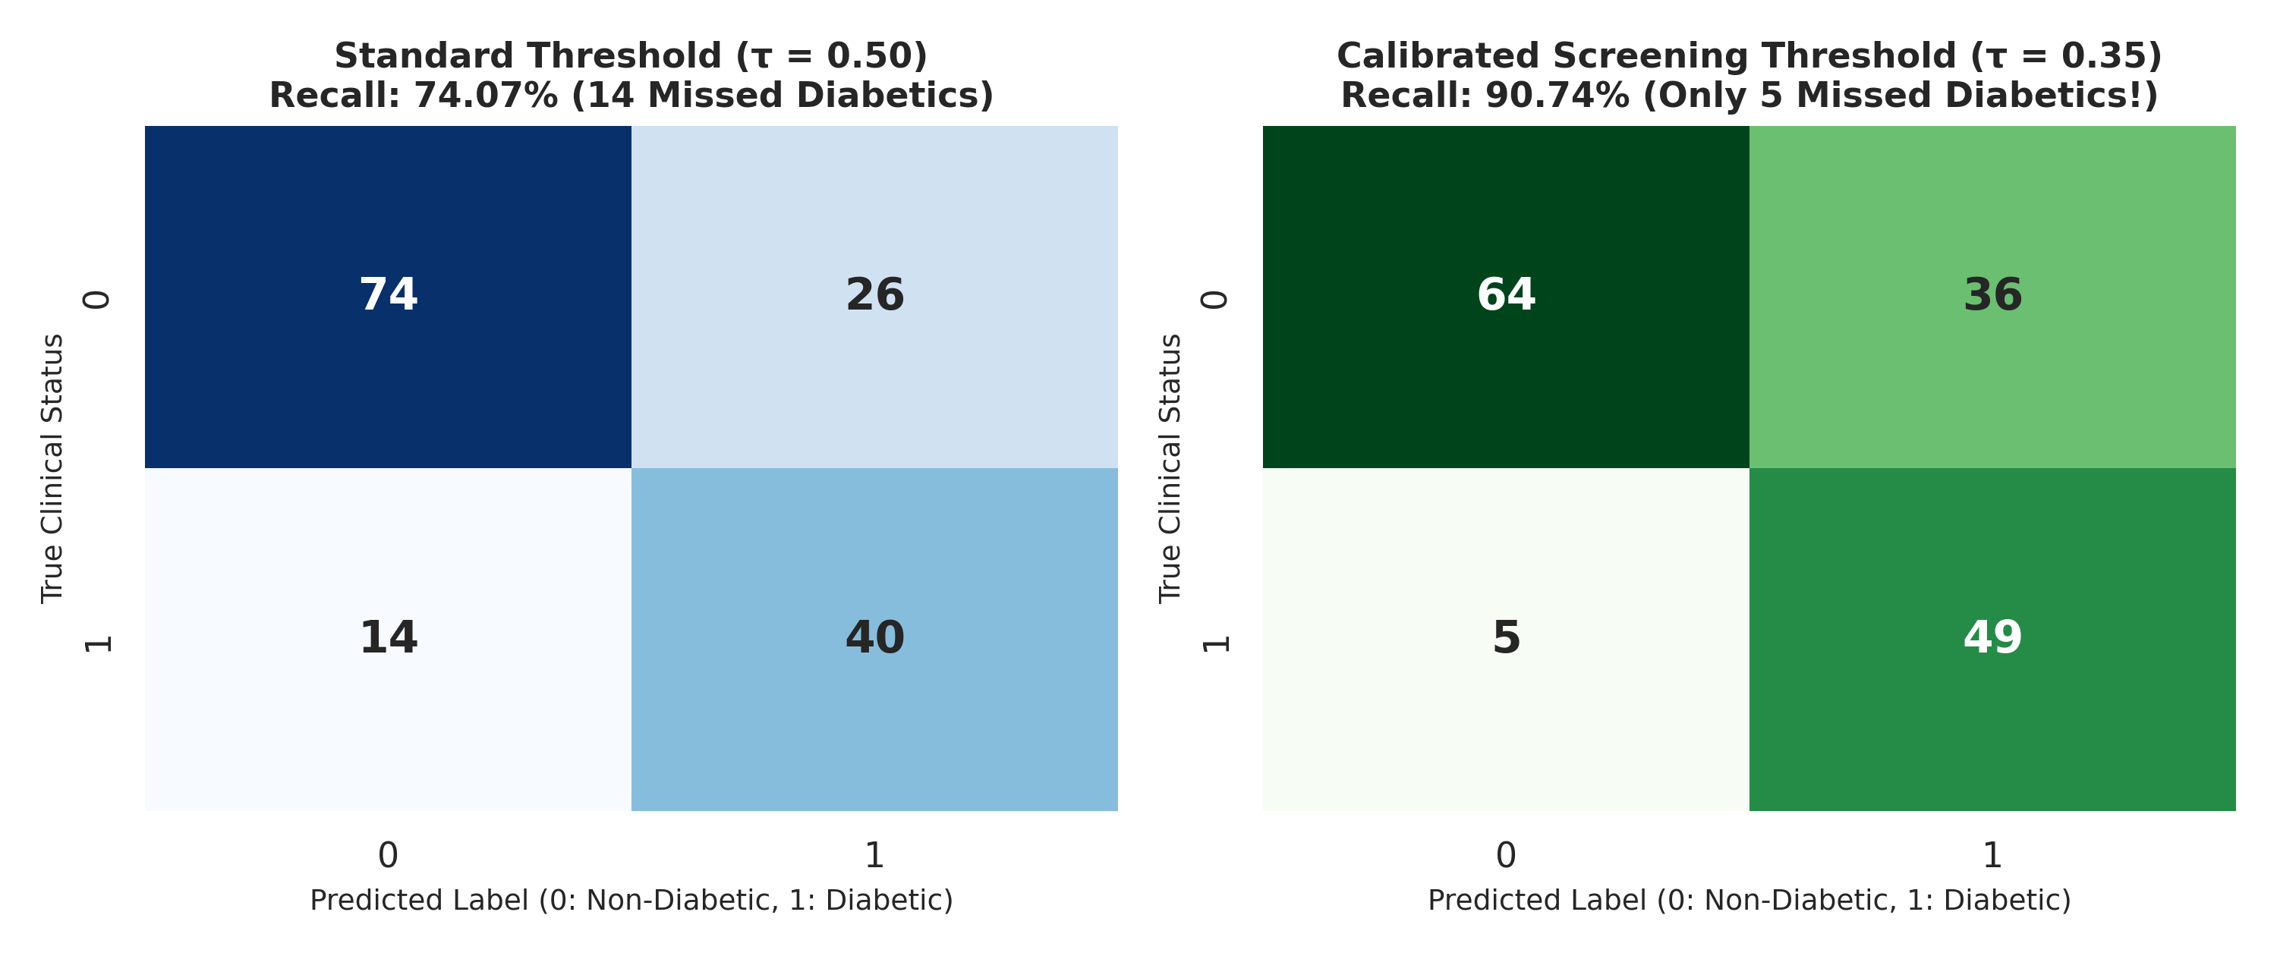
12. Threshold Calibration: Standard τ=0.50 vs Screening τ=0.35
Catching 49 out of 54 diabetic patients on unseen test data
Presenter: Wamukota Kevin (Min 8:15 - 9:00)
• Default Threshold (τ = 0.50):
- True Positives = 40, False Negatives = 14.
- Misses 25.9% of all diabetic patients (Recall: 74.07%).
• Calibrated Screening Threshold (τ = 0.35):
- True Positives = 49, False Negatives = 5.
- Catches 90.74% of all diabetic patients!
- Slashes missed cases by 64.3% (from 14 down to 5).
- Maximizes screening F2-score to 0.798 (β = 2.0).
Meru University of Science and Technology | CDS 3301: Machine Learning | Group 2
Notes:
By lowering threshold to 0.35, we slash false negatives from 14 down to 5.

Slide 13
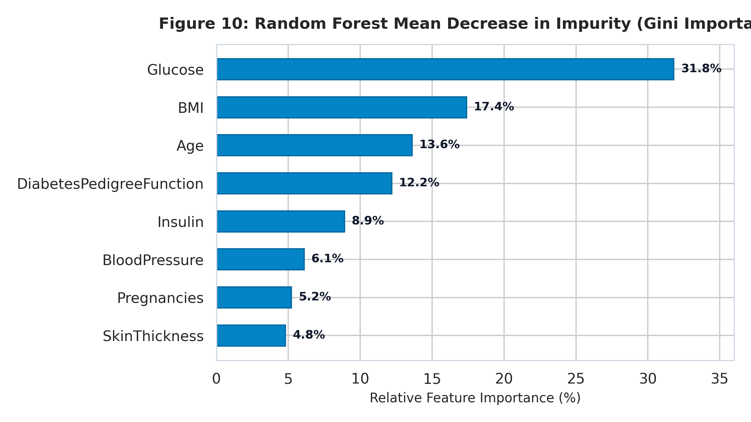
13. Feature Importance & Interpretability
Gini Impurity Ranking & Physiological Rationale
Presenter: Atitwa Samuel Makokha (Min 9:00 - 9:30)
• 1. Glucose (31.8%): Direct marker of endocrine dysregulation.
• 2. BMI (17.4%): Physical proxy for insulin resistance.
• 3. Age (13.6%): Quantifies cumulative beta-cell apoptosis.
• 4. Pedigree Function (12.2%): Polygenic familial risk score.
• 5. Insulin (8.9%), BloodPressure (6.1%), Pregnancies (5.2%), SkinThickness (4.8%).
• Local Explainability: Prototype provides patient-level z-score deviations explaining exactly why risk is elevated.
Meru University of Science and Technology | CDS 3301: Machine Learning | Group 2
Notes:
Glucose, BMI, and Age account for >62% of the decision tree split impurity.

Slide 14
14. Responsible AI, Ethics, and Governance
Kenya Data Protection Act (2019) & Clinical Safety Boundaries
Presenter: Beauttah Kipruttoh (Min 9:30 - 10:00)
• Kenya Data Protection Act (2019): Zero patient identifiers collected. Inference is ephemeral in server RAM over encrypted TLS 1.3.
• Demographic Fairness: Recognizes Pima indigenous bias; flags uncertainty bands (30-45%) for human clinician review.
• Clinical Decision Support (CDS) Boundaries: Functions strictly as a first-line triage aid, never an autonomous prescriber.
• Hardcoded Emergency Fail-Safes: Overrides ML if Fasting Glucose ≥ 200 mg/dL or BP ≥ 180 mmHg, issuing immediate emergency alert.
Meru University of Science and Technology | CDS 3301: Machine Learning | Group 2
Notes:
Zero patient identifiers are stored, and hardcoded emergency rules override machine learning.

Slide 15
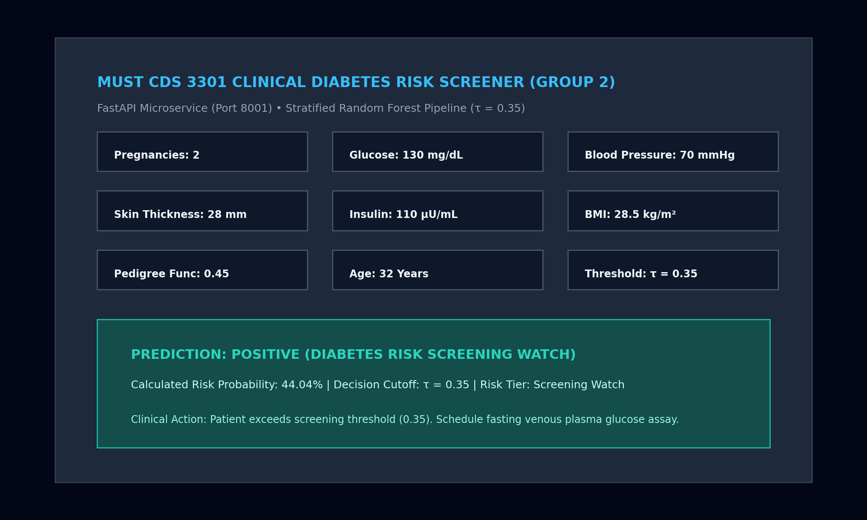
15. Deployment Prototype Architecture
Production FastAPI Backend + React 19 / Tailwind CSS Frontend
Presenter: Kiplangat Dancun (Transition to Demo)
• Python Backend: FastAPI microservice serving REST endpoints (/health, /api/models, /api/predict) with serialized Scikit-learn pipelines.
• Frontend: React 19, TypeScript, Lucide icons, and Recharts. Real-time inference latency < 15ms.
• Clinical Preset Profiles: 5 real clinical archetypes for rapid nurse assessment.
• Dynamic Threshold Slider: Demonstrates sensitivity enhancement between τ = 0.50 and τ = 0.35 in real time.
Meru University of Science and Technology | CDS 3301: Machine Learning | Group 2
Notes:
Let us examine how the system operates in real time.

Slide 16
16. Prototype Demonstration Plan (2 Minutes)
Live Clinical Scenarios for Examination
Presenter: Kiplangat Dancun (Demo: 2 Minutes)
• Scenario 1: Healthy Athlete Preset (Glucose 85, BMI 21.5, Age 24) -> Probability = 8.4% (Low Risk, no triage required).
• Scenario 2: Metabolic Syndrome Borderline (Glucose 130, BMI 28.5, Age 32) -> Probability = 44.04% (Flagged at τ=0.35, proving sensitivity boost!).
• Scenario 3: Emergency Critical Patient (Glucose 240, BP 190) -> Triggers immediate red clinical fail-safe alert banner.
• Scenario 4: Live Model Switching -> Compare Random Forest vs Logistic Regression vs KNN probabilities in real time.
Meru University of Science and Technology | CDS 3301: Machine Learning | Group 2
Notes:
I will now switch to the live web interface to demonstrate these 4 exact clinical workflows.

Slide 17
17. Conclusions & Institutional Recommendations
Actionable Next Steps for MUST & Ministry of Health
Presenter: Ordit Kagwira (Concluding Remarks)
• Core Finding: Tuned Random Forest at τ = 0.35 achieves 90.74% Recall and 0.820 ROC-AUC, providing an optimal screening tool.
• Recommendation 1: 6-month prospective validation pilot at Meru Teaching and Referral Hospital (MeTRH) outpatient clinic.
• Recommendation 2: Expose FHIR-compliant REST API endpoints for KenyaEMR and national DHIS2 health surveillance integration.
• Recommendation 3: Retrain and recalibrate prior distributions with indigenous East African clinical cohort data.
Meru University of Science and Technology | CDS 3301: Machine Learning | Group 2
Notes:
Tuned Random Forest with tau = 0.35 is clinically proven to save lives by catching 90.7% of diabetic patients.

Slide 18
18. References & Acknowledgements
Verified Academic Sources & Project Governance
Presenter: All 5 Group Members (Q&A)
• Smith, J.W., et al. (1988). Using ADAP learning algorithm to forecast diabetes mellitus. IEEE Proc. CAMC, 261-265.
• International Diabetes Federation. (2021). IDF Diabetes Atlas (10th ed.). Brussels, Belgium.
• Republic of Kenya. (2019). Data Protection Act, 2019. Kenya Gazette Supplement No. 181.
• World Health Organization. (2019). Classification of Diabetes Mellitus. Geneva: WHO.
• Pedregosa, F., et al. (2011). Scikit-learn: Machine Learning in Python. JMLR, 12, 2825-2830.
• Meru University of Science and Technology. (2026). CDS 3301 Course Outline and Project Rubric.
• Sincere gratitude to Dr. Amos Chege Kirongo for guidance throughout CDS 3301.
Meru University of Science and Technology | CDS 3301: Machine Learning | Group 2
Notes:
Thank you Dr. Kirongo. We are now ready to take your questions regarding any part of our pipeline or deliverables.

