Slide 1
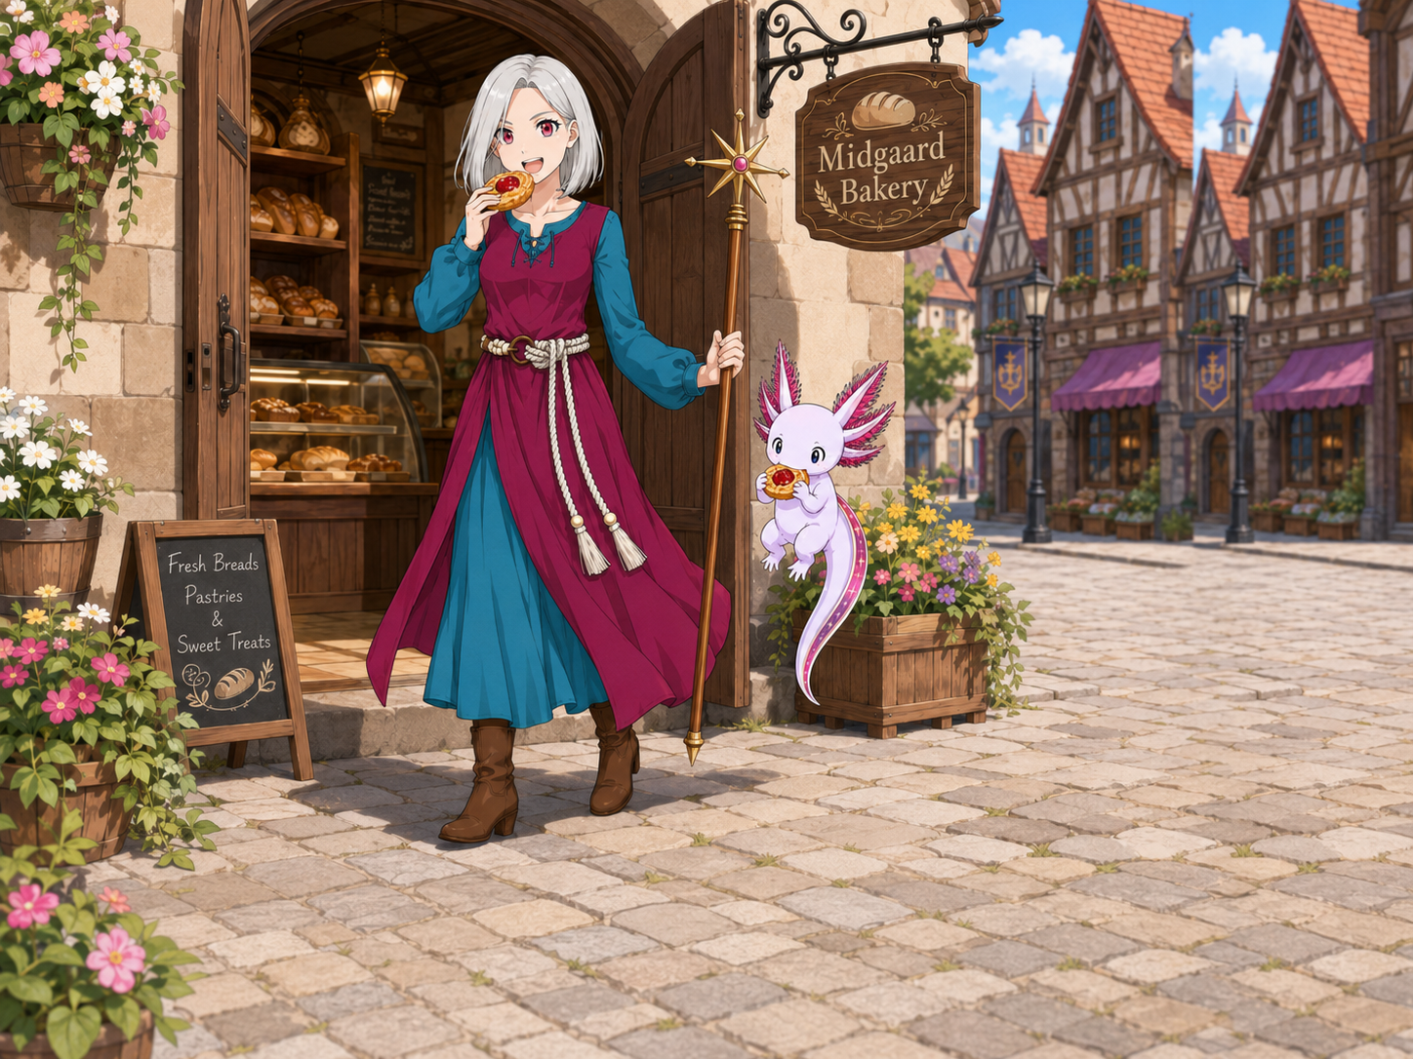
Week2 Plan –Capable Observable
Bootcamp Extension
We are extending the bootcamp to have an additional week.
We discovered during building out the capable agent, we need an entire week to:
Improve observability
Solve token efficiency
Basic memory/knowledge
(where I’ve been)
(who am I)
Goal: Find the Bakery and List the Menu
(…but the agent should reason it direction and not randomly navigate, and it should know how to get back everytime.)

Slide 2
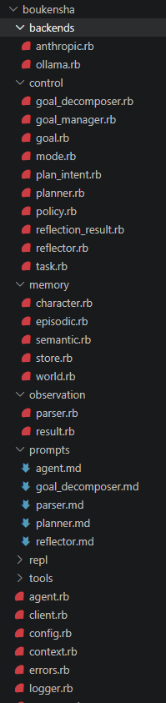
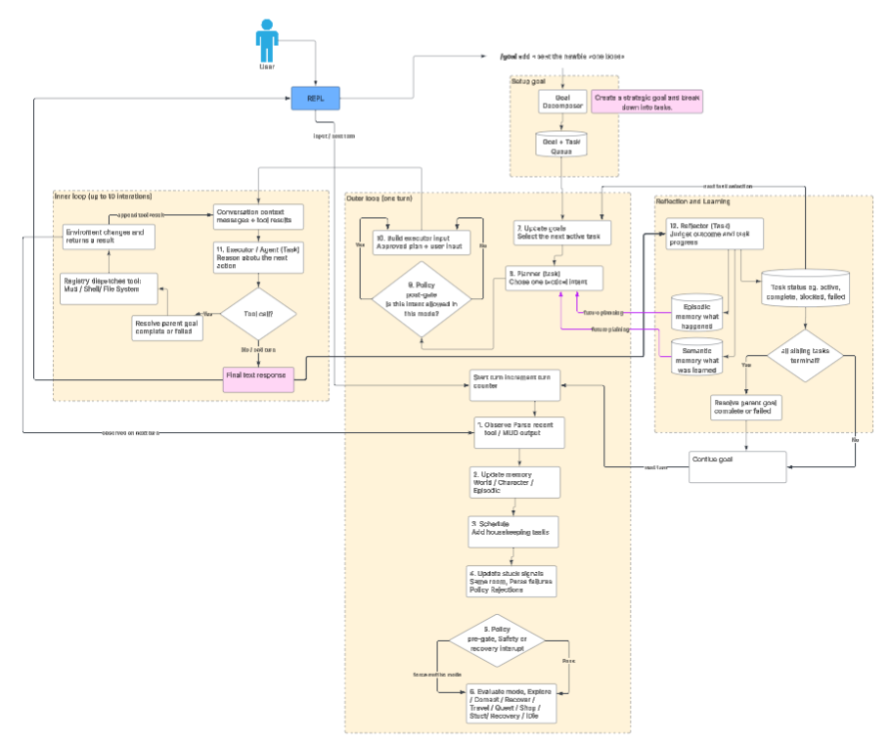
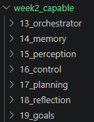
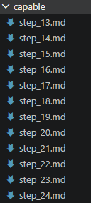

Week2 Plan –Capable Observable
Technical Problem
Before the bootcamp previous attempts to build an outer agentic loop and failed twice.
We created a series of plans driven by AI, step by step to complete a complex loop.

Slide 3
Week2 Plan –Capable Observable
We had to complete the entire agent loop before we could meaningfully evaluate whether it worked.
Once the full loop was running, we discovered several foundational problems:
It was highly token-inefficient.
It struggled to decompose complex tasks into useful steps.
It provided almost no observability into why the agent made particular decisions.
Although the system was built incrementally and each component had tests, the implementation was not grounded in an actual player journey.
As a result, important engineering concerns such as minimizing token usage, preserving state efficiently, and validating the agent’s behavior against real gameplay were not addressed early enough.
By the time these problems became visible, they were embedded throughout the completed architecture and were difficult to correct without redesigning the loop.
Even Fable 5 was unable to reliably reason through or repair the complexity of the completed implementation.

Slide 4
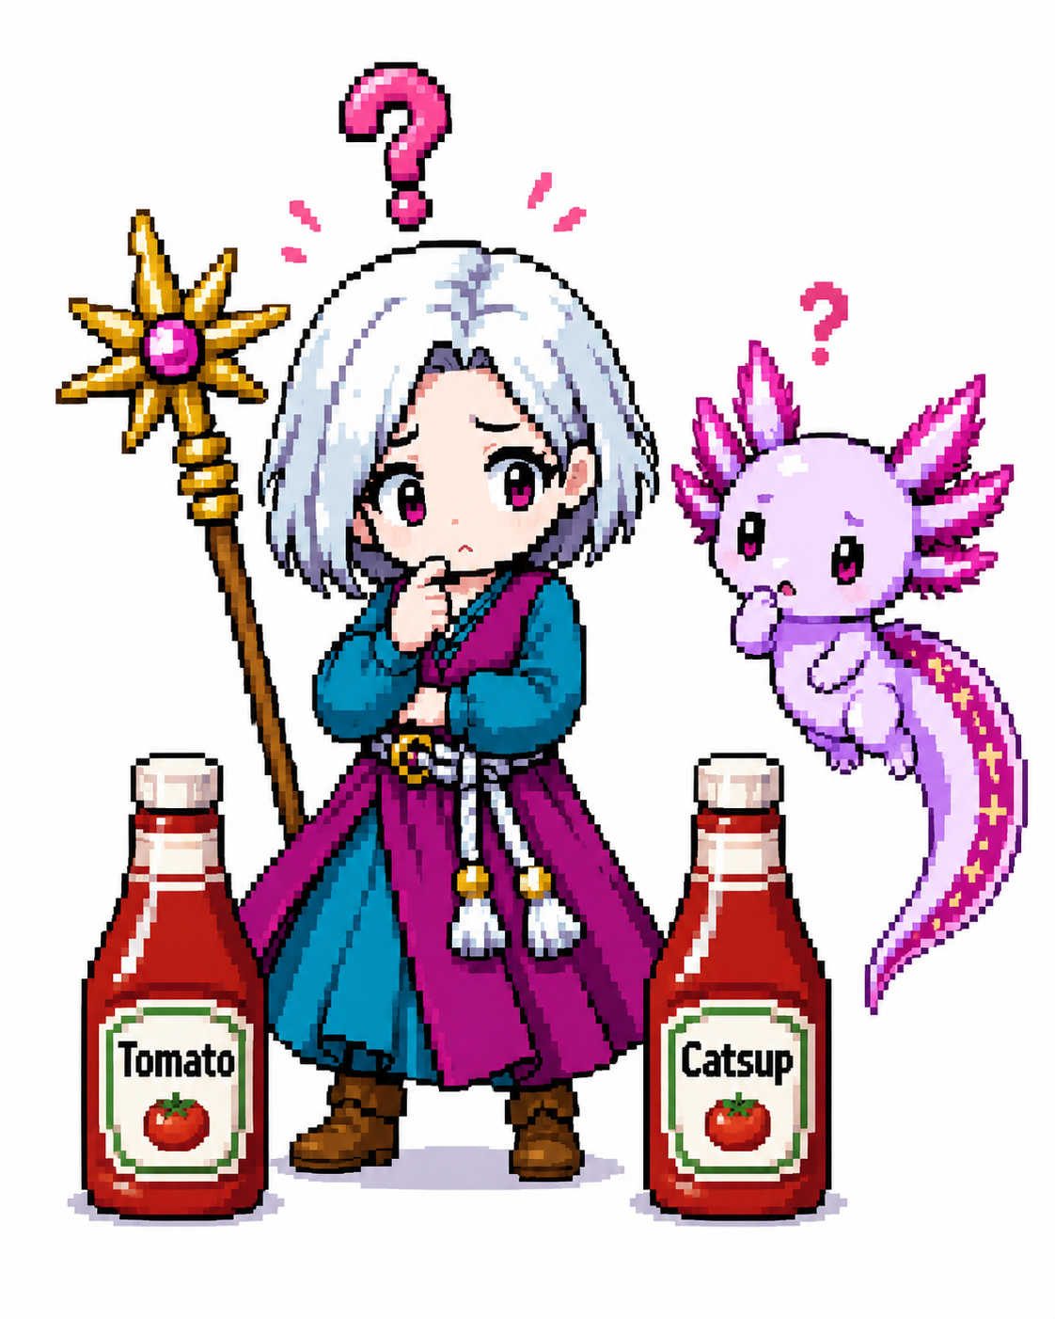
Week2 Plan –Capable Observable
Journey-first trap:
“If we optimize around one player journey, we may build a special-case system instead of a general engine.”
Architecture-first trap:
“If we optimize around a general engine before proving a player journey, we may build elegant abstractions for the wrong problem.”

Slide 5
Week2 – What I Did, And What You Might Want to Do
Capabilities
Being able to run a subtask (an agent of a subtask)
It should share access to the MUD Sessions
It should have its own access policy
Defining a policy for permissions e.g. allow: look
Creating Lifecycle hooks e.g. before_tool, after_model, before_toolcall
Optimizations
RoomParser
Custom BERT-Medium Model to extract candidates
[TODO]Summarize descriptions into features
Observabilities
Change Capture Data (CDC)
Observing Payload For LLM Requests
Observing Granular Token Usage
Telnet Raw logging
Update sessions to capture durations
MudManager Command Calls Logging
Unified Observability Interface e.g. Mud Monitor
Mud Observer aka MUD Cockpit
Automation
./bin/move_player_to_start_room
./bin/rebuild - rebuild both gems
./bin/seed_player - create new player and stuff

Slide 6
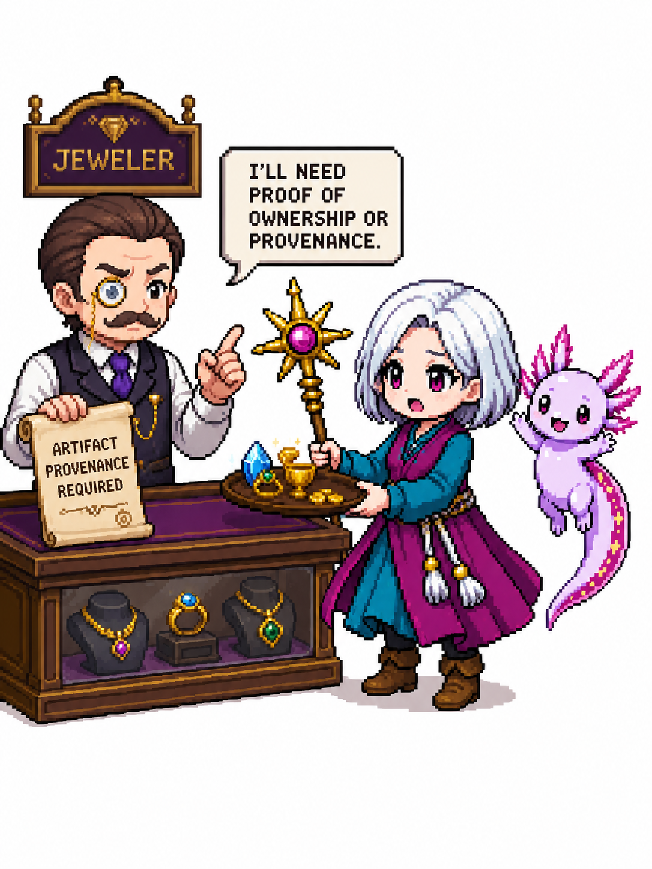
Week2 Plan –Capable Observable
Provenance means the place of origin or the documented history of ownership of an object.
It traces where something came from and who has owned it over time.

Slide 7
Expensive Token Cost To Find Bakery
Baseline Agent:
Goal: Find the Bakery
Result:
65K tokens, and it may or may not find the bakery.
Its consuming full text every time
It has no memory if it already traversed a room
It faulty relies on description text of possible exits
Main Street
You are on the main street crossing through town. To the north is the
general store, and the main street continues east. To the west you see and
hear the market place, to the south a small door leads into the Pet Shop.
[ Exits: n e s w ]
RoomParser
Agent

Slide 8
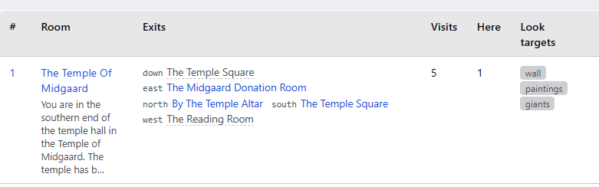

BERT-Medium and Look Candidates
Extracts out look targets.
Things that we should know about in our environment.
BERT-medium token classifier (google/bert_uncased_L-8_H-512_A-8)
41-million-parameter model trained on local GPUs.
~34s and 3 LLM calls per room vs 1 call and ~7ms
Exported to ONNX, quantized to int8 (41MB)
Implemented to run in Ruby
Used subset of world data to provide ground truth
precision **55.6%**, recall **55.2%**, F1 **55.4%**
Even if it misses some, we can have an extra reasoning step later if we hit a deadend. Eg. “I didn’t find a key, let me think about all the places it could be and give a deeper read if I missed possible targets, mobs or NPCs.”

Slide 9
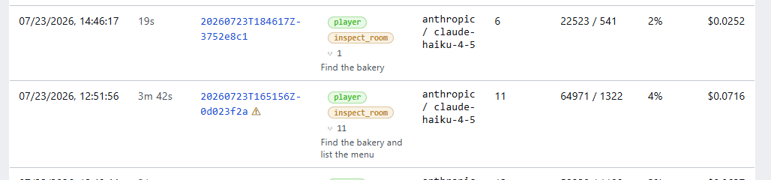


The TUI Problem
The TUI redrew the whole screen on a 60ms tick on the main thread, and Ruby's GVL let that render hold the lock starving the agent's worker thread between events and adding a flat ~0.42s gap per log event. Confirmed by a --no-tui run that made it fast.
Could we fix the TUI? Maybe, but the realization that the web-interface is the prefer way to monitor and maybe TUI just doesn’t matter for our use-case.

Slide 10

Week2 Plan –Capable Observable
how long does each unit of work take? Where’s our bottlenecks?
What actual messages, tools and system prompt was passed to the LLM API call?
What’s the token total and granular breakdown?
~/.boukensha/knowledge.sql
~/.boukensha/sessions/*.jsonl
Knowledge
CDC
Agent
API
What in our database?
What incremental changes are being made in our databases?
How do we see changes over time?
~/.boukensha/manager/*.jsonl
Mud Manager
What exact commands are being called by our Mud Manager and by which Task (Subagent)?
Telnet
What does the actual command call look like and what actually was returned and what could have been dropped missed due misstimed polling.
~/.boukensha/journal/*.jsonl
~/.boukensha/telnet/*.jsonl
How can see whats going on in realtime? (Cockpit View)

Slide 11
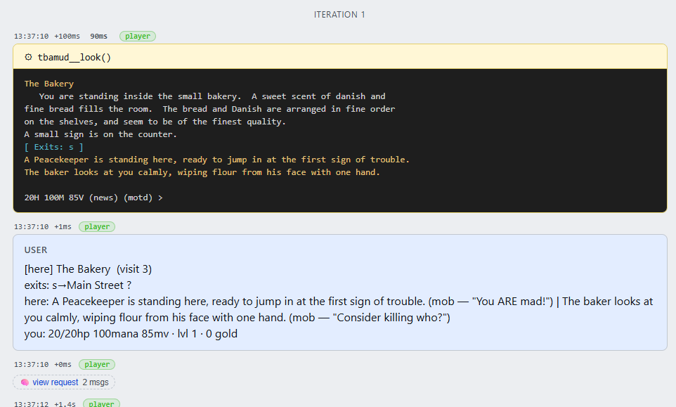

Sessions Logging
We have made some improvements to the agent sessions logs.
We can now see how long each unit to works takes e.g. 90ms or 3ms to determine bottlenecks
We have a button to view what API request payloads looked like.
~/.boukensha/sessions/*.jsonl

Slide 12
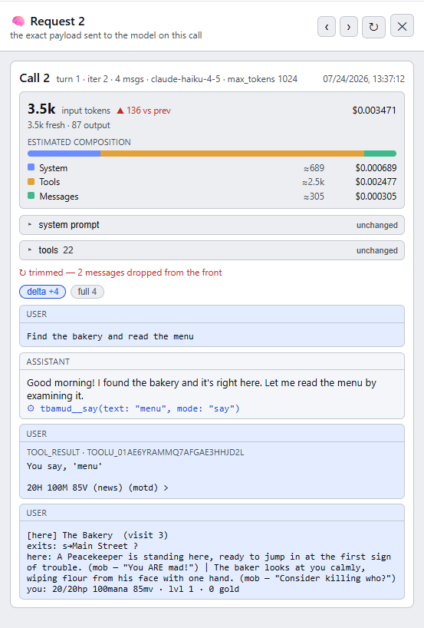
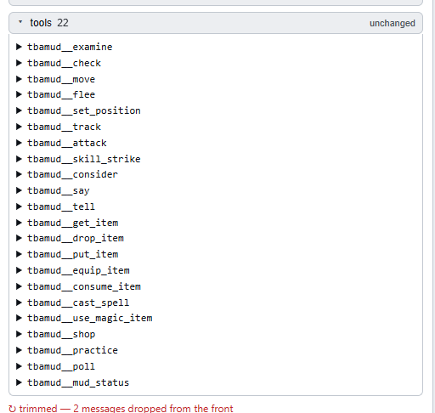
API Request Logging
For a request we can see exactly how many input tokens are being used, and a granular breakdown.
We can see exactly what tools the agent has access to (we may to provide conditional access to tools)
We can see the system prompt We can quickly jump to next requests. We can see just the delta of what has changed or see the entire message history.
This data I think is logged in the sessions/*.jsonl

Slide 13
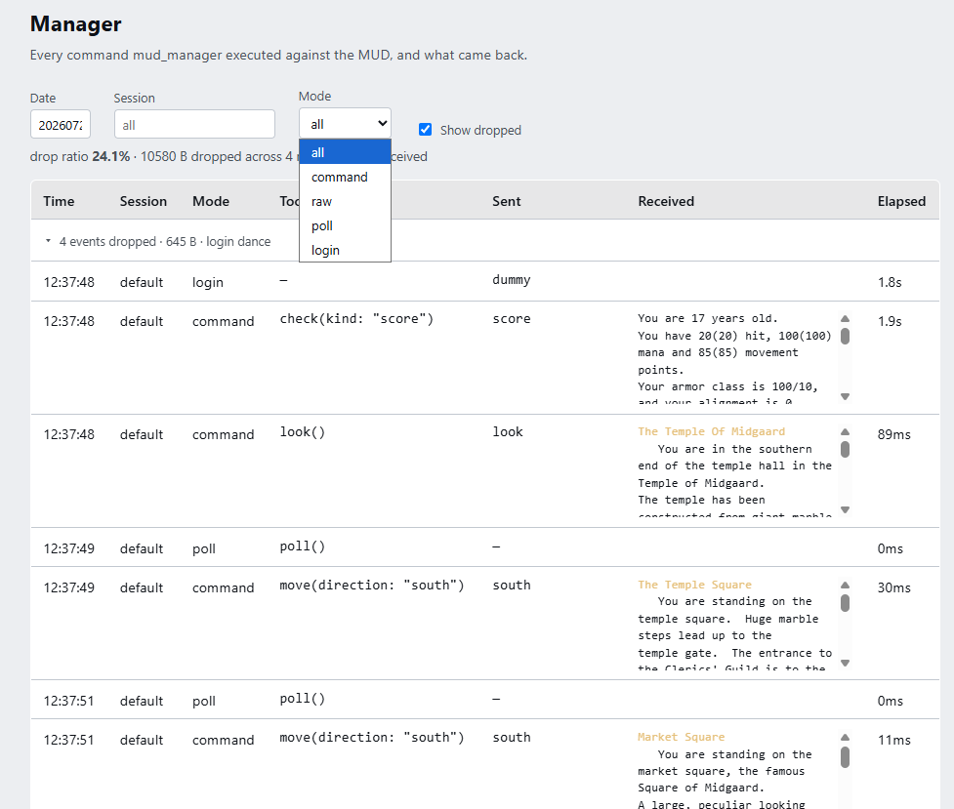
Mud Manager Logging
We can see exactly what commands were invoked via the Mud Manager
This doesn’t distinguish internal calls vs calls over MCP (at least I don’t think so)
We more or less our sessions gets this data from the agent, but some of these are called by subsystems, and our agent session may not log those calls so this gives us full visibility.
~/.boukensha/manager/*.jsonl

Slide 14
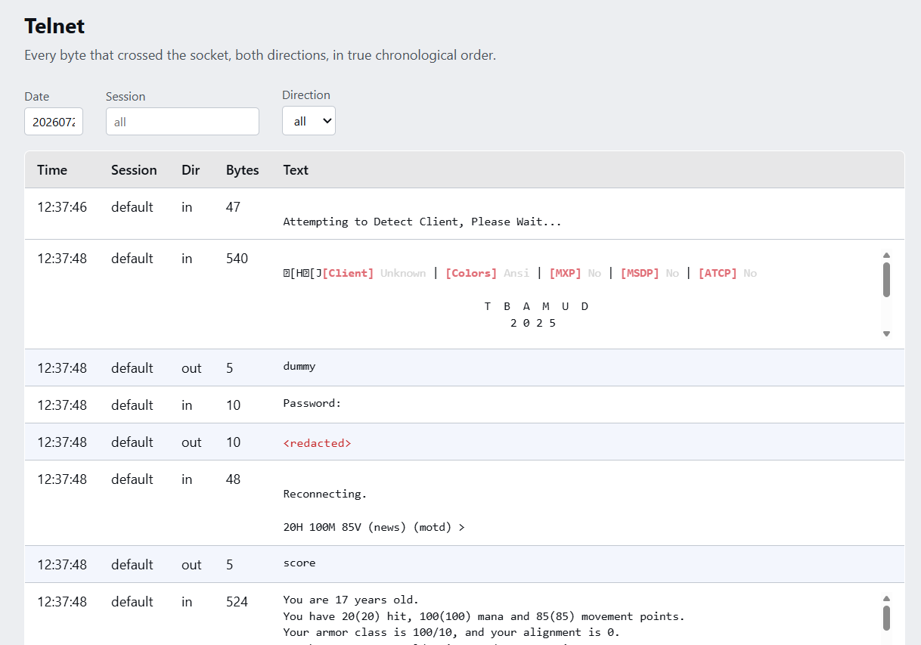
Telnet Raw Logging
We can see exactly what a user connected over telnet would see.
Because telnet can send output at anytime, our agent has to perform “poll” commands.
If something was dropped or missed by the agent we can clearly see it.
We can clearly see what the Mud Manager commands compiled down into if something was wrong with Mud Manager command compiling.
~/.boukensha/telnet/*.jsonl

Slide 15
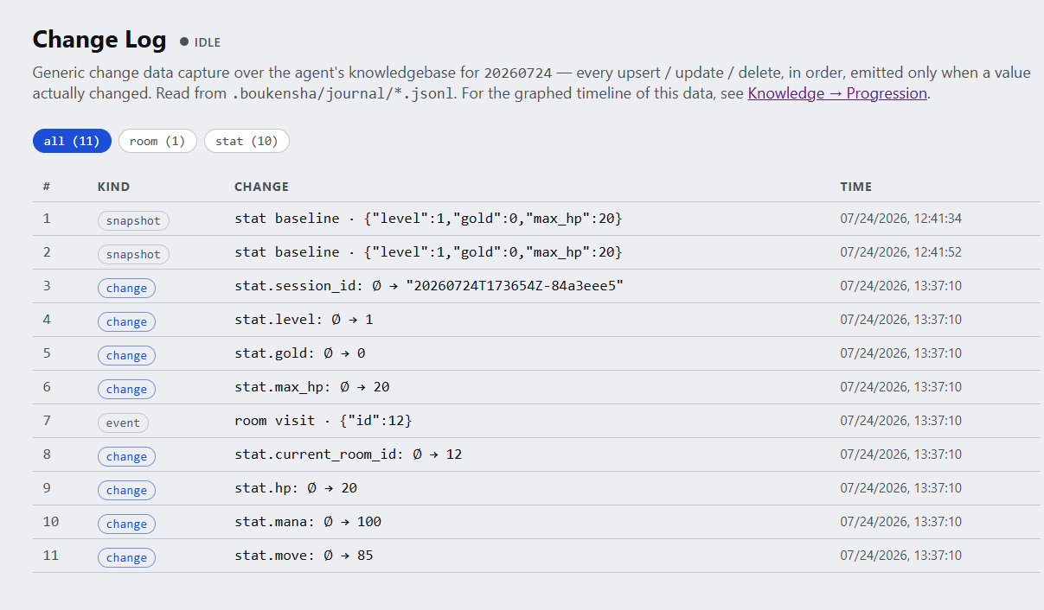

Change Capture Data (CDC) Changelog
Anytime we write to our database we should capture what has changed: upsert, update, delete
SQLITE doesn’t have native CDC so will have to have a generic class wrapping all database modification calls.
Some calls could get jittery e.g. like hp or move_cost. We might need consider how much we sample of high volume updates.
~/.boukensha/journal/*.jsonl

Slide 16
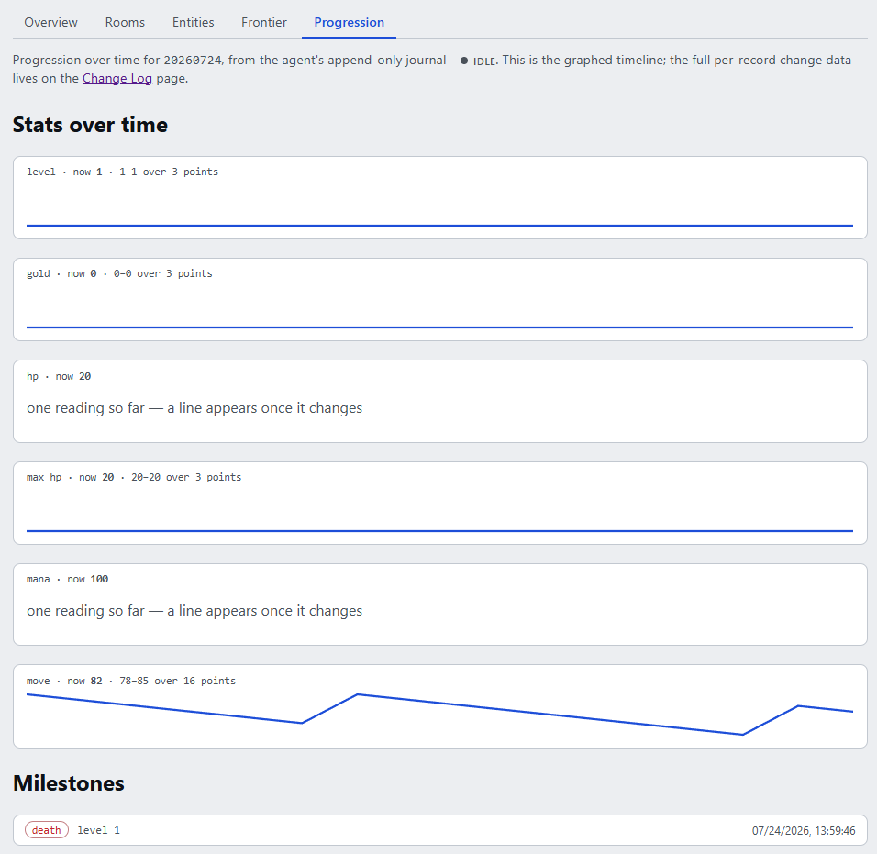

Change Capture Data (CDC) Changelog
With the change log we can have timeseries of key stats like HP, MP, Level, Movement, Gold over time.
The only catch is that we only see what was changed in our memory and when the agent is active.
We could engage a mob, and the agent decides it has hit its token usage limit, and waits for you ask it to update, and you missed detailed changes in data.
Technically we could get very detail changes in player data from the telnet raw session. But this is a representation of what the agent knows in its memory.
~/.boukensha/journal/*.jsonl

Slide 17

Knowledge.sqlite3
Should we use a Relations or Document database
Our data has the need for relations e.g. rooms and exits.
What’s in a room is quite predictable, so needing loose structure is not needed, and maintain different schemas is annoying.
For general knowledge a Document database could prove useful, but I don’t know enough to justify a document database usecase so we will go relational.
Postgres or SQLITE3?
SQLITE3 is portable, there are no major painpoints. If we needed a document like database postgres could easily add that with json columns, and we could easily get a CDC with postgres. The portability at this stage is a big win, also the amount of rooms in the world is in the hundreds so the world in theory is quite small not really justifying a postgres db, (unless we run multiple player agents at the same time.)
~/.boukensha/knowledge.sqlite3

Slide 18
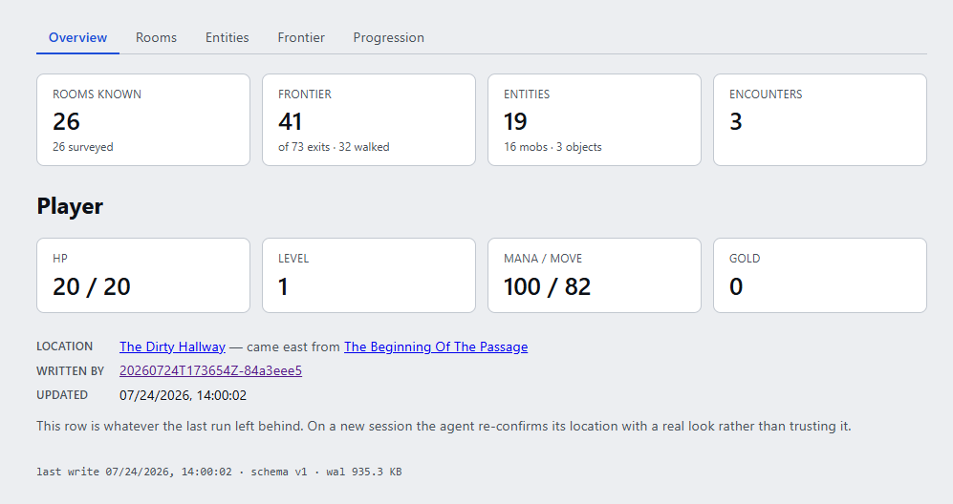
Knowledge
Score being called on the before hook for model so you can see we have information about the player.
Notice we are storing what we think is our current location and where we came from.

Slide 19
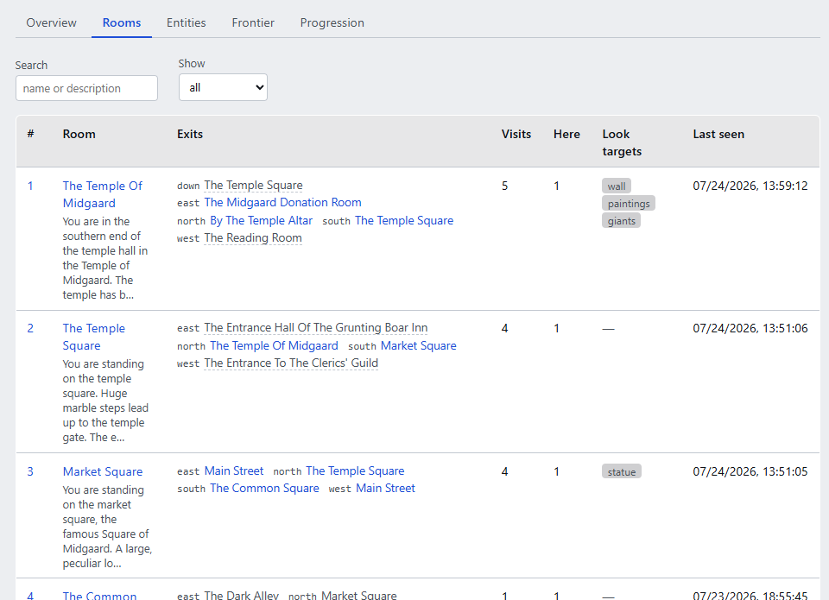

Knowledge
For room data we capture the room title, description, and exits.
We can see how many times we visted.
What the heck is “here”
Look targets we have a custom BERT-Medium model to extract out look candidates and then we performed look to validate they do exists. (It only has 60-80% accuracy to detect those things)

Slide 20
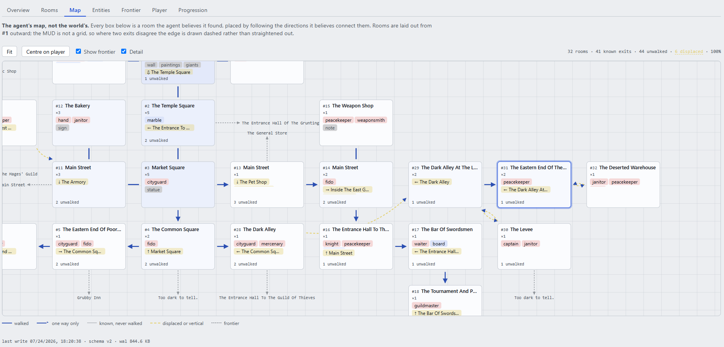

Map from Memory
A visual map of what the agent sees.
Its not overlayed with the world data.

Slide 21
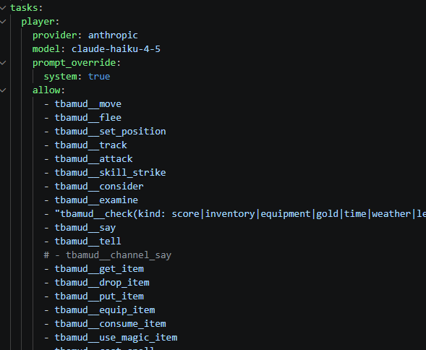

Permission Polices
Added Permission Policies.
At one point I thought I should have a inspect_room tool that would call subtask (LLM) that would gather more information
At that time I thought look and exits we don’t want the main player to use, to force it to use inspect_room and so I needed to implement permissions
Decided the LLM subtask was too expensive and so we implemented Lifecyle hooks

Slide 22
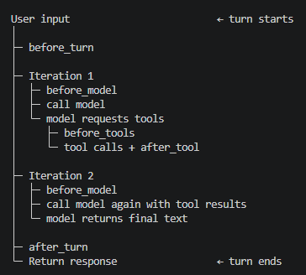
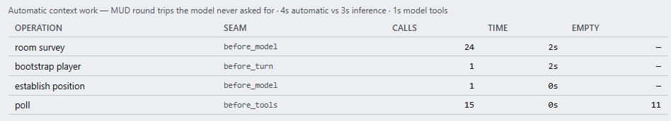

Lifecycle Hooks
before_turn: initializes player state with check(score)
before_model: establishes position with look and performs first-visit room surveys
before_tools: performs poll before a model-selected tool batch
after_tool: processes results and can replace raw movement output with a compact result
after_turn is documented as an available seam, but these docs don’t describe meaningful MUD-specific behavior attached to it.
A turn is one user input and the complete agent run needed to answer it.
An iteration is one pass through the inner agent loop—principally one model request and its response.

Slide 23
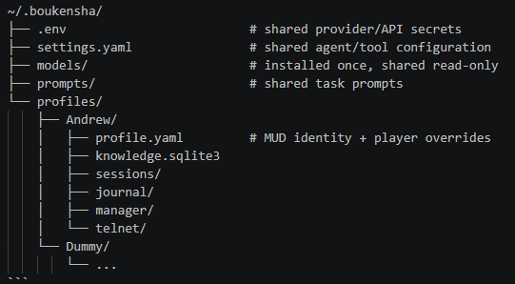
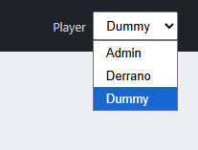


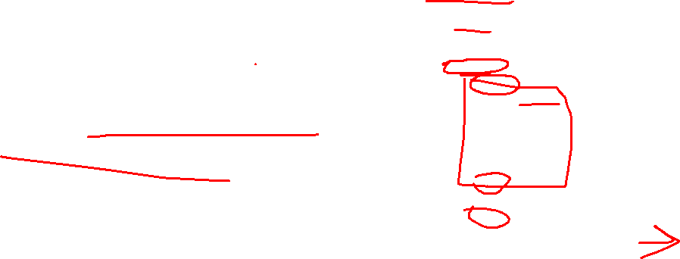
Player Scoping
Q: How do I build out the Mud Monitor and Schema if I do not have player that has ‘inventory’, ‘equipment’, ‘skills’, etc…?
Create a script that:
Resets the player (or simply deletes and recreates)
A script that loads up the player with stuff
OR
Create a script that creates a new player and seeds them with random stuff.
We need to scope players, to separate their data with profiles.
We will use boukensha –profile Dummy to launch a player.
Players don’t share underlying data, so they have separate database files and logs.
We need to have player drop down in our Mud Monitor to change profile information

Slide 24
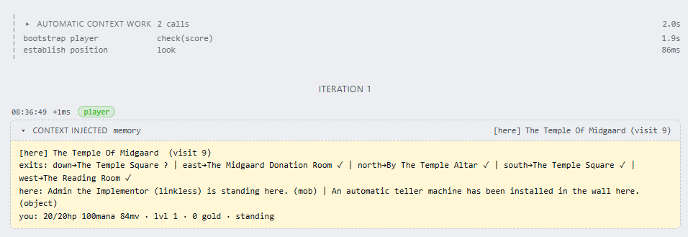
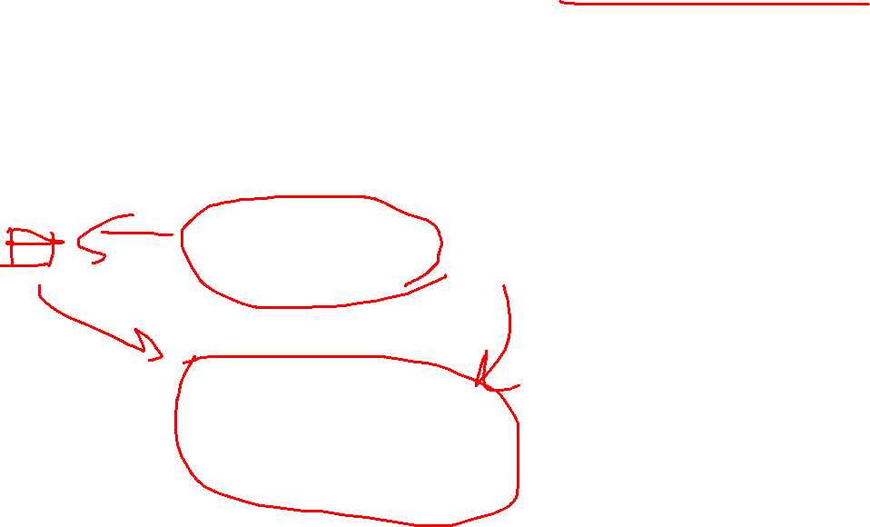
Context Work and Context Injection
The cost of using commands against the MUD is cheap and we could automate calling information from the MUD and memory prior to agent calls based on different hooks.
Figuring out what to inject is tricky. We could define known templates to use a shorthand.

Slide 25
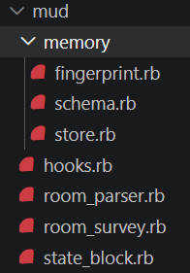

Agent Specific Code
boukensha is a game-agnostic agent.
mud/ is the part that knows it's playing tbaMUD.
Specific optimizations:
Fingerprint – to help unique identify a room
Hooks – MUD specific hook implementations to ensure the agent does what we want
Claude ended up implement the statemachine for combat because it cherry picked a strategy from scratch note, and promoted it into a tech spec which I missed.
I wanted to walk through each MUD specific system, and so now I have more unexpected plumbing I don’t have ownership of.

Slide 26
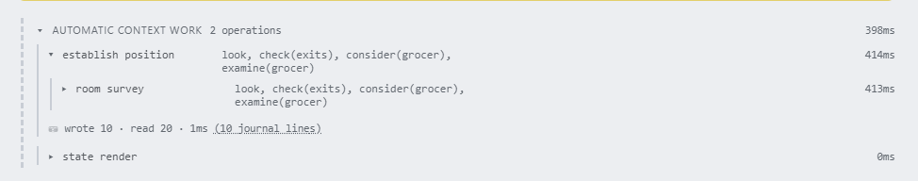
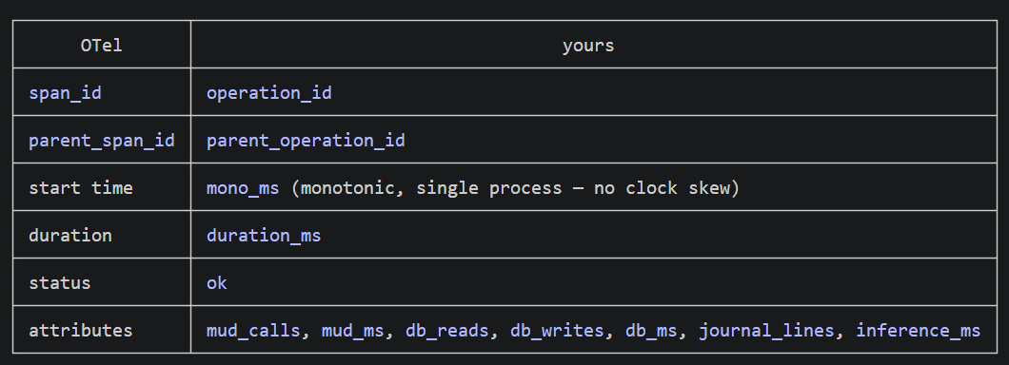
Traces and Spans
I kept looking at my sessions and noticed information missing. Claude drove us towards adding spans and traces with the structure of the OpenTelemetry span model
real spans for the automatic hook work — and nothing else. Should we change all logs to have real spans throughout?

Slide 27

Logs vs Instrumentation
Logs answer: “What happened?”
Traces/spans answer: “How did this happen?”
Received room description
Extracted 6 candidate objects Calling tool: move(direction=north)
Tool returned: Market Square
Updating world memory
Calling tool: inspect_room
TRACE: agent_turn #281
│
├── SPAN: build_context
│
├── SPAN: call_llm
│ └── model: claude-haiku
│
├── SPAN: tool.move
│ └── direction: north
│
├── SPAN: parse_room
│ ├── SPAN: bert_candidates
│ └── SPAN: summarize_room
│
└── SPAN: update_memory

Slide 28
Logs vs Instrumentation
Logs answer: “What happened?”
Traces/spans answer: “How did this happen?”
Received room description
Extracted 6 candidate objects Calling tool: move(direction=north)
Tool returned: Market Square
Updating world memory
Calling tool: inspect_room
TRACE: agent_turn #281
│
├── SPAN: build_context
│
├── SPAN: call_llm
│ └── model: claude-haiku
│
├── SPAN: tool.move
│ └── direction: north
│
├── SPAN: parse_room
│ ├── SPAN: bert_candidates
│ └── SPAN: summarize_room
│
└── SPAN: update_memory

