Slide 1

Predicting Heart Disease Rate
Data Science Career Track
Sam Domeier
March 2021

Slide 2
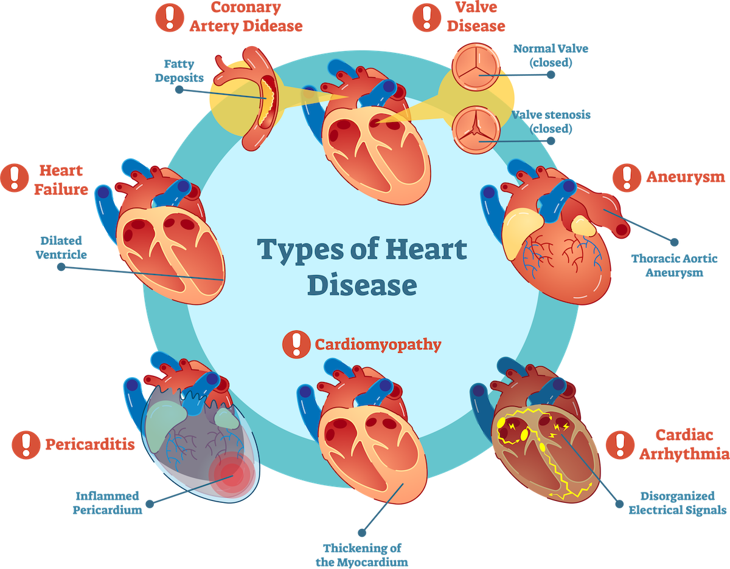
Contents
Overview
The Data
Exploratory Data Analysis (EDA)
Data Wrangling (link to)
Modeling Process
Modeling Results
Recommendation
Future Considerations

Slide 3
Overview
Goal
Predict the rate of heart disease for any given county in the U.S.
This model can be used to identify whether or not county administration needs focus more on heart health
This includes bettering programs for school districts or adding facilities to prevent/treat heart disease
Reason
Heart disease is the leading cause of death in the U.S. with more than 650,000 deaths

Slide 4

The Data
This is a Kaggle dataset
Data was scraped from USDA ERS database and includes socioeconomic indicators as features
The target variable is “heart_disease_mortality_per_100k”
provides an integer, and rate is out of 100K people

Slide 5
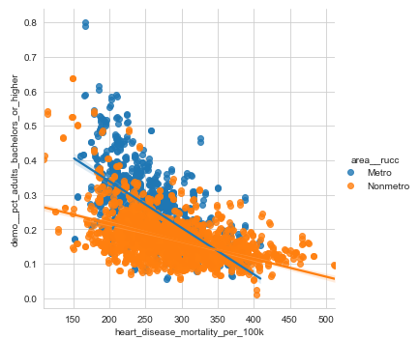
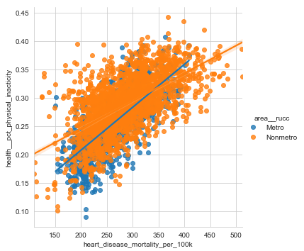
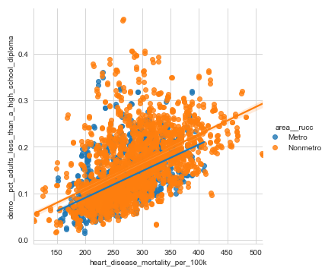
Exploratory Data Analysis (EDA)
Adults with bachelors degree or higher == More likely
Lives in metro area == More Likely
Adults less active == More likely
Adults w/o HS diploma == More likely
Findings: It seems that there is more stress related to the city life

Slide 6
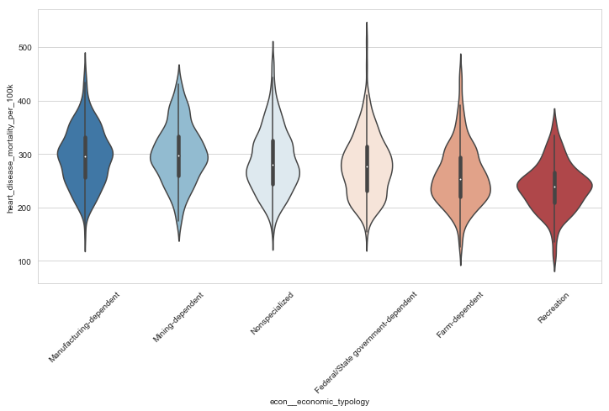
EDA
Economic typology is the type of economy in that county
Recreation focused economies have less heart-related issues
Manufacturing-dependent economies have more heart-related issues

Slide 7
Data Wrangling and Feature Engineering
For detail visit the notebook

Slide 8
Modeling Process
STEP 1
Base model evaluation for 5+ regressors with cross-validation
STEP 2
Create ensembled models with best performing regressors
STEP 3
With best performing models, tune hyperparameters using RandomSearchCV

Slide 9
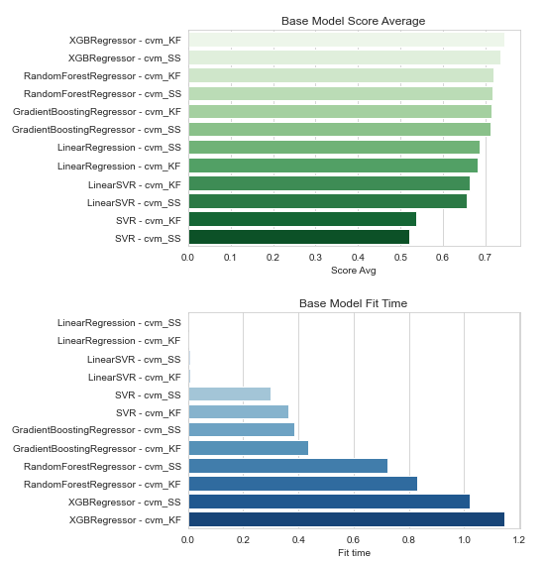
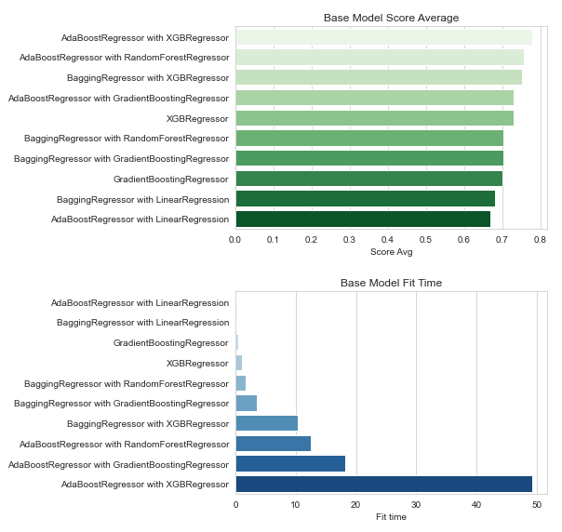
Modeling Results
STEP 1
STEP 2
Results: Best performing models were XGBRegressor and RandomForrestRegressor with AdaBoost

Slide 10
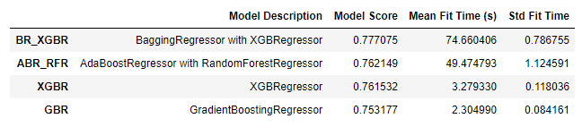
Final Results and Recommendation
Final model results
My recommendation is to use the XGBRegressor
It performs well but takes a fraction of the time as the other top models

Slide 11
Future Considerations
Recreate database with FIPS codes (county codes)
I could correlate these to coordinates and create excellent visuals using Folium and python
Try to gather coordinates to facilities that treat heart disease
hospitals, treatment centers, etc.
Plot data to find high-risk areas with lack of resources

Slide 12

THANK YOU

