Slide 1
Foreign Exchange Binary Trading Model
Data Science Career Track
Sam Domeier
March 2021

Slide 2

Contents
Problem Overview
The Data
Feature Engineering
Modeling Process
Modeling Results
Recommendation
Future Considerations

Slide 3
Problem Overview
Goal
Build a classification model for trading foreign exchange currencies
Model will identify whether or not price will go up or down from current value
Designed for binary trading strategy
Binary trading consists of buying a contract for a specified period with the idea that price will go up on a BUY option and down on a SELL option

Slide 4
The Data
Source
Data was compiled into a local database using the forex datamining notebook
Majority of data created through the use of publicly available API’s
AlphaVantage API for sourcing currency data
Twitter API for sourcing tweet information for sentiment analysis
Partial data was mined through scraping websites
livecharts.co.uk for currency strength data
forexfactory.com for currency event information and sentiment

Slide 5
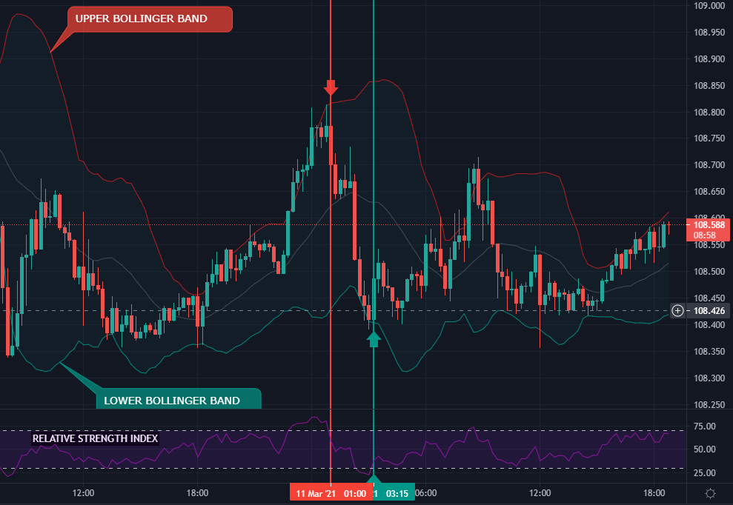
The Data
Data Creation
AlphaVantage API data
Created the technical analysis indicators including:
Relative strength index (RSI)
Bollinger bands
Stochastic oscillators
For more detail please review readme

Slide 6
The Data
Twitter API
Built a public sentiment analysis of the currency pair
Identified a trader sentiment through the tracking of bot outcomes
Currency Strength
Used to monitor increase or decrease in strength
Event Information
Useful for fundamental analysis and identifying large movement in the market

Slide 7
Feature Engineering
Data was clean from local database creation
Features were created through manipulating event data
Sentiment analysis of event news articles was created
Actual result vs predicted result of event
Time to/since the event
Dropped highly correlated features with correlation coefficient
Some features were highly correlated due to being derived from price
Dropped low variance features due to small data sample

Slide 8
Modeling Process
Three data frames were created by filtering with different correlation coefficient
0.9, 0.75, 0.6
These data frames were evaluated using the initial base estimators and cross validated
RandomForestClassifier
AdaBoostClassifier
Create ensembled model with top classifier in step two and tune hyperparameters with RandomSearchCV

Slide 9



Modeling Results
Base estimator analysis (CC = correlation coefficient)
CC = 0.9
CC = 0.75
CC = 0.6
Result
Use data frame with CC = 0.75 (removes highly correlated features)

Slide 10
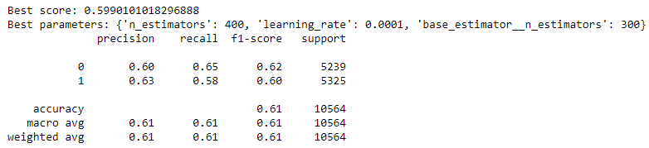
Modeling Results
Hyperparameter tuning using RandomSearchCV
The final model was created using an ensemble of AdaBoostClassifier and RandomForestClassifier

Slide 11
Recommendation
I recommend using this model solely as an indicator, not a tool for executing trades
Although 60% accuracy is good for trading models, my success while using for predictions was very weak
I think this is due to lack of robustness in database

Slide 12
Future Considerations
Improvements
Create a more robust database over a longer period
Build our features off of a longer period candle chart
1 minute chart lacks depth, would use 15 minute chart
Create lexicon database using NLP to provide a better sentiment from twitter and forexfactory
Look into creating a multi-classification model and looking at entries that have bigger movement

Slide 13
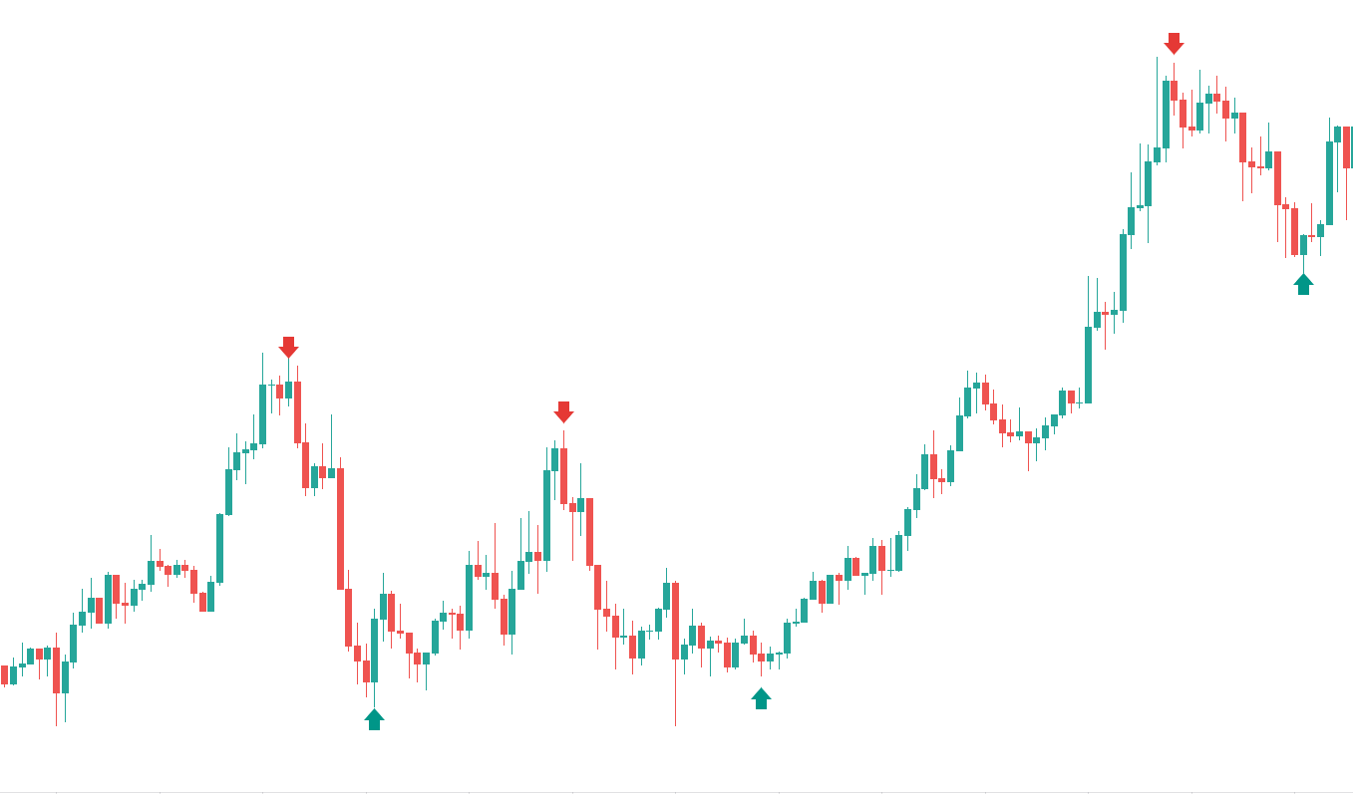


THANK YOU - STONKS

