Slide 1

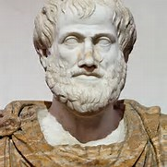

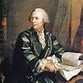
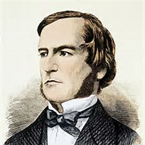
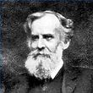

Logic and truth tables – part 3 writing logical propositions as symbols (symbolic logic) Samuel Chukwuemeka B.eng., A.a.t, m.ed., m.s www.samuelchukwuemeka.com
The Joy of a Teacher is the Success of his Students. Samuel Chukwuemeka www.samuelchukwuemeka.com
Notes:
www.samuelchukwuemeka.com

Slide 2
Objectives / Pre-requisites
Students will:
Write logical statements in symbolic form.
Pre-requisites
Logic and Truth Tables – Part 1: Introduction and Concepts
Logic and Truth Tables – Part 2: Logical Connectives
Notes:
www.samuelchukwuemeka.com

Slide 3
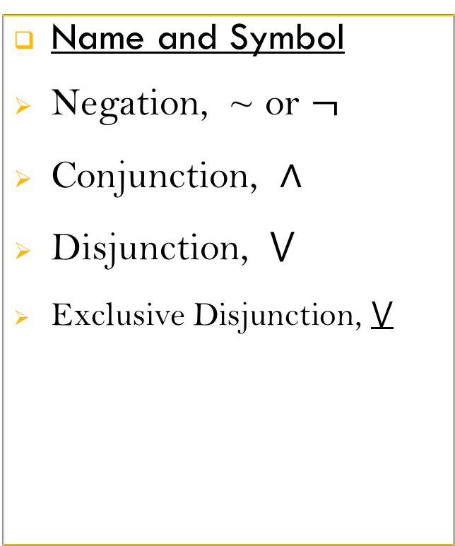
Review of Logical Connectives
Name and Symbol
Negation, ~ or $¬$
Conjunction, $∧$
Disjunction, $⋁$
Exclusive Disjunction, $⋁$
Terms Used
Not; It is false that…; It is not the case that…; It is not true that…
And; But
Or
Either … or…but not both
Notes:
www.samuelchukwuemeka.com

Slide 4
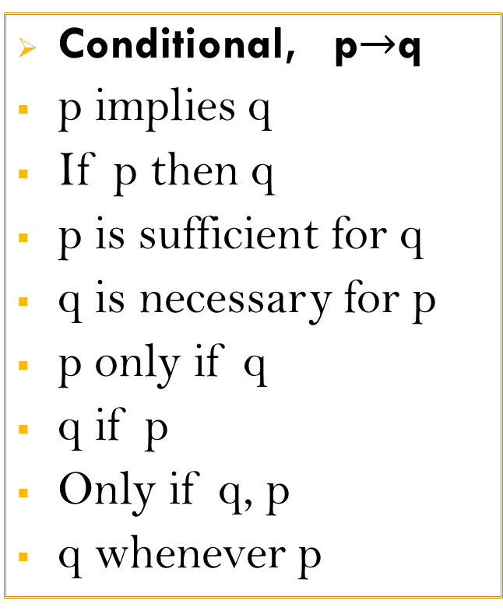
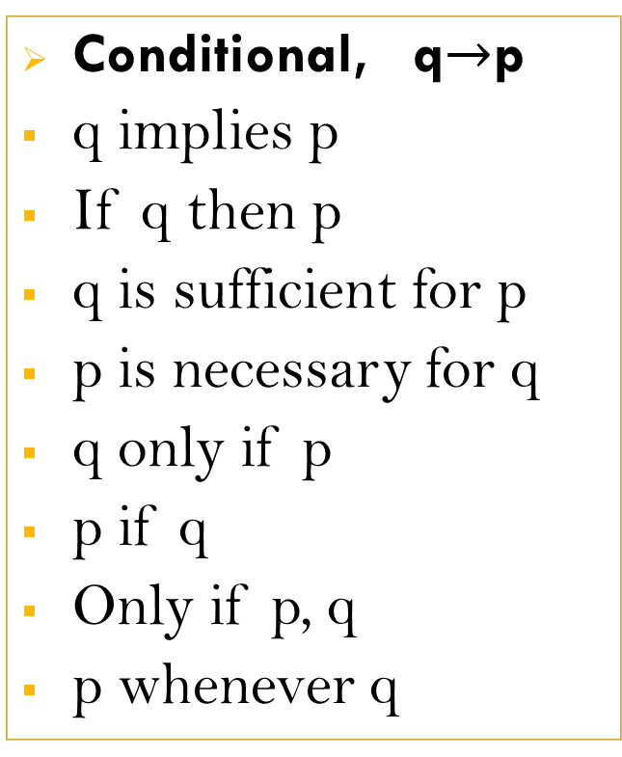
Logical Connectives (contd.)
Conditional, p$→$q
p implies q
If p then q
p is sufficient for q
q is necessary for p
p only if q
q if p
Only if q, p
q whenever p
Conditional, q$→$p
q implies p
If q then p
q is sufficient for p
p is necessary for q
q only if p
p if q
Only if p, q
p whenever q
Notes:
www.samuelchukwuemeka.com

Slide 5
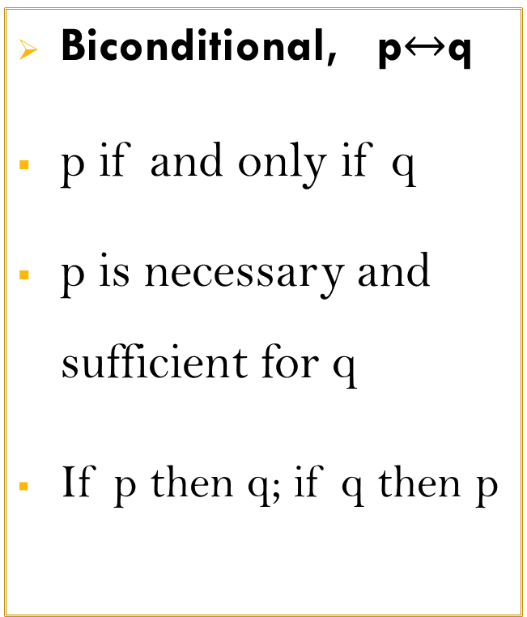

Logical Connectives (contd.)
Biconditional, p$↔$q
p if and only if q
p is necessary and sufficient for q
If p then q; if q then p
Biconditional, q$↔$p
q if and only if p
q is necessary and sufficient for p
If q then p; if p then q
Notes:
www.samuelchukwuemeka.com

Slide 6
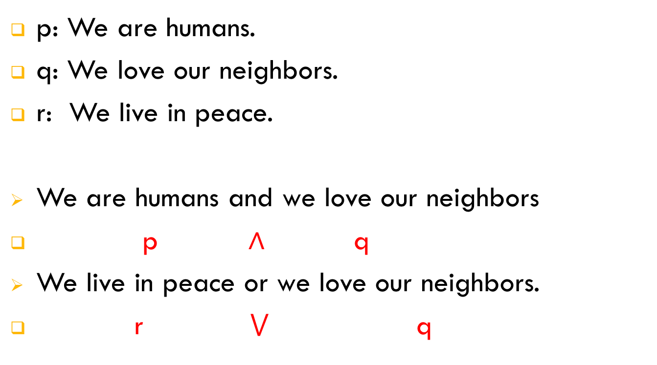
Write in Symbolic Logic
p: We are humans.
q: We love our neighbors.
r: We live in peace.
We are humans and we love our neighbors
p $∧$ q
We live in peace or we love our neighbors.
r $⋁$ q
Notes:
www.samuelchukwuemeka.com

Slide 7
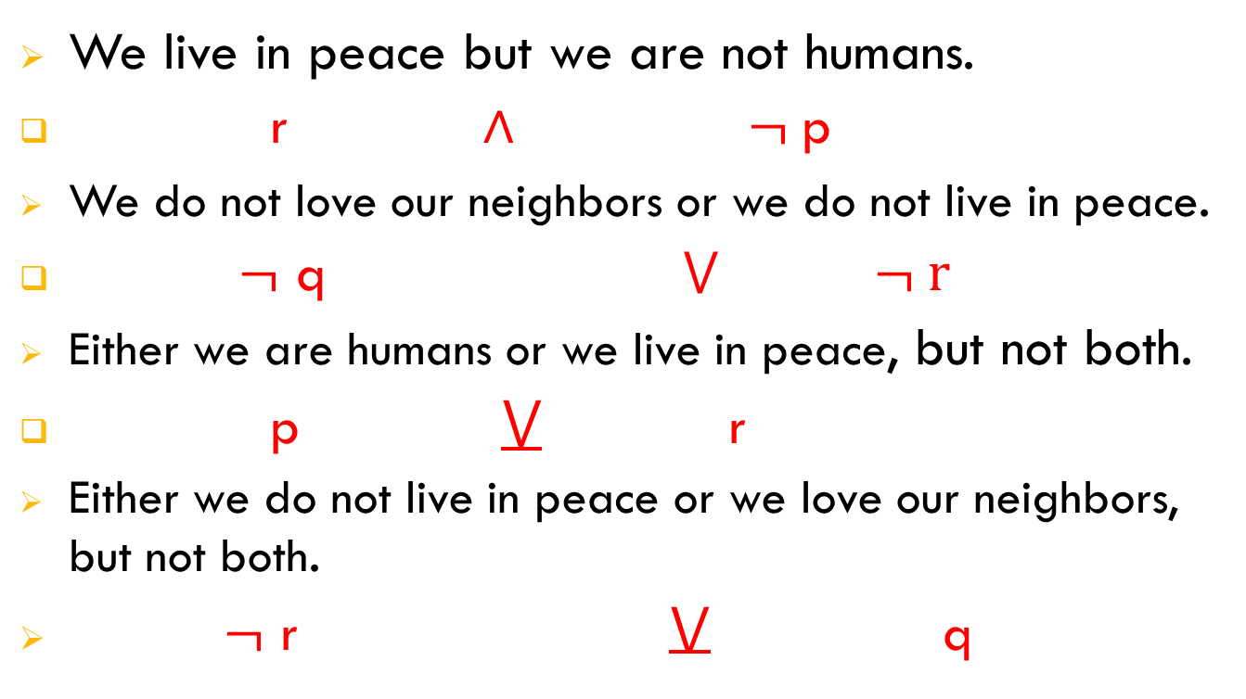
Write in Symbolic Logic
We live in peace but we are not humans.
r $∧$ $¬$p
We do not love our neighbors or we do not live in peace.
$¬$ q $⋁$ $¬ r$
Either we are humans or we live in peace, but not both.
p $⋁$ r
Either we do not live in peace or we love our neighbors, but not both.
$¬$ r $⋁$ q
Notes:
www.samuelchukwuemeka.com

Slide 8
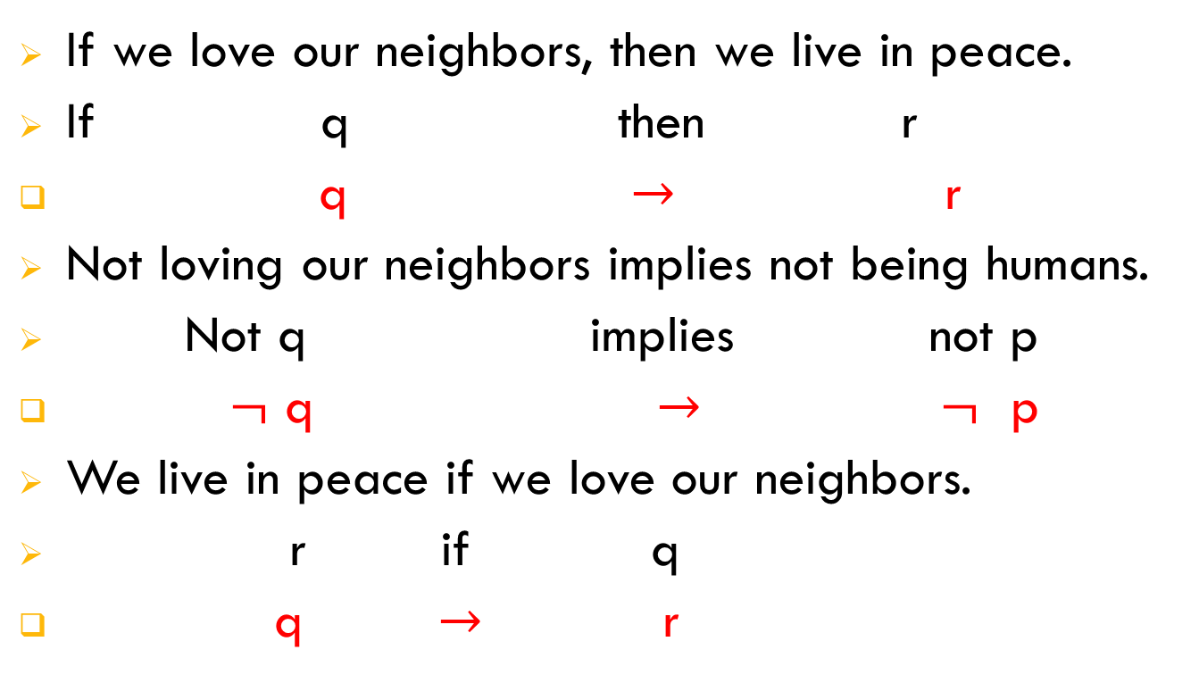
Write in Symbolic Logic
If we love our neighbors, then we live in peace.
If q then r
q $→$ r
Not loving our neighbors implies not being humans.
Not q implies not p
$¬$ q $→$ $¬$ p
We live in peace if we love our neighbors.
r if q
q $→$ r
Notes:
www.samuelchukwuemeka.com

Slide 9
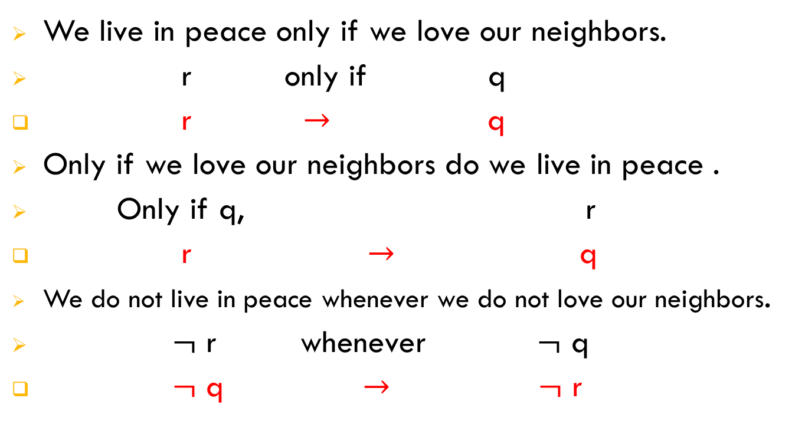
Write in Symbolic Logic
We live in peace only if we love our neighbors.
r only if q
r $→$ q
Only if we love our neighbors do we live in peace .
Only if q, r
r $→$ q
We do not live in peace whenever we do not love our neighbors.
$¬$ r whenever $¬$ q
$¬$ q $→$ $¬$ r
Notes:
www.samuelchukwuemeka.com

Slide 10
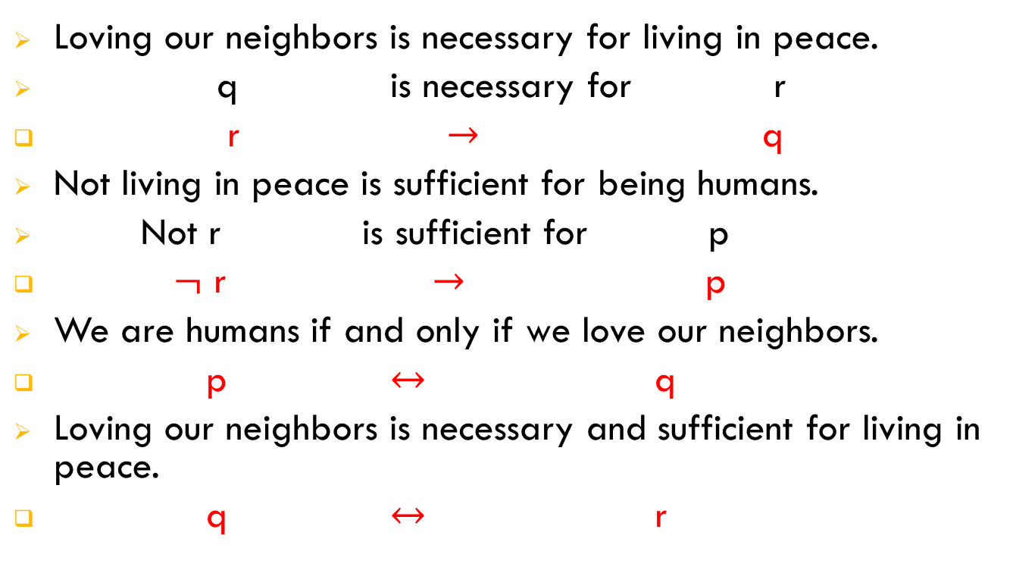
Write in Symbolic Logic
Loving our neighbors is necessary for living in peace.
q is necessary for r
r $→$ q
Not living in peace is sufficient for being humans.
Not r is sufficient for p
$¬$ r $→$ p
We are humans if and only if we love our neighbors.
p $↔$ q
Loving our neighbors is necessary and sufficient for living in peace.
q $↔$ r
Notes:
www.samuelchukwuemeka.com

Slide 11
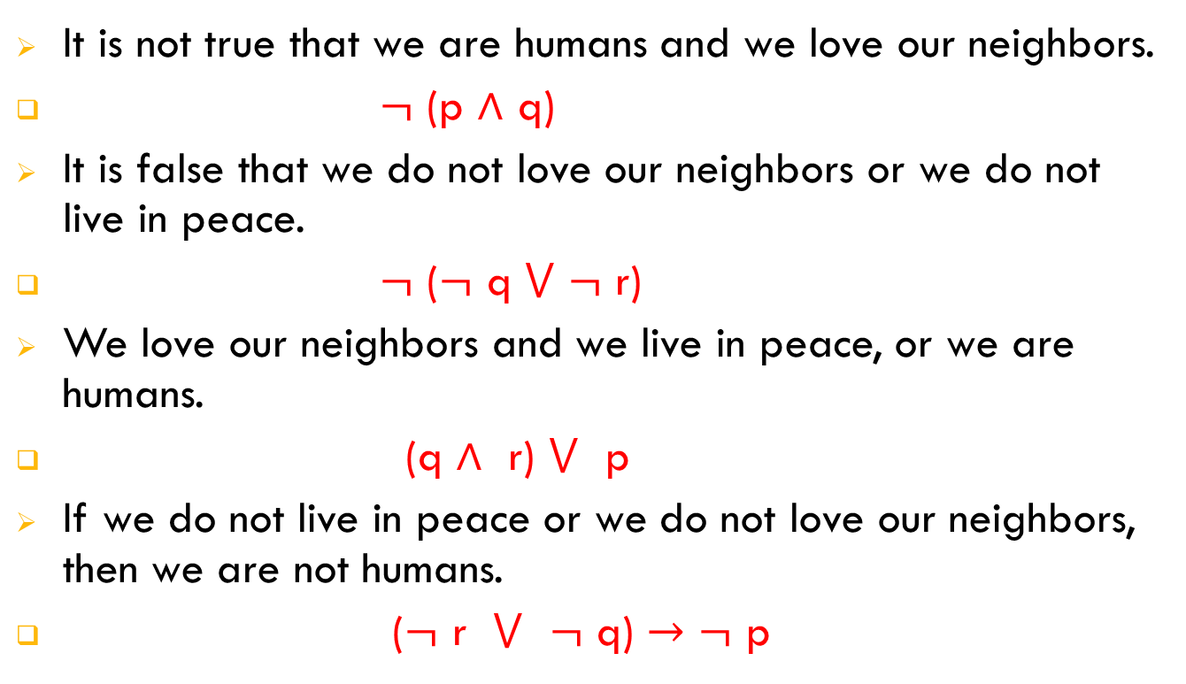
Write in Symbolic Logic
It is not true that we are humans and we love our neighbors.
$¬$ (p $∧$ q)
It is false that we do not love our neighbors or we do not live in peace.
$¬$ ($¬$ q $⋁$ $¬$ r)
We love our neighbors and we live in peace, or we are humans.
(q $∧$ r) $⋁$ p
If we do not live in peace or we do not love our neighbors, then we are not humans.
($¬$ r $⋁$ $¬$ q) $→$ $¬$ p
Notes:
www.samuelchukwuemeka.com

Slide 12
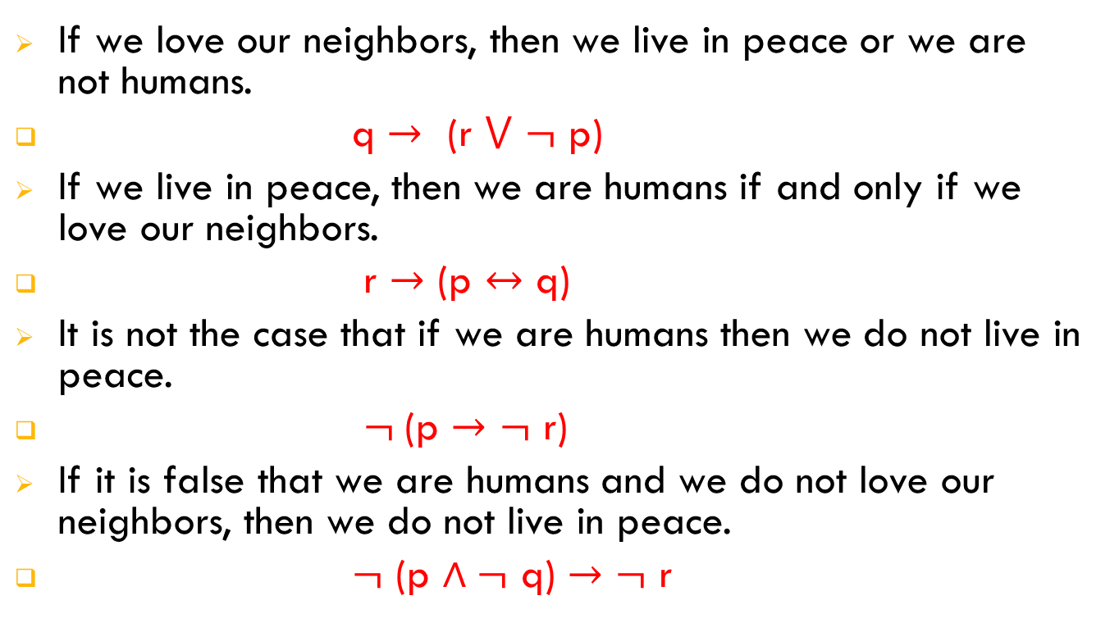
Write in Symbolic Logic
If we love our neighbors, then we live in peace or we are not humans.
q $→$ (r $⋁$ $¬$ p)
If we live in peace, then we are humans if and only if we love our neighbors.
r $→$ (p $↔$ q)
It is not the case that if we are humans then we do not live in peace.
$¬$(p $→$ $¬$ r)
If it is false that we are humans and we do not love our neighbors, then we do not live in peace.
$¬$ (p $∧¬$ q) $→$ $¬$ r
Notes:
www.samuelchukwuemeka.com

Slide 13
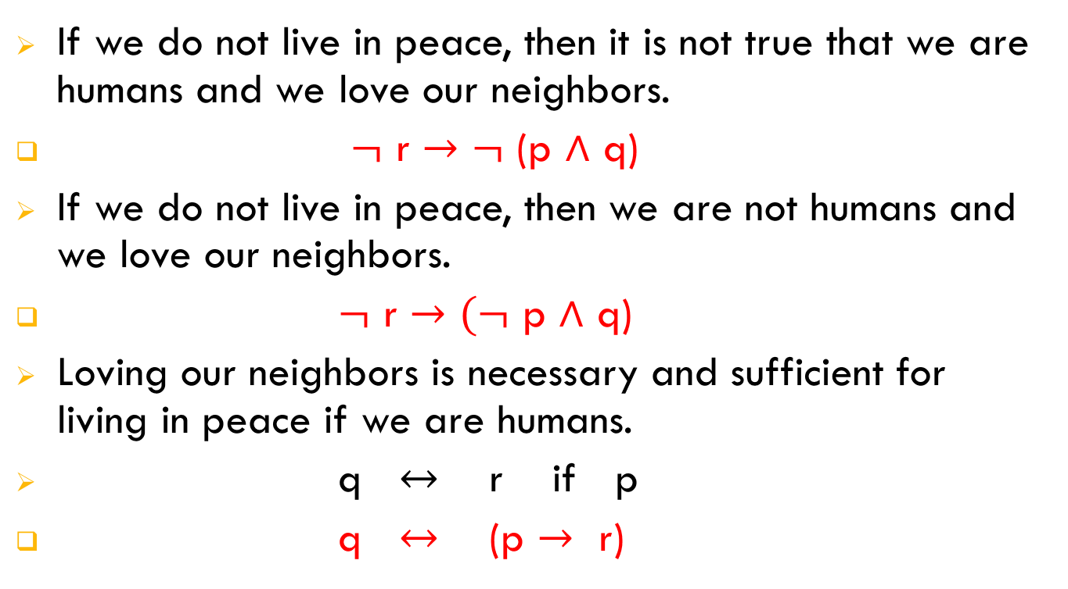
Write in Symbolic Logic
If we do not live in peace, then it is not true that we are humans and we love our neighbors.
$¬$ r $→$ $¬$ (p $∧$ q)
If we do not live in peace, then we are not humans and we love our neighbors.
$¬$ r $→$ $(¬$ p $∧$ q)
Loving our neighbors is necessary and sufficient for living in peace if we are humans.
q $↔$ r if p
q $↔$ (p $→$ r)
Notes:
www.samuelchukwuemeka.com

Slide 14
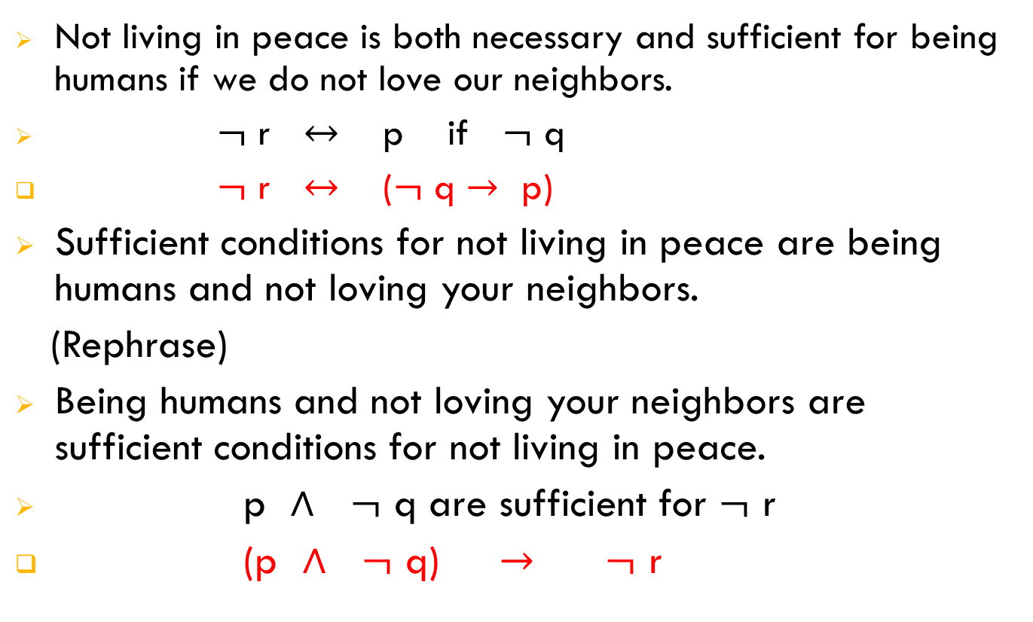
Write in Symbolic Logic
Not living in peace is both necessary and sufficient for being humans if we do not love our neighbors.
$¬$ r $↔$ p if $¬$ q
$¬$ r $↔$ ($¬$ q $→$ p)
Sufficient conditions for not living in peace are being humans and not loving your neighbors.
(Rephrase)
Being humans and not loving your neighbors are sufficient conditions for not living in peace.
p $∧$ $¬$ q are sufficient for $¬$ r
(p $∧$ $¬$ q) $→$ $¬$ r
Notes:
www.samuelchukwuemeka.com

Slide 15
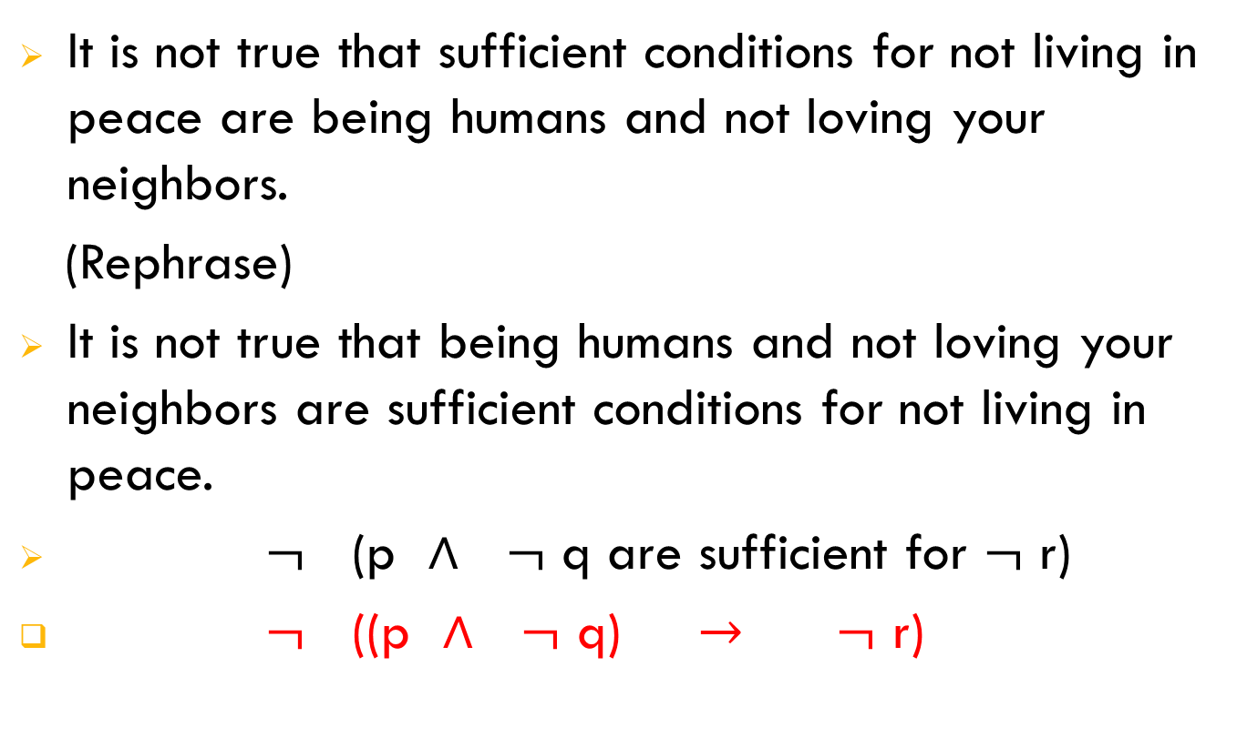
Write in Symbolic Logic
It is not true that sufficient conditions for not living in peace are being humans and not loving your neighbors.
(Rephrase)
It is not true that being humans and not loving your neighbors are sufficient conditions for not living in peace.
$¬$ (p $∧$ $¬$ q are sufficient for $¬$ r)
$¬$ ((p $∧$ $¬$ q) $→$ $¬$ r)
Notes:
www.samuelchukwuemeka.com

Slide 16
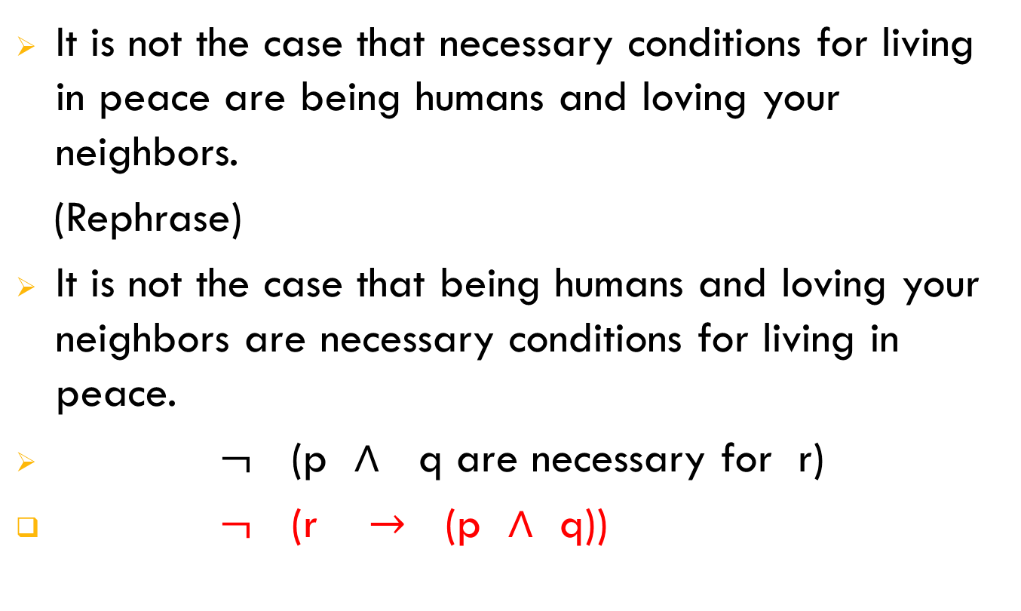
Write in Symbolic Logic
It is not the case that necessary conditions for living in peace are being humans and loving your neighbors.
(Rephrase)
It is not the case that being humans and loving your neighbors are necessary conditions for living in peace.
$¬$ (p $∧$ q are necessary for r)
$¬$ (r $→$ (p $∧$ q))
Notes:
www.samuelchukwuemeka.com

Slide 17
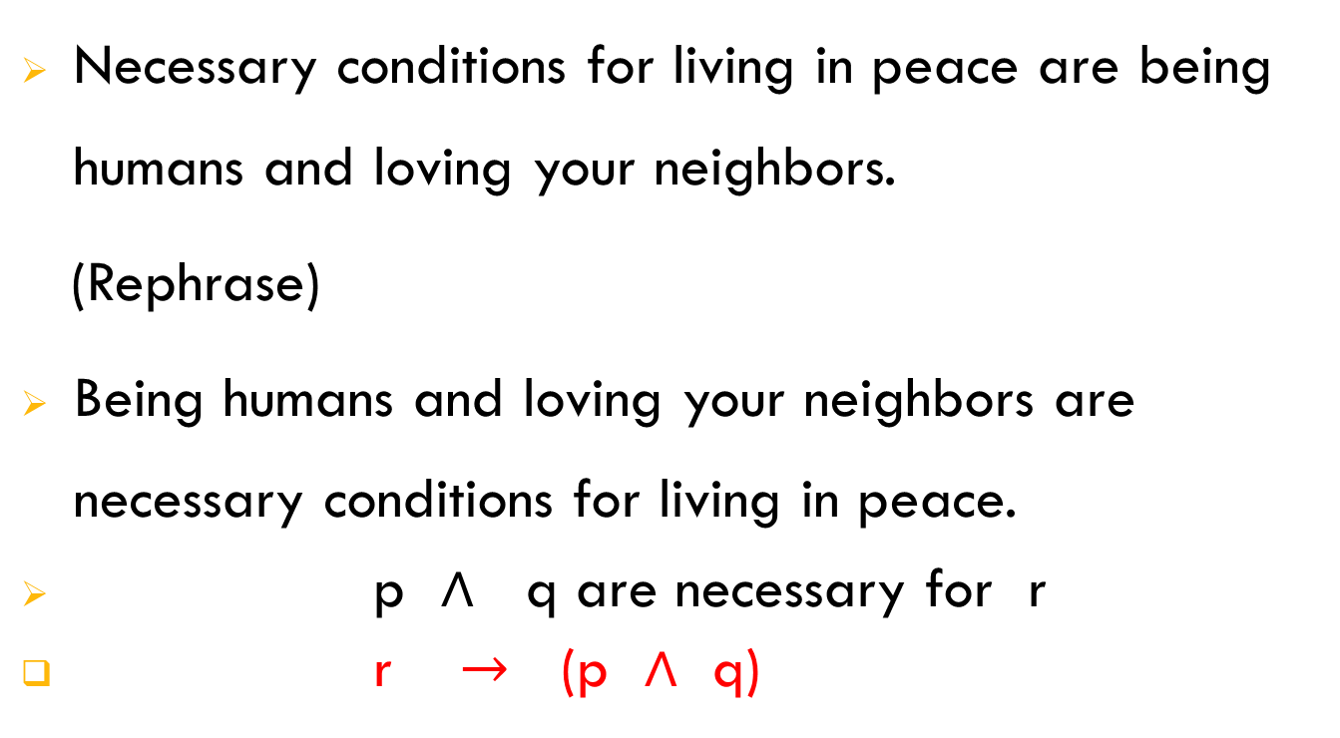
Write in Symbolic Logic
Necessary conditions for living in peace are being humans and loving your neighbors.
(Rephrase)
Being humans and loving your neighbors are necessary conditions for living in peace.
p $∧$ q are necessary for r
r $→$ (p $∧$ q)
Notes:
www.samuelchukwuemeka.com

Slide 18
References
Blitzer, R. (2015). Thinking Mathematically Plus New Mymathlab With Pearson Etext Access Card. Pearson College Div.
Tan, S. (2015). Finite mathematics for the managerial, life, and social sciences (11th ed.).
Images taken from http://en.wikipedia.org/wiki/
Notes:
www.samuelchukwuemeka.com

