Slide 1


JAVA METRICS
FINAL PRESENTATION
Brewing the Numbers Behind U.S. Coffee Imports
STAT 7100
by Sam Doyle

Slide 2





TABLE OF CONTENTS
FINAL PRESENTATION
STAT 7100
Goal
Introduction
EDA
Analysis
Summary
1
2
3
4
5

Slide 3
PROJECT GOAL:
COVID had a severe effect on many aspects of people’s daily lives, including the purchases of goods. I want to compare the amount of coffee imports in USD into the United States in 2019 (pre-COVID) and 2023 (post-COVID) and see if there is a substantial difference.
FINAL PRESENTATION
STAT 7100

Slide 4


DATA INTRODUCTION
The dataset used is from the Economic Research Service (ERS).
It records imports of coffee, tea and spices into the U.S. in USD amount.
There are 25 numeric variables for years 1999-2023
There are two categorical variables, product type and exporting country.
Created 4 categorical variables from years 2019, 2020, 2022 and 2023 separated into 3 levels, “Low,” “Moderate” and “High” based off of Q1 and Q3 values.
FINAL PRESENTATION
STAT 7100

Slide 5
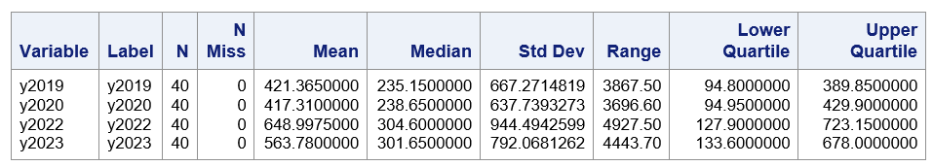
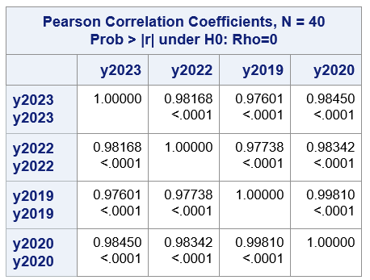
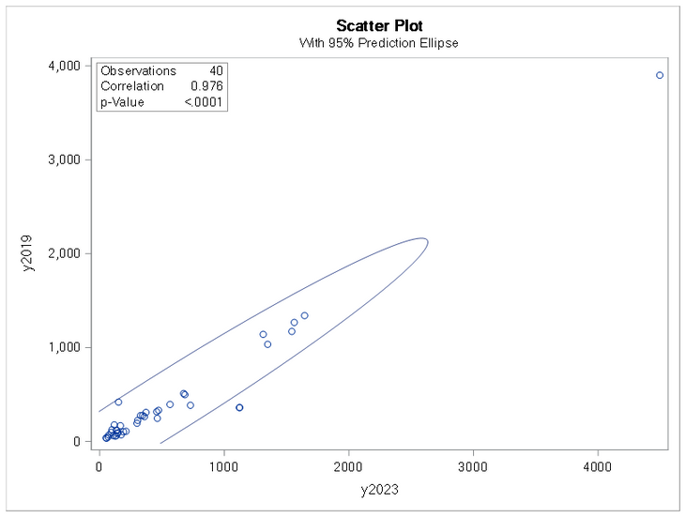
EXPLORATORY FINDINGS
First, to get some basic information about variables, run descriptive statistics about important quantitative variables
Then, check correlation coefficients to see which variables have strong correlations.
FINAL PRESENTATION
STAT 7100
Use y2019 and y2023 to see if the relationship would appropriately use linear regression.

Slide 6


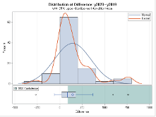
T-TEST
Null and Alternative Hypotheses:
Since the p-value is smaller than 0.05, this means there is a statistically significant difference in the means of the two years. Therefore, the null hypothesis is rejected.
Since the goal is to see if there is a difference between the two years, 2019 (pre-COVID) and 2023 (post-COVID), a paired t-Test with 2 numeric values (y2019 and y2023) is conducted with alpha=0.05.
FINAL PRESENTATION
STAT 7100

Slide 7

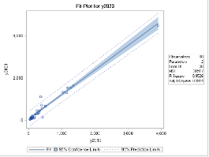
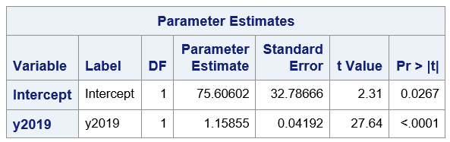
LINEAR REGRESSION
Null and Alternative Hypotheses:
Simple linear regression decision:
Since beta 1 is not equal to 0, the null hypothesis is rejected. There is a linear relationship between the two variables.
Using y2019 and y2023 as x and y respectively, the linear regression table provided in SAS is:
FINAL PRESENTATION
STAT 7100
The equation created is y=75.61 + 1.16x.
This suggests that for every 1 million USD increase in 2019 imports, the 2023 imports increase by 1.16 million USD and 2023 imports start 75.6 million USD ahead of 2019.

Slide 8


CONCLUSION
Using the information from the previous slide, the null hypothesis is rejected. Therefore, there is not sufficient evidence to state that the means from years 2019 and 2023 are the same. This suggests that COVID may have had an impact on coffee imports into the U.S.
LIMITATIONS & FURTHER RESEARCH
FINAL PRESENTATION
STAT 7100
This research was conducted using a limited data set. Inflation was not considered during this analysis. Going forward, a similar analysis could be conducted, but adjusting the 2019 values to take inflation into account would give a more accurate picture of COVIDs effects on the coffee industry.

Slide 9
THANK YOU
FINAL PRESENTATION
STAT 7100

