Slide 1
Situational Pitching Behavior
Sabermetrics
Samuel Reed
Notes:
Hello my name is Sam Reed and for my final project I created Situational Pitching Behavior, or SPB

Slide 2

Motivation
Statistical Evaluation of “Clutch” Pitchers
Understanding of how pitchers perform in specific situations
High Pressure
General performance
Improving batter’s understanding of how a pitcher will pitch
Notes:
Situational Pitching Behavior is different from most statistics. It is a dynamic statistic tool that allows you to look up how a pitcher will perform in a very specific situation. This gives a deeper, more statistical identity for evaluating clutch pitchers and also allows users to get a more confident understanding of how a pitcher will perform in high pressure situations and all situations in general. Situational Pitching Behavior is also very valuable to batters as it allows them to predict how pitcher will behave in a certain situation.

Slide 3


Data Collection
All statcast pitching data from the 2017 Regular Season
A larger range of data could improve confidence in predictions
Notes:
For my data I took all of the pitching data generated by statcast for the 2017 regular series. If a user was to use a larger pool of data the results would be even more confidently supported.

Slide 4

Data Processing
Lookup
Isolate
Process
Display
Notes:
As far as the code goes, the data processing happened in 4 steps. The code first looks up all the data related to the situation and pitcher entered, that data is then isolated or chopped down to only the crucial parts. The isolated data is then processed statistically and then finally the code displays all of the statistics in an understandable format. This is all done in a jupyter notebook though it could be exported relatively easily

Slide 5
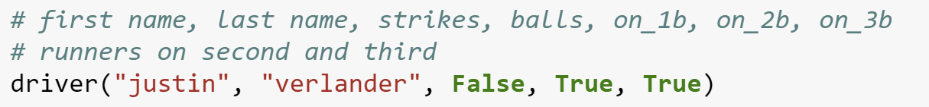
User Interaction
Player First Name
Player Last Name
Bool: Runner on First
Bool: Runner on Second
Bool: Runner on Third
Notes:
Using the situational pitching tool is very easy. All a user has to do is call the driver function with the pitchers first and last name as well as the status of runners on first, second, and third which is indicated by a boolean

Slide 6
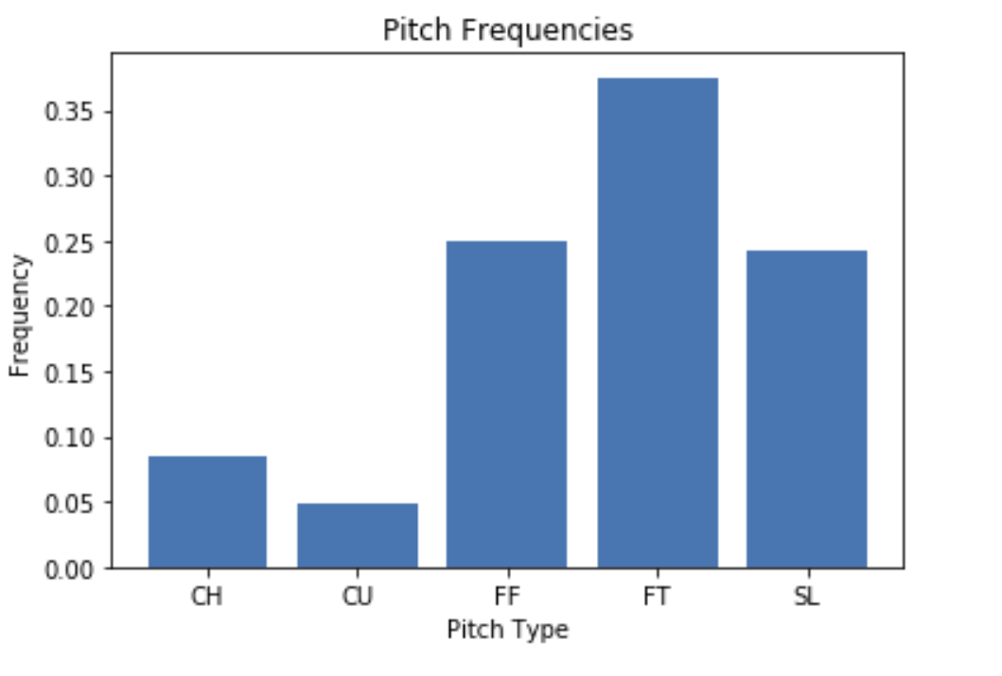
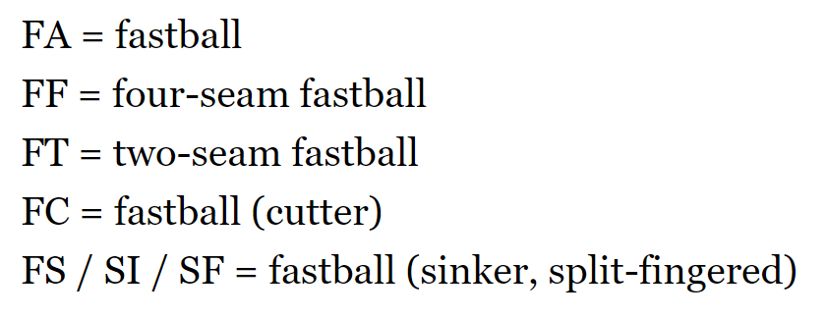
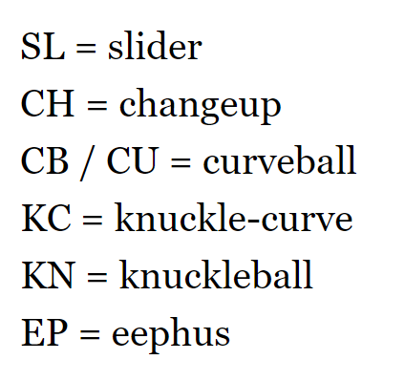
Results - Pitch Frequencies
Frequencies of pitch types thrown in described situation
Uses every instance of described situation to generate frequencies
Notes:
When the data is displayed it will give information about three different areas of pitching. The first of those areas is pitch frequencies. Situational Pitching Behavior will tell the user the frequency of different pitch types thrown by the pitcher in the specific situation outline and will display those results graphically and numerically.

Slide 7
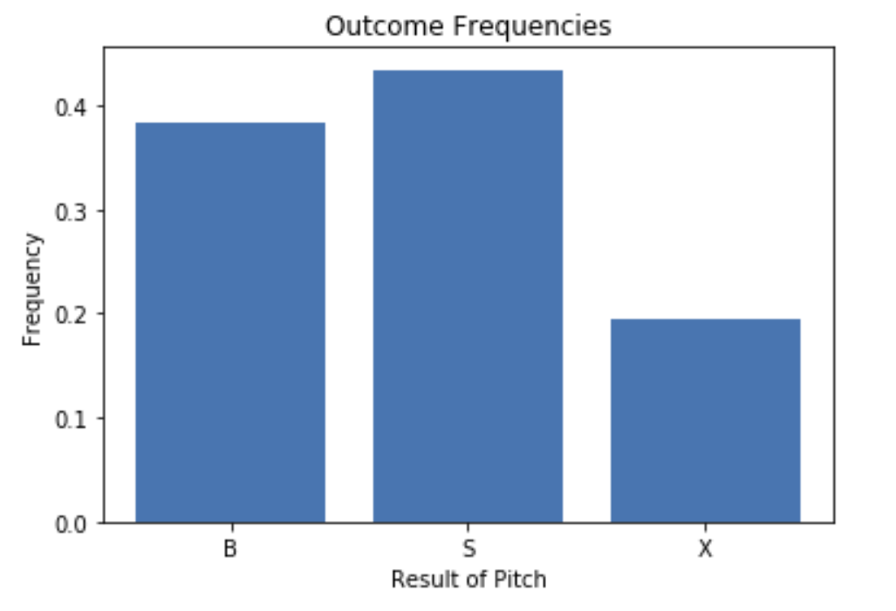
Results - Outcome Frequencies
Historical percentage chance a pitch in the described situation will be a ball (B), a strike (S), or hit into play (X)
Notes:
The second item displayed by Situational Pitching Behavior is the Outcome Frequencies. The outcome frequencies show the user how likely a pitcher is to throw a ball, strike, or hit into play based on their historical performance in the described situation.

Slide 8
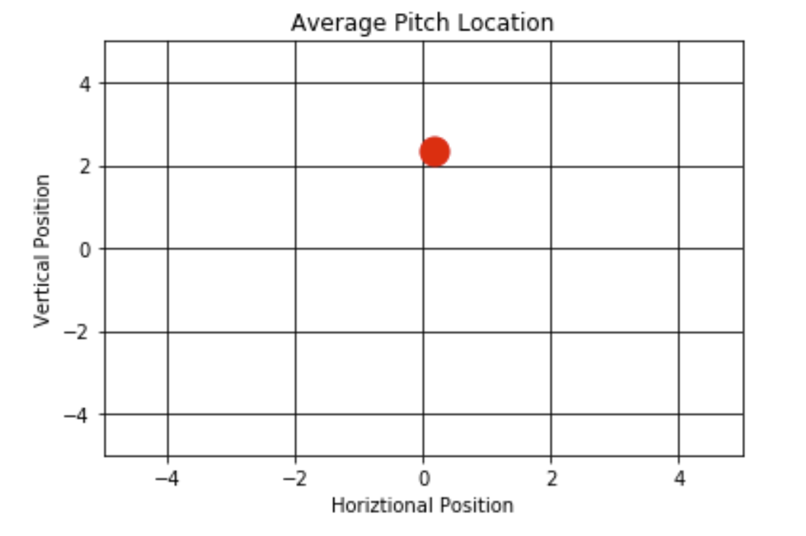
Results - Pitch Position
Average position of where the pitch will be located over the plate
Generated by mean of all other pitch locations in described situation
Notes:
The final data shown by SPB is pitch position. This is generated by averaging the location of all the pitches that pitcher has thrown in the described situation and those numbers will be shown graphically and numerically. The position is from the perspective of the catcher where 0 on the x axis is directly over the center of the plate horizontally. The y axis indicates the height of the pitch.

Slide 9
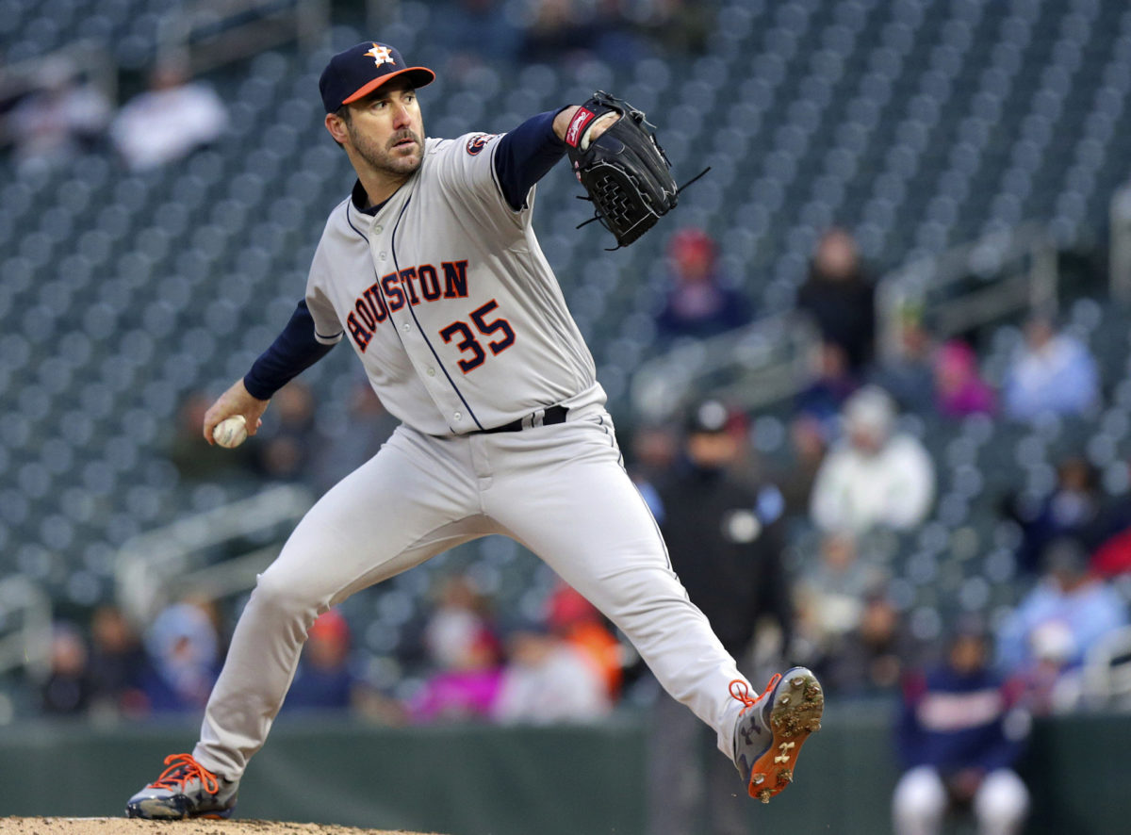
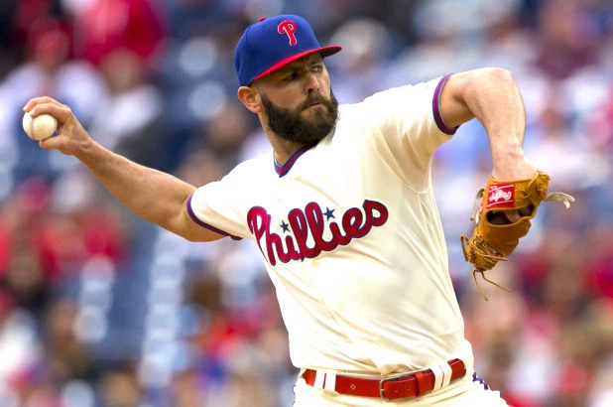
Case Study - Verlander VS Arrieta
Case Study will observe how both pitchers behave in a situation where the bases are loaded
Both players appeared on MLB.com’s “These are the most clutch pitchers in history”
Justin Verlander
Jake Arrieta
Notes:
To show how valuable this tool can be I decided to do a case study. As I said before, SPB is most similar to the idea of a “Clutch Pitcher” so I went on MLB.com and found a list of the most clutch pitchers according to mlb.com. I chose two of these pitchers, Justin Verlander and Jake Arrieta, and decided to see how they had performed when the bases are loaded, which is a very high pressure situation.

Slide 10
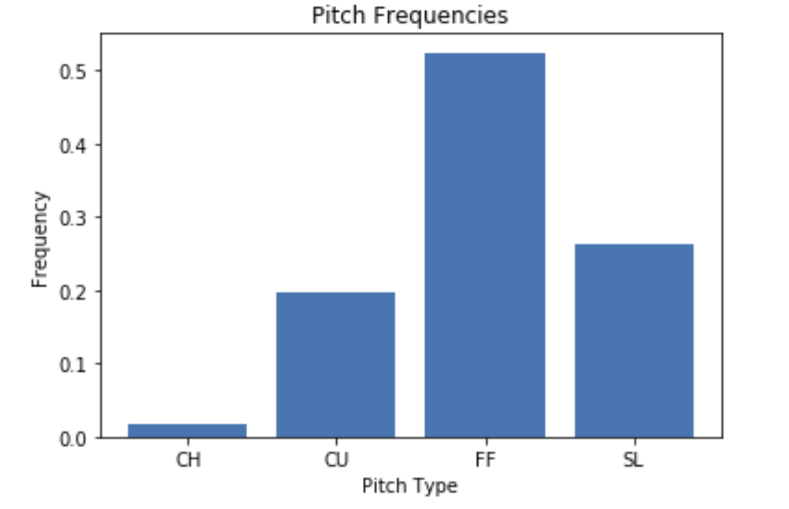
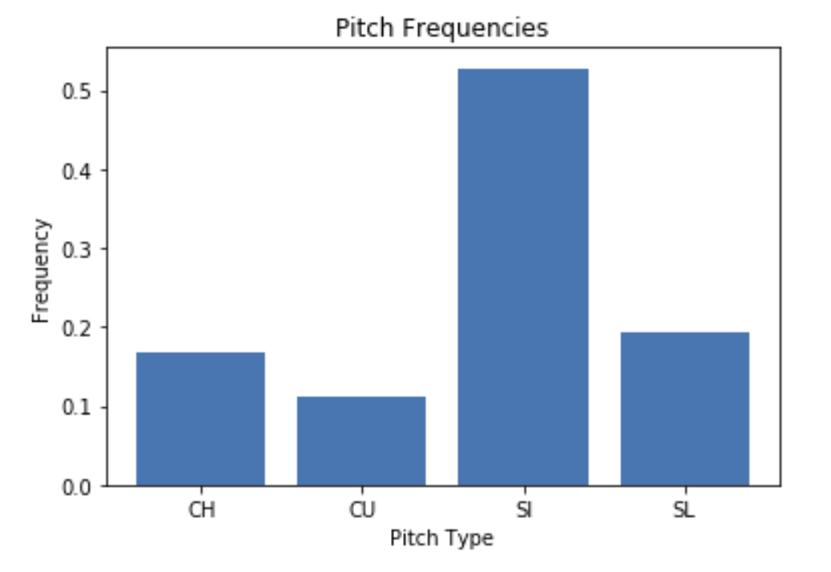
Case Study - Pitch Frequencies
Justin Verlander
Jake Arrieta
Notes:
When looking at the pitch frequencies in this situation the results are very interesting. We see that Justin Verlander throws mostly four seam fastballs while Jake Arrieta throws split finger fastballs. Justin Verlander also throws very little changeups. This can tell us a lot about what kind of pitches these pitchers are most comfortable with.

Slide 11
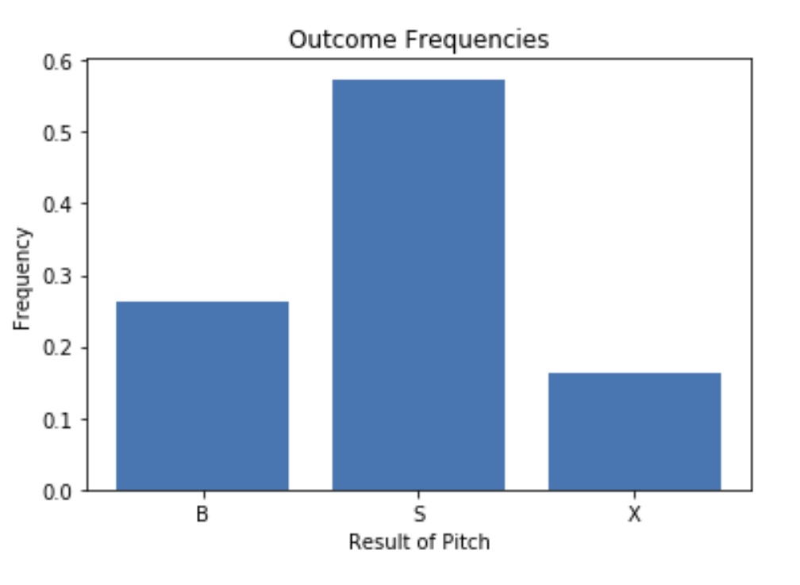
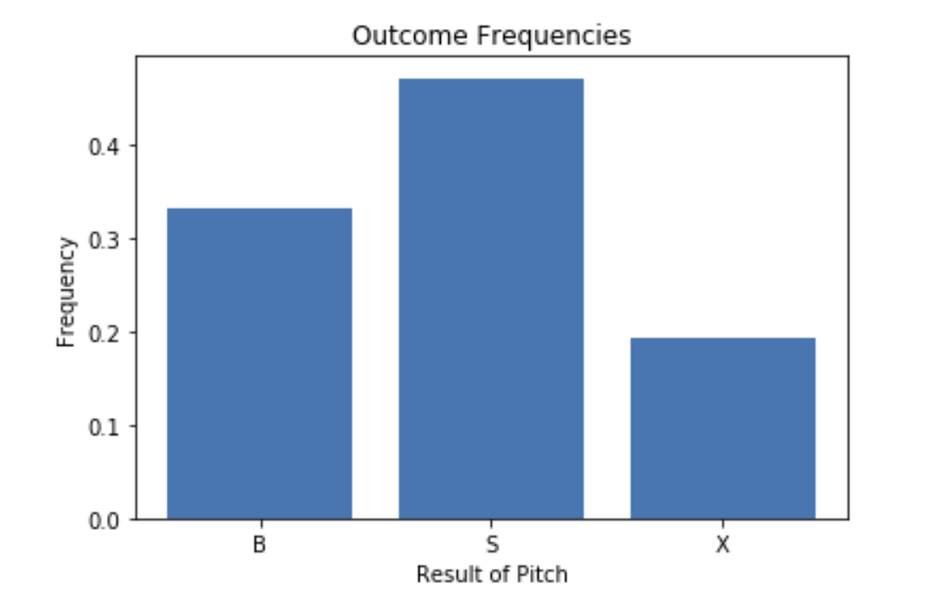
Case Study - Outcome Frequencies
Justin Verlander
Jake Arrieta
Notes:
When looking at the outcome frequencies, we see that these pitchers do perform relatively well in this high pressure situation and could indeed be considered “clutch” as they both throw more strikes than balls.

Slide 12
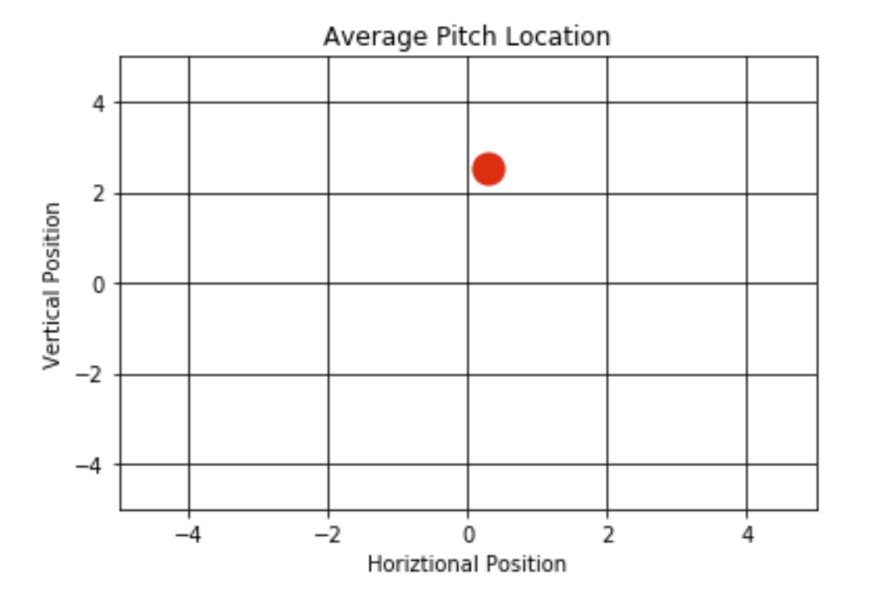
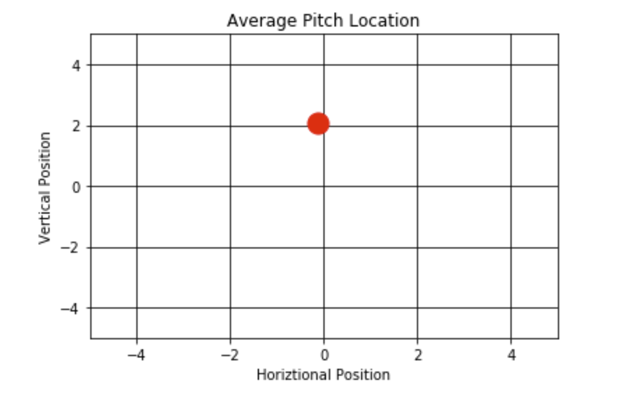
Case Study - Average Position
Justin Verlander
Jake Arrieta
Notes:
When looking at the average position generated by SPB we see that both Verlander and Arrieta throw almost directly over the plate in these situations. This could indicate that they do not want to try and more risky pitchers due to the intensity of the situation.

Slide 13
Conclusion
Increased ability to analyze pitchers in high and low pressure situations
Improve understanding of mental strength
Encourage more thoughtful pitcher selection
Increase ability for batters to understand the mindset of the pitcher they are facing
What types of pitches may be thrown
Historical understanding of how pitcher performs in high pressure situations
Situations can’t be specified down to level of number of balls and strikes because there isn’t enough data to inspire confidence in the results
Notes:
In conclusion, SPB has a lot to offer for pitchers, managers, and batters. Pitchers and managers will have an increased ability to analyze how a pitcher performs in high and low pressure situations which can help them work on any mental weaknesses they may have. Batters are also able to understand the mindset of a pitcher and they could use this tool on the fly to have an idea of what kind of pitches may be thrown against them when they are going up to bat in a specific situation. One change I had to make in this code was to stop allowing the user to specify the exact number of balls and strikes in the situation, because this limited the data too much, but if there is a lot of data on a pitcher this could be included for an even more robust understanding of the pitcher. Overall, Situational Pitching Behavior has a lot to offer for both offensive and defensive users, and it is easily expandable and could be adapted for specific statistics that the user wants to see.

