Slide 1
Hover Aerodynamic Design
Thrust required = 2746.8N
Casing Diameter = 1.2m
Hub-to-tip ratio = 0.3 (to compare with BBSR .xls set to 0)
Free to choose phi (flow coefficient) and sigma (exit duct area ratio)
Analyse ideal case, i.e. no losses

Slide 2






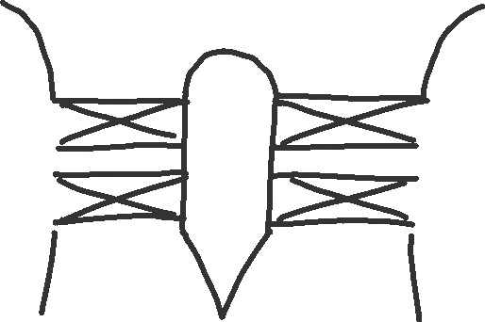







Hover Aerodynamic Design

Slide 3
Cruise Aerodynamic Design
Thrust required = 327N
Forward speed = 45m/s
Casing Diameter = 1.2m
Hub-to-tip ratio = 0.3
Analyse ideal case, i.e. no losses

Slide 4









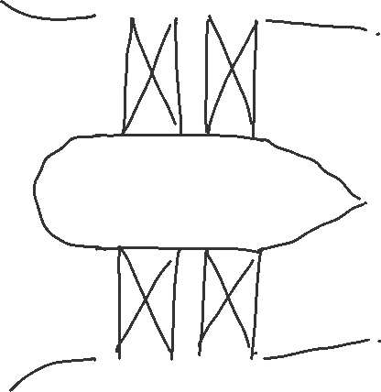

Cruise Aerodynamic Design

Slide 5












Thrust given by momentum equation:

Slide 6












Power and efficiencies:

Slide 7











Shaft Speed for Hover

Slide 8























Stage Loading Coefficient for Hover

Slide 9
















Figure of Merit and Propulsive Efficiency

Slide 10





















Operating Point for Cruise
Continued on next slide

Slide 11








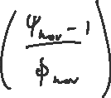











blade speed

Slide 12
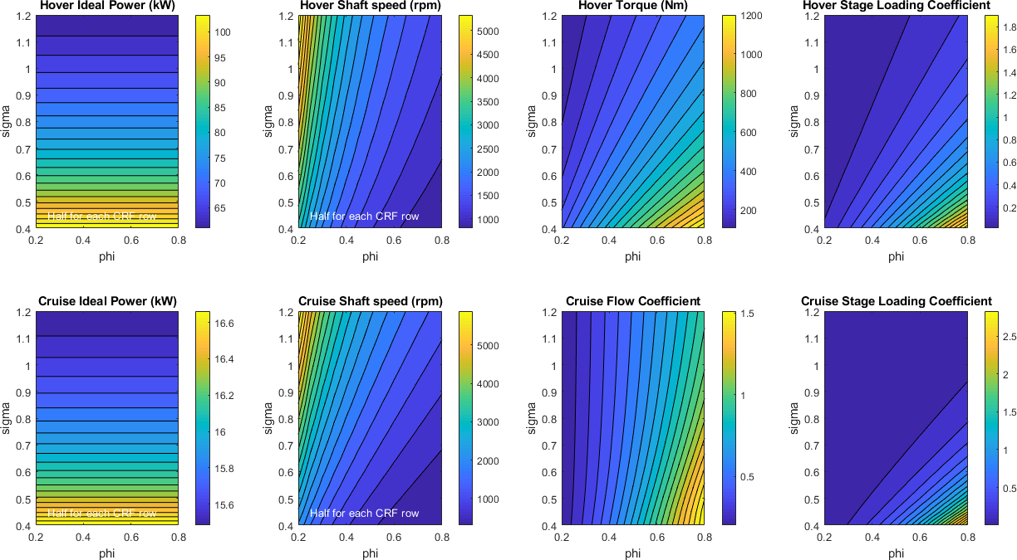
Design maps for hover and cruise
Fixed:
Casing Diameter = 1.2m
Hub-to-tip ratio = 0.4
Hover thrust = 2747N
Cruise thrust = 327N
P = 66.7kW
rpm = 1450
Tq = 439Nm
psi = 0.245
P = 15.6kW
rpm = 1234
phi = 0.857
psi = 0.076

Slide 13
Comparing Initial BB and Whittle Hover Designs
Whittle: phi = 0.7, sigma = 1.0
BBSR ideal case design has figure of merit, M_{f} = 1.0, therefore sigma = 0.5
BBSR tip Mach number gives rpm = 3517, therefore phi = 0.285
N.b. Setting hub-to-tip = 0, gives same results as BBSR .xls for hover

Slide 14
Design options: Contra-Rotating Fan
Fixed:
Hover thrust = 2747N
phi = 0.7
sigma = 1
Hub-to-tip = 0.4
Hover Thrust (N) | Casing Diameter (m) | Hub-to-tip Ratio | Hover Ideal Power (kW) | rpm each row | Torque (Nm) | Relative Tip Mach Number | Comment
2747 | 1.2 | 0.4 | 66.7 | 725 | 439 | 0.268 | “Baseline” design shown on previous slide
3200 | 1.2 | 0.4 | 83.9 | 782 | 512 | 0.290 | Increased thrust
3600 | 1.2 | 0.4 | 100.1 | 830 | 576 | 0.306
2747 | 1.0 | 0.4 | 80.1 | 1044 | 366 | 0.322 | Reduced Casing Diameter
2747 | 0.8 | 0.4 | 100.1 | 1632 | 293 | 0.402
2747 | 1.2 | 0.3 | 64.1 | 718 | 425 | 0.266 | Varying Hub-to-tip Ratio
2747 | 1.2 | 0.5 | 70.6 | 739 | 456 | 0.273

