Slide 1
GAN-based Finger Vein (FV) Image Augmentation for Biometric Authentication
Semester Project
Hak Gu Kim
hakgu.kim@epfl.ch
Image and Visual Representation Lab. (IVRL)
School of Computer and Communication Sciences (IC)
École Polytechnique Fédérale de Lausanne (EPFL)
24. Sept. 2020

Slide 2


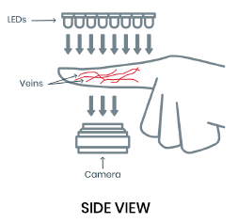
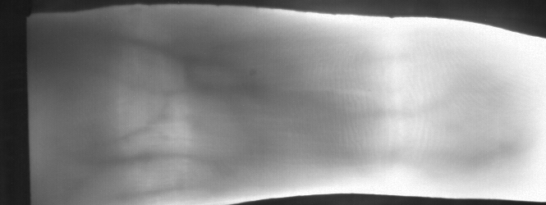






Introduction: FV biometric authentication system
User Enrollment
…
$$⋮$$
$$⋮$$
Database
…
Users
FV Image Acquisition
FV Image of Each User
FV Feature Encoding
User Verification
Feature Matching
…
Result
A user
FV Image Acquisition
FV Image of A user
FV Feature Encoding

Slide 3
Motivation: FV Image Augmentation for Authentication
Importance of Diverse Training Dataset in DL for Biometric Authentication
While deep learning (DL) methods demonstrate state-of-the-art results for biometric authentication, their performance and robustness depend upon the availability of a diverse training dataset to learn the uniqueness of each person such as appearance and shape characteristics in various environments.
Difficulty of Large Scale Data Collection for Biometric Authentication
However, large scale dataset collection for biometric authentication requires several biometric patterns from each person in various conditions, which is time consuming and labor intensive.
The Necessity of Data Augmentation in FV Authentication
The problem is particularly acute for finger vein images since there are uncontrollable factors affecting the finger vein image acquisition such as environmental illumination, ambient temperature, and light scattering in imaging finger tissues, necessitating data augmentation.

Slide 4

Brainstorming: Baseline of FV Image Augmentation
L_{cyc}
Spatial Transformers
Input image,
x
Generated image,
y=G(x)
Remapped input image,
x'=F(y)=F(G(x))
Mapping1
(G)
Mapping2
(F)
Replacement
/Integration
L_{FVA}
Illumination Transformers
Feature Matching
Segmented image,
s=G(x)
Authentication
Temperature Transformers
Feature
Encoder (E)
Enrolled database
Lightening Transformers
$$⋮$$
L_{FVR}
L_{cyc}: Cycle-consistency loss
L_{FVA}: FV Authentication loss
L_{FVR}: FV Region classification loss
Classification
Region
Classifier (C)

Slide 5
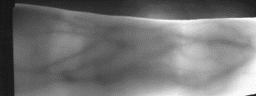
Database
The VERA Finger Vein (FV) Database for FV recognition [Global ID]
440 FV images acquired from 110 subjects (4 images for each subject)
N/A (250x665 pixels)
https://www.idiap.ch/dataset/vera-fingervein
The Hong Kong Polytechnic University Finger Image Database [R1]
6,264 FV images acquired from 156 subjects
Index fingers and middle fingers (N/A pixels)
https://www4.comp.polyu.edu.hk/~csajaykr/fvdatabase.htm
The Finger Vein USM database [R2]
5,904 FV images acquired from 123 subjects (48 images for each subject)
Index fingers and middle fingers from two hands (640x480 pixels)
http://drfendi.com/fv_usm_database/
[R1] A. Kumar and Y. Zhou, “Human identification using finger images,” IEEE Trans. Image Process., 2012.
[R2] M. S. M. Asaari, S. A. Suandi, and B. A. Rosdi, “Fusion of band limited phase only correlation and width centroid contour distance for finger based biometrics,” Expert Syst. Appl., 2014.

