Slide 1
GAN-based Finger Vein (FV) Image Augmentation for Biometric Authentication
Semester Project
Hak Gu Kim
hakgu.kim@epfl.ch
Image and Visual Representation Lab. (IVRL)
School of Computer and Communication Sciences (IC)
École Polytechnique Fédérale de Lausanne (EPFL)
22. Oct. 2020

Slide 2
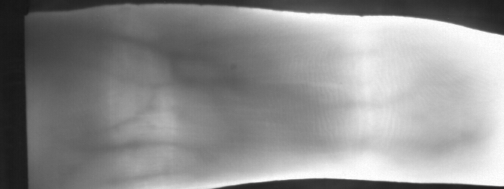
Brainstorming: Baseline of FV Image Augmentation 1
L_{FVA}
Spatial Transformer
Net (S)
Feature Matching
Input image,
x
Spatially
transformed
image, S(x)
Authentication
Feature
Encoder (E)
Enrolled database

Slide 3
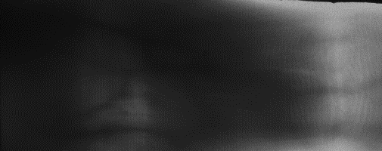
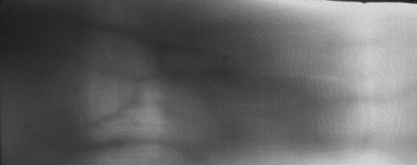

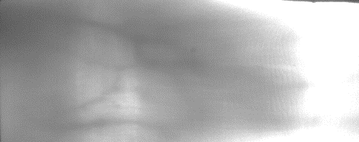
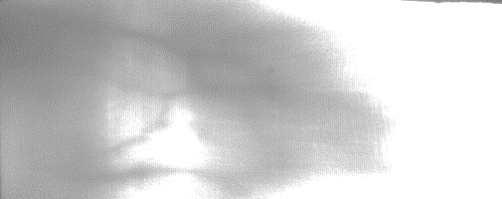
Brainstorming: Baseline of FV Image Augmentation 2
Spatial Transformer
Net (S)
Input image,
x
Spatially
transformed
image, S(x)
Reconstructed
image, S(x’)
G: S(x) -> x’
F: x’ -> S(x)
Spatial +Illumination
Transform image, x’=G(S(x))
CycleGAN for synthesizing
illumination variant images

Slide 4
Brainstorming: Baseline of FV Image Augmentation 2
Spatial Transformer
Net (S)
Input image,
x
Spatially
transformed
image, S(x)
Reconstructed
image, S(x’)
G: S(x) -> x’
F: x’ -> S(x)
L_{FVA}
Spatial +Illumination
Transform image, x’=G(S(x))
Feature Matching
Authentication
Feature
Encoder (E)
Enrolled database

