Slide 1
Why be a developer?
11 July 2011
Sam Dutton
Developer Advocate
Google

Slide 2



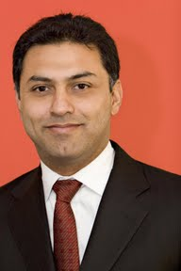




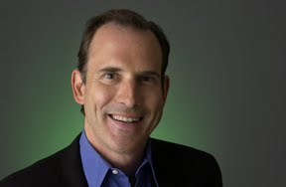
Notes:
First up: I noticed there are several girls in the room.
This is a picture of senior Google execs.
We need more women!

Slide 3

Notes:
That’s why we nee more girls and woment getting jobs in computer industries.
We need to extend the gene pool!

Slide 4
Why?
Fulfilling
Exhilarating
Lots of jobs
Well paid (if you’re lucky)
Flexible

Slide 5
Fulfilling
People are using computers everywhere, all the time
Make things that make a difference
Notes:
Americans now spend more leisure time on computers than watching TV – that was unthinkable when I was a kid.
Exciting to make something beautiful or useful.
Something that people use – something that can improve their lives:
a new gaming platform
a better data entry interface
a life-saving cardio-analysis tool.

Slide 6
Exhilarating
Build a website
Sell a mobile app
Code a successful business application
Contribute to an open source codebase
Join forces with friends and
Notes:
Watch traffic build
Watch sales build
See data build up from a system you collaborated on
Get kudos for good code
Watch the success of a project – e.g. Google Chrome – that you contributed to

Slide 7
Expanding job market
Google added 4,565 workers in 2010
– this year plans over 6000
IT jobs have increased in a difficult economy

Slide 8
£££
Experienced developers can be well paid

Slide 9
Flexible
Part time
Work from home
Flexible/variable hours
Permanent, contract, consultant, volunteer
Variety of sectors: media, finance, scientific, charity…
Variety of corporate cultures, stress levels, team size
Transferrable skills
International
Kids!
Other commitments: family, volunteering…
Notes:
Transferrable: move from one kind of job to another, between sectors

Slide 10
What sort of jobs?
More technical: data analysts, software engineer
Product management, project management
Web developer
‘People jobs’: marketing, audience, education
Graphic design
User experience
Data versus content
Platforms
Specialisms: sectors, product, skill sets, languages…

Slide 11
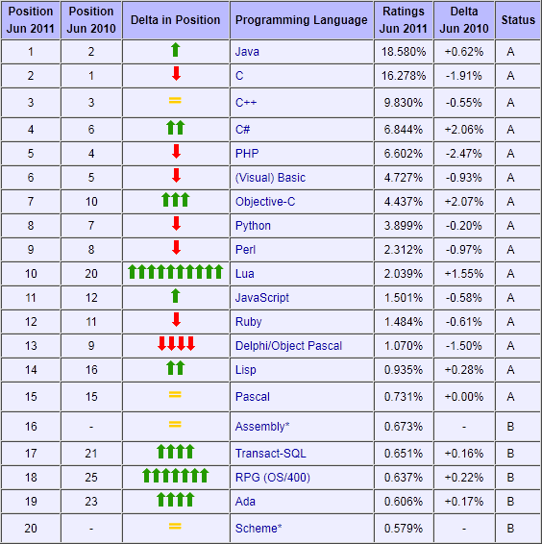
tiobe.com

Slide 12
Sectors
Financial services
Banking
Media
Government
Academic
Charity
Notes:
Don’t think that boring jobs come from boring sectors

Slide 13
Size
Small
Medium
Large

Slide 14
The big split
IT
Developers
Both can be good!
Notes:
Many companies have an IT department and a Developer department

Slide 15
Four types of company
No IT staff
IT staff but no developers
IT staff and developers
Tech-led companies like Google
Notes:
What does this mean?

Slide 16
Developer teams: typical roles
One boss: moderately technical or used to be technical
One project manager
Senior developers
Junior developers
Systems person: the person who runs the servers
User experience designers: the overview
Interface designer: the detail
Graphic designers (if you’re lucky)
Random freelancers

Slide 17
What do you actually do?
Project management and bureaucracy
Meetings and standups
Write tests
Write applications
Build prototypes
Iterate
Maintain software
Teach others
Learn
Notes:
You won’t just write code!

Slide 18
What makes a good developer?
Passion
Sanity
Focus
Learning
Communication
Business skills
Computer science
Maths
Notes:
Passion: you must love what you do
Sanity: it’s not The IT Crowd
Focus: you must be able to think about what your employer wants
Learning: you must be able to keep on learning
Communication: you must be able to talk to a range of other staff
Business skills: people need to eat!
Maths: always useful – and above a certain level, computer science is maths

Slide 19
How people work
Permanent
Contract
Freelance
Unpaid
Notes:
Employers expect good developers to have contributed to open source projects.
They may fund that, but you will have to some of it on your own.

Slide 20
Qualifications?
Lots of successful developers don’t have tech qualifications
BUT
The best jobs need computer science and maths
– Google, Facebook, BBC, in the city...

Slide 21
How to get a job
Get a good CS degree from a top university
Take part in open source projects
Ask yourself... what is there about me that makes me special?
Do reconnaissance: read news, blogs, tweets and books
Find a mentor
Get certified, take a course, learn a technology
Get a foot in the door – any job, any project!
Make something, do something
Sort out your CV – put it online
Network: family, friends, anyone!
Notes:
Women are really good at networking!
Coffee/Facebook/texting versus the old boys network

Slide 22
Ways in: jobs
Non-tech jobs
Data entry
Admin
Application power user
Customer service
Tech support

Slide 23
Interviews
Prepare
Prepare
Prepare
Find out about the interview format
Find out about the job
Get to know the company
Get to know the department
Think what they’re going to ask you
Notes:
I spent at least two weeks preparing for my last three jobs.

Slide 24
How to get a job
Make something
Do something
Notes:
There’s never been a better time to learn and to work with computers.
Companies like Facebook and Google are only interested in what you’ve accomplished.
Contribute to community projects.

Slide 25
Why?
Computers in everything
Everything connected
Everything recorded
Everywhere
All the time
Be a creator, not just a consumer
Notes:
The world needs people like you to get involved and take control.

Slide 26
A problem and an opportunity
ICT GCSE: 33% drop in three years
A level ICT: 33% drop in six years, 57% in eight years
– but what you really need is maths and sciences!
Notes:
Good universities and companies like Google need maths and sciences

Slide 27
What can I do now?
Find a mentor
Learn a computer language: Ruby, Python, JavaScript
Play with hardware: Arduino, Lego
Build a website: HTML, CSS and JavaScript
Think about something you want – and make it!

Slide 28
Thank you!
Any questions?

