Slide 1



CODEMATES.io
Your voice, your community, your forum!

Slide 2

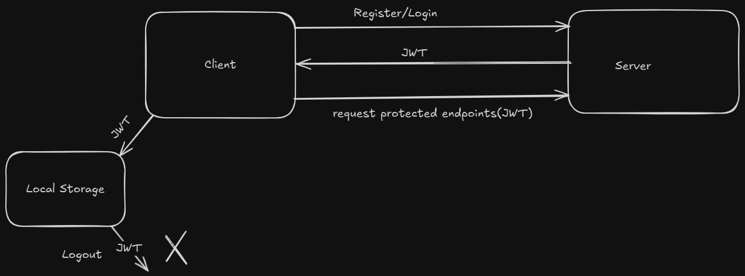
AUTHENTICATION & AUTHORIZATION

Slide 3
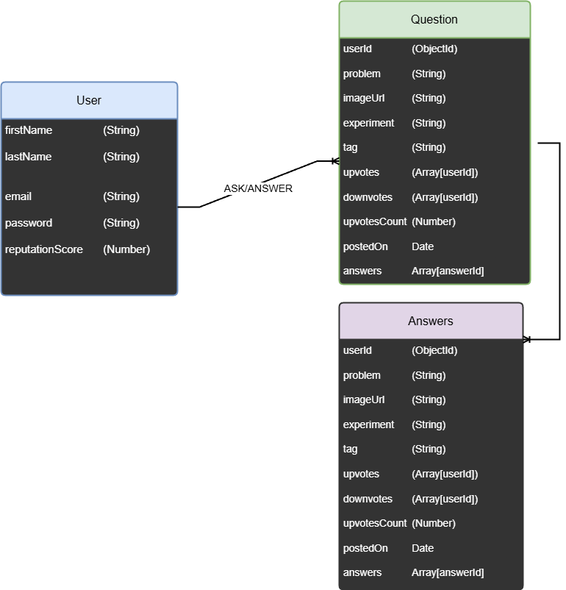
LOGICAL MODEL

Slide 4
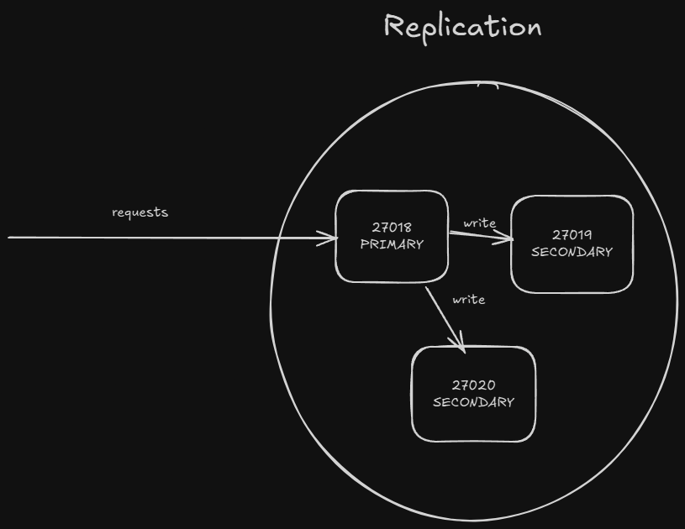
REPLICATION

Slide 5
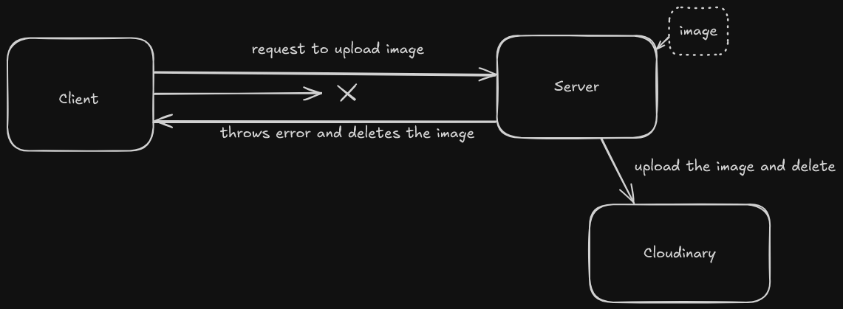
Cloudinary

Slide 6
THANK YOU

