Slide 1
Neural Spike Sorter Project
Sameed Siddiqui

Slide 2
Introduction
Many possible algorithms to use in each sub-section of spike-sorting problem
Open-source programs allow user to chose different algorithms and different methods for most steps of spike-sorting – so does this program.
7 steps in process that was coded by me: filter, spike detection, spike alignment, feature extraction, clustering, classification, analysis
Input file code was mainly supplied by you.

Slide 3
Filter
High-pass filter implemented using filtfilt
After experimentation, learned that different signals provided by you require different cut-off frequencies, ranging between 50Hz – 300Hz.
Solution: give the user two options:
Input manual cutoff frequency
“Smart-filter” (default) – user tells program where in data is “pure” noise and where there is high signal. Program then sets the cutoff frequency based on comparison between FFT of noise and of signal.

Slide 4
Spike Detection + Alignment
Spike detection and alignment go hand-in-hand
As before, I give the user two options on how to handle this:
Detect spikes and align based on energy content – e.g. the code determines which contiguous regions of spikes are above the threshold value. The “center” of the spike (e.g. the point with respect to which alignment is done) is the center of this contiguous above-threshold region. Thus, this center index of the spike should correspond roughly to the energy center of the spike

Slide 5
Spike Detection + Alignment (cont.)
Findpeaks method (default): simpler, it uses matlab’s findpeaks function to find the peaks of the spikes. Additionally, findpeaks ensures that peaks have some sort of reasonable distance between them so that the same spike cannot get counted twice.
User inputs:
Threshold.
Window size for spikes – set for 8 for channel 1 of EMG_example_2_fs_2k

Slide 6
Spike extraction
I use simple PCA to do this. After experimentation, I settled on choosing the first 4 principle components.
Visualization of PCA efficacy is done by plotting the cumulative variance in the first n PCA components
PCA-compressed signals are also plotted using scatter3. The fourth dimension is visualized by assigning a color-spectrum to the scatter3 points.

Slide 7
Clustering
Done using kmeans. Two options for user:
Supervised – user enters the amount of clusters
Semi-unsupervised (default) – k-means is done repeatedly to reach the largest number of clusters possible such that each cluster consists of at least some minimum percentage of total spikes. Currently, this percentage is set at 7.75%. Semi-unsupervised because the user can change this minimum percentage as desired.
Output: Same as PCA output, except different clusters are indicated using different markers in the scatter plot

Slide 8
Classification
Counts how many spikes fell into each of the clusters
Creates and graphs signal templates, one for every cluster, based on the median signal of the signals in that cluster.
Plots all of the neural signals on the same graph, color coding the signals with respect to cluster
Plots all of the neural signals of a particular cluster on the same graph.

Slide 9
Analysis
Creates a bar graph indicating how many spikes per cluster
Replots the original data series, with each detected spike labeled with which cluster it belongs to.
Replots the original data series multiple times, with only the spikes of one particular cluster labeled each time.
Subdivides the signal’s time-axis by some number of bins (100 by default), and then creates a graph which shows how many of which neurons were activated during each time period of the signal.
Input: number_of_bins lets the user control how many segments to divide the time-axis by.

Slide 10
Results
Results will be given for:
Channel 1 of EMG_example_2_fs_2k
For this, we will provide results from both default and alternate approaches to the various steps where applicable. For the other two signals, we’ll only give the best settings’ results.
Channel 1 of EMG_example_1_90s_fs_2k
Channel 1 of EMG_example_3_fs_10k

Slide 11
Channel 1, Example 2 Results

Slide 12
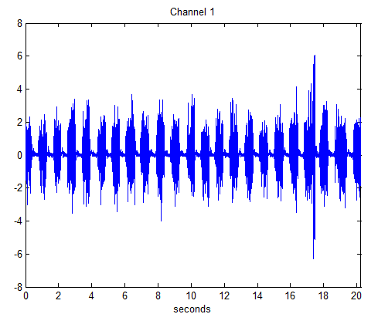
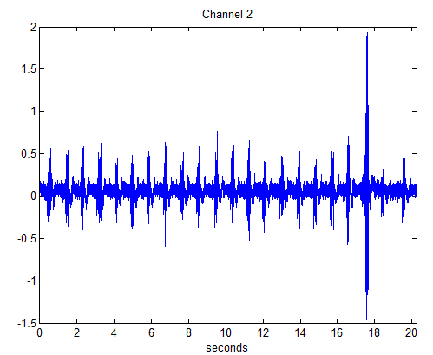
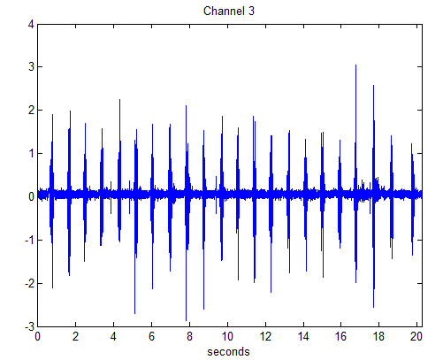
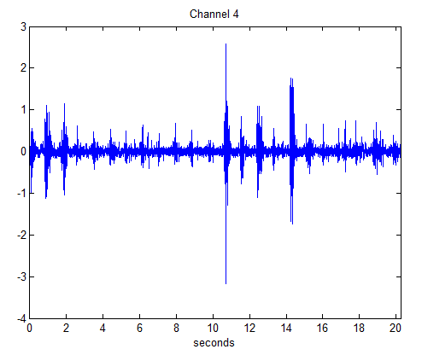
Input section

Slide 13
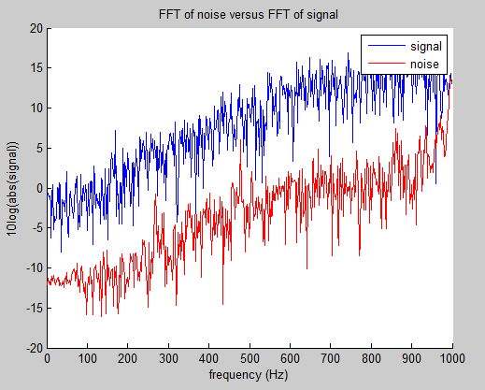
Filtering (smart-filtering option)

Slide 14
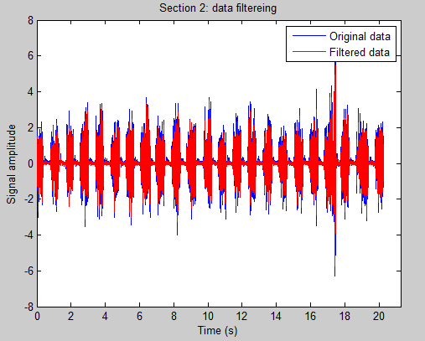
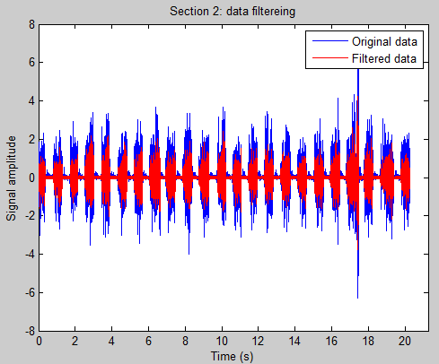
Ch1 Ex2, Filtering cont.
Smart-filtering feature
Regular, manual-cut-off frequency
at cutoff = 200Hz

Slide 15
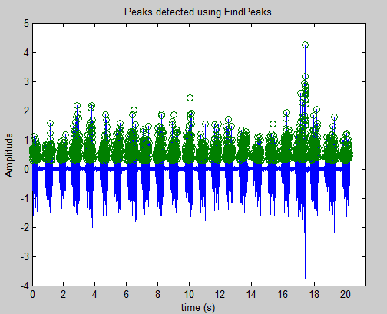
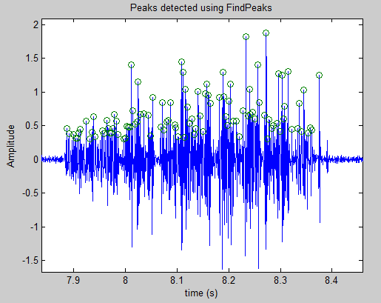
Spike Detection – findpeaks (default)
Full-scale
Zoomed-in

Slide 16
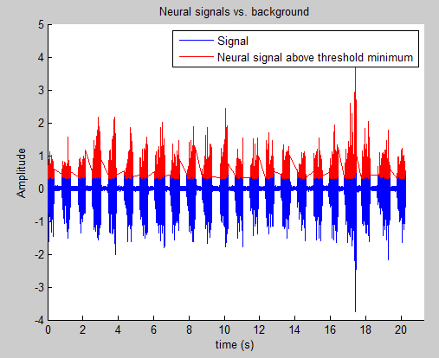
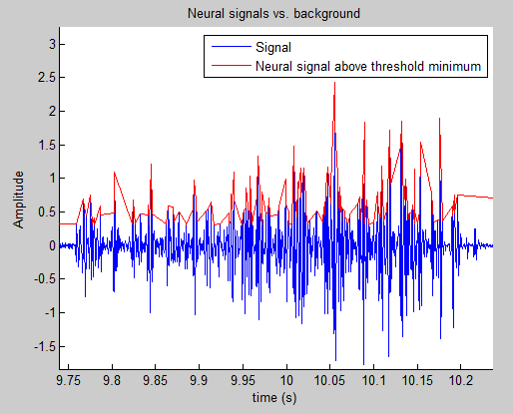
Spike detection – threshold method
Full-scale
Zoomed-in

Slide 17
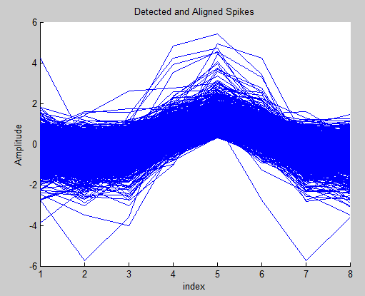
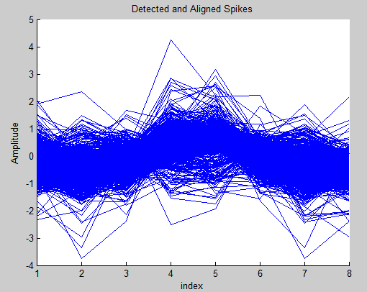
Spike Alignment/Creation
After experimentation, a bin size of 8 was seen as good for this signal:
Find-peaks method (default)
Threshold method (not default)

Slide 18
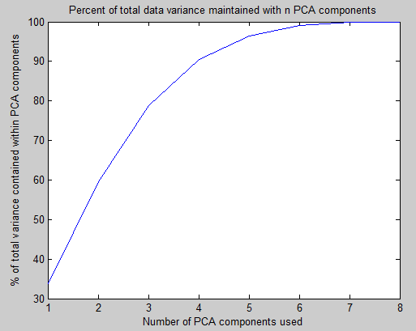
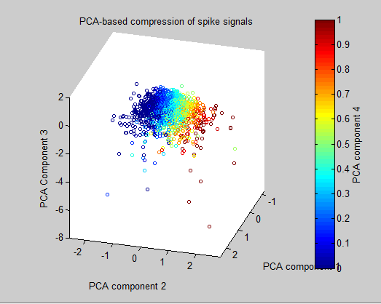
Feature Extraction
PCA Used, output:

Slide 19
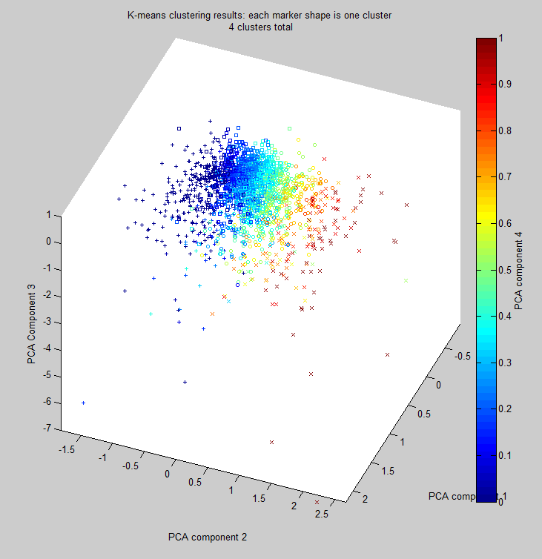
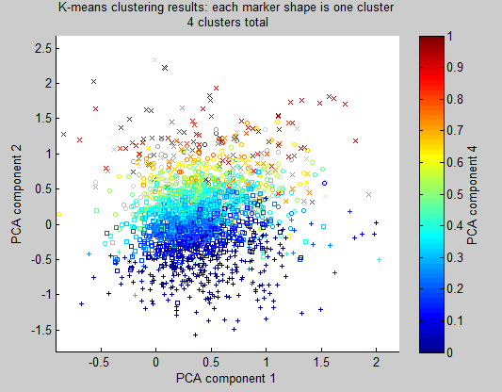
Clustering

Slide 20
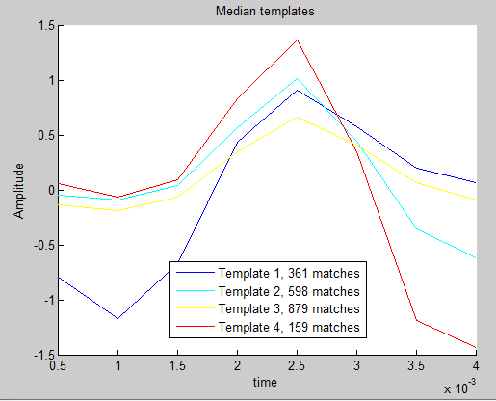
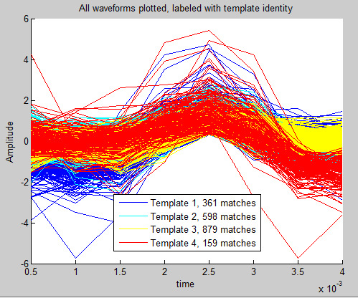
Classification

Slide 21
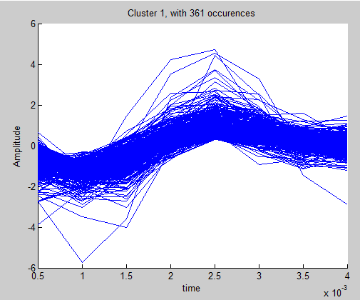
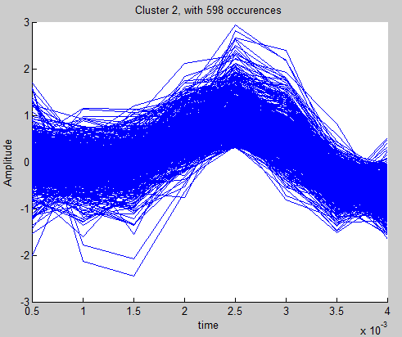
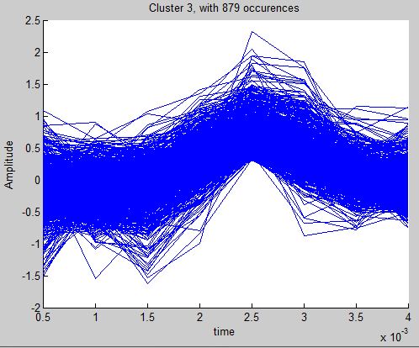
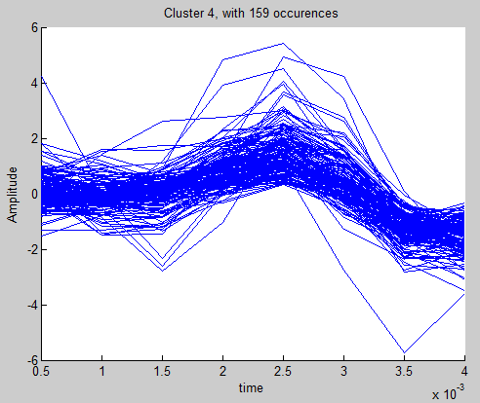
Classification (cont.)

Slide 22
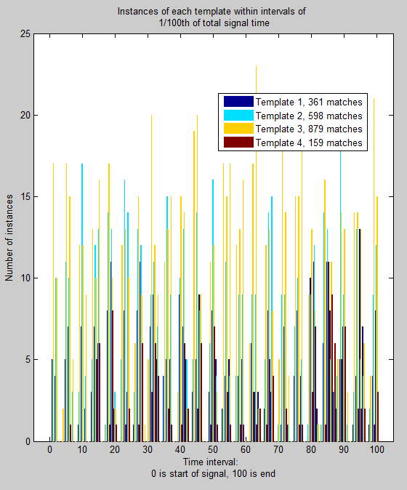
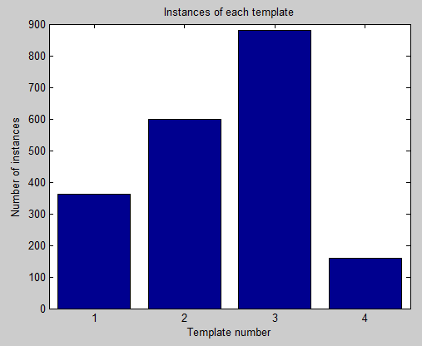
Analysis

Slide 23
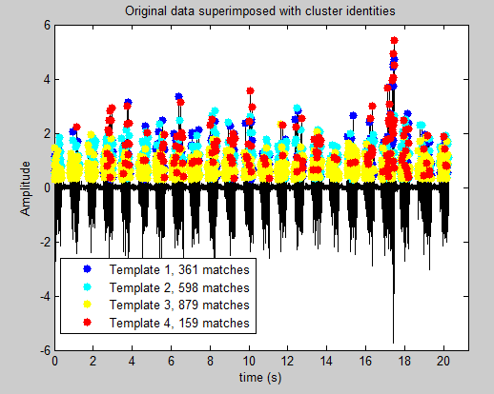
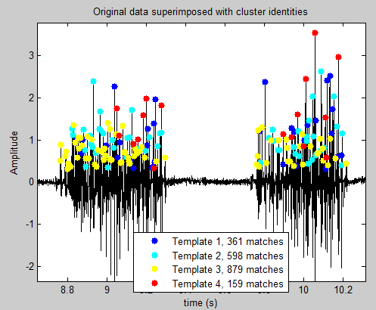
Analysis (cont)
Full-scale
Zoomed-in

Slide 24
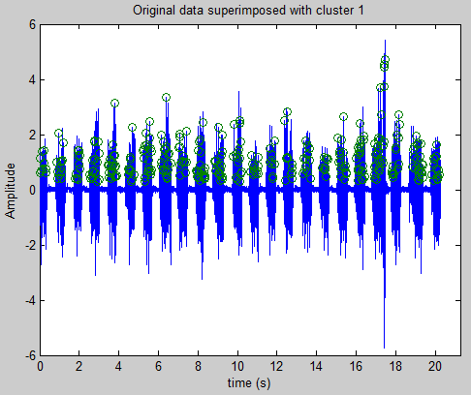
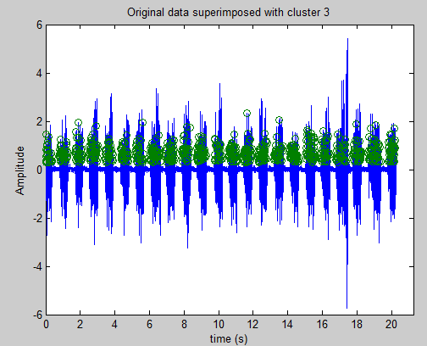
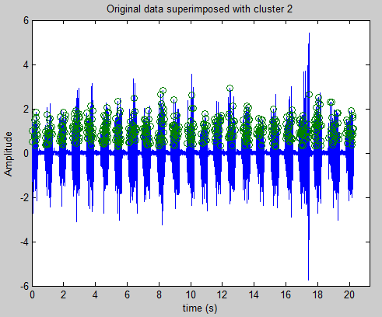
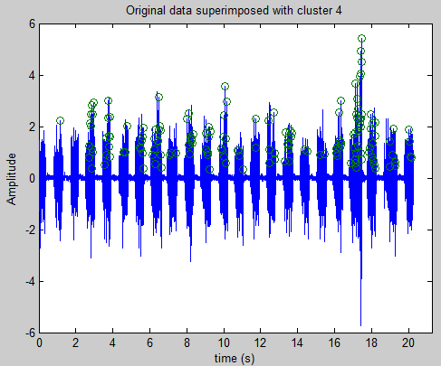
Analysis (cont).

Slide 25
Channel 2, Example 1 Results

Slide 26
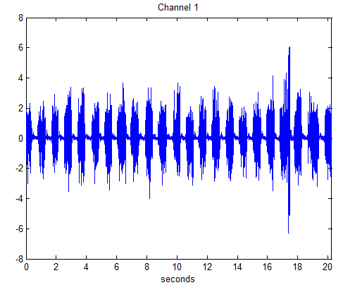
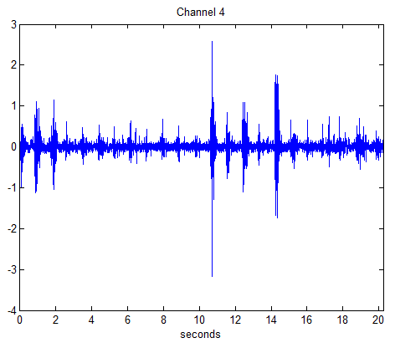
Input section – channel 2 chosen

Slide 27
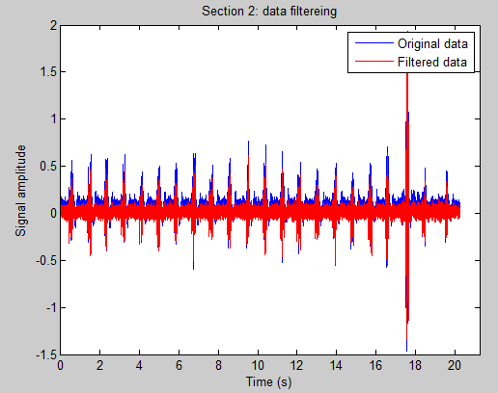
Filtering
For this system, because there was so much low-frequency noise, our smart-filter did not give us optimal results: a manual cutoff frequency of 50Hz was best

Slide 28
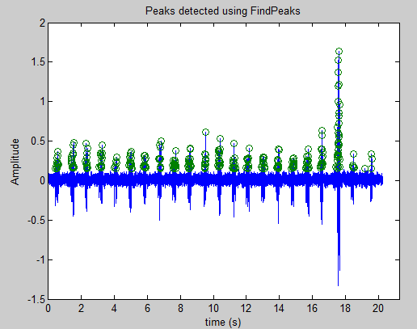
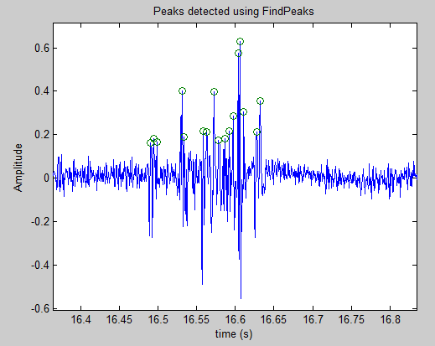
Spike Detection – findpeaks
Full-scale
Zoomed-in

Slide 29
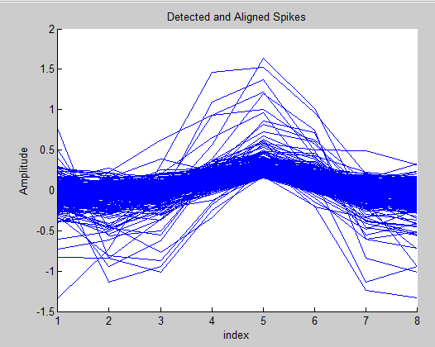
Spike Alignment/Creation
After experimentation, a bin size of 8 was seen as good for this signal:
Find-peaks method (default)

Slide 30
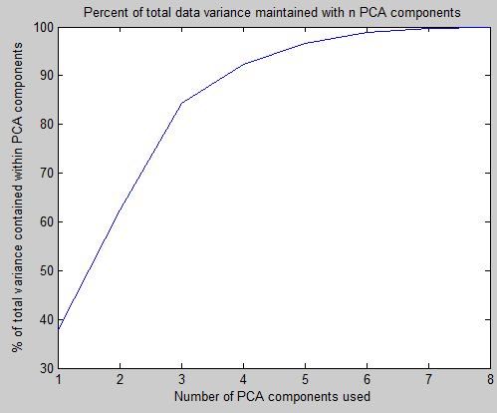
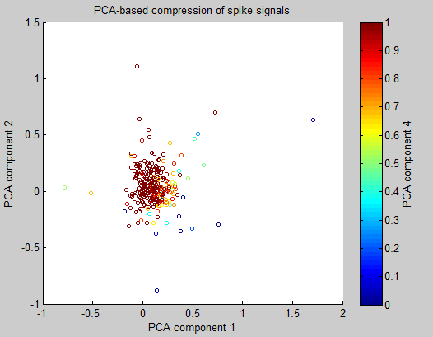
Feature Extraction
PCA Used, output:

Slide 31
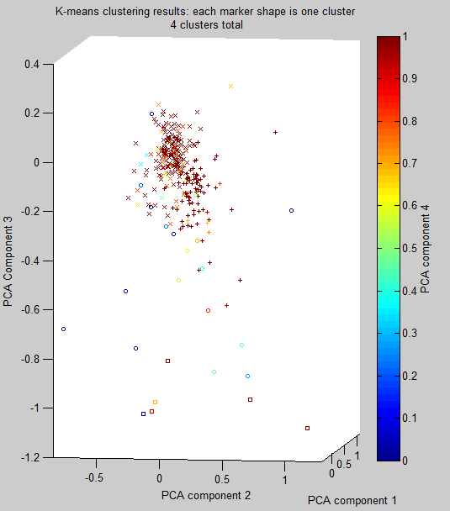
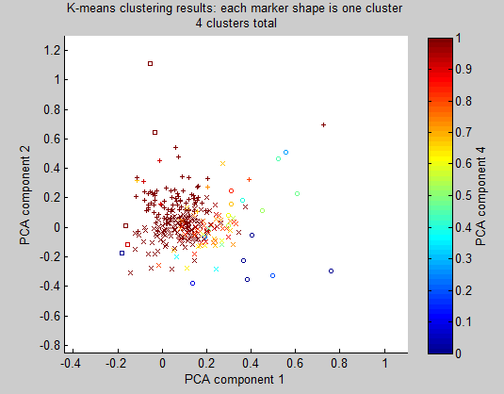
Clustering

Slide 32
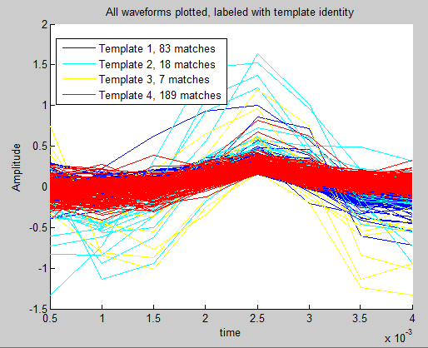
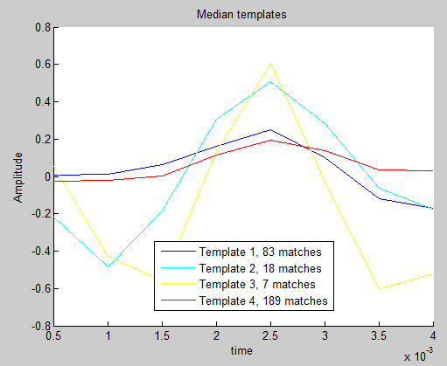
Classification

Slide 33
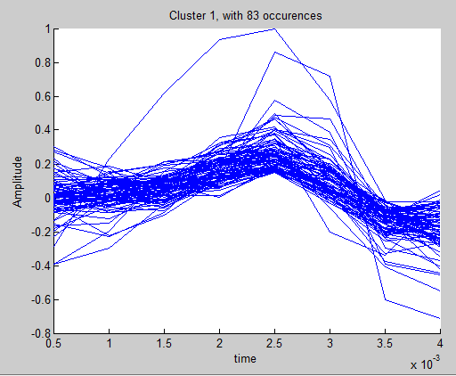
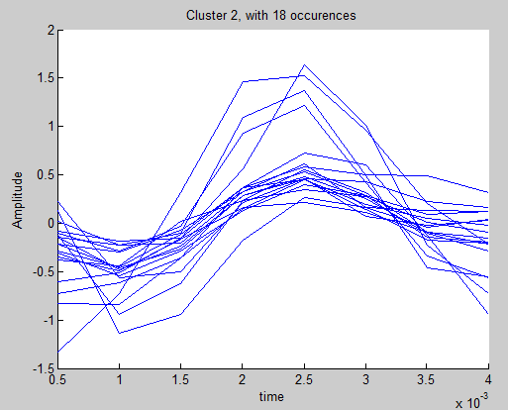
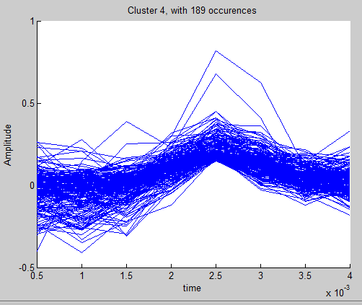
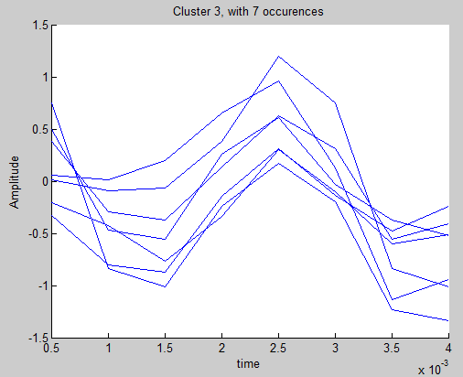
Classification (cont.)

Slide 34
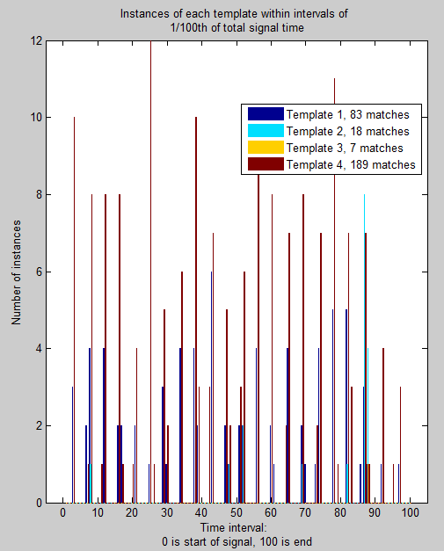
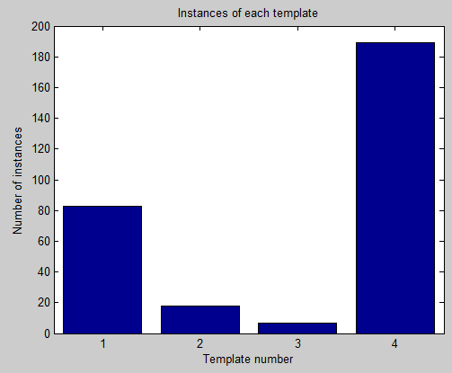
Analysis

Slide 35
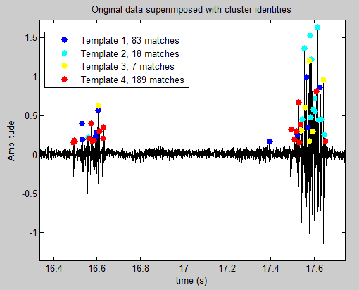

Analysis (cont)
Full-scale
Zoomed-in

Slide 36




Analysis (cont).

Slide 37
Channel 3, Example 3 Results

Slide 38




Input section – channel 3 chosen

Slide 39


Filtering
We used smart filtering here. It worked well.

Slide 40


Spike Detection – findpeaks
Full-scale
Zoomed-in

Slide 41

Spike Alignment/Creation
After experimentation, a bin size of 30 was seen as acceptable for this signal:
Find-peaks method (default)

Slide 42


Feature Extraction
PCA Used, output:

Slide 43

Clustering

Slide 44


Classification

Slide 45




Classification (cont.)

Slide 46


Analysis

Slide 47


Analysis (cont)
Full-scale
Zoomed-in

Slide 48




Analysis (cont).

Slide 49
Discussion

Slide 50
Input Section
This section is very straightforward. The only thing is that for EMG example 1, we had to enter the sampling time ourselves and create the time axis:
sampling_rate = 2000;
time= 0:1/sampling_rate:1/sampling_rate*length(M(:,1))- 1/sampling_rate;

Slide 51
Filter
As mentioned, we had two filter options: manual and smart.
Smart filter proved useful for the first and third trials – showed us the FFT and quickly generated a good filter. In future versions of this code, this smart filter could be smarter by being piecewise instead of simple highpass.
In the second trial, our signal was dominated by low-frequency noise, so our smart-filter did not give us optimal results, because it cut away too much of our real signal: a manual cutoff frequency of 50Hz was best
Results of the second trial show the importance of having a readily available FFT when analyzing signals for filtering: because our program automatically did this, we were quickly able to determine a manual frequency.

Slide 52
Spike detection + Aligning
Two methods available for the combined process of detecting and aligning in our program: energy-based, peak-based.
Energy-centering appears to be messier, gives somewhat worse results (slide 17).
However, in the first trial, the threshold method gave me 2234 spikes while the findpeaks gave 2107 peaks. About 5% difference, which is very small. This shows that both methods are self-consistent, which further validates the methods’ reliability.
Possible future improvement for detection: somehow automatically generate the threshold? Perhaps this can be done by making the threshold level 3 std deviations or so above noise level?
Others have used Wavelets to do aligning and spike detection. I tried (and ran out of time) implementing this; it’s worth future investigation!

Slide 53
Extract Features
Simple PCA was used. Interesting to note that the total variance contained within the first 4 components was approximately the same when we had a window size of 8 as when we had a window size of 30.
Our PCA worked as expected. Visualization using 4 dimensions was particularly interesting and helped us visually recognize potential clusters very easily.

Slide 54
Clustering
We had two clustering options: supervised (e.g. entering number of clusters) and semi-supervised (allowing the program to determine the number of clusters using another parameter). The semi-supervised method essentially allows you to quickly come up with an estimate on how many clusters there may really be in the system. It’s very useful because you don’t have to worry about visually detecting the number of clusters – all you need to do is determine the definition of a cluster (e.g. minimum of 7% representation).
It can be seen that in our program, the clusters k-means detects indeed correspond to visually-discernable clusters in the PCA-compression. For example, in the first trial, in PCA component 4 it’s evident that the gradient of colors corresponds to a gradient in clusters. Similarly can be seen in PCA-component 2! This is also very evident in the third trial.
The second trial had surprisingly good result. The two large clusters weren’t discernable by me by eye, and I was shocked that the large spikes were actually picked up as separate clusters. Our program detected 4 clusters (based on unsupervised) – however, it’s quite possible that there really should have only been three – the two large clusters of ~160 samples each and then a combined cluster from the ~15 samples each set which correspond to the large-neural spikes. That being said, I think this performance was very impressive.

Slide 55
Classification
Looking at the results of this section, it is evident that the program is robust and is able to handle a variety of different waveforms. In particular, we can note a vast different in the waveform of trial 2 (very sharp) with that of trial 3 (smoother).
The only likely false-positive in our system would be trial 3: it is likely that in reality templates 2 and 3 may have come from the same neuron. Other than this, it seems that our resulting template neural signals are sufficiently differentiated from each other that we can conclude that they represent real, distinct neurons. Thus it is likely that our three trials had 4, 3, and 4 distinct neurons making the signals.

Slide 56
Analysis
It is clear that one neuron generally tends to dominate our signal.
In the three signals we’ve analyzed, it seems that most of the neurons in each respective signal were consistently on – the only major exception being in trial 2, clusters 2 and 3 seemed to have been activated towards the end of that neural spike, perhaps indicating some muscle activity.

Slide 57
Conclusion
Overall, I think that this project was a success. I was able to implement many techniques together to differentiate and find neural signals that I was not able to find by eye. In particular, I believe that my “smart-filtering” technique was a good innovation – I think I might end up using that trick in the future when I need to analyze a lot of data with varying noise. Similarly, the semi-supervised version of k-means is also interesting, as it helps guide the process of determining the number of clusters by adding an additional quantitative factor that helps define a cluster.
While I am ecstatic about the success of the trials I’ve conducted, future innovations can still be made in this project. In particular, I spent a lot of time researching wavelets but was unable to implement wavelets for either spike detection or for feature extraction. This is definitely a topic that deserves future investigation.
All in all, this was a very fun project, and I learned a lot about signal processing.

