Slide 1

FINAL YEAR PROJECT · FINAL EVALUATION
An AI-Assisted Mental Health
Support Platform
Compassionate, always-available support that bridges the gap between therapy sessions.
PROJECT GROUP · F25CS186
Sameed Saeed L1F22BSCS0956
Hassan Hayat L1F22BSCS0976
Faziyab Ahmad L1F22BSCS1111
Supervisor Mam Misha Asif

Slide 2

INTRODUCTION
The Problem We Are Solving
Mental health care is hard to access — and even harder to sustain between sessions.
Therapy is expensive and infrequent. Patients are left without support during the days and weeks between appointments.
Early warning signs are missed. Therapists lack visibility into a patient’s mood and crisis moments outside the clinic.
Self-help is fragmented. Resources, mood logs, scheduling and records live in disconnected tools.
73%
1 in 4
24/7
of people cite cost & access as barriers to care
adults experience a mental-health condition
support gap between scheduled sessions

Slide 3





PROJECT SCOPE
Objectives & Goals
Always-on AI companion
Give patients an empathetic, private space to talk and reflect between therapy sessions.
Safety first
Detect crisis and self-harm language and guide users toward professional help immediately.
Track mood & progress
Let patients log moods and goals, and give therapists clear insight into their journey.
Connect to real care
Verified therapists, appointment booking, secure chat and video — all in one platform.
Private & secure
Protect sensitive records with JWT auth, two-factor login and access-controlled data.

Slide 4



PROPOSED SOLUTION
Meet Benzi — One Connected Platform
Patient App
Therapist Portal
Admin Dashboard
AI companion, mood tracking, appointments, secure chat, self-help resources & goals.
Verification, client management, availability, reports and crisis alerts.
Therapist approval, subscriptions, coupons, revenue and platform oversight.
Powered by the Benzi AI Engine
A locally-hosted, fine-tuned empathetic language model running on Ollama — paired with a crisis-detection safety layer and retrieval over the patient’s own records. Private by design: the model runs on our own infrastructure.

Slide 5
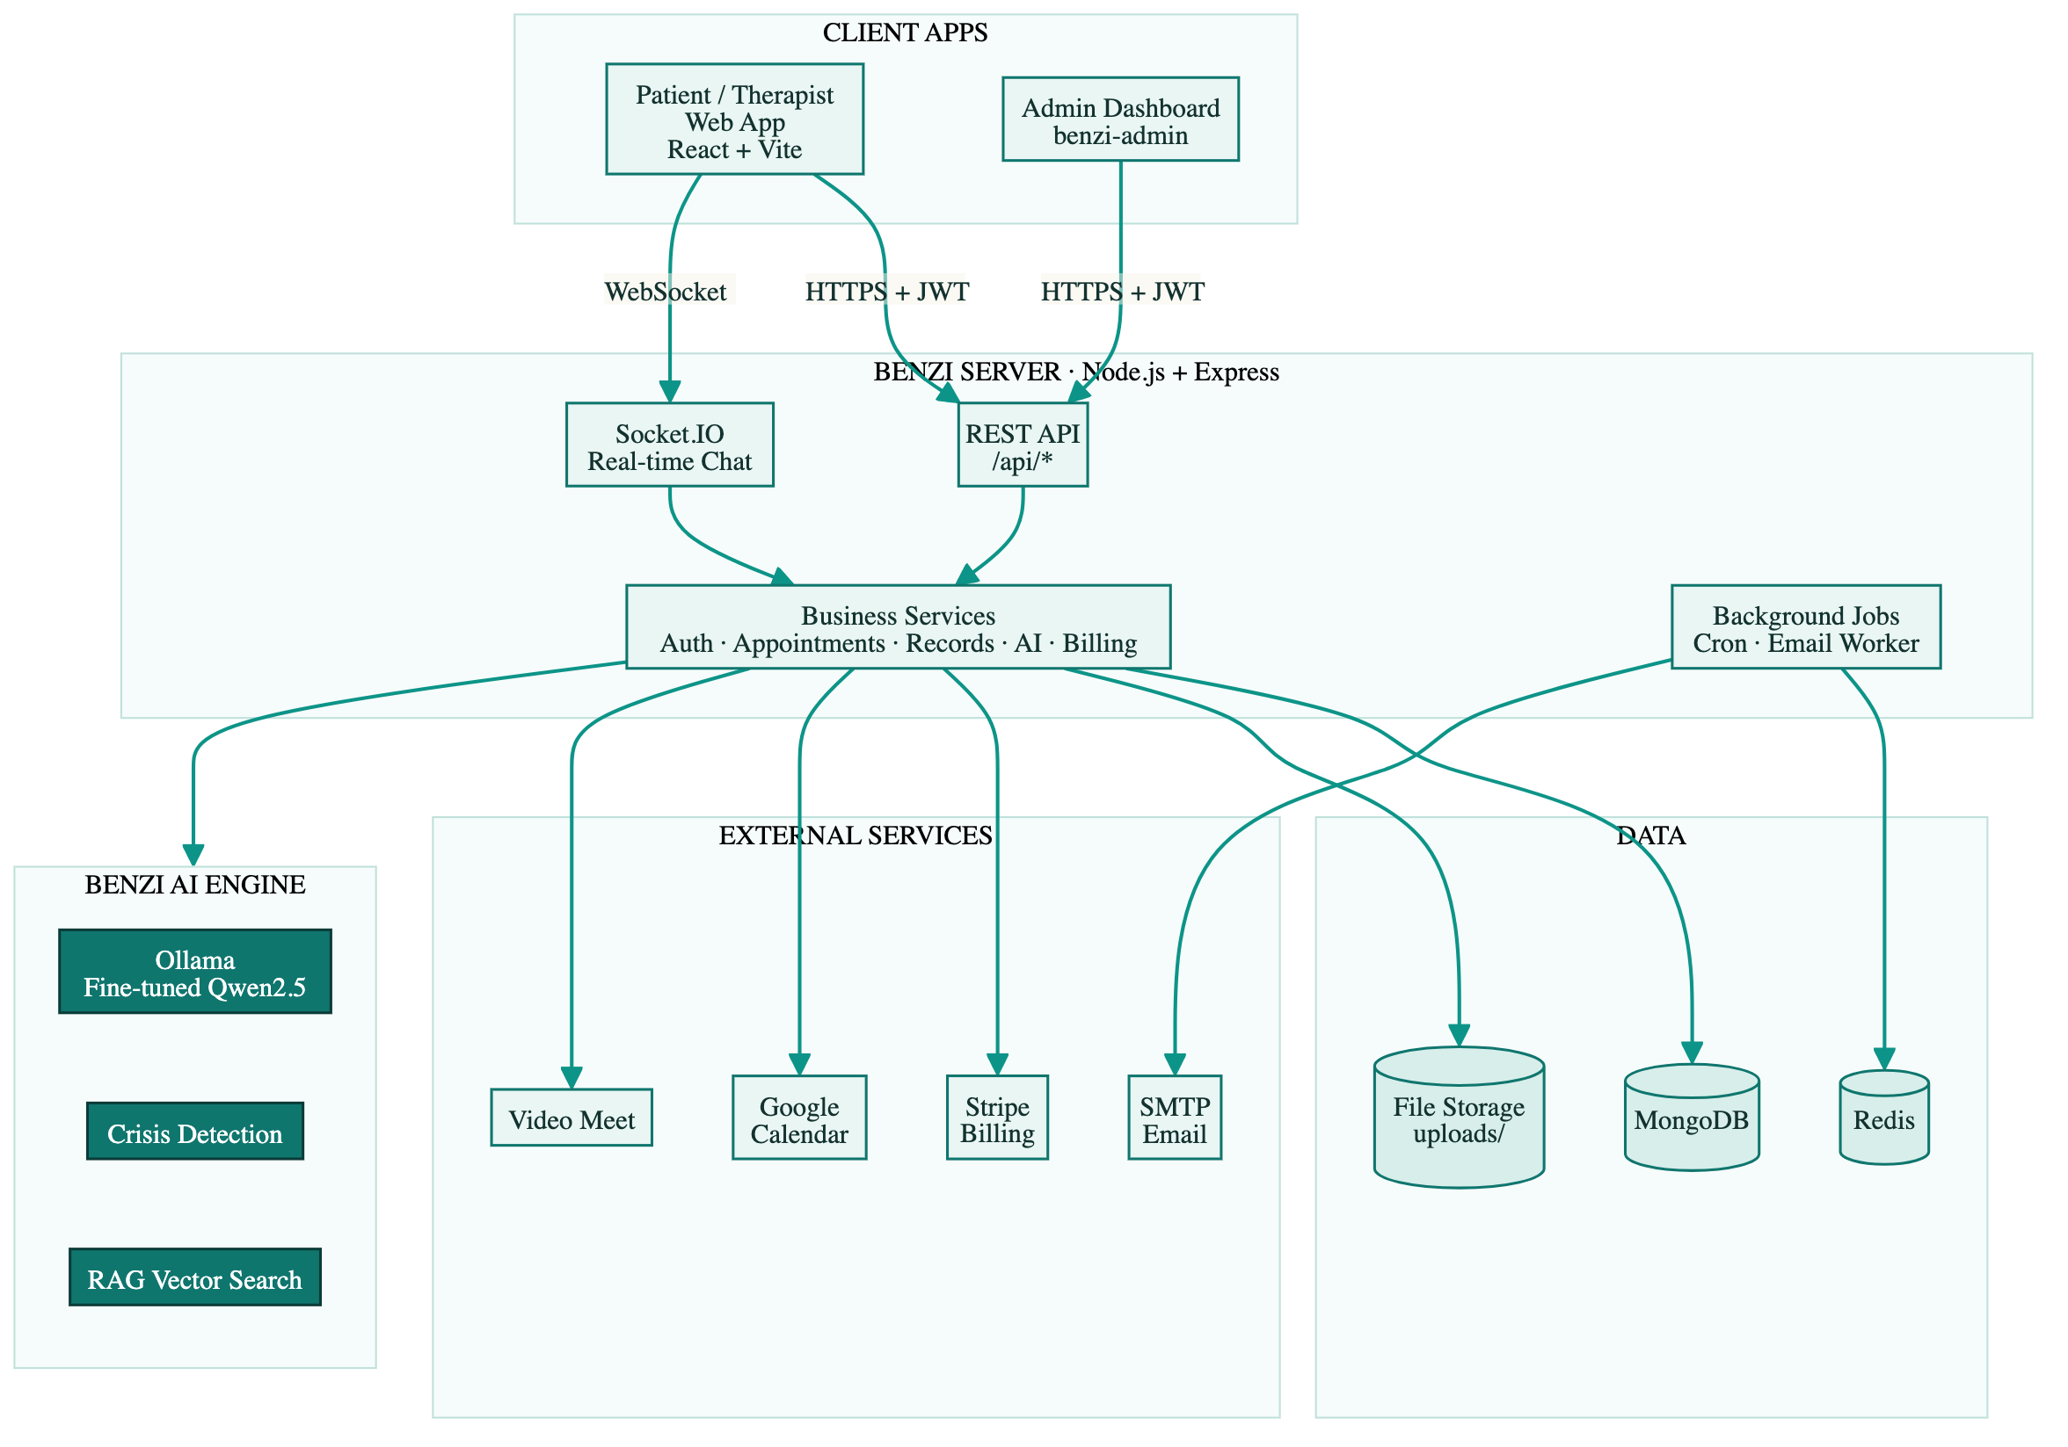
SYSTEM DESIGN
System Architecture
A modular client–server architecture: React web apps talk to a Node.js / Express REST API and a Socket.IO real-time layer, backed by MongoDB and a Redis-powered job queue, with the Benzi AI engine served locally via Ollama.

Slide 6



THE DIFFERENTIATOR
The Benzi AI Engine
Empathetic companion
Fine-tuned
Empathetic Model
Acknowledges feelings, reflects, and asks one gentle question — concise and supportive, never a diagnosis.
Base model
Qwen2.5 Instruct
Method
QLoRA fine-tuning (PEFT)
Served with
Ollama — runs locally
Training data
1,000 curated examples
Crisis-detection safety layer
Flags self-harm and crisis language and steers users to their therapist or emergency help.
Retrieval (RAG) over records
Grounds replies in the patient’s own notes and documents using vector embeddings.
Sentiment & mood analysis
Reads emotional tone to log mood trends and surface insights for therapists.

Slide 7




KEY FEATURES
For Patients
Benzi AI Companion
Mood Tracking
Appointments
Private, always-available empathetic chat with voice input support.
Daily mood logs that build a visual picture of emotional wellbeing.
Browse verified therapists and book, reschedule or cancel sessions.
Secure Chat & Video
Self-Help Resources
Goals & Progress
Real-time messaging and anonymous video meets with your therapist.
Curated meditations, exercises and guidance for between sessions.
Set wellness goals and track achievements and progress over time.

Slide 8




KEY FEATURES
For Therapists & Admins
Therapist Verification
Client Management
Availability & Scheduling
Document upload and admin approval before therapists go live.
Per-patient panels with history, notes and AI-generated context briefs.
Set working hours, services and pricing; sync with appointments.
Crisis Alerts
Subscriptions & Billing
Revenue & Analytics
Instant email alerts when a patient shows crisis signals in chat.
Stripe-powered plans, coupons and usage limits for therapists.
Admin dashboards for revenue, subscriptions and platform health.

Slide 9
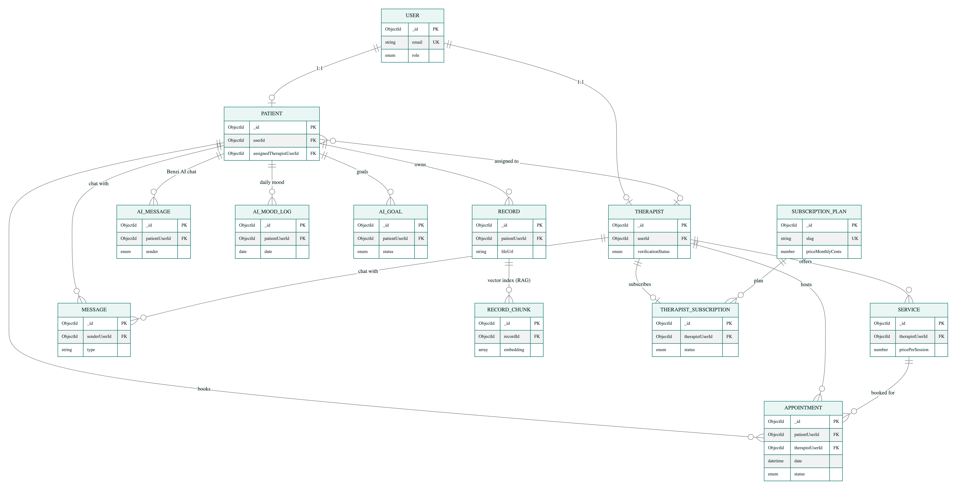
SYSTEM DESIGN
Entity Relationship Diagram
Core entities — User · Patient · Therapist · Appointment · Service · Message · Record · AI data · Subscriptions

Slide 10
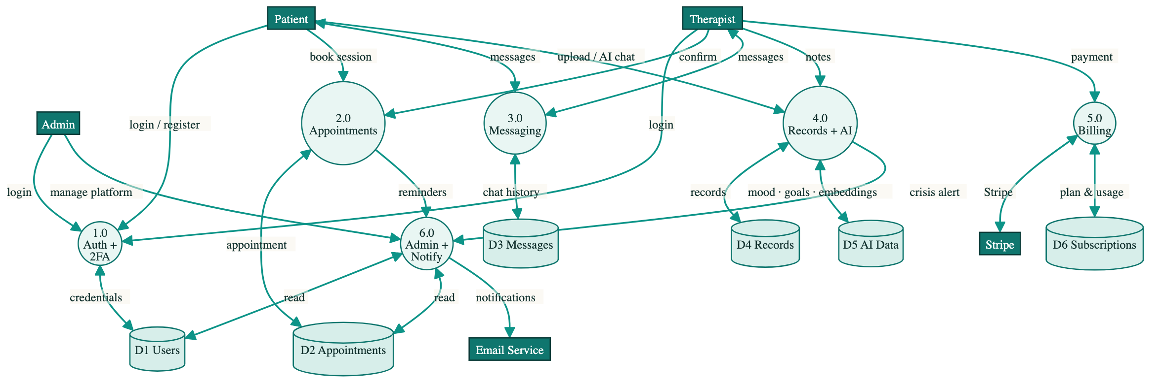
SYSTEM DESIGN
Data Flow Diagram — Level 1
External entities, six core processes and data stores — auth, appointments, messaging, records & AI, billing, admin

Slide 11




IMPLEMENTATION
Technology Stack
Frontend
Backend
AI / ML
Integrations
React + Vite
Tailwind CSS
Socket.IO client
React Router
Node.js + Express
MongoDB + Mongoose
Redis + BullMQ
Socket.IO
Python · PyTorch
Qwen2.5 + QLoRA
Ollama (local)
RAG embeddings
Stripe billing
JWT + 2FA auth
Nodemailer email
Google Calendar

Slide 12
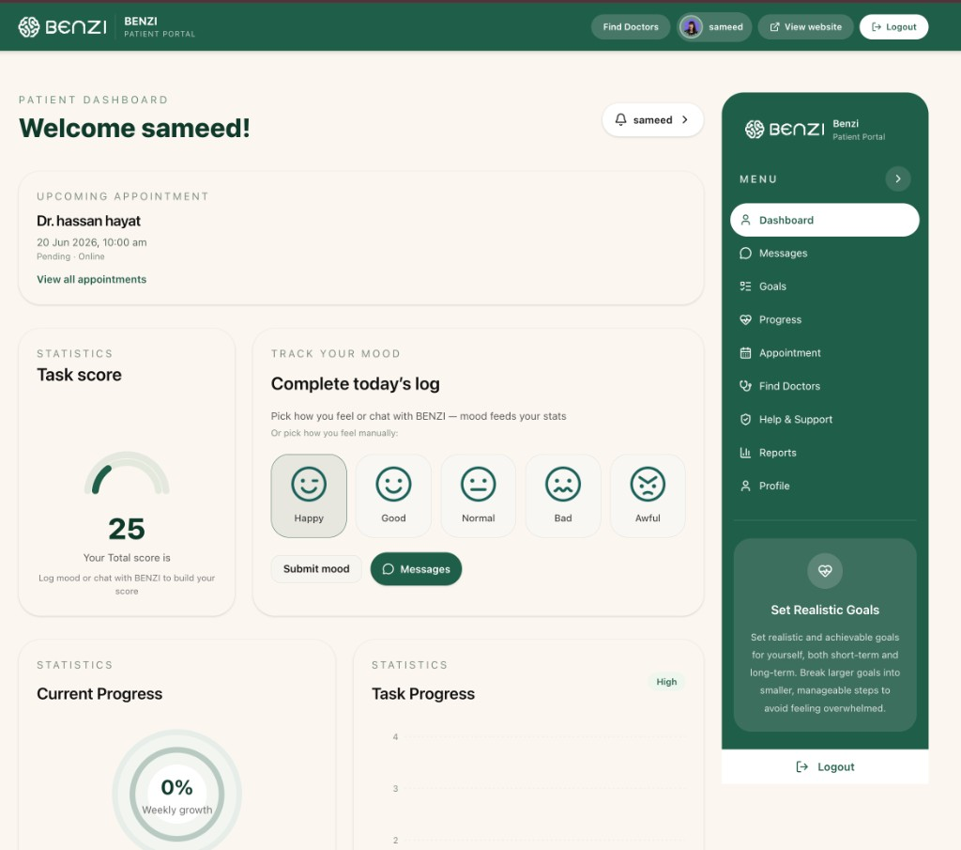
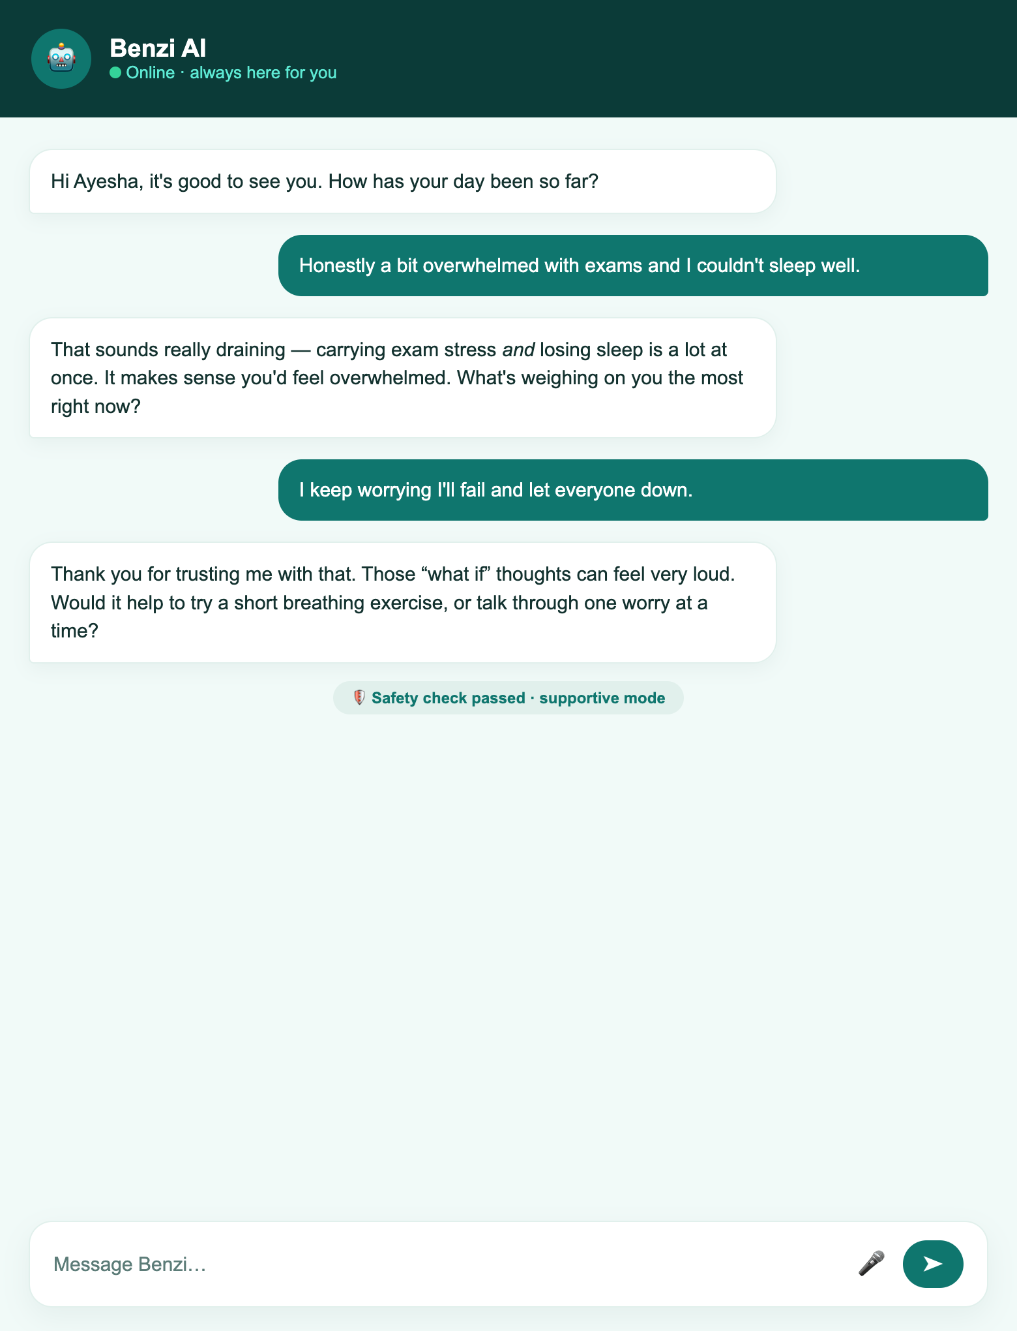
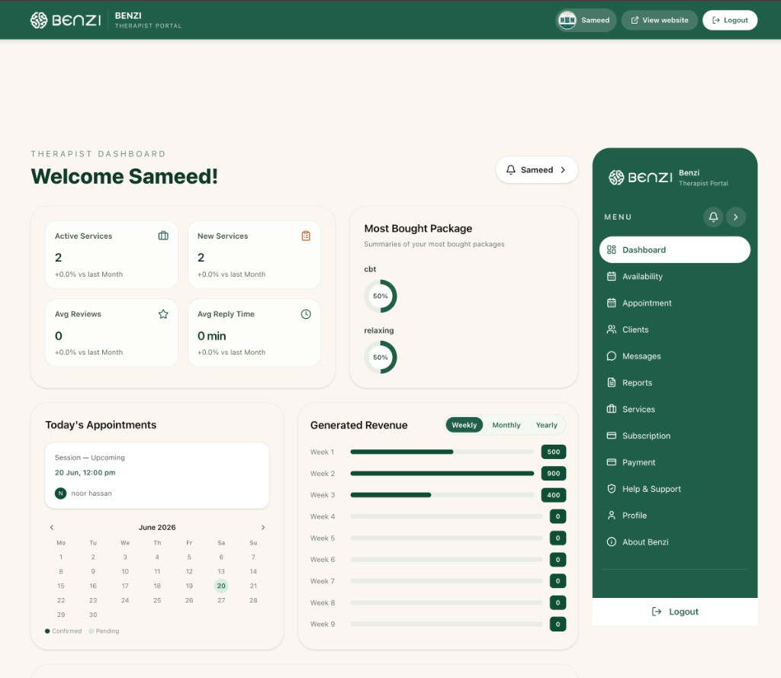
DEMONSTRATION
Application Screenshots
Patient Dashboard
Benzi AI Chat
Therapist Dashboard

Slide 13

WRAPPING UP
Conclusion & Future Work
What we delivered
Where we go next
A full-stack platform with patient, therapist and admin apps
A locally-hosted, fine-tuned empathetic AI companion on Ollama
A crisis-detection safety layer with real-time therapist alerts
Mood tracking, appointments, secure chat, video & subscriptions
Secure auth with JWT and two-factor login
Mobile apps for iOS and Android
Larger fine-tuning dataset & multilingual support
Voice-first conversations with the AI companion
Wearable & sleep data for richer mood insights
Clinical validation studies with partner therapists

Slide 14
Thank You
Questions & Discussion
Group F25CS186 · Supervisor: Mam Misha Asif
Sameed Saeed · Hassan Hayat · Faziyab Ahmad

