Slide 1
Concept Learning

Slide 2
Concept Learning
Concept
Concept learning
Example of the concept learning task
Concept learning search

Slide 3
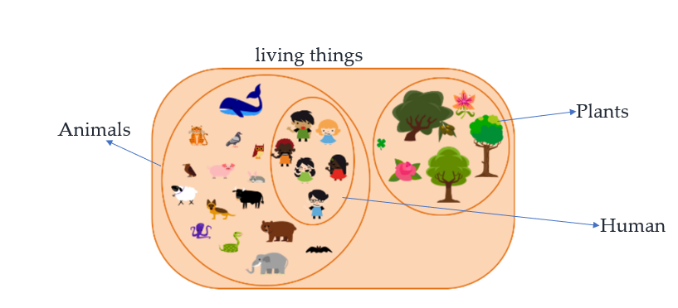
Concept
A concept is a subset of objects or events defined over a large set.
For example, we refer to the set of everything (ie.,all objects) as a set of things.
Plants are a subset of living things.
Animals are a subset of living things.
Human beings are a subset of animals.

Slide 4
Concept
A formal definition of the concept is a Boolean valued function defined over this large set.
For example, a function defined over all animals whose value is true for birds and false for every other animal.
Animals
Living things
Birds

Slide 5
Concept Learning
Given a set of examples labelled as a member or non-members of a concept, Concept learning consists of automatically inferring the general definition of this concept.
In technically, Concept learning consists of approximating a Boolean valued function from training examples of its inputs and outputs.
Concepts in Machine Learning can be thought of as a boolean-valued function defined over a large set of training data.

Slide 6
Example of a concept learning Task
Taking a very simple example, one possible target concept may be to Find the day when my friend enjoys his favorite sport.
Concept: Good days for sport (Values: Yes, No)
Attributes/Features :
Sky (Values: Sunny, Cloudy, Rainy)
Air Temperature (Values: Warm, Cold)
Humidity (Values: Normal, High)
Wind (Values: Strong, Weak)
Water (Values: Warm, Cold)
Forecast (Values: Same, Change)

Slide 7
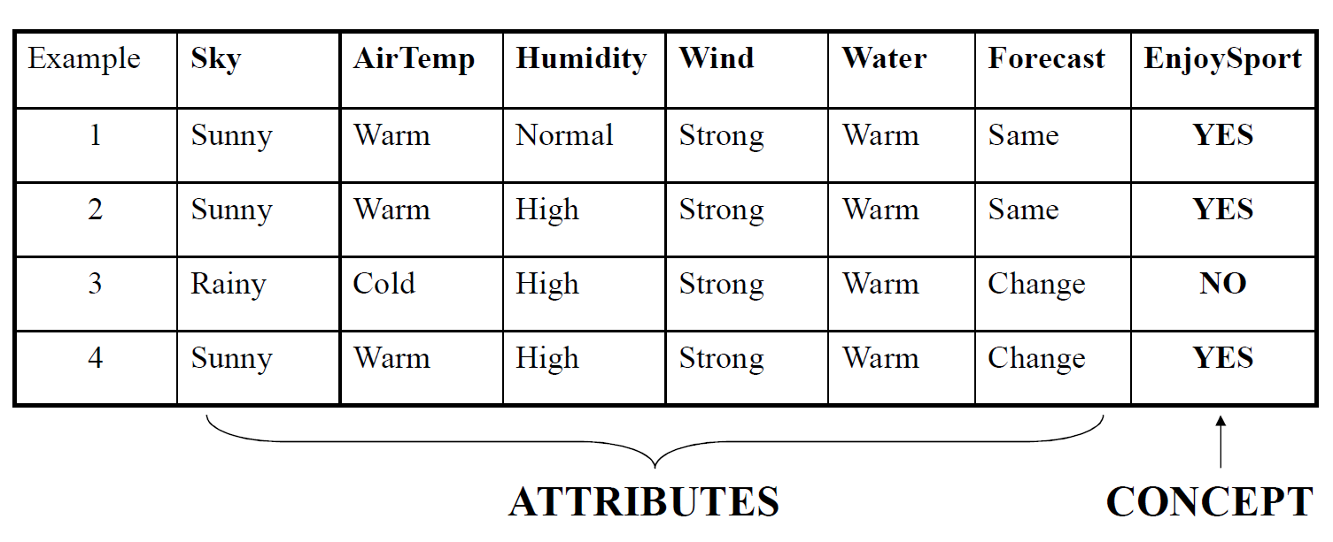
Training examples
A set of example days and each is described by six attributes.

Slide 8
Enjoy Sport – Hypothesis Representation
Let’s Design the problem formally with TPE(Task, Performance, Experience):
Problem: Leaning the day when my friend enjoys the sport.
Task T: Learn to predict the value of EnjoySport for an arbitrary day, based on the values of the attributes of the day.
Performance measure P: Total percent of days (EnjoySport) correctly predicted.
Training experience E: A set of days with given labels (EnjoySport: Yes/No)

Slide 9
EnjoySport – Hypothesis Representation
Each hypothesis consists of a conjunction of constraints on the instance attributes.
Each hypothesis(h) will be a vector of six constraints, specifying the values of the six attributes– (Sky, AirTemp, Humidity, Wind, Water, and Forecast).
h_{i}(x) := <x1, x2, x3, x4, x5, x6>
where x1, x2, x3, x4, x5, and x6 are the values of Sky, AirTemp, Humidity, Wind, Water, and Forecast.

Slide 10
EnjoySport – Hypothesis Representation
Each attribute will be:
? - indicating any value is acceptable for the attribute (don’t care or generic hypothesis )
0 - indicating no value is acceptable for the attribute (no value)
single value – specifying a single required value (ex. Warm) (specific)
For an example of a hypothesis,<?, cold, High,?,?,?>
If the air temperature is cold and the humidity high then it’s a good day for sports.

Slide 11
Hypothesis Representation
A hypothesis:
Sky AirTemp Humidity Wind Water Forecast
< Sunny, ? , ? , Strong , ? , Same >
The most general hypothesis – that every day is a positive example <?, ?, ?, ?, ?, ?>
The most specific hypothesis – is that no day is a positive example <0, 0, 0, 0, 0, 0>
EnjoySport concept learning task requires learning the sets of days for which EnjoySport=yes, describing this set by a conjunction of constraints over the instance attributes.

Slide 12
EnjoySport Concept Learning Task
Given
– Instances X : a set of all possible days, each described by the attributes
Sky – (values: Sunny, Cloudy, Rainy)
AirTemp – (values: Warm, Cold)
Humidity – (values: Normal, High)
Wind – (values: Strong, Weak)
Water – (values: Warm, Cold)
Forecast – (values: Same, Change)
– Target Concept (Function) c : EnjoySport : X→ {0,1}
– Hypotheses H : Each hypothesis is described by a conjunction of constraints on the attributes.
– Training Examples D : positive and negative examples of the target function.
Determine
– A hypothesis h in H such that h(x) = c(x) for all x in D.

Slide 13
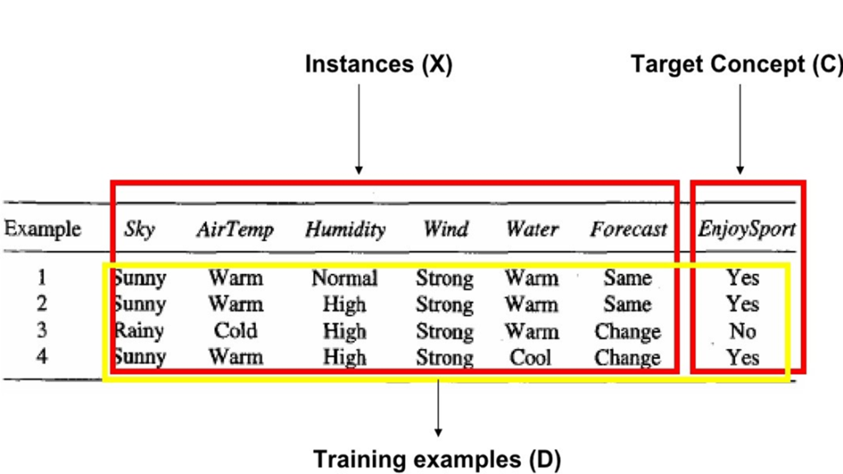

Slide 14
The Inductive Learning Hypothesis
Although the learning task is to determine a hypothesis h identical to the target concept to cover the entire set of instances X, the only information available about c is its value over the training examples.
- Inductive learning algorithms can at best guarantee that the output hypothesis fits the target concept over the training data.
- Lacking any further information, our assumption is that the best hypothesis regarding unseen instances is the hypothesis that best fits the observed training data. This is the fundamental assumption of inductive learning.
Inductive learning hypothesis: Any hypothesis found to approximate the target function well over a sufficiently large set of training examples will also approximate the target function well over any other unobserved examples.

Slide 15
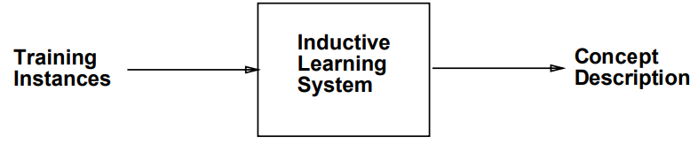
The Inductive Learning Hypothesis
Assumptions for Inductive Learning Algorithms:
The training sample represents the population
The input features permit discrimination
The System tries to induce a general rule from a set of observed instances.

Slide 16
Concept Learning As Search
Concept learning can be viewed as the task of searching through a large space of hypotheses implicitly defined by the hypothesis representation.
The goal of this search is to find the hypothesis that best fits the training examples.
By selecting a hypothesis representation, the designer of the learning algorithm implicitly defines the space of all hypotheses that the program can ever represent and therefore can ever learn

Slide 17
Enjoy Sport - Hypothesis Space
Sky has 3 possible values, and the other 5 attributes have 2 possible values.
There are 96 (= 3.2.2.2.2.2) distinct instances in X.
There are 5120 (=5.4.4.4.4.4) syntactically distinct hypotheses in H.
– Two more values for attributes: ? And 0
Every hypothesis containing one or more 0 symbols represents the empty set of instances; that is, it classifies every instance as negative.
There are 973 (= 1 + 4.3.3.3.3.3) semantically distinct hypotheses in H.
– Only one more value for attributes: ?, and one hypothesis representing an empty set of instances.
Although EnjoySport has a small, finite hypothesis space, most learning tasks have much larger (even infinite) hypothesis spaces.
– We need efficient search algorithms for the hypothesis spaces

Slide 18
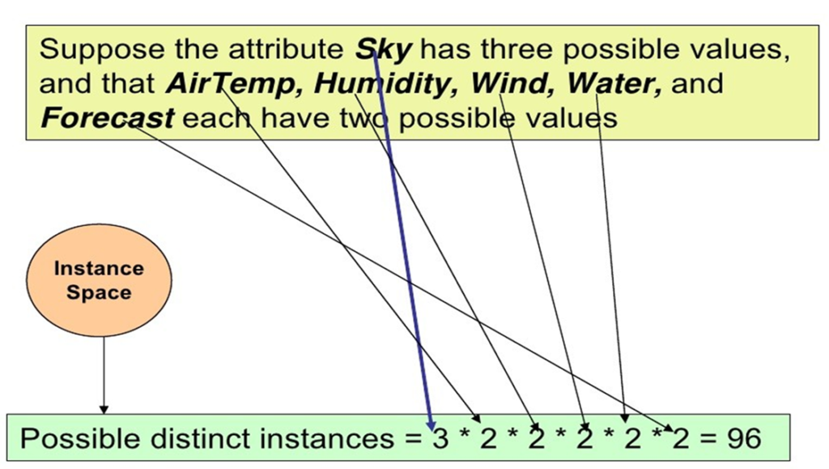

Slide 19
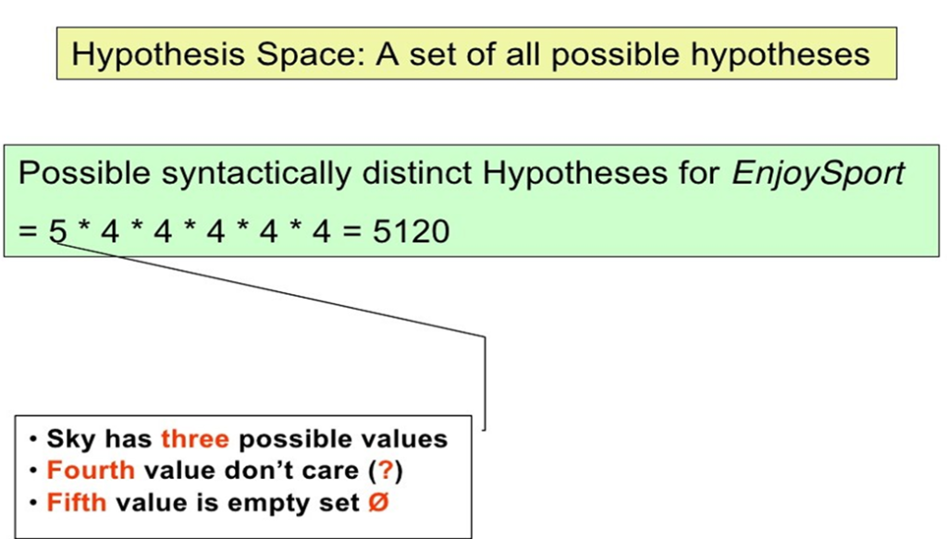

Slide 20
General-to-Specific Ordering of Hypotheses
Many algorithms for concept learning organize the search through the hypothesis space by relying on a general-to-specific ordering of hypotheses.
By taking advantage of this naturally occurring structure over the hypothesis space, we can design learning algorithms that exhaustively search even infinite hypothesis spaces without explicitly enumerating every hypothesis.
Consider two hypotheses
h1 = (Sunny, ?, ?, Strong, ?, ?)
h2 = (Sunny, ?, ?, ?, ?, ?)
Now consider the sets of instances that are classified positive by hl and by h2.
– Because h2 imposes fewer constraints on the instance, it classifies more instances as positive.
– In fact, any instance classified positive by hl will also be classified positive by h2.
– Therefore, we say that h2 is more general than hl.

Slide 21
More-General-Than Relation
For any instance x in X and hypothesis h in H, we say that x satisfies h if and only if h(x) = 1.
More-General-Than-Or-Equal Relation:
Let h1 and h2 be two boolean-valued functions defined over X.
Then h1 is more-general-than-or-equal-to h2 (written h1 ≥ h2)
if and only if any instance that satisfies h2 also satisfies h1.
h1 is more-general-than h2 ( h1 > h2) if and only if h1≥h2 is true and h2≥h1 is false. We also say h2 is more-specific-than h1.

Slide 22
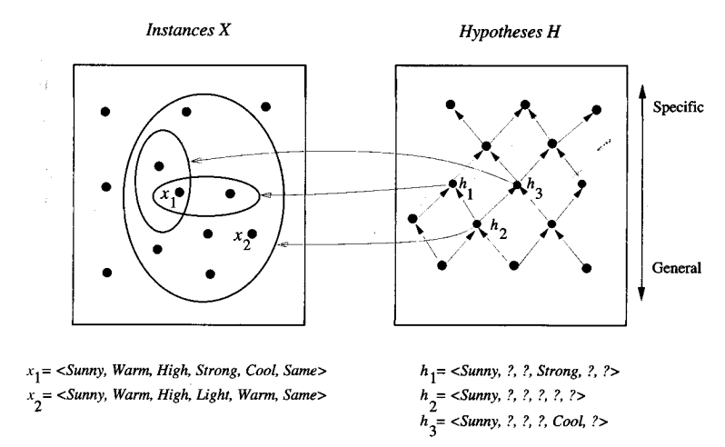
More-General-Relation
h2 > h1 and h2 > h3
But there is no more-general relation between h1 and h3

