Slide 1
Relational model in DBMS
Ex: Student
R.no | Name | Marks | Branch
1 | Ramesh | 90 | CSE
2 | Mahesh | 95 | IT
3 | Suresh | 80 | ECE

Slide 2
Terminology:
1. Attributes
2. Tuples
3. Domain
4. NULL
5. Cardinality of Relation
6. Degree of Relation

Slide 3
7. Relational model
8. Relational Schema
9. Relational DBMS
10. Relational Instance

Slide 4
Cartesian product or cross product operation in Relational Algebra
Combines each tuple of one relation with all tuples in other relation.
Name | Age
a | 10
b | 20
c | 30
Name | Age
d | 15
e | 30
f | 45
If R1 contains ‘m’ attributes and R2 has ‘n’ attributes then m x n contains m+n.
If R1 contains ‘m’ rows and R2 has ‘n’ rows then cross product contains mxn rows.

Slide 5
Name | Age | Name | Age
a | 10 | d | 15
a | 10 | e | 30
a | 10 | f | 45
b | 20 | d | 15
b | 20 | e | 30
b | 20 | f | 45
c | 30 | d | 15
c | 30 | e | 30
c | 30 | f | 45

Slide 6
Three Schema Architecture or Three levels of Abstraction
Abstraction: Representing essential features while hiding unnecessary details.
Schema: Describes structure of a database
1. External Schema
2. Conceptual Schema
3. Physical Schema

Slide 7
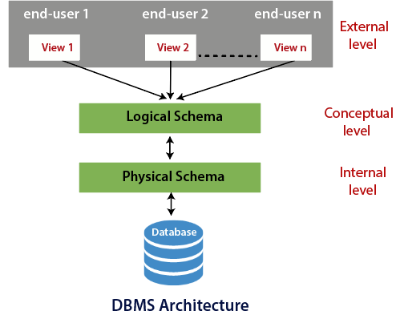

Slide 8
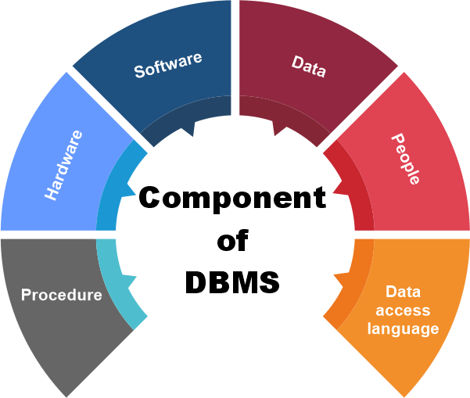
Components of DBMS

Slide 9
1. Hardware
The hardware includes output devices like a printer, monitor, etc., and storage devices like a hard disk.
This equipment is used to capture the data and present the output to the user.
With the help of hardware, the DBMS can access and update the database.
2. Software
Software is defined as the collection of programs that are used to instruct the computer about its work.
Also, we can say that computer software is a set of instructions that is used to instruct the computer hardware for the operation of the computers.

Slide 10
This software has the ability to understand the database accessing language and then convert these languages to real database commands and then execute the database.
Some examples of DBMS software include MySQL, Oracle, SQL Server, dBase, FileMaker, Clipper, Foxpro, Microsoft Access, etc.
3. Data
The term data means the collection of any raw fact stored in the database. Here the data are any type of raw material from which meaningful information is generated.
The database can store any form of data, such as structural data and non-structural data.
The structured data are highly specific in the database and have a structured format. But in the case of non-structural data, it is a collection of different types of data, and these data are stored in their native format.

Slide 11
Data is the most important part of the DBMS. Here the database contains the actual data and metadata. Here metadata means data about data.
For example, when the user stores the data in a database, some data, such as the size of the data, the name of the data, and some data related to the user, are stored within the database. These data are called metadata.
4. Procedures
The procedure is a type of general instruction or guidelines for the use of DBMS.
This instruction includes
how to set up the database
how to install the database
how to log in and log out of the database
how to manage the database
how to take a backup of the database, and
how to generate the report of the database.

Slide 12
5. Database Access Language
Database Access Language is a simple language that allows users to write commands to perform the desired operations on the data that is stored in the database.
Examples of database languages are SQL (structured query language), My Access, Oracle, etc.
A database language is comprised of two languages.
Data Definition Language(DDL)
Data Manipulation Language(DML)
6. People
The people who control and manage the databases and perform different types of operations on the database in the DBMS.
The people include database administrator, software developer, and End-user.

Slide 13
Data Independence
Data independence refers characteristic of being able to modify the schema at one level of the database system without altering the schema at the next higher level.
There are two types of data independence:
1. Logical Data Independence
Logical data independence refers characteristic of being able to change the conceptual schema without having to change the external schema.
Logical data independence is used to separate the external level from the conceptual view.

Slide 14
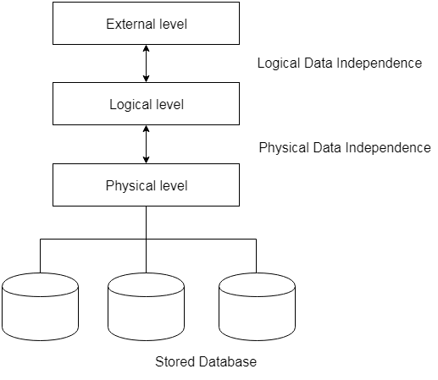
2. Physical Data Independence
Physical data independence can be defined as the capacity to change the internal schema without having to change the conceptual schema.
If we do any changes in the storage size of the database system server, then the Conceptual structure of the database will not be affected.

Slide 15
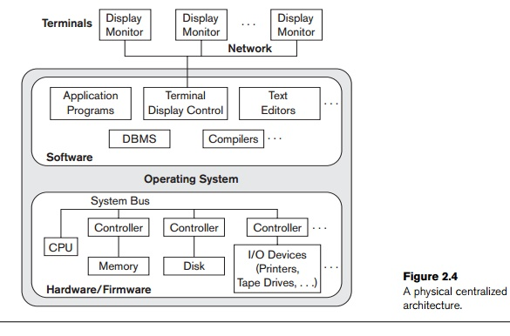
1. Centralized DBMSs Architecture

Slide 16
Architectures for DBMSs have followed trends similar to those for general computer system architectures.
Earlier architectures used mainframe computers to provide the main processing for all system functions.
users accessed such systems via computer terminals that did not have processing power and only provided display capabilities.
All processing was performed remotely on the computer system
Display information and controls were sent from the computer to the display terminals, which were connected to the central computer via various types of communications networks.

Slide 17
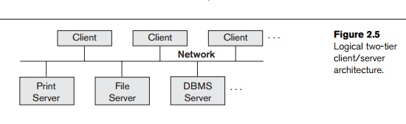
2. Basic Client/Server Architectures
The client/server architecture was developed to deal with computing environments in which a large number of PCs, workstations, file servers, printers, database servers,

Slide 18
Web servers, e-mail servers, and other software and equipment are connected via a network.
The idea is to define specialized servers with specific functionalities.
For example, it is possible to connect a number of PCs or small workstations as clients to a file server that maintains the files of the client machines.
Another machine can be designated as a printer server by being connected to various printers; all print requests by the clients are forwarded to this machine.
Web servers or e-mail servers also fall into the specialized server category.
The resources provided by specialized servers can be accessed by many client machines.

Slide 19
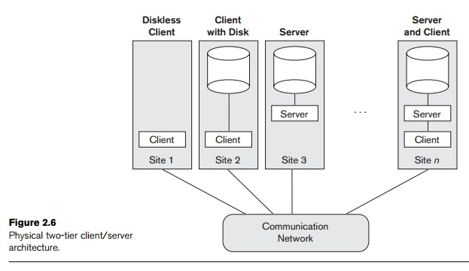

Slide 20
The concept of client/server architecture assumes an underlying framework that consists of many PCs and workstations as well as a smaller number of mainframe machines, connected via LANs and other types of computer networks.
A client in this framework is typically a user machine that provides user interface capabilities and local processing.
When a client requires access to additional functionality— such as database access—that does not exist at that machine, it connects to a server that provides the needed functionality.
A server is a system containing both hard-ware and software that can provide services to the client machines, such as file access, printing, archiving, or database access.
Two main types of basic DBMS architectures were created on this underlying client/server framework: two-tier and three-tier.

Slide 21
Two-Tier Client/Server Architectures for DBMSs
Because SQL provided a standard language for RDBMSs, this created a logical dividing point between client and server.
Hence, the query and transaction functionality related to SQL processing remained on the server side.
In such an architecture, the server is often called a query server or transaction server because it provides these two functionalities.
In an RDBMS, the server is also often called an SQL server.
The user interface programs and application programs can run on the client side.

Slide 22
A standard called Open Database Connectivity provides an application programming interface (API), which allows client-side programs to call the DBMS, as long as both client and server machines have the necessary software installed.
The architectures described here are called two-tier architectures because the soft-ware components are distributed over two systems:
client and server.
Advantages:
simplicity and
compatibility with existing systems.

Slide 23
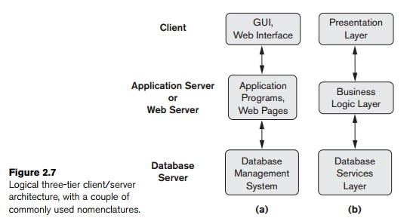
Three-Tier and n-Tier Architectures for Web Applications

Slide 24
This server plays an intermediary role by running application programs and storing business rules (procedures or constraints) that are used to access data from the database server.
It can also improve database security by checking a client’s credentials before forwarding a request to the data-base server.
Clients contain GUI interfaces and some additional application-specific business rules.
The presentation layer displays information to the user and allows data entry.
The business logic layer handles intermediate rules and constraints before data is passed up to the user or down to the DBMS.
The bottom layer includes all data management services.

