Slide 1
Dynamic Routing Protocols II
OSPF
Relates to Lab 4. This module covers link state routing and the Open Shortest Path First (OSPF) routing protocol.

Slide 2

Distance Vector vs. Link State Routing
With distance vector routing, each node has information only about the next hop:
    Node A: to reach F go to B
    Node B: to reach F go to D
    Node D: to reach F go to E
    Node E: go directly to F
Distance vector routing makes
poor routing decisions if
directions are not completely
correct
(e.g., because a node is down).
If parts of the directions incorrect, the routing may be incorrect until the routing algorithms has re-converged.
A
B
C
D
E
F

Slide 3
Distance Vector vs. Link State Routing
In link state routing, each node has a complete map of the topology
If a node fails, each
node can calculate
the new route
Difficulty: All nodes need to
have a consistent view of the
network
A
B
C
A
B
C
A
B
C
D
E
F
D
E
F
D
E
F
A
B
C
D
E
F
A
B
C
A
B
C
A
B
C
D
E
F
D
E
F
D
E
F

Slide 4
Link State Routing: Properties
Each node requires complete topology information
Link state information must be flooded to all nodes
Guaranteed to converge

Slide 5
Link State Routing: Basic princples
  1. Each router establishes a relationship (“adjacency”) with its neighbors
  2.Each router generates link state advertisements (LSAs) which are distributed to all routers
      LSA = (link id, state of the link, cost, neighbors of the link)
  3. Each router maintains a database of all received LSAs (topological database or link state database), which describes the network as a graph with weighted edges
  4. Each router uses its link state database to run a shortest path algorithm (Dijikstra’s algorithm) to produce the shortest path to each network

Slide 6
Operation of a Link State Routing protocol
IP Routing
Table
Received
LSAs
Link State
Database
Dijkstra’s
Algorithm
LSAs are flooded
to other interfaces

Slide 7
Dijkstra’s Shortest Path Algorithm for a Graph
Input: Graph (N,E) with
N the set of nodes and E the set of edges
d_{vw} link cost (d_{vw} = infinity if (v,w) ∉ E, d_{vv} = 0)
s source node.
Output: D_{n} cost of the least-cost path from node s to node n
M = {s};
for each n ∉ M
D_{n} = d_{sn};
while (M ≠ all nodes) do
Find w ∉ M for which D_{w} = min{D_{j} ; j ∉ M};
Add w to M;
for each n ∉ M
D_{n} = min_{w} [ D_{n}, D_{w} + d_{wn} ];
Update route;
enddo

Slide 8
OSPF
OSPF = Open Shortest Path First
The OSPF routing protocol is the most important link state routing protocol on the Internet
The complexity of OSPF is significant
History:
  1989: RFC 1131 OSPF Version 1
  1991: RFC1247 OSPF Version 2
  1994: RFC 1583 OSPF Version 2 (revised)
  1997: RFC 2178 OSPF Version 2 (revised)
  1998: RFC 2328 OSPF Version 2 (current version)

Slide 9
Features of OSPF
Provides authentication of routing messages
Enables load balancing by allowing traffic to be split evenly across routes with equal cost
Type-of-Service routing allows to setup different routes dependent on the TOS field
Supports subnetting
Supports multicasting
Allows hierarchical routing

Slide 10
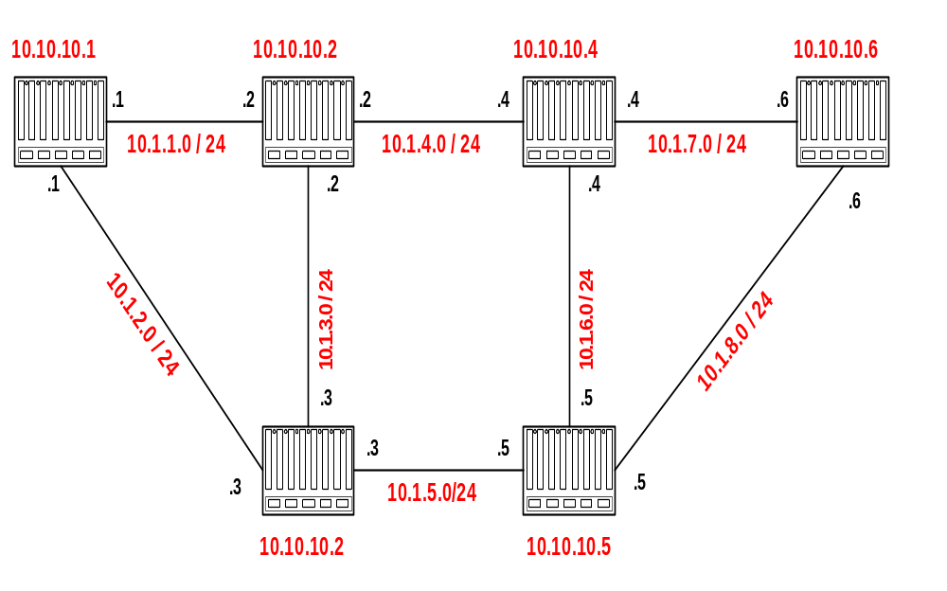
Example Network
4
2
1
Router IDs are selected independent of interface addresses
3
2
3
1
5
Link costs are called Metric
Metric is in the range [0 , 2¹⁶]
Metric can be asymmetric

Slide 11

Link State Advertisement (LSA)
4
The LSA of router 10.10.10.1 is as
follows:
Link State ID: 10.10.10.1 = can be Router ID
Advertising Router: 10.10.10.1 = Router ID
Number of links: 3 = 2 links plus router itself
Description of Link 1: Link ID = 10.1.1.1, Metric = 4
Description of Link 2: Link ID = 10.1.2.1, Metric = 3
Description of Link 3: Link ID = 10.10.10.1, Metric = 0
3
2
Each router sends its LSA to all routers in the network
(using a method called reliable flooding)

Slide 12
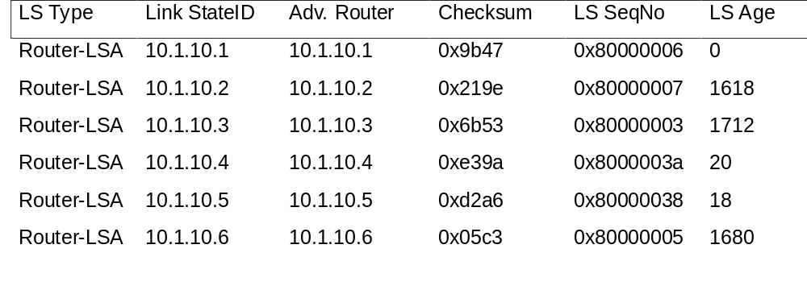
Network and Link State Database
Each router has a database which contains the LSAs from all other routers

Slide 13
Link State Database
The collection of all LSAs is called the link-state database
Each router has and identical link-state database
      Useful for debugging: Each router has a complete description of the network
If neighboring routers discover each other for the first time, they will exchange their link-state databases
The link-state databases are synchronized using reliable flooding

Slide 14
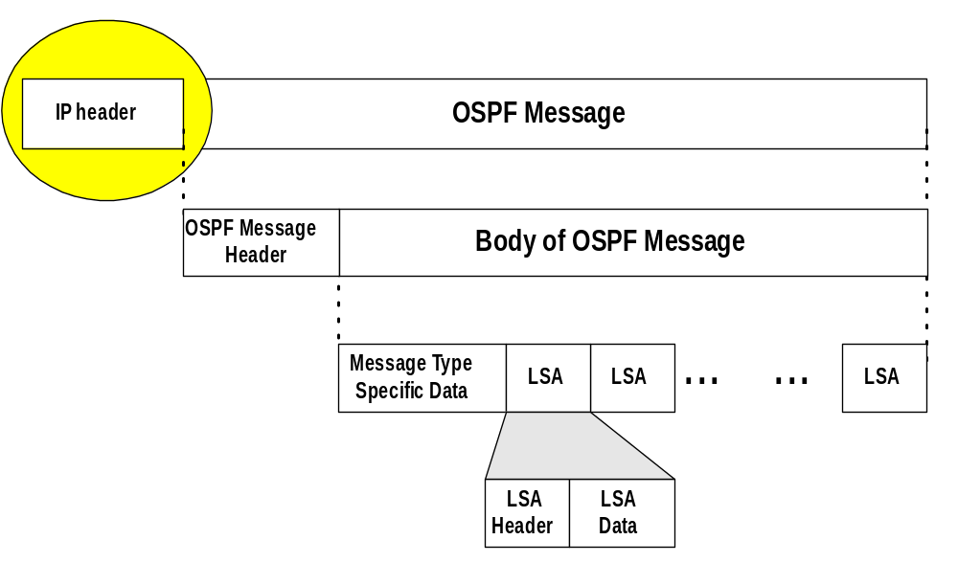
OSPF Packet Format
OSPF packets are not carried as UDP payload!
OSPF has its own IP protocol number: 89
TTL: set to 1 (in most cases)
Destination IP: neighbor’s IP address or 224.0.0.5 (ALLSPFRouters) or 224.0.0.6 (AllDRouters)

Slide 15
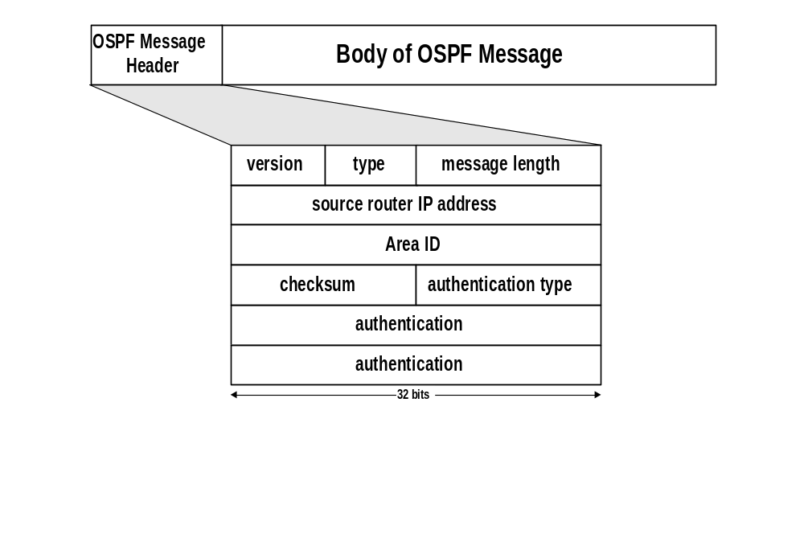
OSPF Packet Format
2: current version is OSPF V2
ID of the Area from which the packet originated
Message types:
1: Hello (tests reachability)
2: Database description
3: Link Status request
4: Link state update
5: Link state acknowledgement
0: no authentication
1: Cleartext password
2: MD5 checksum
(added to end packet)
Standard IP checksum taken over entire packet
Authentication passwd = 1: 64 cleartext password
Authentication passwd = 2: 0x0000 (16 bits)
KeyID (8 bits)
Length of MD5 checksum (8 bits)
Nondecreasing sequence number (32 bits)
Prevents replay attacks

Slide 16
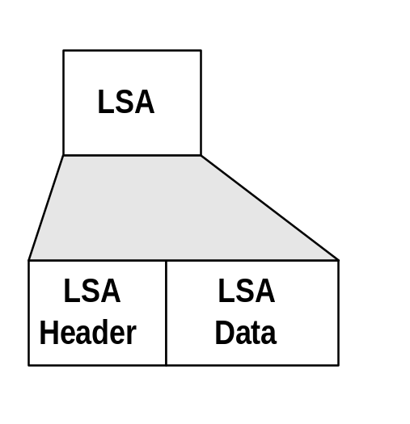
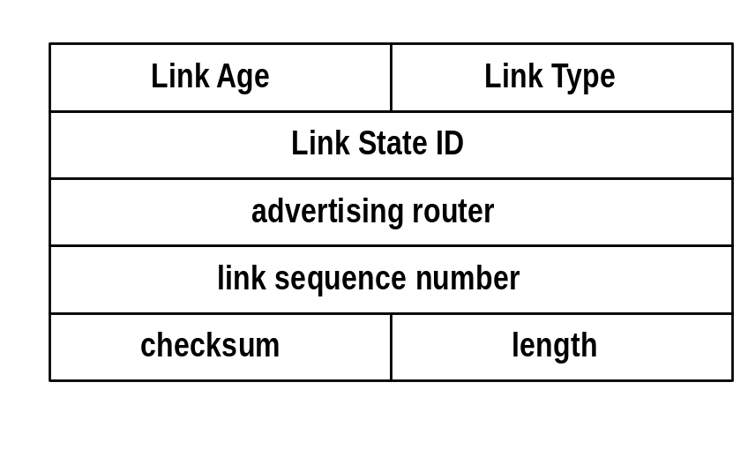
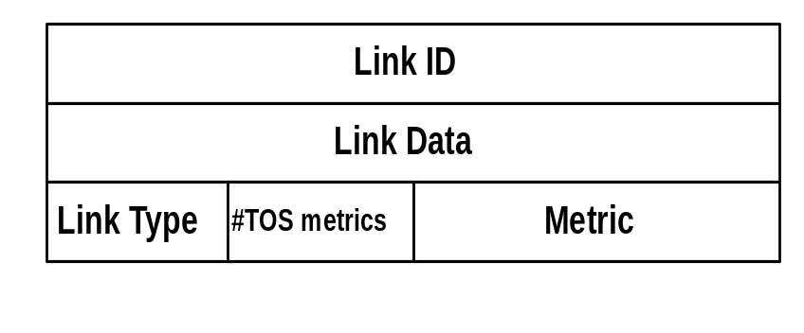
OSPF LSA Format
LSA Header
Link 1
Link 2

Slide 17
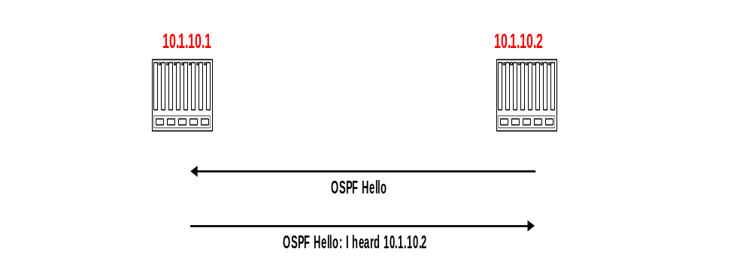
Discovery of Neighbors
Routers multicasts OSPF Hello packets on all OSPF-enabled interfaces.
If two routers share a link, they can become neighbors, and establish an adjacency
After becoming a neighbor, routers exchange their link state databases
Scenario:
Router 10.1.10.2 restarts

Slide 18
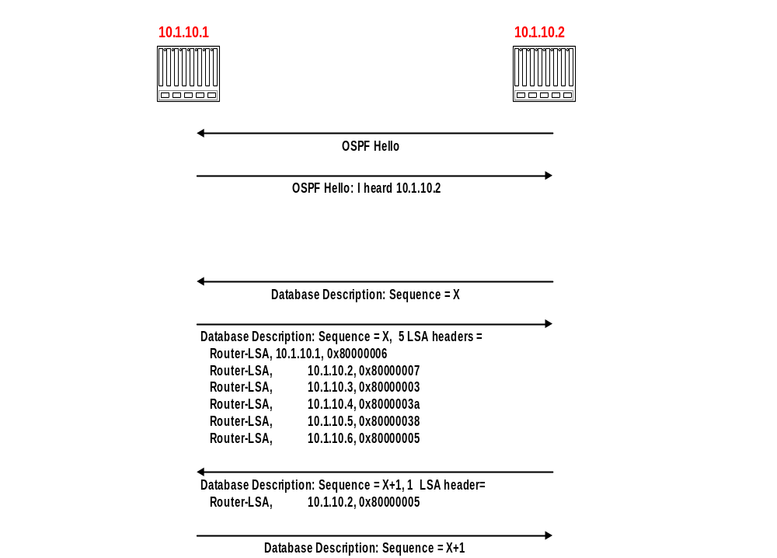
Neighbor discovery and database synchronization
Scenario:
Router 10.1.10.2 restarts
Discovery of
adjacency
After neighbors are discovered the nodes exchange their databases
Sends database description.
(description only contains LSA headers)
Sends empty database description
Database description of 10.1.10.2
Acknowledges receipt of description

Slide 19
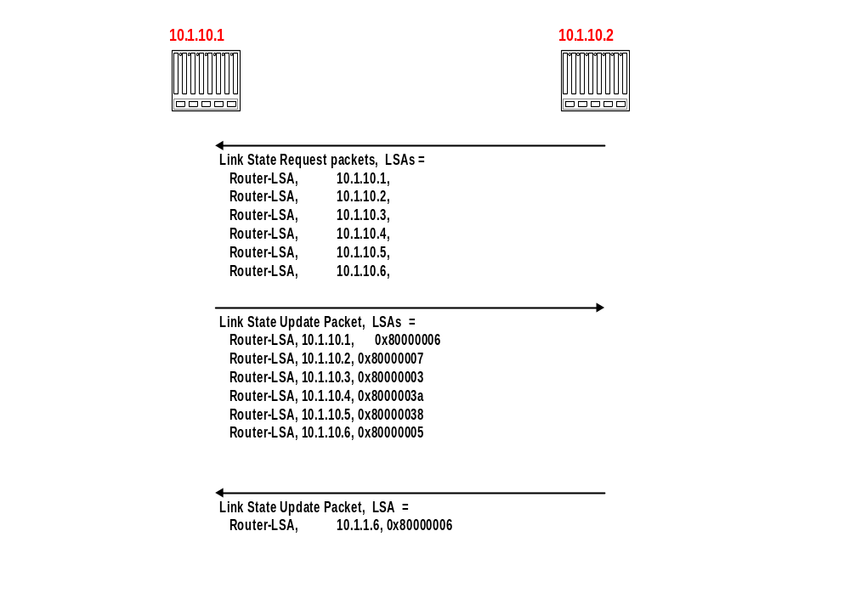
Regular LSA exchanges
10.1.10.2 explicitly requests each LSA from 10.1.10.1
10.1.10.1 sends requested LSAs
10.1.10.2 has more recent value for 10.0.1.6 and sends it to 10.1.10.1
(with higher sequence number)

Slide 20
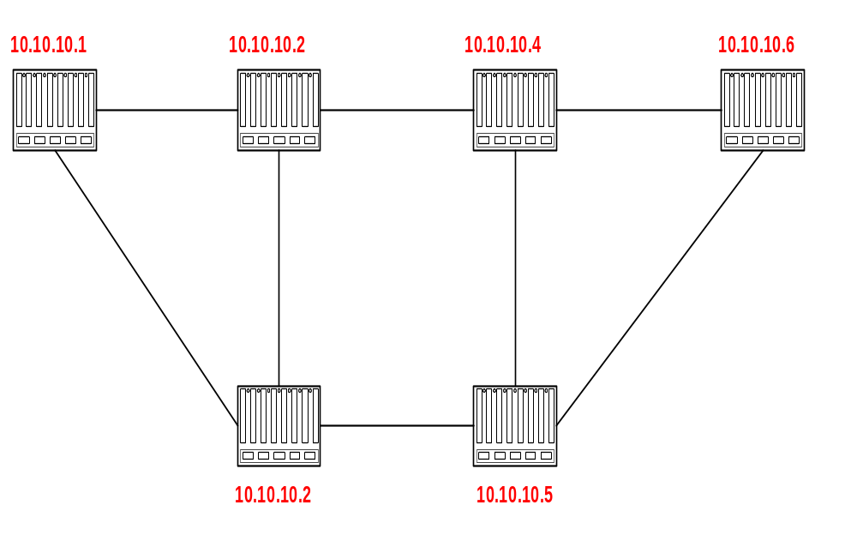
Routing Data Distribution
LSA-Updates are distributed to all other routers via Reliable Flooding
Example: Flooding of LSA from 10.10.10.1
LSA
LSA
LSA
ACK
ACK
Update
database
Update
database
Update
database
ACK
LSA
ACK
ACK
ACK
ACK
LSA
LSA
LSA
LSA
LSA
ACK
ACK
LSA
ACK
Update
database
Update
database
ACK
ACK
ACK

Slide 21
Dissemination of LSA-Update
A router sends and refloods LSA-Updates, whenever the topology or link cost changes. (If a received LSA does not contain new information, the router will not flood the packet)
Exception: Infrequently (every 30 minutes), a router will flood LSAs even if there are no new changes.
Acknowledgements of LSA-updates:
    explicit ACK, or
    implicit via reception of an LSA-Update

Slide 22
Autonomous Systems
An autonomous system is a region of the Internet that is administered by a single entity.
Examples of autonomous regions are:
    UVA’s campus network
    MCI’s backbone network
    Regional Internet Service Provider
Routing is done differently within an autonomous system (intradomain routing) and between autonomous system (interdomain routing).

Slide 23
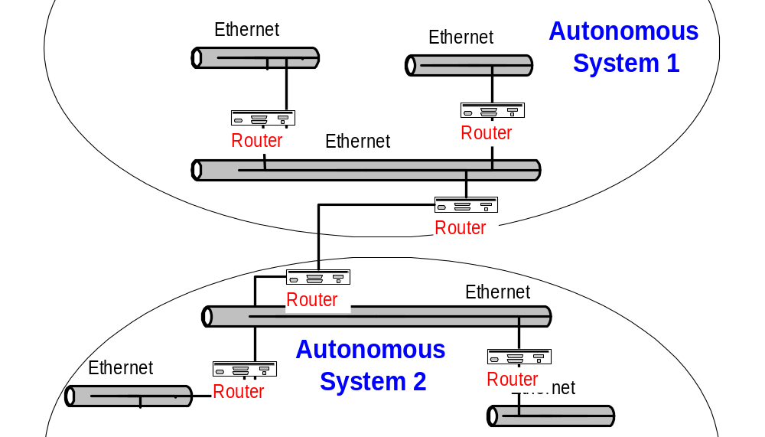
Autonomous Systems (AS)

Slide 24
BGP
BGP = Border Gateway Protocol
Currently in version 4
Note: In the context of BGP, a gateway is nothing else but an IP router that connects autonomous systems.
Interdomain routing protocol for routing between autonomous systems
Uses TCP to send routing messages
BGP is neither a link state, nor a distance vector protocol. Routing messages in BGP contain complete routes.
Network administrators can specify routing policies

Slide 25
BGP
BGP’s goal is to find any path (not an optimal one). Since the internals of the AS are never revealed, finding an optimal path is not feasible.
For each autonomous system (AS), BGP distinguishes:
    local traffic = traffic with source or destination in AS
    transit traffic = traffic that passes through the AS
    Stub AS = has connection to only one AS, only carry local traffic
    Multihomed AS = has connection to >1 AS, but does not carry transit traffic
    Transit AS = has connection to >1 AS and carries transit traffic

Slide 26
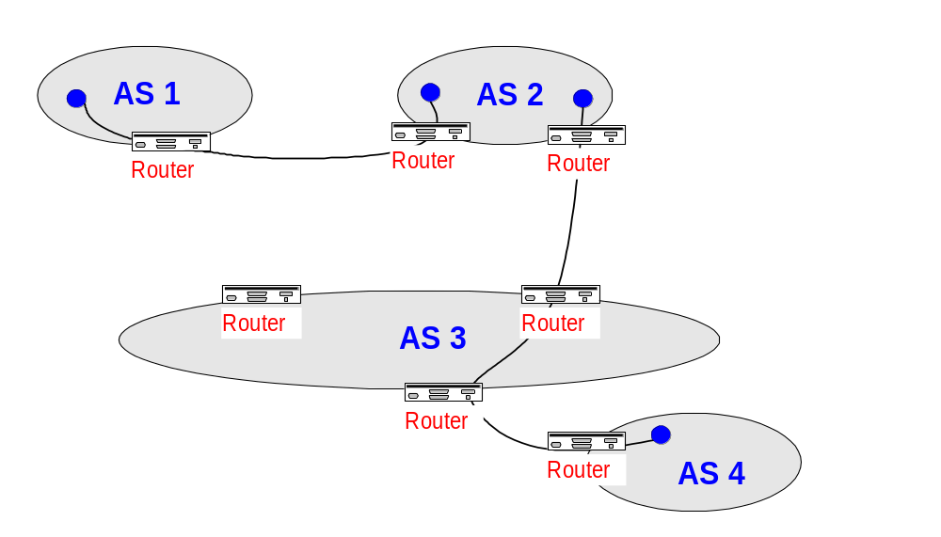
BGP

