Slide 1
Module-6
Application Layer
Dr. R. Prashanth

Slide 2
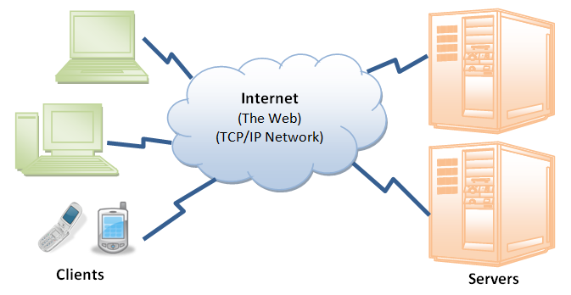
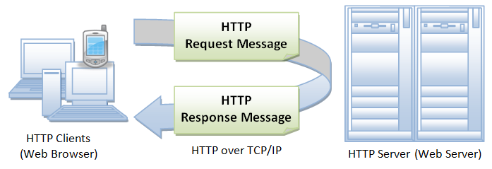

Slide 3
Introduction
Application layer protocols refer to an abstract network layer providing end-to-end communication between different computational applications.
It is the 7th layer of the OSI model and the 4th layer of the TCP/IP model.
The popular protocols in Application Layers are:
FTP, NFS, SMTP, SNMP, DNS, HTTTP/HTTPS…etc

Slide 4
HTTP
HTTP stands for HyperText Transfer Protocol.
It is a protocol used to access the data on the World Wide Web (www).
The HTTP protocol can be used to transfer the data in the form of plain text, hypertext, audio, video, and so on.
This protocol is known as HyperText Transfer Protocol because of its efficiency that allows us to use in a hypertext environment where there are rapid jumps from one document to another document.

Slide 5
Features of HTTP:
Connectionless protocol: HTTP is a connectionless protocol. HTTP client initiates a request and waits for a response from the server. When the server receives the request, the server processes the request and sends back the response to the HTTP client after which the client disconnects the connection.
Media independent: HTTP protocol is a media independent as data can be sent as long as both the client and server know how to handle the data content.
Stateless: HTTP is a stateless protocol as both the client and server know each other only during the current request. Due to this nature of the protocol, both the client and server do not retain the information between various requests of the web pages.

Slide 6
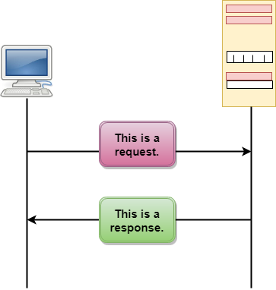
HTTP working flow

Slide 7
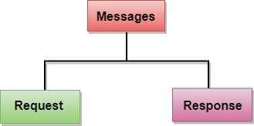

Slide 8
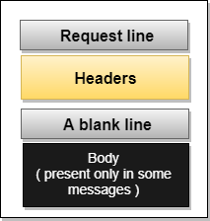
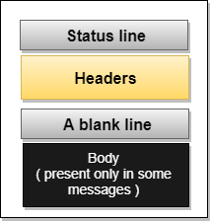
Request Message: The request message is sent by the client that consists of a request line, headers, and sometimes a body.
Response Message: The response message is sent by the server to the client that consists of a status line, headers, and sometimes a body.

Slide 9
There are several stages of development of HTTP but we will focus mainly on HTTP/1.1 which was created in 1997 & the new one is HTTP/2 which was created in 2015.
HTTP/1.1: For better understanding, let’s assume the situation when you make a request to the server for the geeksforgeeks.html page & server responds to you as a resource geeksforgeeks.html page.
Before sending the request and the response there is a TCP connection established between client & server, again you make a request to the server for image img.jpg & the server gives a response as an image img.jpg. the connection was not lost here after the first request because we add a keep-alive header which is the part of the request so there is an open connection between the server & client.
There is a persistent connection which means several requests & responses are merged in a single connection.

Slide 10
HTTP/1.1 :— The standardized protocol
Released in 1997
Commonly used version.
Methods supported: GET , HEAD , POST , PUT , DELETE , TRACE , OPTIONS
cache support.
chunked transfers,
Connection nature: long-lived

Slide 11
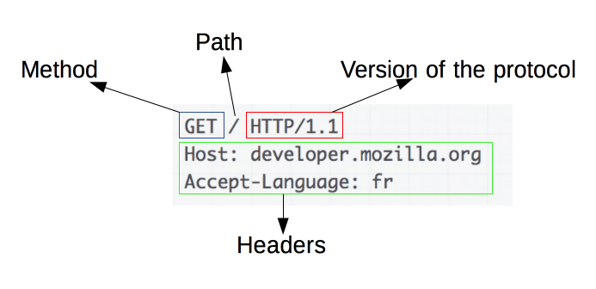
The first problem is HTTP/1.1 transfer all the requests & responses in the plain text message form.
The second one is head of line blocking in which TCP connection is blocked all other requests until the response does not receive. all the information related to the header file is repeated in every request.

Slide 12
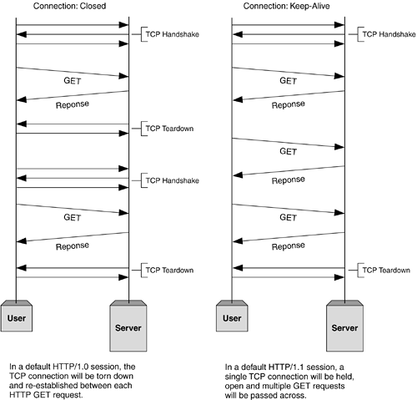

Slide 13
SMTP

Slide 14
Introduction
Email is emerging as one of the most valuable services on the internet today. Most internet systems use SMTP as a method to transfer mail from one user to another.
SMTP is a push protocol and is used to send the mail whereas POP (post office protocol) or IMAP (internet message access protocol) is used to retrieve those emails at the receiver’s side.
SMTP is used most commonly by email clients, including Gmail, Outlook, Apple Mail and Yahoo Mail.

Slide 15
SMTP is an application layer protocol. The client who wants to send the mail opens a TCP connection to the SMTP server and then sends the mail across the connection.
The SMTP server is an always-on listening mode. As soon as it listens for a TCP connection from any client, the SMTP process initiates a connection through port 25.
After successfully establishing a TCP connection the client process sends the mail instantly.

Slide 16
The SMTP model is of two types:
End-to-end method
Store-and-forward method
The end-to-end model is used to communicate between different organizations whereas the store and forward method is used within an organization.
An SMTP client who wants to send the mail will contact the destination’s host SMTP directly, in order to send the mail to the destination. The SMTP server will keep the mail to itself until it is successfully copied to the receiver’s SMTP.

Slide 17
Model of SMPT
In the SMTP model user deals with the user agent (UA), for example, Microsoft Outlook, Netscape, Mozilla, etc.
In order to exchange the mail using TCP, MTA is used. The user sending the mail doesn’t have to deal with MTA as it is the responsibility of the system admin to set up a local MTA.
The MTA maintains a small queue of mail so that it can schedule repeat delivery of mail in case the receiver is not available.
The MTA delivers the mail to the mailboxes and the information can later be downloaded by the user agents.

Slide 18
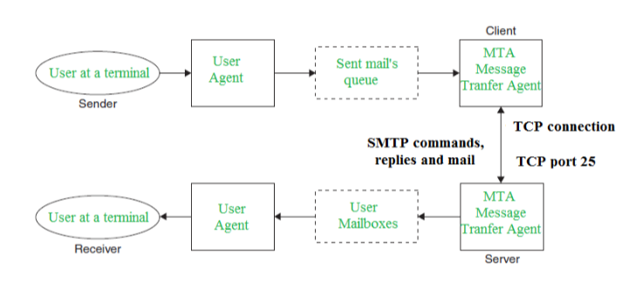

Slide 19
Components of SMTP:
Mail User Agent (MUA)
Mail Submission Agent (MSA)
Mail Transfer Agent (MTA)
Mail Delivery Agent (MDA)
1. Mail User Agent (MUA): It is a computer application that helps you in sending and retrieving mail. It is responsible for creating email messages for transfer to the mail transfer agent(MTA).
2. Mail Submission Agent (MSA): It is a computer program that basically receives mail from a Mail User Agent(MUA) and interacts with the Mail Transfer Agent(MTA) for the transfer of the mail.
3. Mail Transfer Agent(MTA): It is basically software that has the work to transfer mail from one system to another with the help of SMTP.
4. Mail Delivery Agent(MDA): A mail Delivery agent or Local Delivery Agent is basically a system that helps in the delivery of mail to the local system.

Slide 20
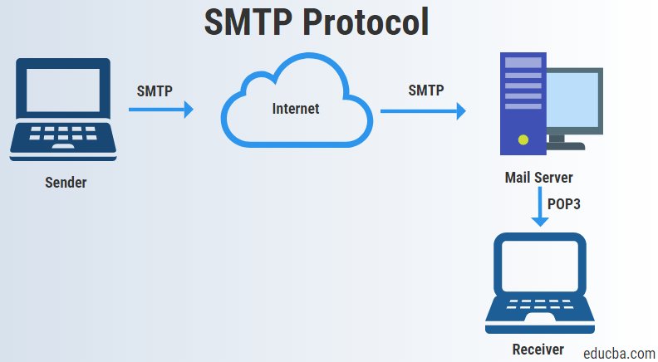

Slide 21
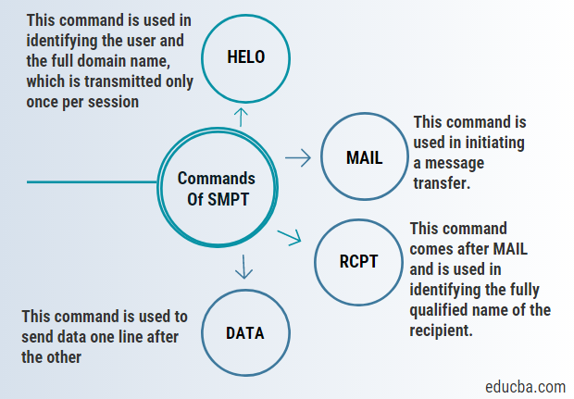
Commands of SMTP

Slide 22
To transfer mails, SMTP uses three phases, i.e. connection establishment, mail transfer and connection termination and commands, which are used to send data from client to server and responses, which is used to send data from server to client.
It can also perform the following tasks:
It can transmit a message to more than one recipient.
It can attach text, video voice or graphics in the message.
It can transmit messages on networks external to the internet, as well.

Slide 23
HELO – This command is used in identifying the user and the full domain name, which is transmitted only once per session.
MAIL – This command is used in initiating a message transfer.
RCPT – This command comes after MAIL and is used to identify the recipient’s fully qualified name. For multiple recipients, we use one RCPT for each of the recipients.
DATA – This command is used to send data one line after the other.

