Slide 1
Module-3 Datalink Layer
Dr. R. Prashanth

Slide 2
Error Detection & Correction

Slide 3
Introduction
The Data-link layer is the second layer from the bottom in the OSI (Open System Interconnection) network architecture model. It is responsible for the node-to-node delivery of data.
Its major role is to ensure error-free transmission of information.
DLL is also responsible to encode, decode and organize the outgoing and incoming data.
This is considered the most complex layer of the OSI model as it hides all the underlying complexities of the hardware from the other above layers.

Slide 4
Introduction
There are many reasons such as noise, cross-talk etc., which may help data to get corrupted during transmission.
The upper layers work on some generalized view of network architecture and are not aware of actual hardware data processing.
Hence, the upper layers expect error-free transmission between the systems. Most of the applications would not function expectedly if they receive erroneous data.
Applications such as voice and video may not be that affected and with some errors they may still function well.

Slide 5



Types of Errors
There may be three types of errors:
Single bit error
Multiple bits error
Burst error

Slide 6
Error control mechanism may involve two possible ways:
Error detection
Error correction

Slide 7
Error detection
Error detection techniques are:
Simple parity
2D parity check
Checksum
CRC (Cyclic Redundancy Check)

Slide 8
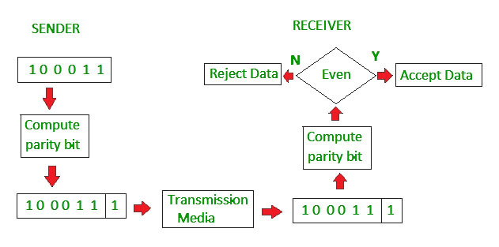
Simple parity check
Simple-bit parity is a simple error detection method that involves adding an extra bit to a data transmission.
Even parity
It works as:
1 is added to the block if it contains an odd number of 1’s, and
0 is added if it contains an even number of 1’s

Slide 9
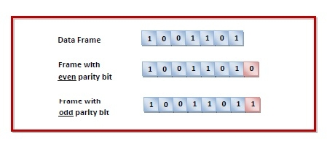
Odd parity:
It works as:
0 is added to the block if it contains an odd number of 1’s, and
1 is added if it contains an even number of 1’s

Slide 10
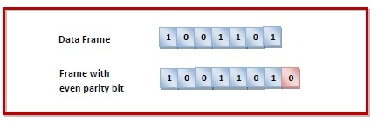
Example
Suppose that a sender wants to send the data 1001101 using even parity check method. It will add the parity bit as shown below.
The receiver will decide whether an error has occurred by counting whether the total number of 1s is even. When the above frame is received, three cases may occur namely, no error, single bit error detection and failure to detect multiple bits error. This is illustrated as follows -

Slide 11
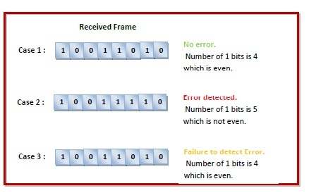

Slide 12
Limitations of single parity
Single Parity check is not able to detect even no. of bit error.
For example, the Data to be transmitted is 101010. Codeword transmitted to the receiver is 1010101 (we have used even parity). Let’s assume that during transmission, two of the bits of code word flipped to 1111101. On receiving the code word, the receiver finds the no. of ones to be even and hence no error, which is a wrong assumption.

Slide 13
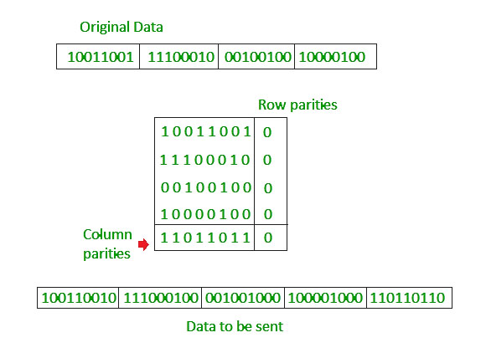
Two-dimensional Parity Check
Two-dimensional Parity check bits are calculated for each row, which is equivalent to a simple parity check bit.
Parity check bits are also calculated for all columns, then both are sent along with the data.
At the receiving end, these are compared with the parity bits calculated on the received data.

Slide 14
Checksum
Checksum error detection is a method used to identify errors in transmitted data.
The process involves dividing the data into equally sized segments and using a 1’s complement to calculate the sum of these segments.
The calculated sum is then sent along with the data to the receiver.
At the receiver’s end, the same process is repeated and if all ones are obtained in the sum, it means that the data is correct.
Checksum = Check + Sum
Sender side: Checksum Creation
Receiver side: Checksum Validation

Slide 15
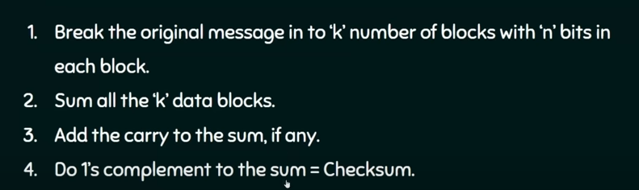
Checksum – Operation at Sender’s Side

Slide 16
Checksum – Operation at Receiver’s Side
At the receiver’s end, all received segments are added using 1’s complement arithmetic to get the sum.
If the result is all ones, the received data is accepted; otherwise discarded.

Slide 17
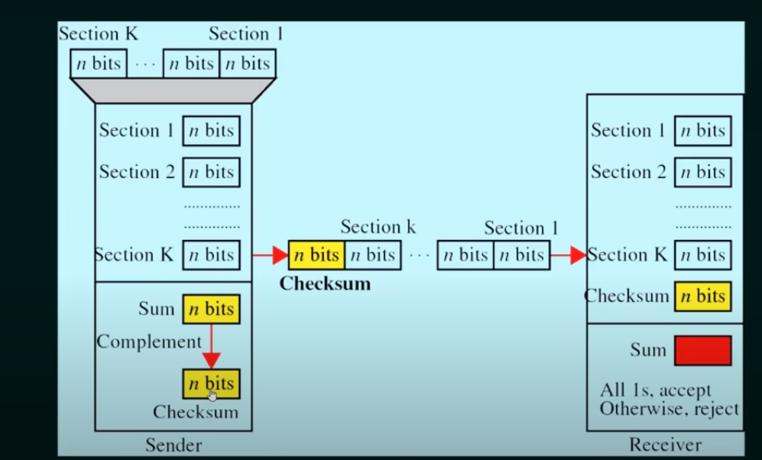
For more info: https://www.youtube.com/watch?v=AtVWnyDDaDI

Slide 18
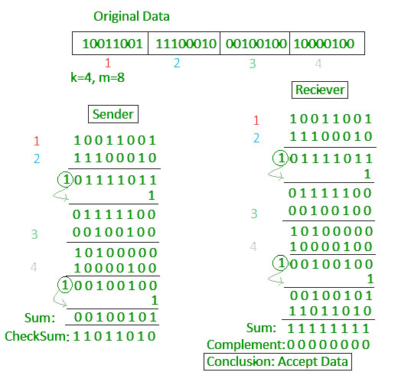
Example

Slide 19
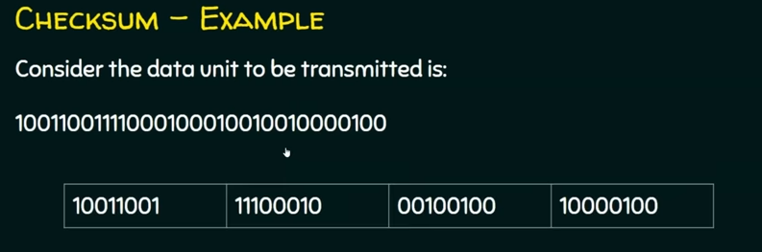
Example

Slide 20
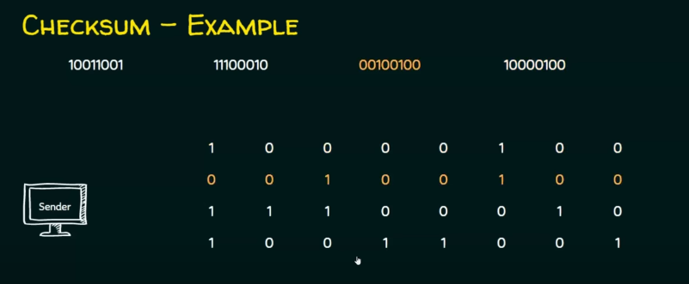
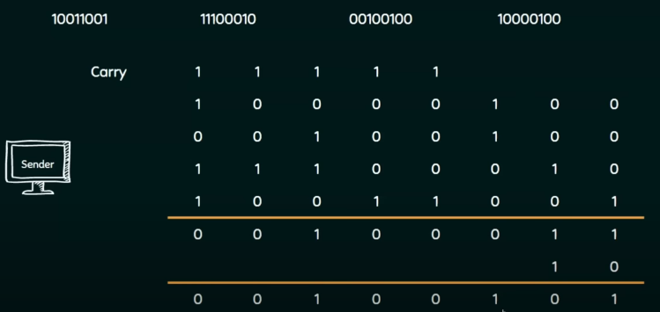
Do Binary addition

Slide 21
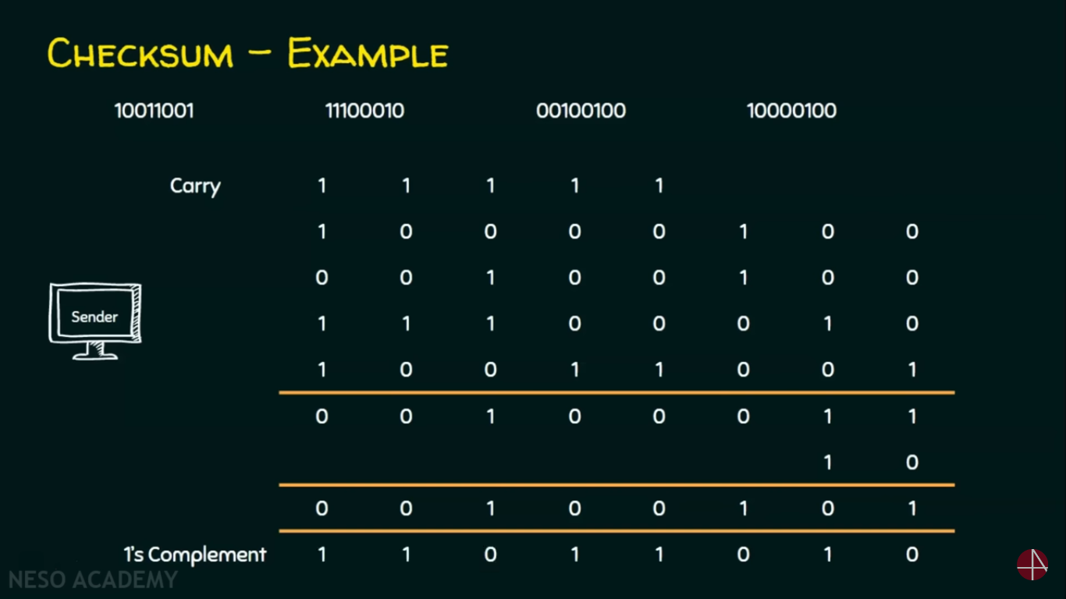
Do 1’s complement to get checksum

Slide 22
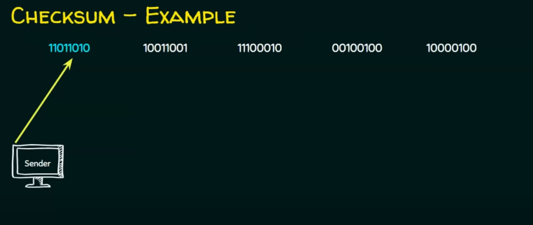
Send the all the data along with check sum (append it) to the receiver

Slide 23
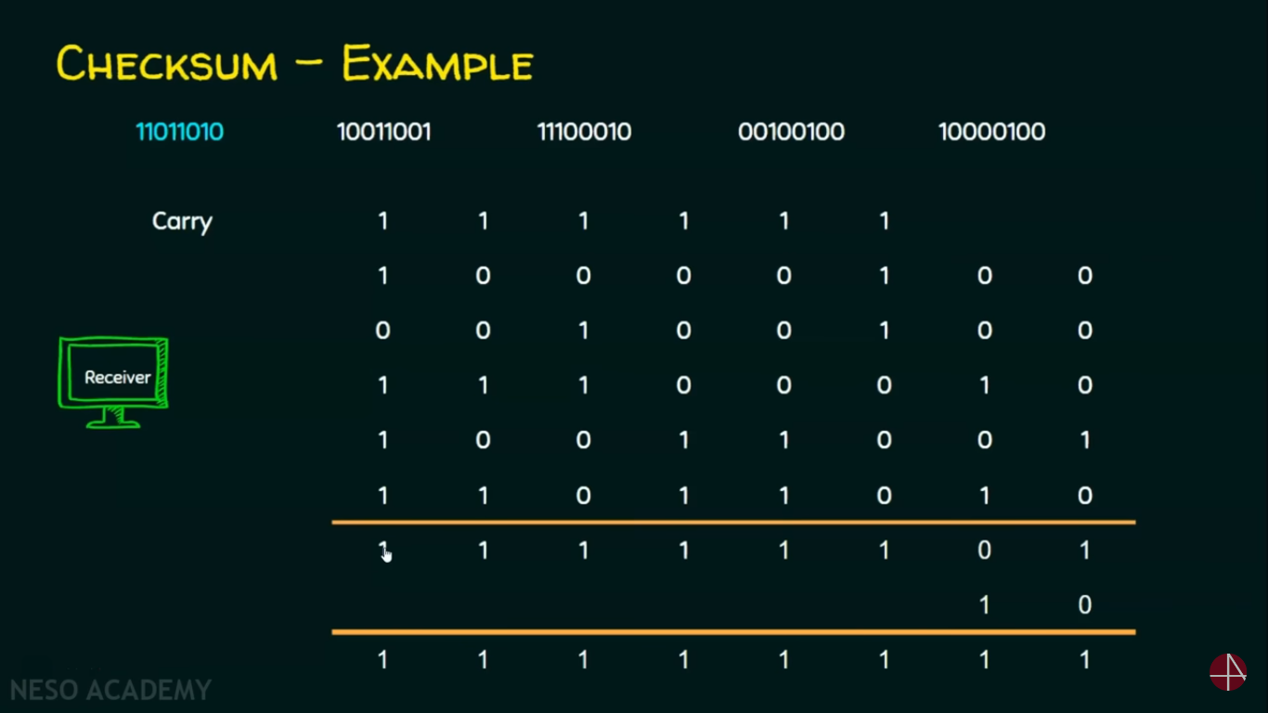
Receiver side operation (binary addition)

Slide 24
Disadvantages
If one or more bits of a segment are damaged and the corresponding bit or bits of opposite value in a second segment are also damaged.
Examples: Assume the sender wants to send four frames and each frame consists of 8-bits, where the frames are 10110011, 10101011, 01011010, 11010101. Then
A. Determine the checksum
B. Prove that transmission has done without any error
Source: https://www.youtube.com/watch?v=t4NFfQmppJ4

Slide 25
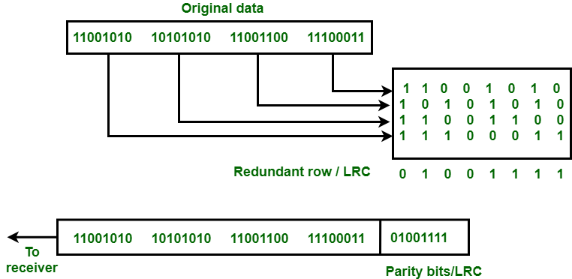
Longitudinal redundancy check
Longitudinal Redundancy Check (LRC) is also known as 2-D parity check.
In this method, data which the user want to send is organised into tables of rows and columns.
A block of bit is divided into table or matrix of rows and columns. In order to detect an error, a redundant bit is added to the whole block and this block is transmitted to receiver.
The receiver uses this redundant row to detect error. After checking the data for errors, receiver accepts the data and discards the redundant row of bits.

Slide 26
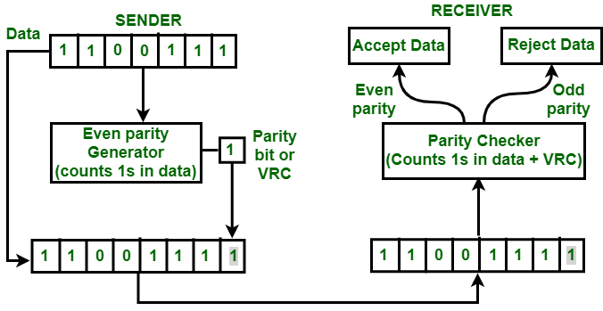
Vertical redundancy check
Vertical Redundancy Check is also known as Parity Check. In this method, a redundant bit also called parity bit is added to each data unit. This method includes even parity and odd parity.
Even parity means the total number of 1s in data is to be even and odd parity means the total number of 1s in data is to be odd.

Slide 27
Cyclic Redundancy Check (CRC)
Unlike the checksum scheme, which is based on addition, CRC is based on binary division.
In CRC, a sequence of redundant bits, called cyclic redundancy check bits, are appended to the end of the data unit so that the resulting data unit becomes exactly divisible by a second, predetermined binary number.
At the destination, the incoming data unit is divided by the same number. If at this step there is no remainder, the data unit is assumed to be correct and is therefore accepted.
A remainder indicates that the data unit has been damaged in transit and therefore must be rejected.
CRC is based on binary division and is also called “polynomial code checksum.”

Slide 28
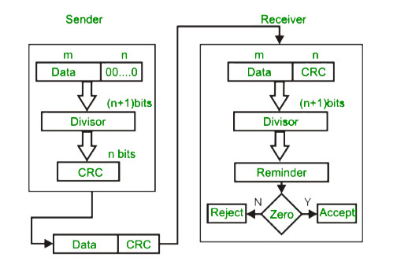

Slide 29
Example
Find the CRC for data blocks 100100 with the divisor 1101?
So. Process consists of two parts i.e
Sender side and
Receiver side

Slide 30
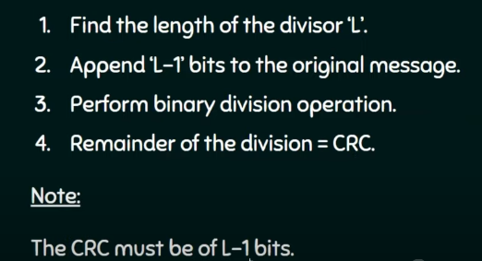
Sender side
Note: Binary division operation = Ex-OR operation

Slide 31
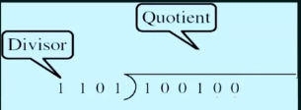
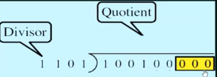
Steps
Step 1: L = 4, hence add (append) L-1 zeros to original message i.e, 3 zeros
Step 2: Do the binary division operation

Slide 32
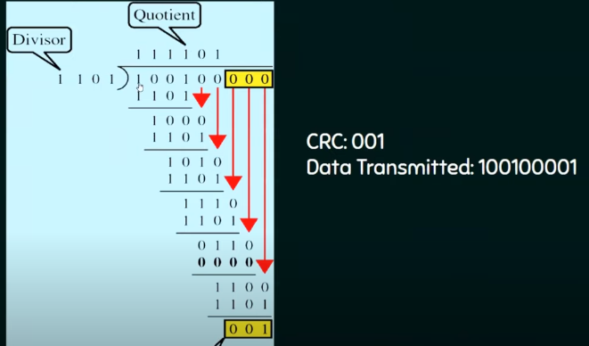

Slide 33
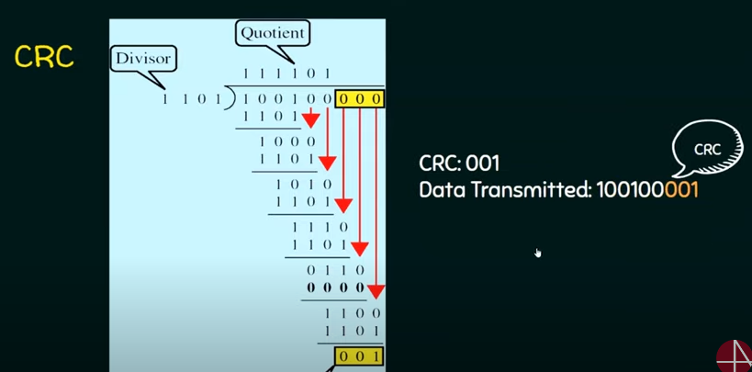
Receiver side

Slide 34
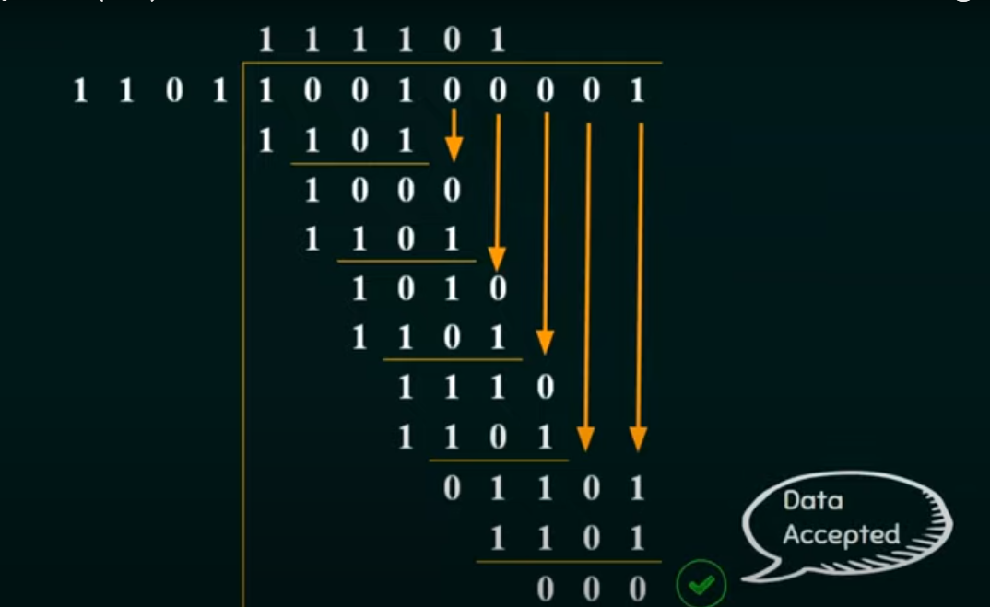
More details: https://www.youtube.com/watch?v=wQGwfBS3gpk

Slide 35
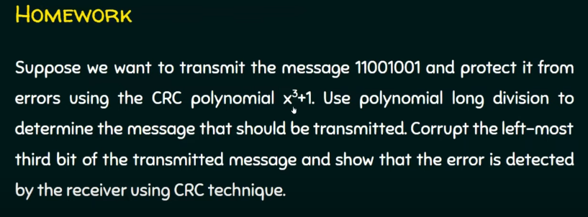
Find CRC for 1110010101 with the divisor X3+X2+1?
2.

Slide 36
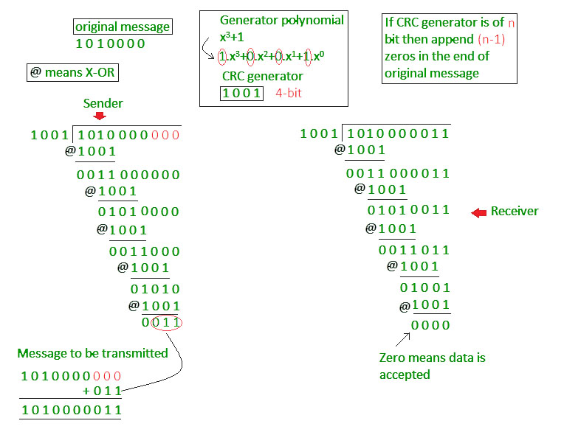

Slide 37
Error detection and Correction
(Hamming Code)

Slide 38
Reliable Transmission

Slide 39
Introduction
Frames are sometimes corrupted while in transit, with an error code like CRC used to detect such errors. While some error codes are strong enough also to correct errors, in practice the overhead is typically too large to handle the range of bit and burst errors that can be introduced on a network link.
Even when error-correcting codes are used (e.g., on wireless links) some errors will be too severe to be corrected. As a result, some corrupt frames must be discarded.
Reliable delivery is usually accomplished using a combination of two fundamental mechanisms—acknowledgments and timeouts.

Slide 40
An acknowledgment (ACK for short) is a small control frame that a protocol sends back to its peer saying that it has received an earlier frame.
The receipt of an acknowledgment indicates to the sender of the original frame that its frame was successfully delivered.
If the sender does not receive an acknowledgment after a reasonable amount of time, then it retransmits the original frame. This action of waiting a reasonable amount of time is called a timeout.
The general strategy of using acknowledgments and timeouts to implement reliable delivery is sometimes called automatic repeat request (abbreviated ARQ).

Slide 41
Reliable transmission Protocols
Stop and Wait ARQ
Sliding Window Protocol
Sliding window protocol has two types:
Go-Back-N ARQ
Selective Repeat ARQ

Slide 42
Stop-and-Wait ARQ
The simplest ARQ scheme is the stop-and-wait algorithm. The idea of stop-and-wait is straightforward:
After transmitting one frame, the sender waits for an acknowledgment before transmitting the next frame.
If the acknowledgment does not arrive after a certain period of time, the sender times out and retransmits the original frame.

Slide 43
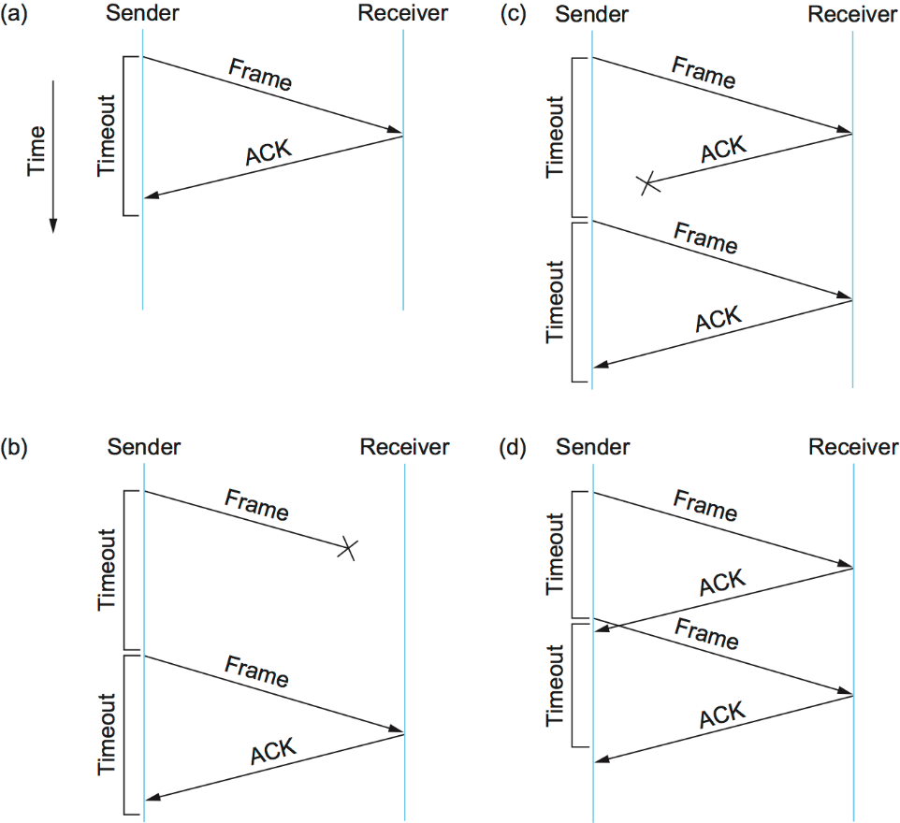

Slide 44
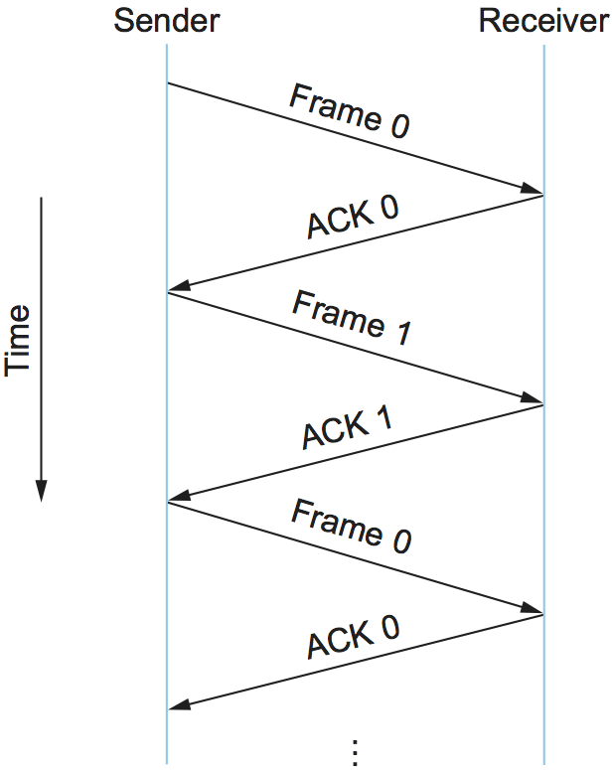
Used in Connection-oriented communication.
It offers error and flows control
In both cases, the sender times out and retransmits the original frame, but the receiver will think that it is the next frame, since it correctly received and acknowledged the first frame. This has the potential to cause duplicate copies of a frame to be delivered.
To address this problem, the header for a stop-and-wait protocol usually includes a 1-bit sequence number—that is, the sequence number can take on the values 0 and 1—and the sequence numbers used for each frame alternate

Slide 45
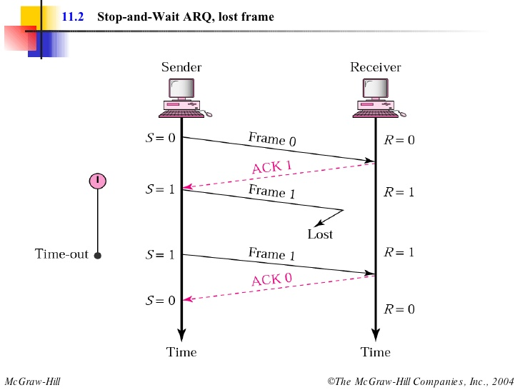

Slide 46
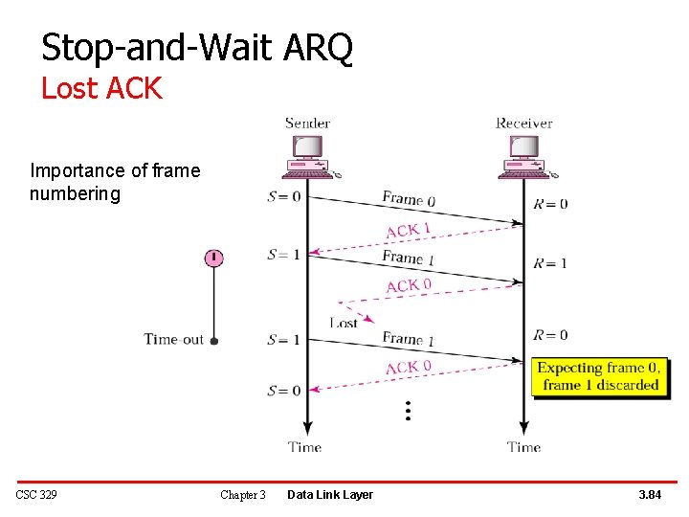

Slide 47
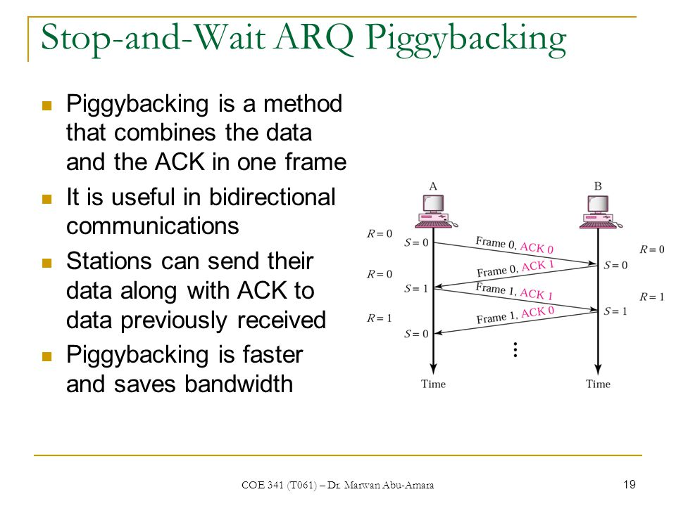
The main shortcoming of the stop-and-wait algorithm is that it allows the sender to have only one outstanding frame on the link at a time, and this may be far below the link’s capacity.

Slide 48
Sliding Window Protocol
The sliding window is a technique for sending multiple frames at a time. Sliding window protocols are data link layer protocols for reliable and sequential delivery of data frames. The sliding window is also used in Transmission Control Protocol.
In this protocol, multiple frames can be sent by a sender at a time before receiving an acknowledgment from the receiver. The term sliding window refers to the imaginary boxes to hold frames. Sliding window method is also known as windowing.
Sliding window protocol has two types:
Go-Back-N ARQ
Selective Repeat ARQ

Slide 49
Go-Back-N ARQ
Go-Back-N ARQ protocol is also known as Go-Back-N Automatic Repeat Request.
It is a data link layer protocol that uses a sliding window method. In this, if any frame is corrupted or lost, all subsequent frames have to be sent again.
For example, Go-Back-8, the size of the sender window, will be 8. The receiver window size is always 1.

Slide 50
It uses the principle of protocol pipelining in which the multiple frames can be sent before receiving the acknowledgment of the first frame.
If we have five frames and the concept is Go-Back-3, which means that the three frames can be sent, i.e., frame no 1, frame no 2, frame no 3 can be sent before expecting the acknowledgment of frame no 1.
The number of frames that can be sent at a time totally depends on the size of the sender's window. So, we can say that 'N' is the number of frames that can be sent at a time before receiving the acknowledgment from the receiver.
If the acknowledgment of a frame is not received within an agreed-upon time period, then all the frames available in the current window will be retransmitted.

Slide 51
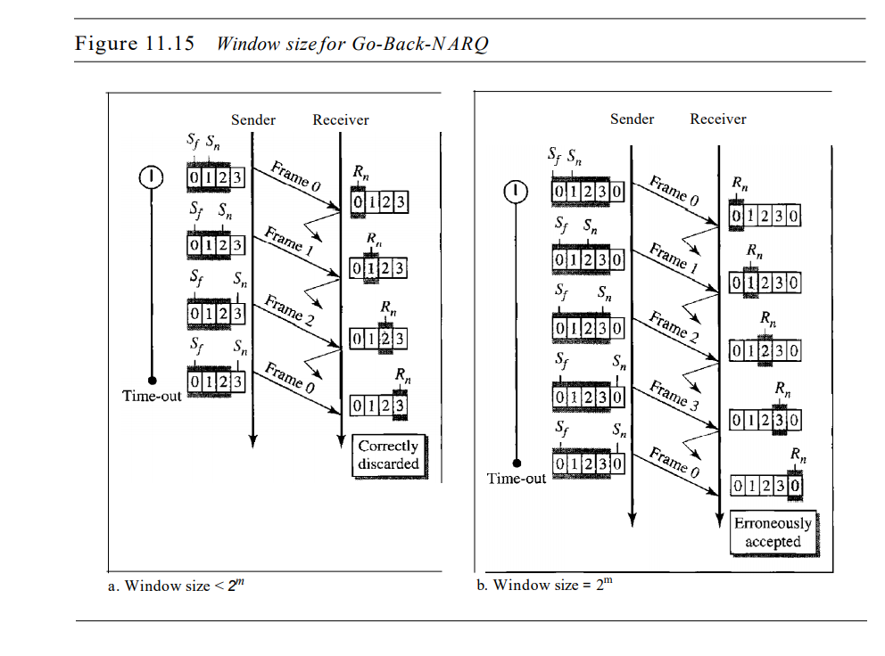

Slide 52
Working example
Suppose there are a sender and a receiver, and let's assume that there are 11 frames to be sent. These frames are represented as 0,1,2,3,4,5,6,7,8,9,10, and these are the sequence numbers of the frames.
Let's consider the window size as 4, which means that the four frames can be sent at a time before expecting the acknowledgment of the first frame.

Slide 53
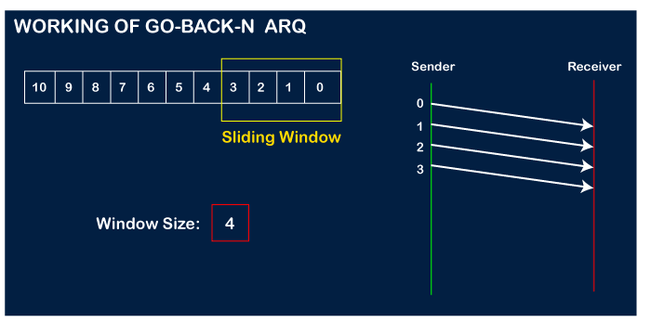
Steps:
Firstly, the sender will send the first four frames to the receiver, i.e., 0,1,2,3, and now the sender is expected to receive the acknowledgment of the 0th frame.

Slide 54
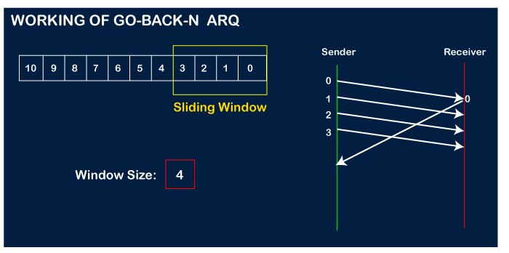
Let's assume that the receiver has sent the acknowledgment for the 0 frame, and the receiver has successfully received it.

Slide 55
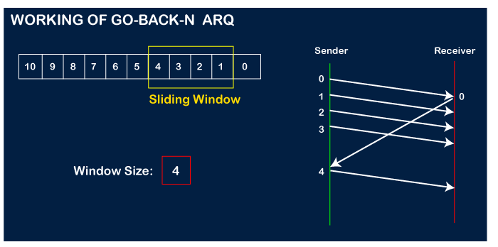
The sender will then send the next frame, i.e., 4, and the window slides containing four frames (1,2,3,4).

Slide 56
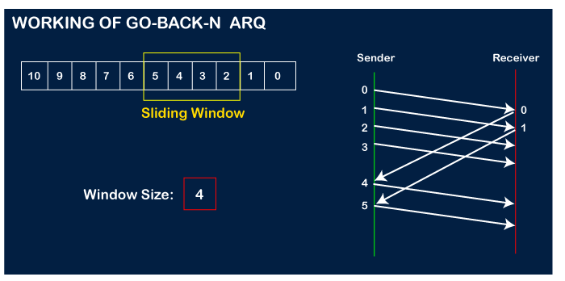
The receiver will then send the acknowledgment for the frame no 1. After receiving the acknowledgment, the sender will send the next frame, i.e., frame no 5, and the window will slide having four frames (2,3,4,5).

Slide 57
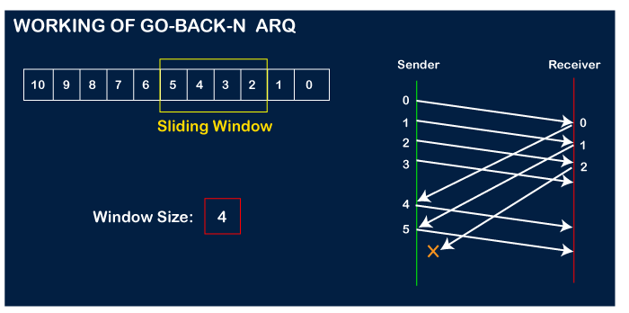
Now, let's assume that the receiver is not acknowledging the frame no 2, either the frame is lost, or the acknowledgment is lost. Instead of sending the frame no 6, the sender Go-Back to 2, which is the first frame of the current window, retransmits all the frames in the current window, i.e., 2,3,4,5.

Slide 58
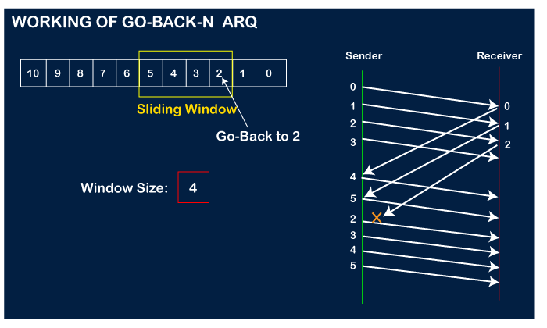

Slide 59
Selective Repeat ARQ
It is also known as the Selective Repeat Automatic Repeat Request.
It is a data link layer protocol that uses a sliding window method.
In this protocol, the size of the sender window is always equal to the size of the receiver window. The size of the sliding window is always greater than 1.
The go-back-n protocol works well if errors are less, but if the line is poor it wastes a lot of bandwidth on retransmitted frames. An alternative strategy, the selective repeat protocol,

Slide 60
It is to allow the receiver to accept and buffer the frames following a damaged or lost one. Selective Repeat attempts to retransmit only those packets that are actually lost (due to errors) :
Receiver must be able to accept packets out of order.
Since receiver must release packets to higher layer in order, the receiver must be able to buffer some packets.
The receiver while keeping track of sequence numbers buffers the frames in memory and sends NACK for only frames which are missing or damaged. The sender will send/retransmit a packet for which NACK is received.

Slide 61
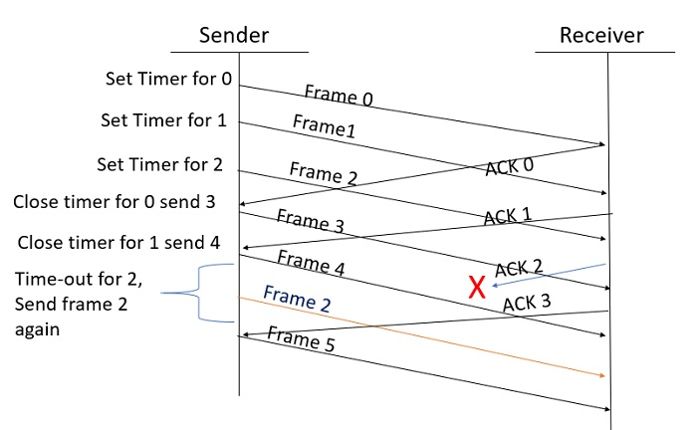
Example

Slide 62
Working process
Step 1 − Frame 0 sends from sender to receiver and set timer.
Step 2 − Without waiting for acknowledgement from the receiver another frame, Frame1 is sent by sender by setting the timer for it.
Step 3 − In the same way frame2 is also sent to the receiver by setting the timer without waiting for previous acknowledgement.
Step 4 − Whenever sender receives the ACK0 from receiver, within the frame 0 timer then it is closed and sent to the next frame, frame 3.
Step 5 − whenever the sender receives the ACK1 from the receiver, within the frame 1 timer then it is closed and sent to the next frame, frame 4.
Step 6 − If the sender doesn’t receive the ACK2 from the receiver within the time slot, it declares timeout for frame 2 and resends the frame 2 again, because it thought the frame2 may be lost or damaged.

Slide 63
