Slide 1
(Border Gateway Protocol(BGP)

Slide 2
BGP references
BGP4: Inter-Domain Routing in the Internet
  by John W. Stewart III
Request for Comments (RFC 1771)
BGP tutorials on the web

Slide 3
Contents of the Talk
Autonomous Systems and Gateways
Inter-domain vs Intra-domain routing
Classless Inter-domain routing
BGP Messages, Attributes and Features
AS Relationships and BGP Policies

Slide 4
Big Picture
Large ISP
Large ISP
Stub
Small ISP
Dial-Up
ISP
Access
Network
Stub
Stub
The Internet contains a large number of diverse networks

Slide 5
Autonomous System(AS)
Internet is not a single network
  Collection of networks controlled by different administrations
An autonomous system is a network under a single administrative control
An AS owns an IP prefix
Every AS has a unique AS number
ASes need to inter-network themselves to form a single virtual global network
  Need a common protocol for communication

Slide 6
Who speaks BGP?
AS2
AS1
BGP
R2
R3
R1
R
border router
internal router
Two types of routers
  Border router(Edge), Internal router(Core)
Two border routers of different ASes will have a BGP
session

Slide 7
Purpose of BGP
you can reach
net A via me
AS2
AS1
BGP
R2
R3
traffic to A
R1
A
table at R1:
dest next hop
A R2
border router
R
internal router
Share connectivity information across ASes

Slide 8
Intra-domain vs Inter-domain
An AS is a routing domain
Within an AS:
  Can run a link-state routing protocol
  Trust other routers
  Scale of network is relatively small
Between ASes:
  Lack of information about other AS’s network (Link-state not possible)
  Crossing trust boundaries
  Link-state protocol will not scale
  Routing protocol based on route propogation

Slide 9
I-BGP and E-BGP
I-BGP
IGP: Interior Gateway Protocol.
Examples: IS-IS, OSPF
IGP
R3
R2
A
AS1
E-BGP
announce B
AS2
R1
AS3
R5
R4
R
border router
internal router
B

Slide 10
Sharing routes
One router can participate in many BGP sessions.
Initially … node advertises ALL routes it wants neighbor to know (could be >50K routes)
Ongoing … only inform neighbor of changes
AS1
BGP Sessions
AS3
AS2

Slide 11
Assigning IP address and AS numbers (Ideally)
A host gets its IP address from the IP address block of its organization
An organization gets an IP address block from its ISP’s address block
An ISP gets its address block from its own provider OR from one of the 3 routing registries:
  ARIN: American Registry for Internet Numbers
  RIPE: Reseaux IP Europeens
  APNIC: Asia Pacific Network Information Center
Each AS is assigned a 16-bit number (65536 total)
  Currently 10,000 AS’s in use

Slide 12
Addressing Schemes
Original addressing schemes (class-based):
  32 bits divided into 2 parts:
  Class A
  Class B
  Class C
CIDR introduced to solve 2 problems:
  exhaustion of IP address space
  size and growth rate of routing table
0
8
0
network
host
0
16
0
network
host
0
24
0
network
~2 million nets
256 hosts
host

Slide 13
Problem #1: Lifetime of Address Space
Example: an organization needs 500 addresses.
A single class C address not enough (256 hosts).
Instead a class B address is allocated. (~64K hosts) That’s overkill -a huge waste.
CIDR allows networks to be assigned on arbitrary bit boundaries.
  permits arbitrary sized masks: 178.24.14.0/23 is valid
  requires explicit masks to be passed in routing protocols
CIDR solution for example above: organization is allocated a single /23 address (equivalent of 2 class C’s).

Slide 14
Problem #2: Routing Table Size
Without CIDR:
232.71.0.0
232.71.1.0
232.71.2.0
…..
232.71.255.0
232.71.0.0
232.71.1.0
232.71.2.0
…..
232.71.255.0
service
provider
Global
internet
With CIDR:
232.71.0.0
232.71.1.0
232.71.2.0
…..
232.71.255.0
service
provider
232.71.0.0/16
Global
internet

Slide 15
CIDR: Classless Inter-Domain Routing
Address format <IP address/prefix P>.
  The prefix denotes the upper P bits of the IP address.
Idea - use aggregation - provide routing for a large number of customers by advertising one common prefix.
  This is possible because nature of addressing is hierarchical
Summarization reduces the size of routing tables, but maintains connectivity.
Aggregation
  scalability and survivability of the Internet
Notes:
Instead of announcing all routes individually ...

Slide 16
BGP Details
Classless Inter-domain Routing
Path-vector protocol
BGP Messages, Attributes
Preference-based routing
Export and Import Policies

Slide 17
BGP: A Path-vector protocol
ner-routes>show ip bgp
BGP table version is 6128791, local router ID is 4.2.34.165
Status codes: s suppressed, d damped, h history, * valid, > best, i - internal
Origin codes: i - IGP, e - EGP, ? - incomplete
Network Next Hop Metric LocPrf Weight Path
* i3.0.0.0 4.0.6.142 1000 50 0 701 80 i
* i4.0.0.0 4.24.1.35 0 100 0 i
i12.3.21.0/23 192.205.32.153 1000 50 0 7018 4264 6468 I
e128.32.0.0/16 192.205.32.153 1000 50 0 7018 4264 6468 25 e
Every route advertisement contains the entire AS path
  generalization of distance vector
Can implement policies for choosing best route
Can detect loops at an AS level

Slide 18
Route Attributes
ORIGIN:
  Who originated the announcement? Where was a prefix injected into BGP?
  IGP, EGP or Incomplete (often used for static routes)
AS-PATH:
  a list of AS’s through which the announcement for a prefix has passed
  each AS prepends its AS # to the AS-PATH attribute when forwarding an announcement

Slide 19
Basic Messages in BGP
Open:
  Establishes BGP session (uses TCP port #179)
  BGP uses TCP
Notification:
  Report unusual conditions
Update:
  Inform neighbor of new routes that become active
  Inform neighbor of old routes that become inactive
Keepalive:
  Inform neighbor that connection is still viable

Slide 20
UPDATE Message
used to either advertise and/or withdraw prefixes
path attributes: list of attributes that pertain to ALL the prefixes in the Reachability Info field
FORMAT:
Withdrawn routes length (2 octets)
Withdrawn routes (variable length)
Total path attributes length (2 octets)
Path Attributes (variable length)
Reachability Information (variable length)

Slide 21
Attribute: Multi-Exit Discriminator (MED)
when AS’s interconnected via 2 or more links
AS announcing prefix sets MED
enables AS2 to indicate its preference
AS receiving prefix uses MED to select link
a way to specify how close a prefix is to the link it is announced on
AS1
Link B
Link A
MED=50
MED=10
AS2
AS4
AS3

Slide 22
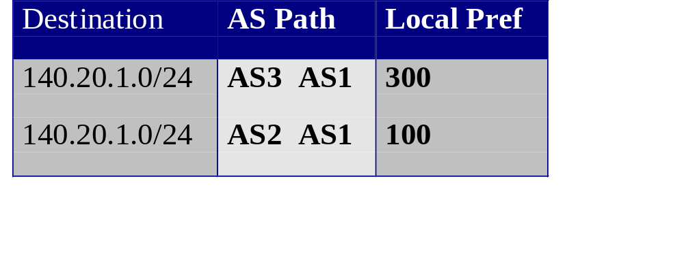
Attribute: Local Preference
140.20.1.0/24
Used to indicate preference among multiple paths for the same prefix anywhere in the internet.
The higher the value the more preferred
Exchanged between IBGP peers only. Local to the AS.
Often used to select a specific exit point for a particular destination
AS1
AS2
AS3
AS4
BGP table at AS4:
Notes:
Because communicated to all IBGP routers within AS, all routers have a common view of how to exit the AS.
This differs from MED in 2 ways: (1) the destination prefix can be anywhere in the internet, not just in the next AS (as in the case for MED). (2) the AS that sets Local_Pref, is also the one that uses it. This allows one node to tell everyone locally what the best way out is.
MED can’t be used in this example because there is exactly one connection between any pair of AS’s.

Slide 23
Choosing best route
Choose route with highest LOCAL_PREF
  Preference-based routing
If multiple choices, select route with shortest hop-count
If multiple choices for same neighboring AS, choose path with max MED value
Choose route based on lowest origin type
  IGP < EGP < INCOMPLETE
Among IGP paths, choose one with lowest cost
Finally use router ID to break the tie.

Slide 24
Routing Process Overview
accept,
deny, set
preferences
Choose
best route
forward,
not forward
set MEDs
Routes
received
from
neighbors
Routes
sent to
neighbors
Import
Policy
Engine
Routes
used by
router
Export
policy
engine
Decision
process
BGP table
IP routing
table
Notes:
Routes used by router are the best routes, and these are the ones that become candidates to readvertise.

Slide 25
Import and Export Policies
Inbound filtering controls outbound traffic
  filters route updates received from other peers
  filtering based on IP prefixes, AS_PATH, community
Outbound Filtering controls inbound traffic
  forwarding a route means others may choose to reach the prefix through you
  not forwarding a route means others must use another router to reach the prefix
Attribute Manipulation
  Import: LOCAL_PREF (manipulate trust)
  Export: AS_PATH and MEDs

Slide 26

Transit vs. Nontransit AS
Transit traffic = traffic whose source and destination are outside the AS
Nontransit AS: does not carry transit traffic
Transit AS: does carry transit traffic
Advertise own routes only
Do not propagate routes learned from other AS’s
case 1:
Advertises its own routes PLUS routes
learned from other AS’s
ISP1
r3
ISP2
ISP1
r3
ISP2
r1
r1
r1
r3
r1
r3
r2
r2
r2,r3
r2,r1
AS1
AS1
r2
r2
case 2:
r1
AS2
r3
r1
r3
r2
r2
AS1
r2

Slide 27
AS relationships, Export rules
AS has customers, providers and peers
Relationships between AS pairs:
  customer-provider
  peer-to-peer
Type of relationship influences policies
Exporting to provider:
AS exports its routes & its customer’s routes, but not routes learned from other providers or peers
Exporting to peer:
(same as above)
Exporting to customer:
AS exports its routes plus routes learned from its providers and peers

Slide 28
Customer-Transit problem
Large ISP
Large ISP
r1
r3
r1
r3
r2,r3
r2,r1
Small ISP
r2
Assume that the small ISP is a customer of two large ISPs
If customer ISP does not obey export rules
  forwards advertisements from one large ISP to another
  Carries huge volume of transit traffic between two large
  ISPs

Slide 29
Take-aways
Internet is composed of various ASes which use BGP to inter-network themselves
Internet switched to classless addressing
BGP as a routing protocol
  Path-vector based
  Supports route-aggregation
  Supports preferential routing
  Uses Import and Export policies
BGP is the protocol that “holds” the Internet intact

