Slide 1
Human Activity Recognition
AI/ML Project Using Smartphone Sensor Data

Slide 2
Table of contents
01
02
03
Project Overview
Problem Statement
Objectives
04
05
06
Dataset Used
Model Evaluation
Application

Slide 3
Project Overview
With the rise of smart devices, recognizing human activities using smartphone sensors like accelerometers and gyroscopes has become a powerful tool in AI. This project uses motion sensor data and machine learning to accurately classify activities such as walking, sitting, and jogging.
By combining data preprocessing, feature engineering, and model training, we aim to develop a reliable system with real-world applications in:
Healthcare – Remote monitoring & fall detection
Fitness – Personalized activity tracking
Workplace Safety – Injury prevention in hazardous environments
Rehabilitation – Real-time feedback in physical therapy

Slide 4
Problem Statement
Human Activity Recognition (HAR) is essential for enabling intelligent systems that understand and respond to user behavior. However, traditional methods for activity monitoring often lack automation, adaptability, and real-time capabilities.
With the increasing availability of sensor-rich smartphones, there's an opportunity to build accurate and efficient systems that recognize physical activities from motion data. The challenge lies in effectively processing noisy sensor signals, extracting meaningful patterns, and selecting the right machine learning models to classify different activities.
Our project addresses the need for a scalable, data-driven solution that can:
Accurately classify human activities using sensor data
Operate efficiently in real-time environments
Support diverse applications across healthcare, fitness, safety, and rehabilitation

Slide 5
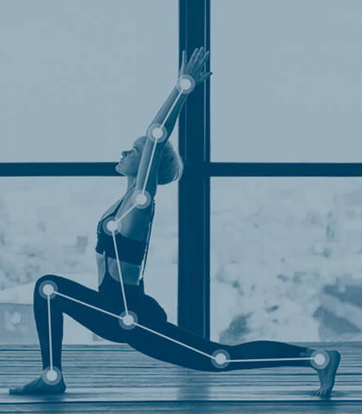
Objectives
Preprocess and clean raw motion sensor data from smartphones
Perform feature engineering to highlight activity-related patterns
Train and evaluate multiple models: Decision Tree, Random Forest, SVM, and LSTM
Compare model performance for accuracy and efficiency
Explore the feasibility of real-time implementation on mobile or wearable devices

Slide 6
Dataset Used
We utilized the Human Activity Recognition Using Smartphones dataset, available from two reputable sources, UCI Machine Learning Repository and Kaggle Dataset
Dataset Details:
Participants: 30 volunteers aged 19–48
Activities: Walking, Walking Upstairs, Walking Downstairs, Sitting, Standing, Laying
Device: Samsung Galaxy S II smartphone (worn on the waist)
Sensors:
Accelerometer – measures body acceleration
Gyroscope – measures body angular velocity
Sampling Rate: 50 Hz (i.e., 50 readings per second)
Preprocessing:
Data segmented into 2.56-second windows (128 readings each)
Windows are labeled based on activity performed
Versions:
Raw signal data
Feature-engineered data (561 features extracted per window)
4. These datasets provide robust input for training machine learning models to accurately classify human activities.

Slide 7
Model Evaluation
We evaluated our models using standard classification metrics and visual tools:
Evaluation Metrics:
Accuracy – Measures how many predictions were correct overall
Precision – Measures how many predicted activities were actually correct
Recall – Measures how many actual activities were correctly identified
F1 Score – Combines precision and recall into a single score
Confusion Matrix: Shows which activities were misclassified and helps understand which activities are difficult to distinguish
Model Comparison: Compared classical machine learning models (Decision Tree, Random Forest, SVM) with deep learning (LSTM)
Analyzed differences in:
Accuracy and F1 score
Training time
Performance on test data
This helped us identify the best model for accurate and efficient activity recognition.

Slide 8
Applications
Healthcare Enables continuous remote monitoring of patients, especially the elderly or those with mobility issues. The system can detect abnormal movement patterns or falls and send alerts to caregivers or medical staff in real time.
Fitness Tracking Enhances fitness apps by accurately identifying different exercises and activity levels. Can provide users with tailored feedback, track progress, and recommend adjustments to workout routines.
Workplace Safety Useful in industrial or hazardous work environments (like construction or manufacturing). It can monitor worker movements to detect unsafe behavior, ensure compliance with safety protocols, and help prevent injuries.
Rehabilitation Programs Assists physiotherapists by tracking patient activity during recovery exercises. Offers real-time insights into performance, adherence to prescribed routines, and progress over time, improving treatment outcomes.

Slide 9
Research references
UCI Human Activity Recognition Dataset https://archive.ics.uci.edu/dataset/240/human+activity+recognition+using+smartphones
Kaggle HAR Dataset https://www.kaggle.com/datasets/uciml/human-activity-recognition-with-smartphones
Introduction to Human Activity Recognition https://towardsdatascience.com/human-activity-recognition-har-tutorial-with-ml-and-deep-learning-30f9f6f04f0f
Understanding Accelerometer and Gyroscope Data https://learn.sparkfun.com/tutorials/accelerometer-basics/all

Slide 10
Thanks
Sameer Shukla
Himanshu Gupta
Akshat Gupta
E23CSEU1101
E23CSEU1096
E23CSEU1087

