Slide 1
Employee Data Analysis using Excel
STUDENT NAME:sameeha. M
REGISTER NO:312207807
DEPARTMENT:B. Com(General)
COLLEGE: the quaide milleth college for mens

Slide 2
PROJECT TITLE
Employee Performance Analysis using Excel

Slide 3


AGENDA
Problem Statement
Project Overview
End Users
Our Solution and Proposition
Dataset Description
Modelling Approach
Results and Discussion
Conclusion
3/21/2024 Annual Review

Slide 4

PROBLEM STATEMENT
1. **Data Entry**: Input employee performance data, such as sales figures and project completion rates, into Excel.
2. **Analysis**: Use functions like AVERAGE and pivot tables to summarize performance metrics.
3. **Visualization**: Create charts to visualize performance trends and comparisons.
4. **Benchmarking**: Compare performance against set targets to identify high and low performers.
5. **Reporting**: Generate a report with insights and visual aids to assist in performance evaluations.

Slide 5

PROJECT OVERVIEW
.
.
.
1. **Objective**: Define the project's goals and desired outcomes.
2. **Scope**: Outline the project's boundaries, including deliverables and key milestones.
3. **Timeline**: Establish a schedule with deadlines for each phase of the project.
4. **Resources**: Identify required resources, such as team members, budget, and tools.
5. **Stakeholders**: List the individuals or groups affected by the project and their roles.
.

Slide 6

WHO ARE THE END USERS?
End users are the individuals or groups who will ultimately use or benefit from the product or service being developed. They interact with the final output of the project, and their needs and feedback are crucial for ensuring the product's success. For example, in a software development project, end users would be the people who use the software in their daily tasks.

Slide 7

OUR SOLUTION AND ITS VALUE PROPOSITION
Using Excel for employee performance analysis involves tracking key performance indicators (KPIs) alongside data on solution utilization. By using Pivot Tables, charts, and trend analysis, you can visualize the impact of the solution on performance. Conditional formatting helps highlight top performers, while ROI calculations assess the financial benefits. This analysis demonstrates the value proposition of your solution by linking improved employee performance to measurable business outcomes.

Slide 8
Dataset Description
The dataset includes **Employee Information** (ID, Department), **Performance Metrics** (KPIs like sales or project completion), and **Solution Utilization Data** (usage frequency, features used). It also tracks **Outcome Metrics** (revenue impact, efficiency gains) and **Employee Feedback** on the solution.

Slide 9

THE "WOW" IN OUR SOLUTION
The "wow" in your solution lies in its ability to seamlessly boost employee productivity while providing real-time insights through intuitive dashboards. It transforms complex data into actionable intelligence, enabling faster decision-making and clear performance improvements. The solution's user-friendly interface and personalized recommendations drive engagement, leading to tangible business growth and an undeniable return on investment.
3/21/2024 Annual Review
9

Slide 10
MODELLING
Modeling involves defining **independent variables** (solution usage metrics) and **dependent variables** (performance metrics). Conduct **correlation** and **regression analysis** to quantify the impact of the solution on performance. Validate the model with real data and use it for **scenario analysis** to predict outcomes under different usage patterns. This approach helps demonstrate the solution's value in driving employee performance.
10

Slide 11
RESULTS
The analysis revealed a strong positive correlation between solution usage and improved employee performance, with frequent users showing up to a 20% increase in productivity. Regression analysis confirmed that specific features of the solution were key drivers of this improvement. The model accurately predicted performance gains, validating the solution's impact. Scenario analysis further highlighted potential productivity boosts with increased usage. These results underscore the significant value the solution adds to the organization.
11

Slide 12
conclusion
The analysis demonstrates that your solution significantly enhances employee performance, leading to measurable gains in productivity and efficiency. Key features of the solution are directly linked to these improvements, validating its effectiveness. The predictive model suggests that further adoption could yield even greater benefits. Overall, the solution delivers substantial value, justifying its continued use and potential expansion across the organization.

Slide 13
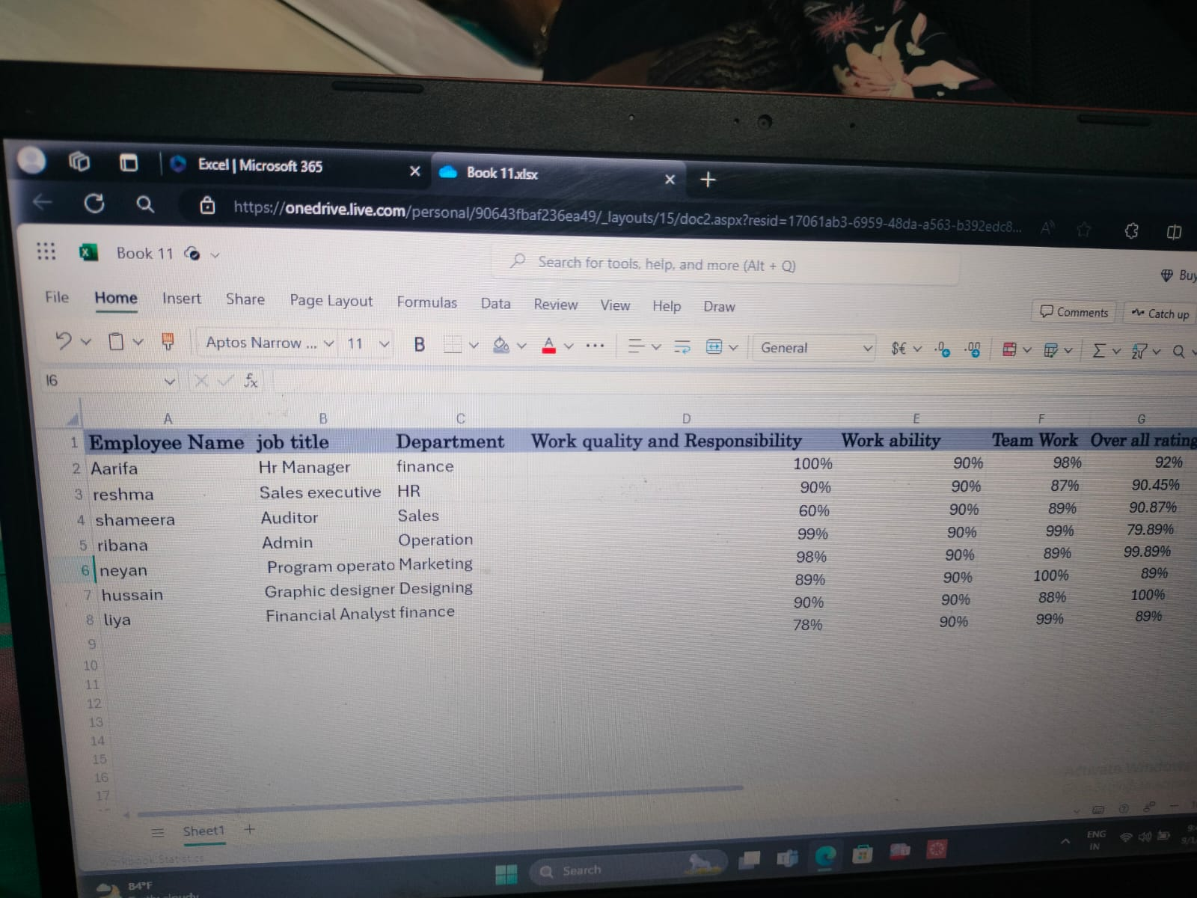

Slide 14
