Slide 1

VendorAI
AI-Powered GST & Business Copilot
An Intelligent GST Automation Platform for Compliance, Tax Optimization, Business Insights, and AI Decision Support
Presented by
Sameeksha Gour
M.Tech (Computer Science – AI/ML)
Jaypee Institute of Information Technology
Python • FastAPI • PostgreSQL • OCR • Machine Learning • LLM • RAG • React • Docker

Slide 2



Why VendorAI?
Businesses, especially MSMEs, face multiple challenges while managing GST and financial operations.
Existing Problems
Proposed Solution
Manual invoice processing
VendorAI integrates AI, OCR, Machine Learning, and Large Language Models into a single platform that automates GST compliance while providing intelligent business recommendations.
Time-consuming GST filing
Missing Input Tax Credit (ITC)
Duplicate or fake invoices
Inventory mismanagement
From manual effort to AI-driven growth
Lack of business insights
Manual
Process
VendorAI
Smart Business
Decisions
Poor cash-flow prediction
No intelligent assistant for GST queries
VendorAI | Problem Statement & Motivation
2

Slide 3
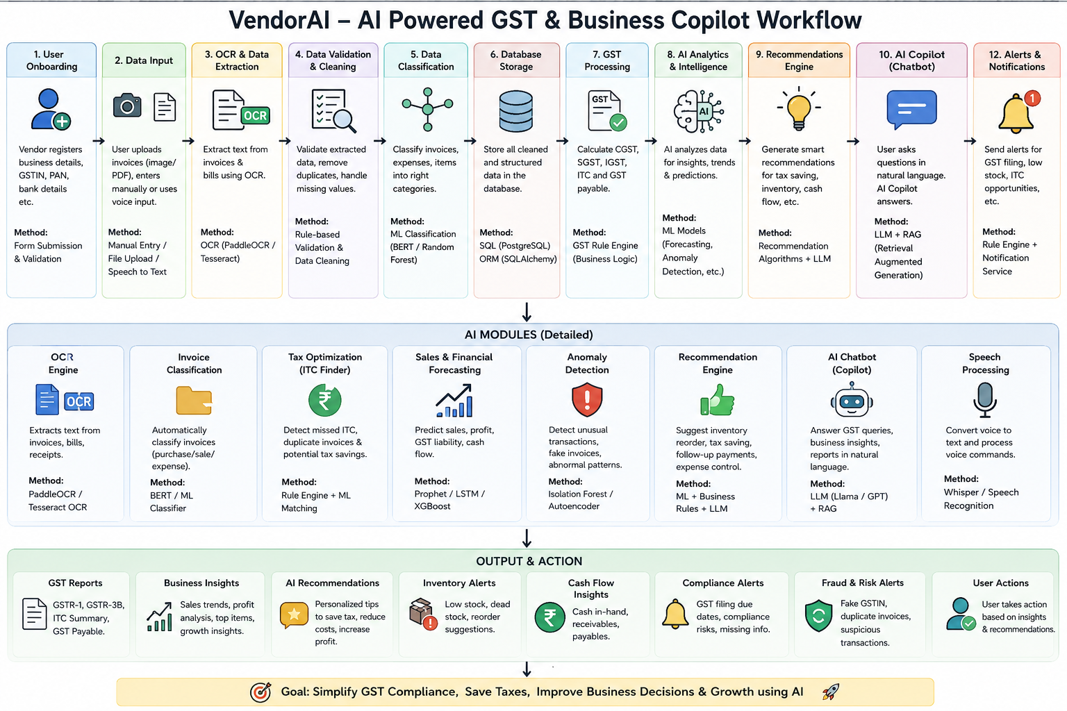
VendorAI Overall Architecture
Workflow
User
Upload Invoice / Voice Input
OCR Engine
Validation & Cleaning
ML Classification
Database
GST Rule Engine
AI Analytics
Recommendation Engine
LLM Copilot
Reports & Alerts
VendorAI | System Architecture
3

Slide 4








Artificial Intelligence Components
Module
Technique Used
Purpose
OCR
PaddleOCR / Tesseract
Extract invoice data
Invoice Classification
BERT / Random Forest
Categorize invoices
ITC Finder
Rule Engine + ML
Detect tax-saving opportunities
Forecasting
Prophet / LSTM
Predict sales & cash flow
Fraud Detection
Isolation Forest / Autoencoder
Detect fake invoices
Recommendation Engine
ML + LLM
Suggest business actions
AI Copilot
Llama / GPT + RAG
Answer GST questions
Speech Module
Whisper
Voice interaction
Benefits
Automation
High Accuracy
Faster Decision Making
Reduced Human Errors
VendorAI | Core AI Modules
4

Slide 5





Major Features & Technology Stack
Business Features
Technology Stack
Automated Invoice Processing
Frontend
React.js
GST Calculation
Backend
FastAPI
ITC Optimization
Database
PostgreSQL
Financial Forecasting
AI / ML
Scikit-learn, PyTorch, Llama, RAG
Fraud Detection
Inventory Alerts
OCR
PaddleOCR
Compliance Monitoring
Deployment
Docker
AI Chatbot
VendorAI | Features & Technologies
5

Slide 6






Output & Expected Impact
Outputs Generated
Expected Benefits
Manual Work
↓ 80%
GST Reports
ITC Summary
Invoice Processing Time
↓ 70%
GST Filing Errors
↓ Significant
Business Dashboard
Cash Flow Prediction
Tax Savings
↑ ITC Utilization
Business Insights
Real-Time
Compliance
Automated
Inventory Alerts
Fraud Alerts
AI Recommendations
GST Chat Assistant
VendorAI | Output & Expected Impact
6

Slide 7




Future Scope & Conclusion
Future Enhancements
Conclusion
Multi-language Support
VendorAI transforms traditional GST management into an AI-driven intelligent ecosystem by integrating OCR, Machine Learning, Forecasting, Recommendation Systems, and Large Language Models. The platform not only automates GST compliance but also provides actionable business intelligence, enabling organizations to save time, reduce costs, maximize tax benefits, and make data-driven decisions.
Mobile Application
AI Voice Assistant
Predictive Tax Planning
Blockchain-based Invoice Verification
Integration with ERP (SAP, Tally, Zoho)
Generative AI Business Advisor
Thank You
Questions & Discussion
VendorAI | Future Scope & Conclusion
7

