Slide 1
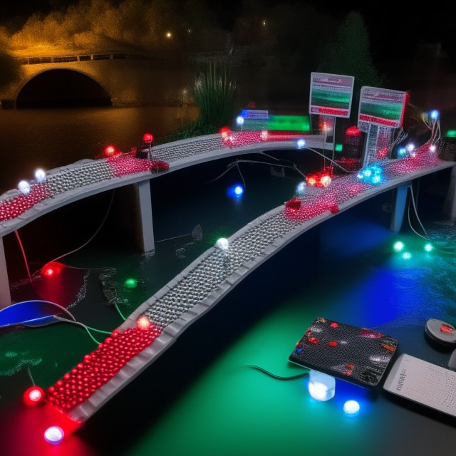
PI-Node BRIDGE
SAMIKSHA BC

Slide 2
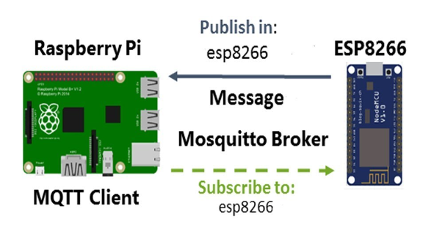
INTRODUCTION
The purpose of this project is to establish communication and connection between Raspberry Pi and ESP8266 (Node-MCU) after triggering MQTT (Message Queuing Telemetry Transport) Server.

Slide 3



Software Requirement
-Arduino IDE for Node-MCU
-Raspbian OS for Raspberry Pi
-Mosquitto Server

Slide 4



Programming language and Libraries
C++ for Node-MCU
Python for Raspberry Pi
Paho MQTT Python for Client

Slide 5
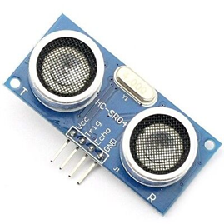
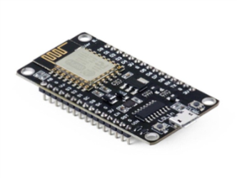
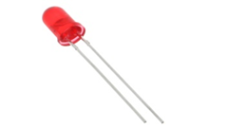
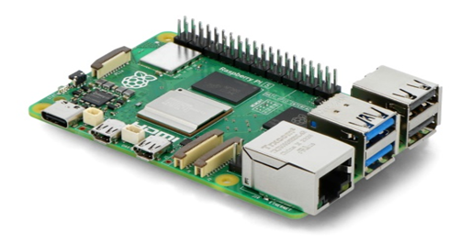
Hardware Requirement
-Raspberry Pi
-Node MCU(ESP8266)
-LED
-Ultrasonic Sensor

Slide 6
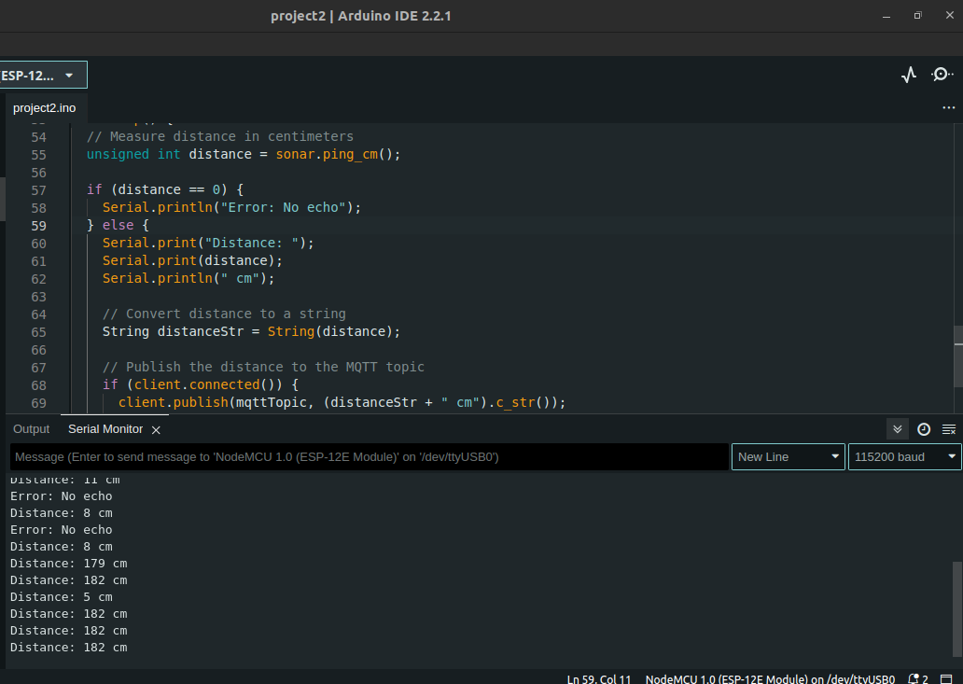
Distance determine by Node MCU
Real-time distance values
determined.

Slide 7
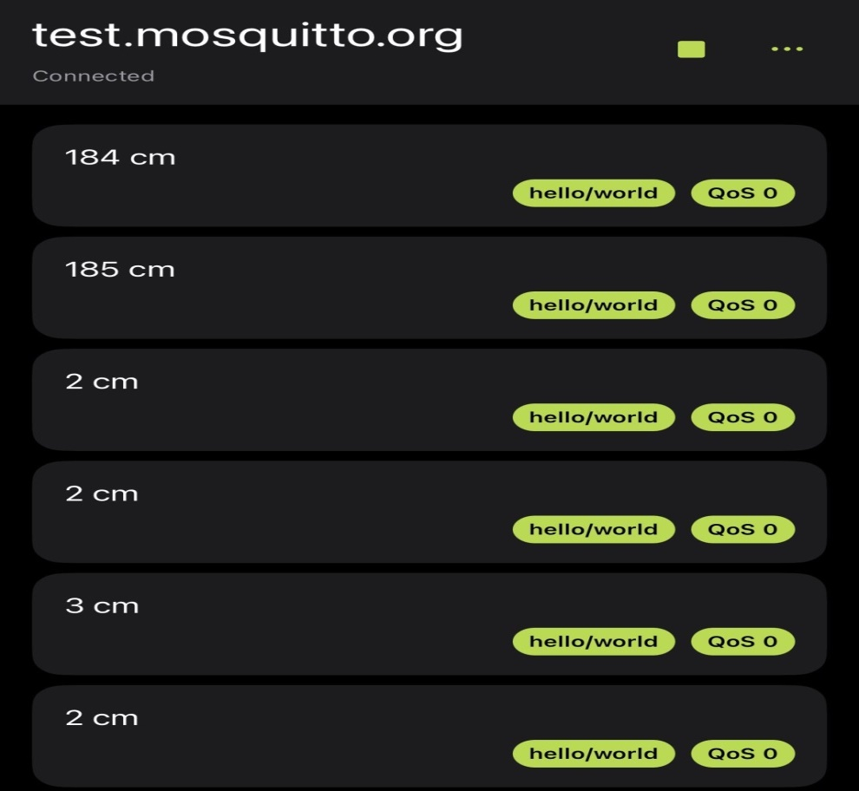
MQTT Routes the Data
MQTT server, with the received data from Node MCU and routing to raspberry pi is illustrated in the attached diagram.

Slide 8
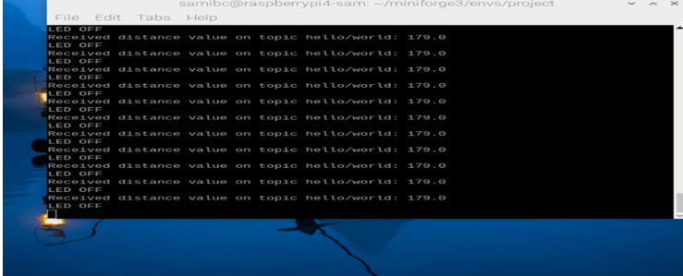
Data Received by Raspberry Pi
Raspberry Pi
Subscribed messages and
controls
LED
based on the received instructions.

Slide 9
Weekly Progress Report
Weekly progress report for the Project :
Hardware Implementation
Software Implementation
and
Research .

Slide 10
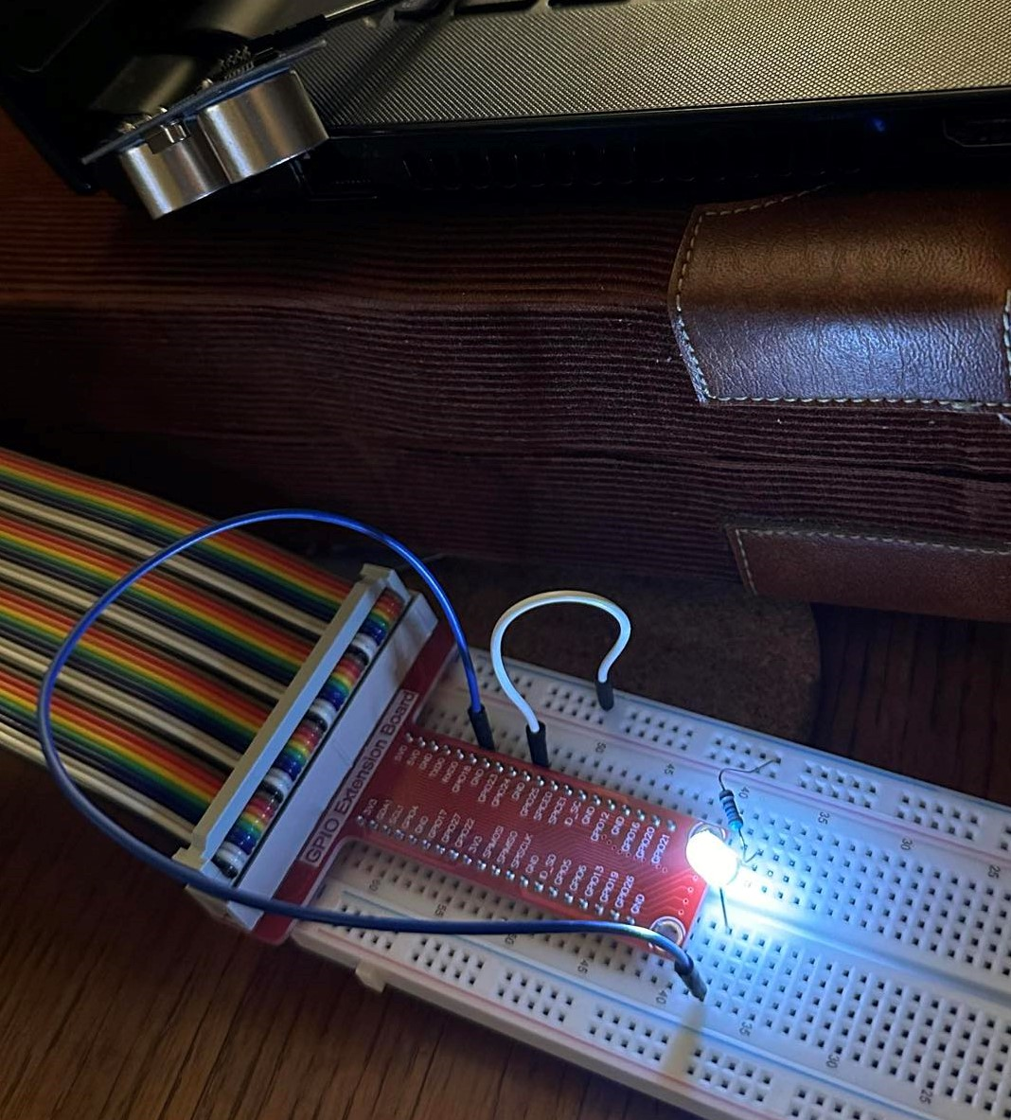
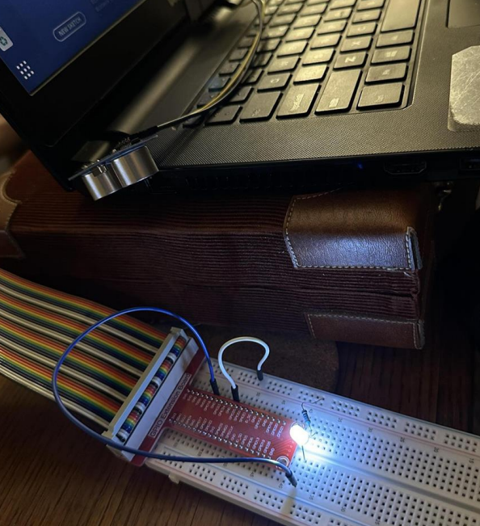
MQTT Working Diagram
Two electronic devices communicating.

Slide 11
Demo Video:
Here Is the project's YouTube demonstration video link showcasing its functionalities and features.
https://www.youtube.com/shorts/gt0mtLpTfgc

Slide 12

Thank You!

