Slide 1


SMART INDIA HACKATHON 2026
SatQuery AI
Agentic Vision-Language Intelligence for Satellite Imagery
PROBLEM STATEMENT ID
PROBLEM STATEMENT TITLE
SIH26167
[ Paste exact PS title from the SIH portal ]
THEME
PS CATEGORY
Space Technology
Software
TEAM ID
TEAM NAME
[ Fill from portal ]
[ Fill — as registered on portal ]
@SIH Idea submission- Template
1

Slide 2



IDEA TITLE
IDEA TITLE
SatQuery AI — one conversational interface, six mandated remote-sensing capabilities, genuinely adapted
What it is
A natural-language agentic assistant over satellite imagery: ask a question and get VQA answers, grounded bounding boxes, bi-temporal change detection with change-VQA, optical+SAR fusion, and zero-shot land-cover search — all from one interface with a downloadable, auditable execution trace.
How it addresses the problem statement
The central vision-language model (Qwen2.5-VL-3B) is genuinely fine-tuned via LoRA on real, image-grounded VRSBench examples — not a generic LLM wrapped in a chat UI. An agentic router validates every input (image count, modality, format, CRS) before dispatching to the correct specialist model.
Innovation and uniqueness
A 5-tier honest fallback chain that never fails silently and names which tier answered every time; confidence scores tagged model-derived vs. heuristic; a live, evidence-driven retraining loop (real bugs diagnosed → real fixes); plus 9 extra capabilities beyond the mandatory scope — multi-instance detection, live ISRO/Copernicus data ingestion, and bilingual voice SITREPs.
@SIH Idea submission- Template
2

Slide 3
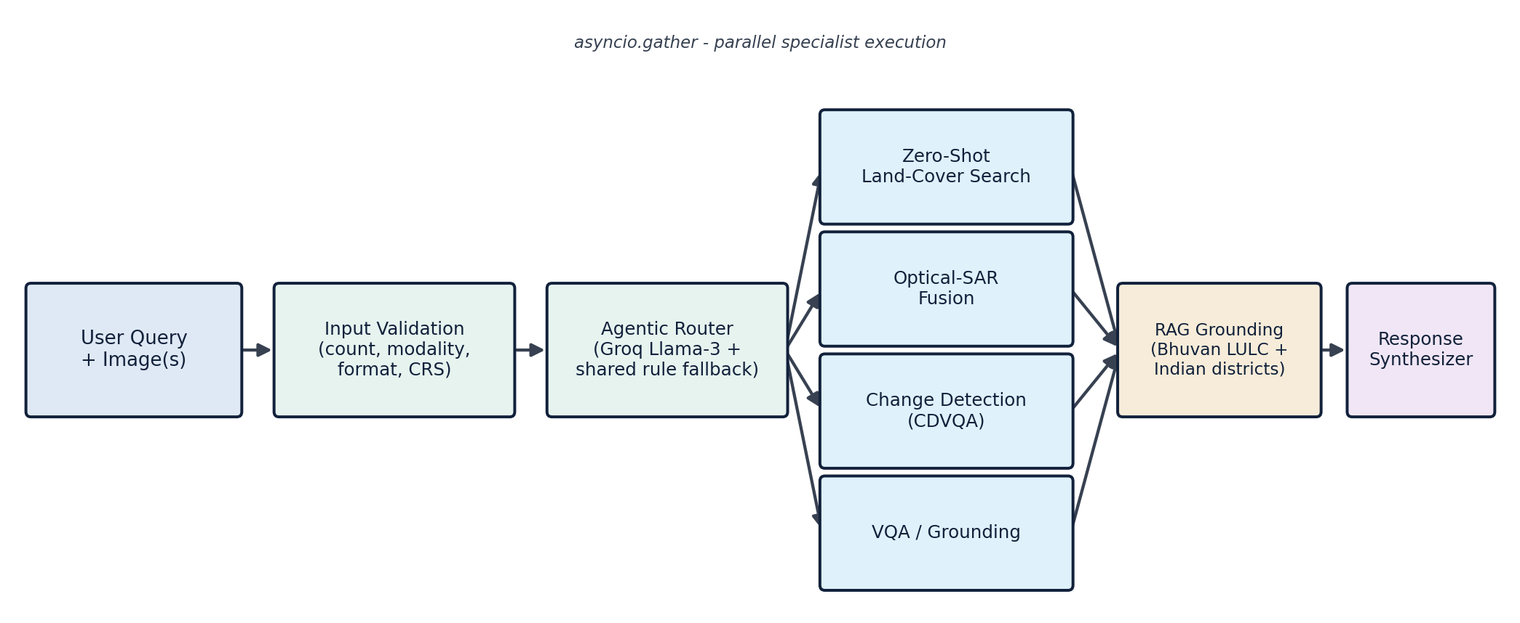
TECHNICAL APPROACH
TECHNICAL APPROACH
TECHNOLOGIES USED
Qwen2.5-VL-3B-Instruct + LoRA
bitsandbytes NF4 4-bit
FastAPI (Python)
React + Vite + Leaflet.js
AdaptFormer-CD / ChangeFormer
RemoteCLIP (ViT-L/14)
Grounding DINO + SAHI
Groq Llama-3-8B
Kaggle T4 GPU + HF Hub
METHODOLOGY — END-TO-END REQUEST PIPELINE
Input validation → agentic routing (Groq Llama-3 + rule fallback) → parallel specialist execution (asyncio.gather) → RAG grounding → response synthesis + audit report
@SIH Idea submission- Template
3

Slide 4



FEASIBILITY AND VIABILITY
FEASIBILITY AND VIABILITY
Feasible today
Risks and challenges
Mitigation strategy
Working end-to-end pipeline — 12/12 benchmark queries pass live
Runs on a single 8 GB consumer GPU
Fine-tuning trained on free-tier Kaggle GPU, near-zero cost
Self-hostable — no dependency on expensive closed APIs
Final ISRO evaluation uses undisclosed Cartosat-2S/RISAT imagery, never seen in development
Grounding localization precision is still being actively hardened
Cloud fallback tiers depend on external API availability
5-tier fallback keeps the system responsive even if a higher tier fails
Continuous evidence-driven retraining targets the grounding gap directly
Roadmap scales to the full VRSBench + BigEarthNet-MM corpus
@SIH Idea submission- Template
4

Slide 5



IMPACT AND BENEFITS
IMPACT AND BENEFITS
WHO BENEFITS
ISRO / NRSC Analysts
NDMA — Disaster Response
MNCFC — Agriculture
MoHUA — Urban Planning
INCOIS — Maritime
State GovTech Portals
Citizens (long-term)
Environmental & disaster impact
Faster flood and land-cover change detection speeds up disaster response and environmental oversight.
Economic impact
Automates manual GIS analysis — cuts turnaround from hours to seconds; a sub-50 KB 2D map runs on cellular data.
Social & accessibility impact
Bilingual (Hindi/English) voice interaction and plain-language answers open satellite analysis to non-expert field officers.
@SIH Idea submission- Template
5

Slide 6

RESEARCH AND REFERENCES
RESEARCH AND REFERENCES
Datasets & Benchmarks
Models & Methods
VRSBench — A Versatile Vision-Language Benchmark for Remote Sensing (NeurIPS 2024)
RSVQA — Visual Question Answering for Remote Sensing Data
CDVQA — Change Detection Meets Visual Question Answering
BigEarthNet.txt — large-scale multi-sensor image-text benchmark
Qwen2.5-VL Technical Report (Qwen Team, Alibaba)
LoRA / QLoRA — low-rank & quantized fine-tuning
GeoChat — Grounded Vision-Language Model for Remote Sensing
Grounding DINO + SAHI — open-set, tiled detection
RemoteCLIP — vision-language foundation model for RS
ChangeFormer / LEVIR-CD — Siamese change detection
Trained adapter (Hugging Face Hub): huggingface.co/Sameelkazi/satquery-qwen25vl-vrsbench-lora-v2
@SIH Idea submission- Template
6

