Slide 1
Data-Driven Insights for Digital Marketing Campaigns

Slide 2
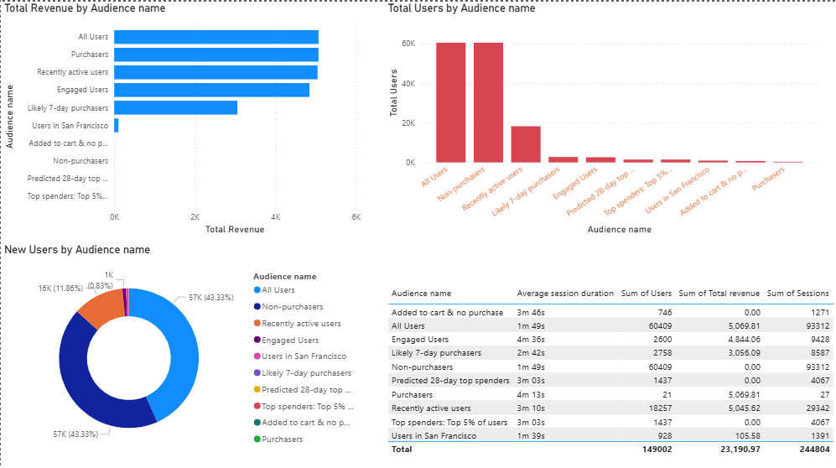
Executive Dashboard

Slide 3
KPI Overview
Total Users: 149K
Total Revenue: 23.19K
Total Sessions: 224.8K
Average Session Duration: ~3 Minutes
Highest Revenue Audience: All Users & Purchasers
Business Insights
Most revenue is generated by All Users and Purchasers.
Non-purchasers form the largest audience but contribute no revenue.
Recently Active Users show strong engagement and conversion potential.
Added to Cart but No Purchase users indicate cart abandonment opportunities.
Targeting high-engagement audiences with personalized campaigns can increase conversions and revenue.

Slide 4
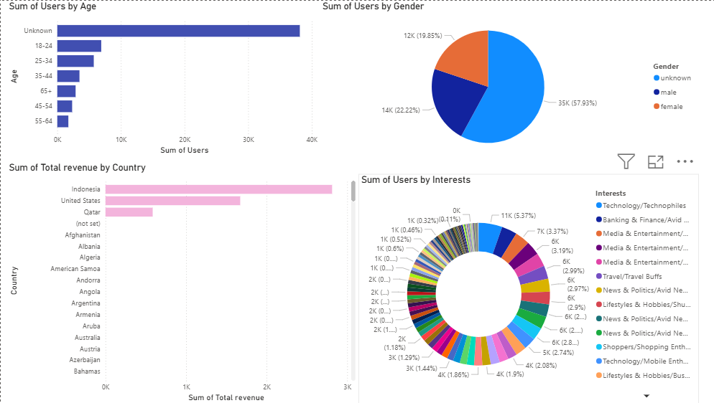
Demographic Analysis

Slide 5
KPI Overview
Top Age Group: Unknown, followed by 18–24 years
Gender Distribution: 58% Unknown, 22% Male, 20% Female
Highest Revenue Country: Indonesia
Second Highest Revenue: United States
Top User Interests: Technology, Banking & Finance, Media & Entertainment
Marketing Insights
The 18–24 age group represents the largest identified audience segment.
A high percentage of unknown demographic data limits customer analysis.
Indonesia generates the highest revenue, making it a priority market.
Users are primarily interested in Technology and Finance, offering targeted marketing opportunities.
Improving demographic data collection can enable better audience segmentation and campaign performance.

Slide 6
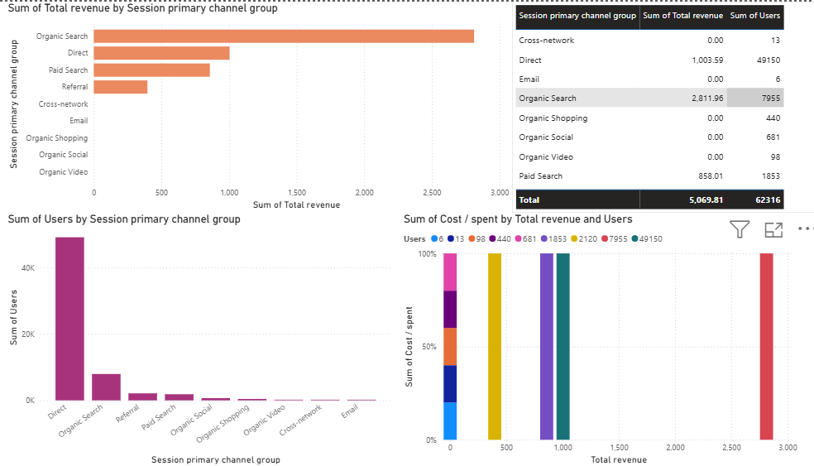
Acquisition Dashboard

Slide 7
KPI Overview
Total Users: 62.3K
Total Revenue: 5.07K
Top Revenue Channel: Organic Search (2.81K)
Highest User Acquisition: Direct (49.1K Users)
Top Performing Channels: Organic Search, Direct & Paid Search
Business Insights
Organic Search generates the highest revenue, highlighting the value of SEO.
Direct traffic brings the most users but has lower revenue per user.
Paid Search contributes steady revenue despite a smaller audience.
Referral traffic has growth potential with optimization efforts.

Slide 8
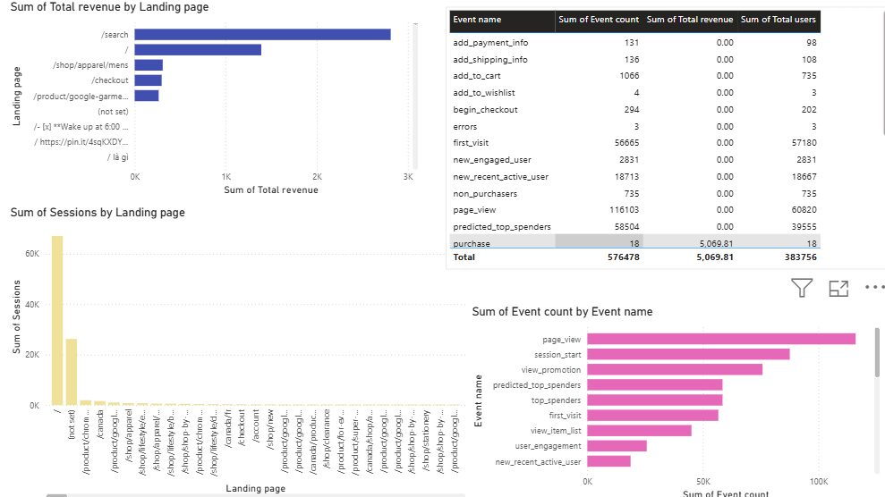
Landing Pages & Events

Slide 9
KPI Overview:
Total Revenue: 5.07K
Total Event Count: 576.48K
Total Users: 383.76K
Top Landing Page: /search
Most Frequent Event: page_view
Business Insights:
The /search landing page generates the highest revenue and traffic.
Page View is the most common event, indicating strong user activity.
High session_start and first_visit events reflect strong user acquisition.
A large gap between Add to Cart and Purchase suggests checkout optimization opportunities.

Slide 10
My Recommendations:
Focus on Organic Search and high-performing channels to maximize ROI.
Target high-intent audiences with personalized campaigns to increase conversions.
Optimize the checkout process to reduce cart abandonment and improve purchases.
Improve top landing pages with better CTAs and user experience.
Use demographic and behavioral insights to deliver personalized marketing campaign.

Slide 11
THANK YOU
Name

