Slide 1
Intro to Python
Material adapted from previous workshops by Benjamin Z. Rudski and Najia Bouaddouch
Lead: Sameena Karsan
Facilitator: James Randolph
February 18, 2026

Slide 2

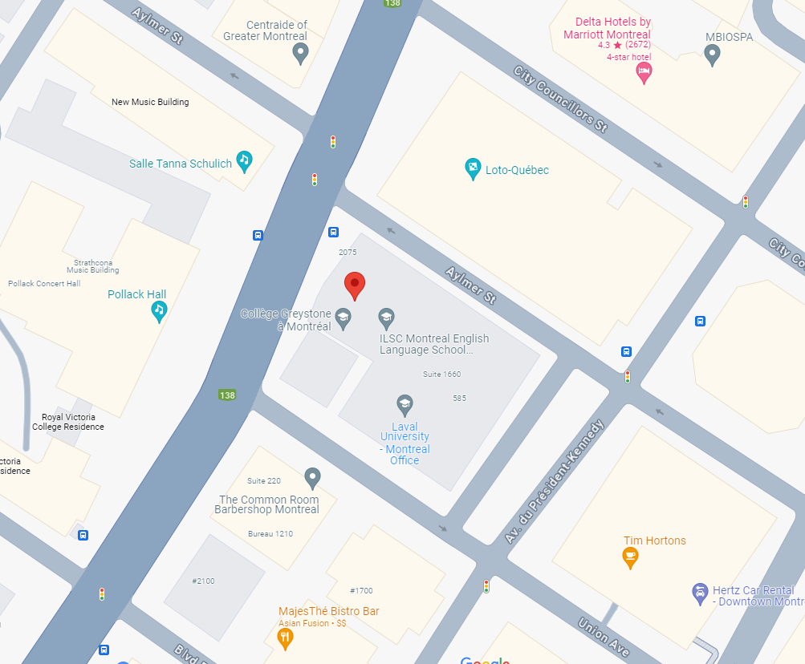
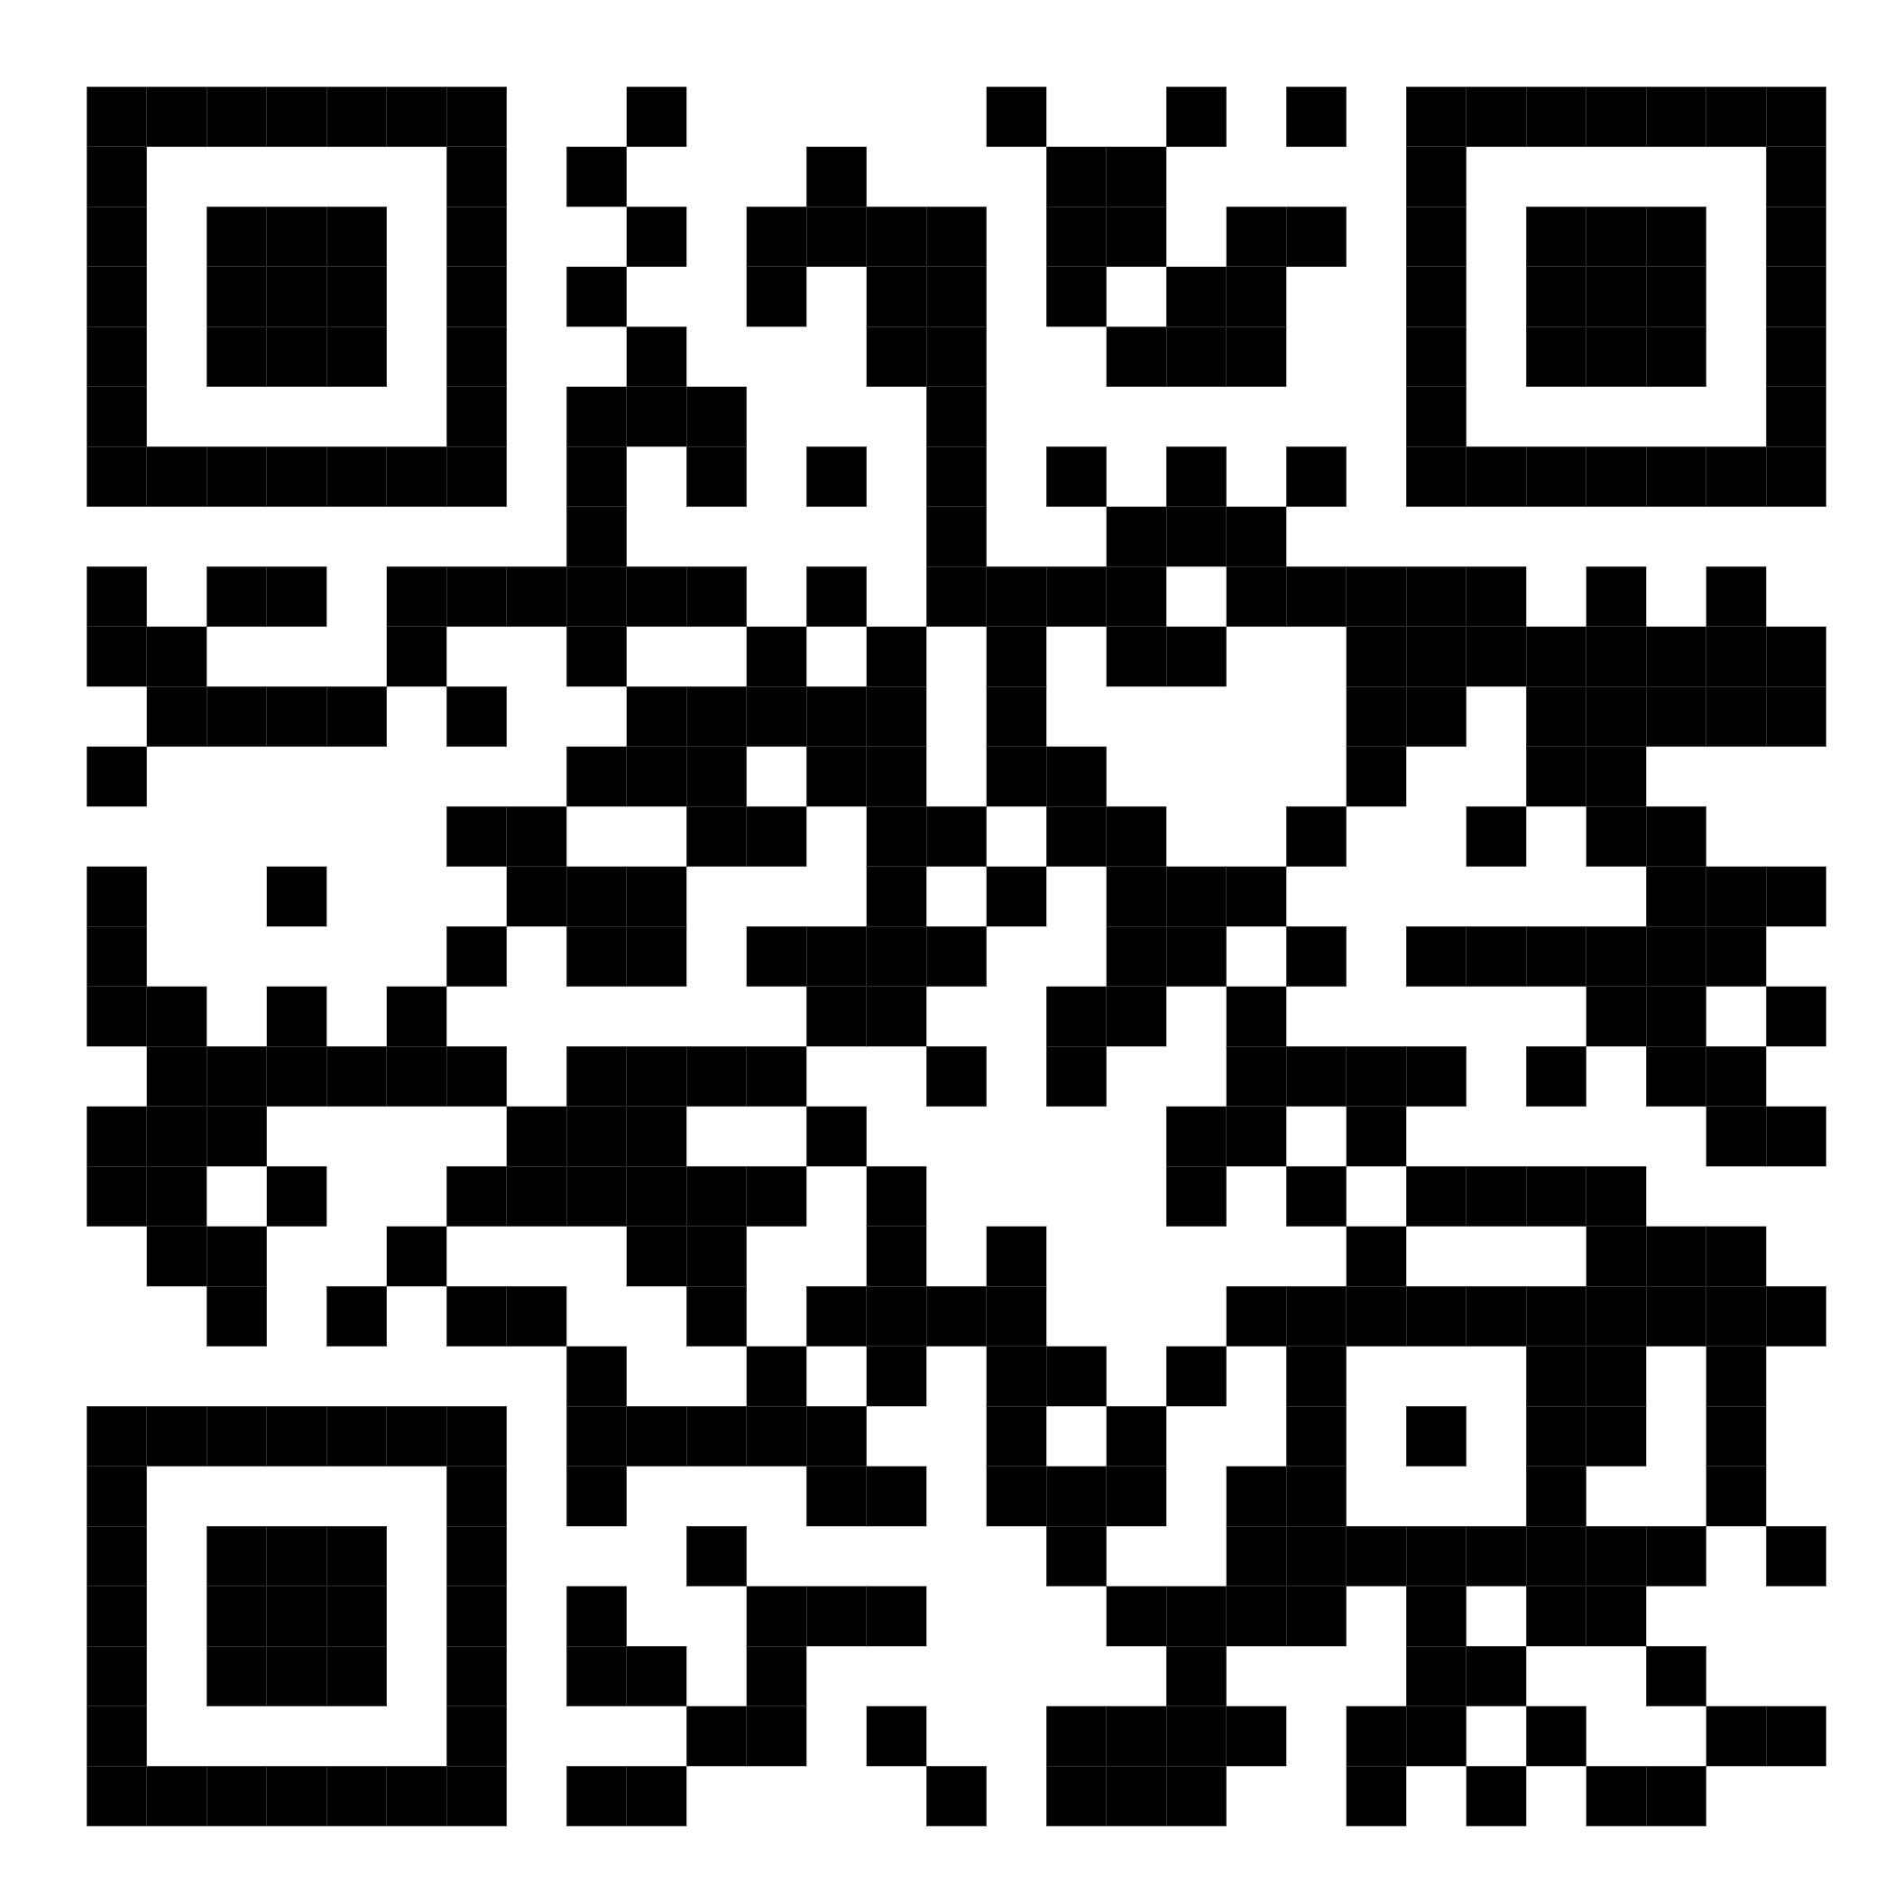
QLS-MiCM mission statement: deliver quality workshops designed to help biomedical researchers develop the skills they need to succeed.
Location: 550 Sherbrooke Street, Montreal, Quebec
Scan the QR code to sign up
for our mailing list
Contact: workshop-micm@mcgill.ca

Slide 3
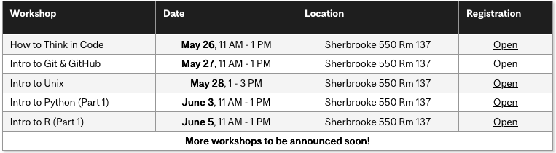
Workshop Series
https://www.mcgill.ca/micm/training/workshops-series

Slide 4
Learning Outcomes
Summary
In this 2-hour workshop, participants will be introduced to the basics of programming in Python. Students will journey from the beginnings of creating variables and performing simple mathematical operations to writing code that can perform fundamental tasks and wrapping this code into functions. Participants will learn how to write the important building blocks that make up complex programs.
Learning Objectives
Store data in variables and collections.
Perform basic operations on these data.
Use control flow and loops to write powerful code.
Define functions to create repeatable units of behaviour.

Slide 5
Outline
Module 1 – Python Basics (30 minutes)
  Hello, World!
  Variables
  Numbers and Comparisons
  Intro to strings
  Exercise
Module 2 – Collections (30 minutes)
  Lists and List Methods
  Tuples
  Dictionaries
  Exercise

Slide 6
Outline
Module 3 - Intro to Control Flow and Loops (30 minutes)
  Control Flow: the if statement
  Loops
  Exercise
Module 4 – Introduction to Functions (25 minutes)
  Function Overview
  Writing Custom Functions
  Documenting Functions
  To script, or not to script?
  Exercise
Module 5 – Where to go from here (5 minutes)

Slide 7
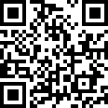
Interactive Workshop!
That’s pretty much all that will be in the slides… For the rest, we’ll go to a Jupyter Notebook:
To the repository!

Slide 8
To summarize
Data can be stored in variables of several types, including strings, integers, floating point numbers and Booleans.
Collection types, such as tuples, lists and dictionaries can be used to store multiple data points.
Control flow and loops help decide which lines to run and allow lines to be repeated.
Functions help package up behaviour into units that you can easily reuse.
Now you are ready to:
Store data in variables and collections.
Perform basic operations on these data.
Use control flow and loops to write powerful code.
Write functions to repeat complicated tasks.

Slide 9
Acknowledgements
Thank you to QLS-MiCM for giving me this opportunity and for helping me along the way.
Thank you to Najia Bouaddouch for her workshop material.
Thank you to the professors from the McGill School of Computer Science for helping me along my programming journey and for inspiring me to share my programming experience with others.
Thank you to Professor Mathieu Blanchette, whose COMP 204 course helped introduce me to Python (back in Fall 2018).
Thank you to the Python community!

Slide 10
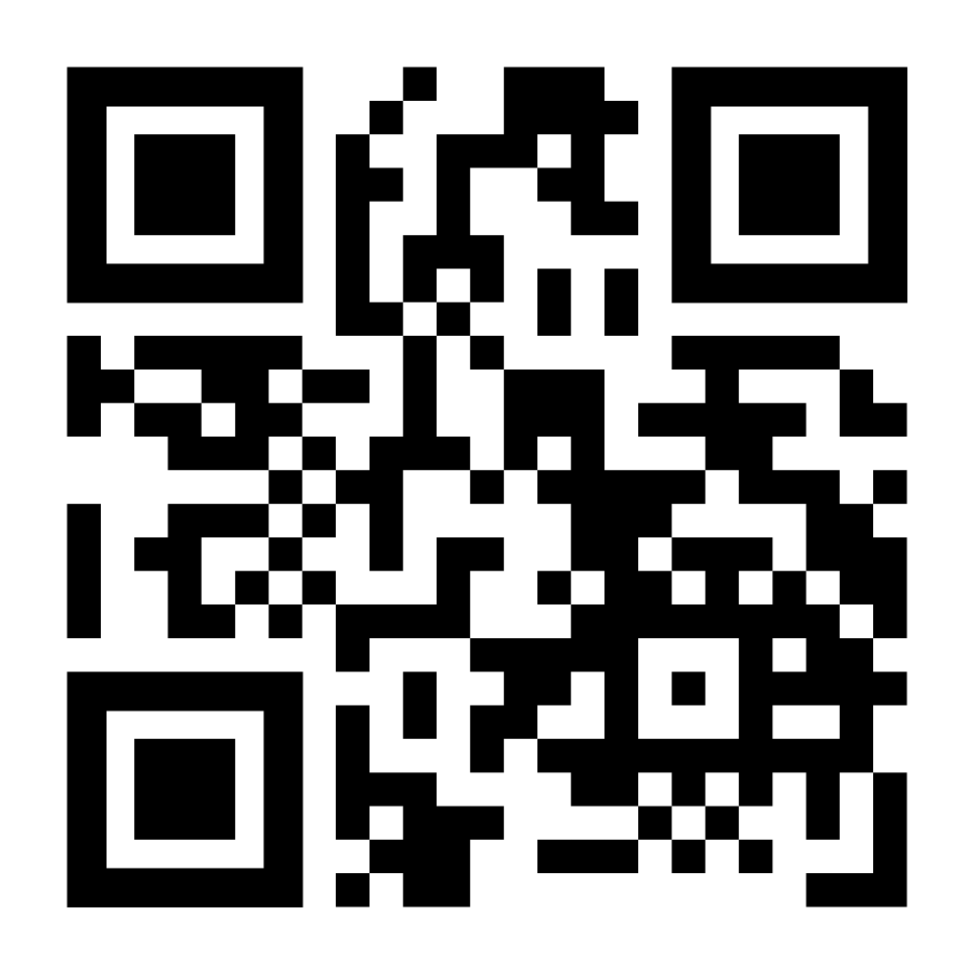
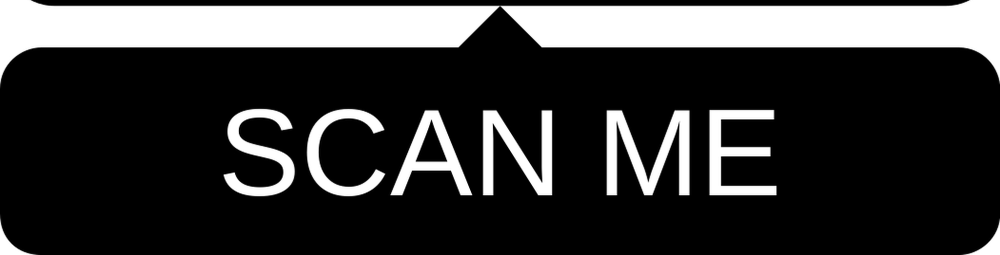
Feedback

