Slide 1

Karachi Citizen Helper
Essential Karachi services, simplified.
WEB DEVELOPMENT PROJECT

Slide 2

The Problem
📍 Where do I go?
📋 What do I need?
No single place to find offices, hospitals, or government services
Unclear procedures and required documents for basic civic tasks
📞 Who do I call?
Emergency and helpline numbers scattered across dozens of sources

Slide 3
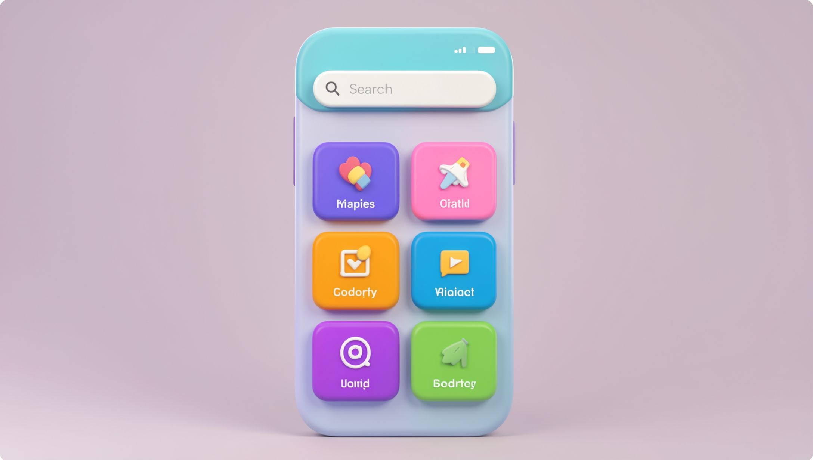

The Solution
One searchable hub
Karachi Citizen Helper organizes verified civic information into a clean, easy-to-navigate experience — linking users directly to official government sources.
Organized by categories users actually need
Verified info, official links — not a replacement for government portals
Fast, simple, mobile-friendly
Aapko kis cheez ki zarurat hai? — You choose. We guide.

Slide 4

How It Works
Open Home Page
View Details
See info and contact details
Start at the main site
Choose Category
Use Official Link
Select a category or area
Open link or view map
A guided path from question to answer — in four simple steps.

Slide 5





Core Categories
Documents
Education
Emergency
CNIC, Domicile, Passport, Driving Licence, Birth Certificate
Universities, Admissions, Scholarships, Entry Tests
Hospitals, Ambulance, Police, Fire Brigade, Helplines
Utilities
Area Finder
Water, Sewerage, Gas, Electricity, Municipal Complaints
Select your area — discover nearby services, offices, and contacts

Slide 6


Area-Based Experience
📍 FUTURE COLONY — EXAMPLE
Select your area. Discover everything nearby.
Nearest Hospital & Pharmacy
Police Station & Emergency Contacts
Government Offices & Schools
Transport Info & Complaint Links

Slide 7
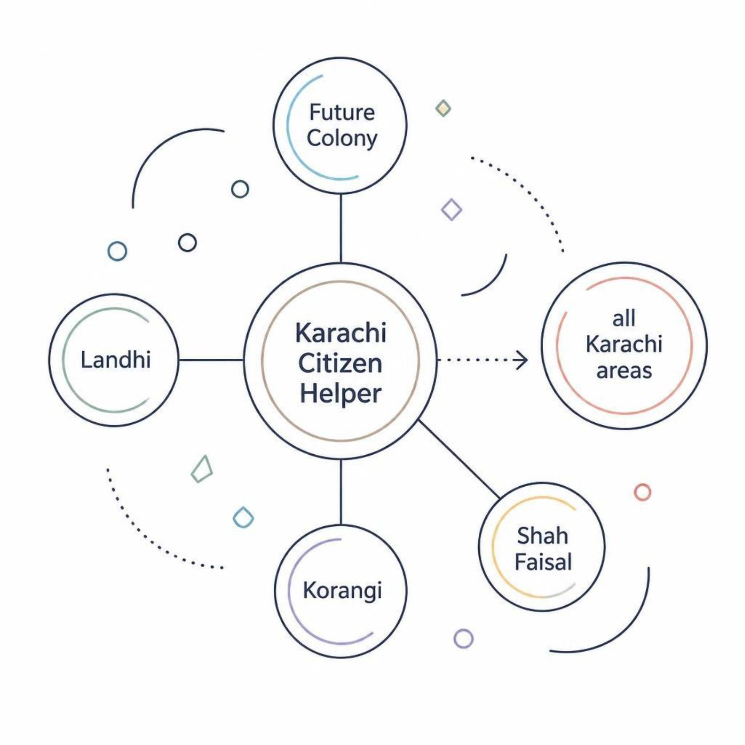
MVP Scope
Start small. Validate fast.
Rather than attempting all of Karachi at once, the MVP launches with four manageable areas.
Future Colony — primary pilot area
Landhi, Korangi, Shah Faisal — adjacent expansion
Test real usage and gather feedback before scaling
Easier to verify and maintain accurate data at small scale

Slide 8





Key Features
Smart Search
Category Nav
Area Filter
Find any service instantly by keyword
Structured browsing by topic and need
Results tailored to your neighborhood
Official Links
Mobile-First UI
Direct access to verified government portals
Designed for phones — where users actually search

Slide 9
Future Expansion
Phase 1 — MVP
1
4 areas live, core categories, verified data
2
Phase 2 — Grow
More Karachi areas, user feedback loop, data updates
Phase 3 — Expand
3
Multilingual support (Urdu), more civic services
4
Phase 4 — Scale
Full Karachi coverage, community-verified information
Every phase is driven by real usage data — not assumptions.

Slide 10

Impact & Conclusion
🕐 Less Time Lost
✅ Less Confusion
Find the right office, number, or procedure in seconds — not hours
Organized, verified civic info — always linked to official sources
🌆 Scalable Impact
Built to grow — from 4 areas to all of Karachi
Start local. Make it useful. Scale Karachi-wide.

