Slide 1

Solar Industries India Limited
Smart Inventory Management System
DS 001
Team ID 6062506344144233981
Team Details:
Shantanu Rajurkar
Sameer Bagde
Shubham Mishra

Slide 2
Project Description
Problem Statement
Design a Smart Inventory Management System that optimizes stock levels, forecasts demand using time series models, and reduces supply chain costs. By leveraging an ETL pipeline and dynamic optimization, the system ensures efficient inventory management and data-driven decision-making.
Objectives
Demand Forecasting Model: To help with precise inventory planning, use time series analysis—more especially, ARIMA—to forecast product demand based on past sales data.
Data Optimization: To ensure effective data flow and usability, apply data optimization strategies to improve and expedite the processing, analysis, and storage of sales and inventory data.
ETL Pipeline: Create and improve an ETL pipeline to clean, structured data for additional modeling by extracting data from MySQL, transforming it in Python, and loading it into an analysis-ready format.
Benefits
Improved Demand Forecasting: Accurate demand predictions using time series models help businesses plan better, ensuring products are available without overstocking or stockouts.
Enhanced Supply Chain Efficiency: Streamlined inventory management reduces bottlenecks, improving overall supply chain performance and responsiveness.

Slide 3
Methodology & Process
ETL Pipeline
Developed a robust pipeline to extract, transform, and load data from MySQL, ensuring seamless and reliable data processing.
Exploratory Data Analysis (EDA)
Analyzed data to identify patterns and trends, driving better forecasting and inventory management decisions.
ARIMA Forecasting
Applied ARIMA to predict future demand, providing a solid foundation for accurate inventory recommendations.
Data Optimization
Enhanced data processing for faster, more efficient analysis, ensuring scalability as the system grows.
Data Preparation
Connect to a MySQL database, retrieve inventory data, clean it, and aggregate by time periods.
ARIMA Model Training
Select 𝑝, 𝑑, 𝑞 parameters, train the ARIMA model on inventory quantities, and evaluate it using AIC/BIC.
Forecasting and Evaluation
Generate inventory forecasts, then assess accuracy with MAE, MAPE, and RMSE.
Inventory Optimization
Report Generation
EOQ: Calculate optimal order size to minimize costs.
Safety Stock: Buffer for demand spikes
Summarize ARIMA and inventory optimization results for actionable insights on inventory management.

Slide 4



Technology Stack
Challenges Faced
Data Integration
Integrating and cleaning data from MySQL and external sources was time-consuming, ensuring consistency across platforms.
Model Accuracy
Fine-tuning the ARIMA model to accurately forecast demand involved a lot of trial and error.
Inventory Optimization Complexity
Balancing multiple factors like holding costs and lead times made the optimization algorithm complex and challenging.
Real-time Data Processing
Ensuring efficient real-time data processing while scaling to handle large datasets was a significant challenge.
Programming Language Database
Platform Used
Machine Learning Algorithms:
Exploratory Data Analysis (EDA)
Autoregressive Integrated Moving Average(ARIMA)

Slide 5
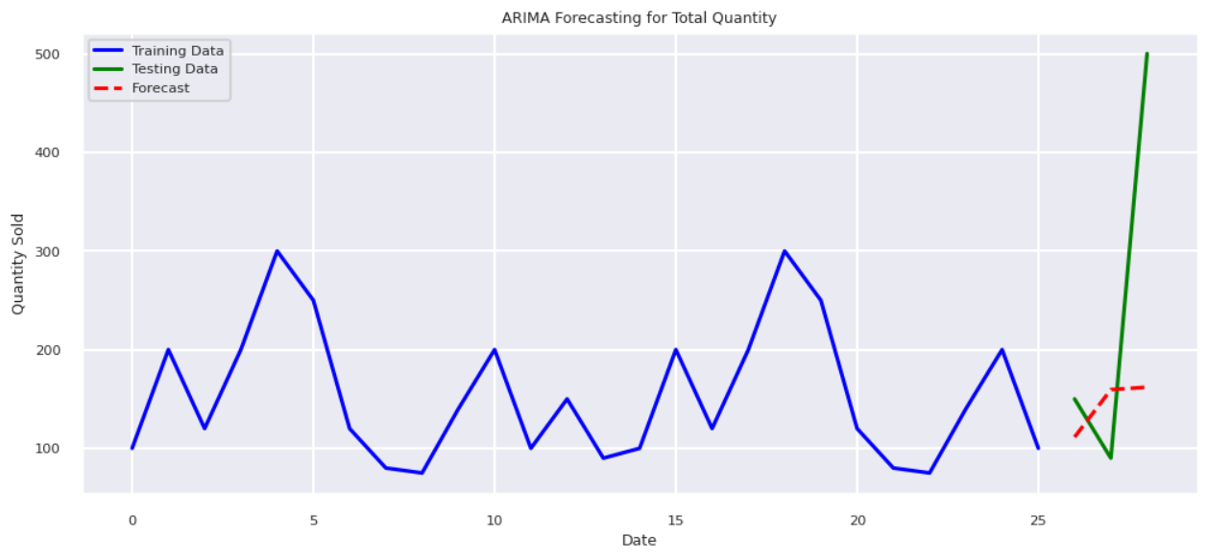
Result Analysis
GitHub Link
ARIMA Model Training and Forecasting Evaluation:
Shapiro-Wilk Test Stat: 0.949409721370511, p-value: 0.2246254566753353
ARIMA Model | MAE | MAPE | RMSE
(3, 1, 2) | 151.33 | 0.56 | 205.85
(5, 1, 0) | 1.74 | 0.24 | 2.20
Fig. ARIMA Forecast

Slide 6
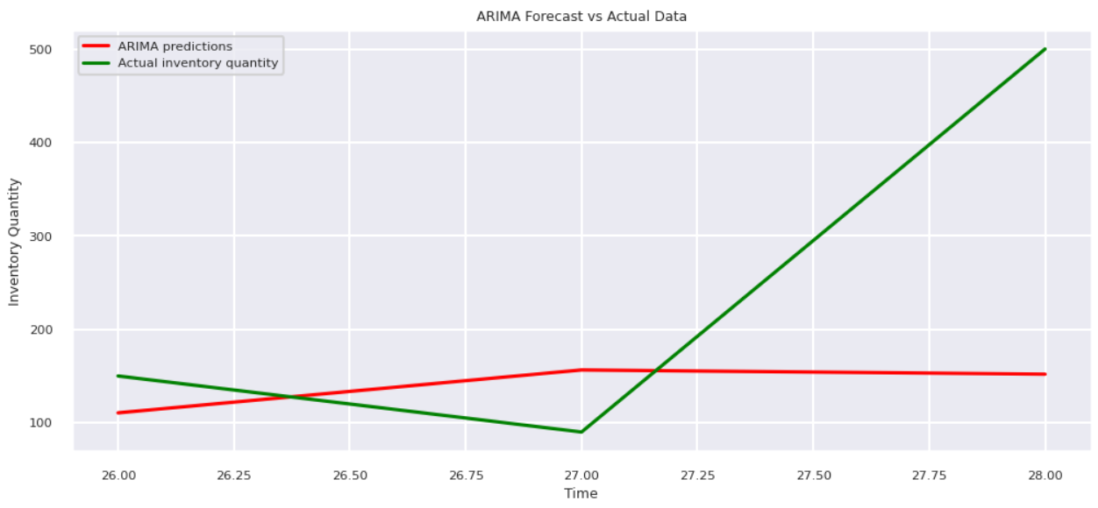
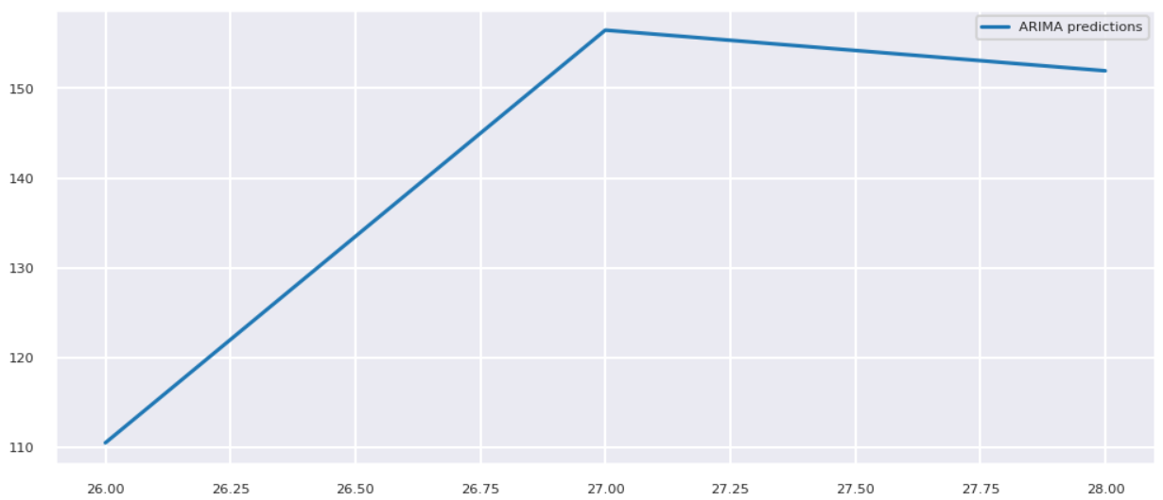
Output Screenshots
Fig. ARIMA Forecast vs Actual Data
Fig. ARIMA Prediction

Slide 7
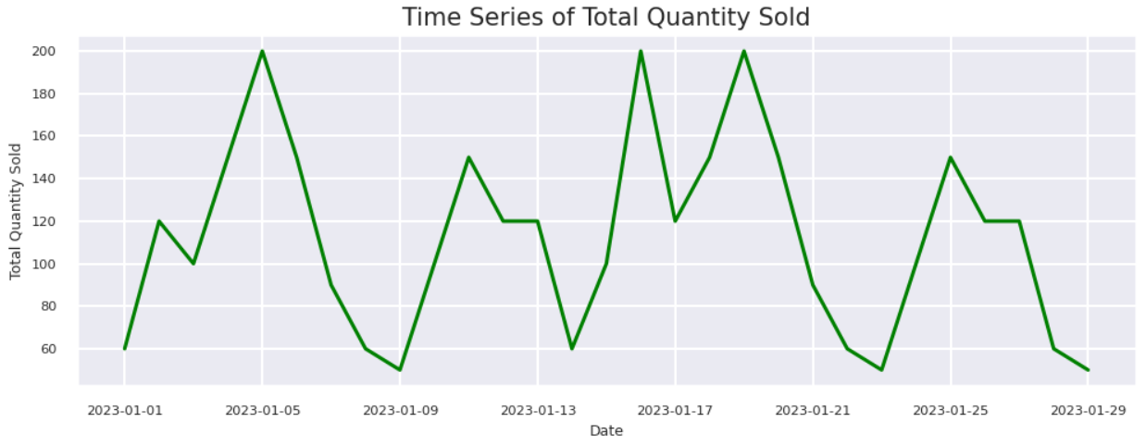
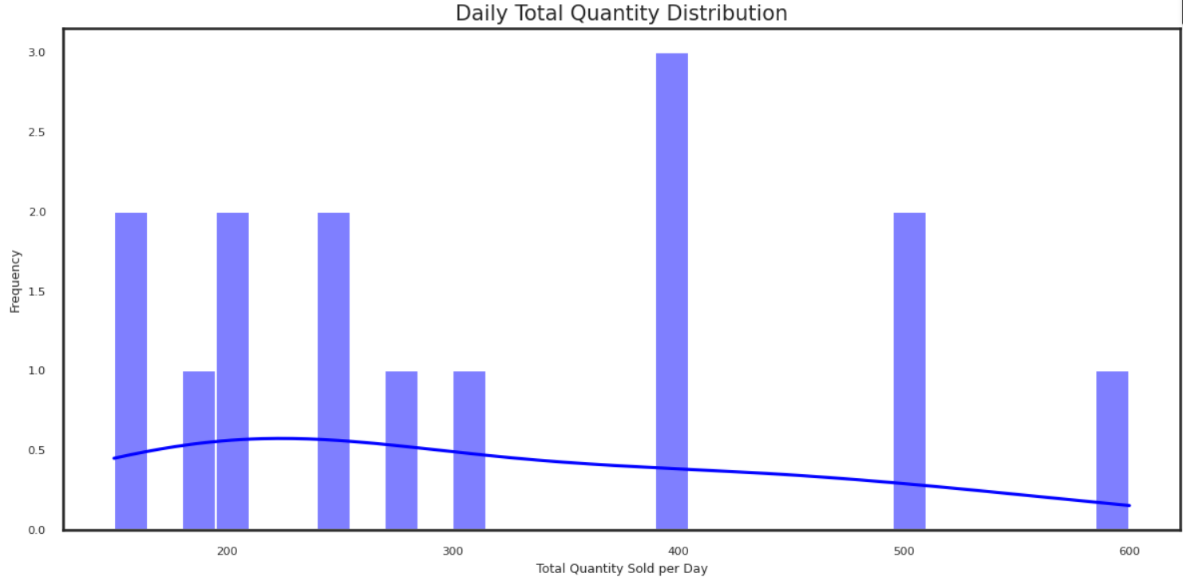
Output Screenshots
Fig. Time Series
Fig. Quantity Distribution

Slide 8
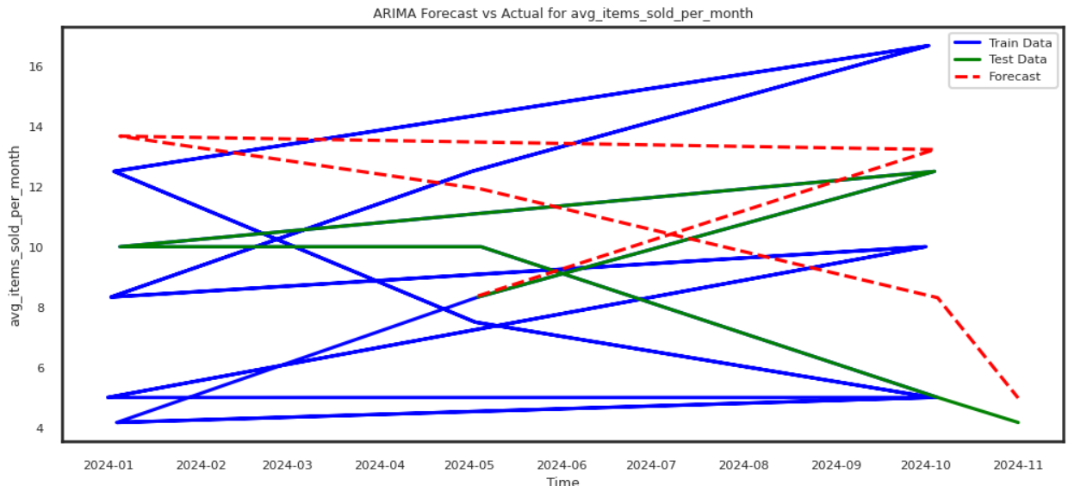
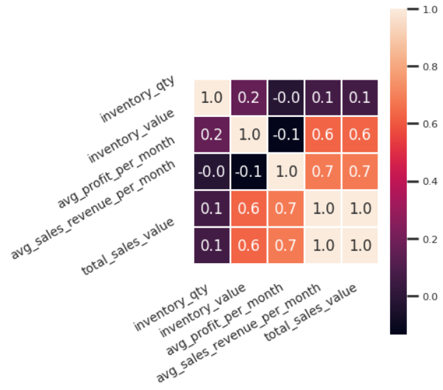
Output Screenshots
Fig. ARIMA Forecast vs Actual Data
Fig. ARIMA Forecast Confusion Matrix

Slide 9
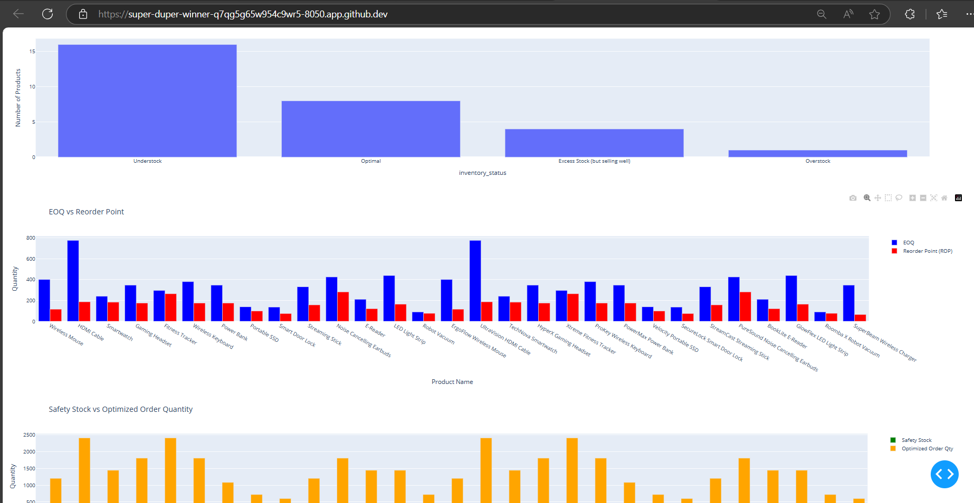
Output Screenshots
Fig. Graphs

Slide 10
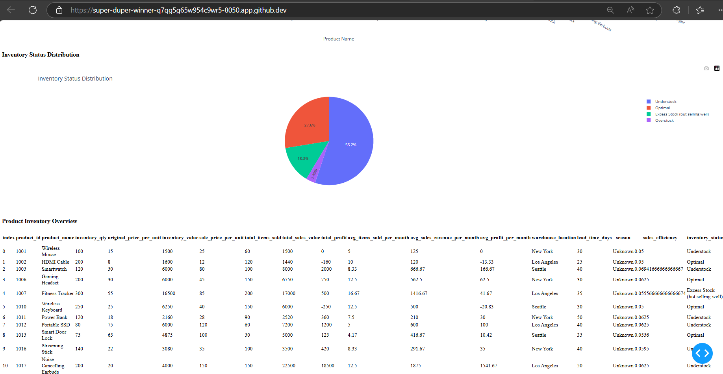
Output Screenshots
Fig. Dashboard

Slide 11
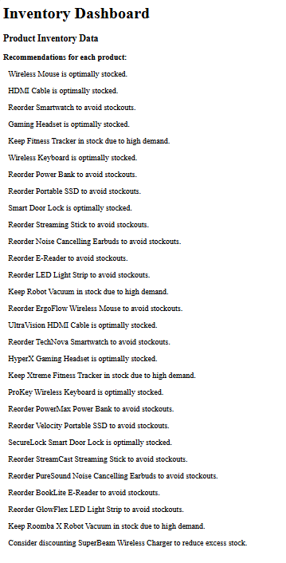
Output Screenshots
Fig. Inventory Dashboard

