Slide 1
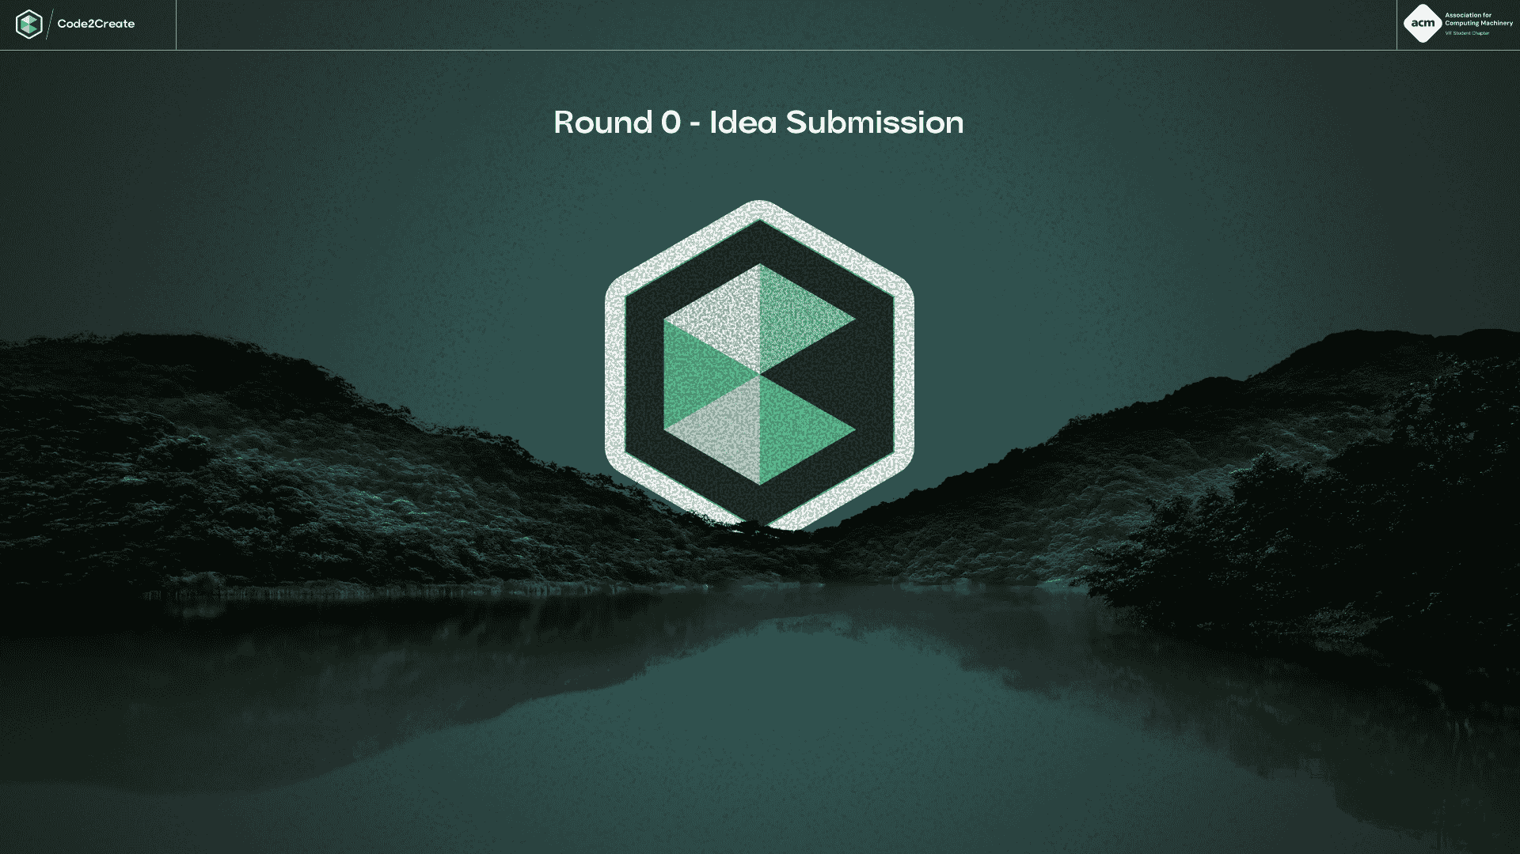
{Enter Team Name}
CodeForSurvival

Slide 2
CodeForSurvival
Team members
Sameer Kumar
Karnati Abhinav Reddy
Aaryan Gupta
Omkar Joshi

Slide 3
CodeForSurvival
Track chosen: Game Over
Problem Statement:
In India, millions of people spend hours binge-watching popular web series and movies on streaming platforms like Netflix, Prime, and Hotstar... but how many of them actually remember key details or trivia about the shows they watch? There's no fun, interactive way for users to test their memory or engage deeper with the content while watching. Existing solutions are either dry quiz apps (not tailored to binge-watchers) or fragmented trivia websites with outdated data and zero gamification.

Slide 4
CodeForSurvival
Proposed Solution:
Introducing LeetFlix - The ultimate gamified trivia platform for binge-watchers LeetFlix turns your favorite shows (Game of Thrones, Stranger Things, Sacred Games...) into interactive trivia challenges where every watched episode becomes an opportunity to flex your memory muscle
Users select a show and episode they've watched. LeetFlix serves bite-sized trivia questions (MCQs, true/false, image-based).Answers are timed, scored, and tracked in a personal progress dashboard |High scores and streaks unlock badges, bragging rights, and social sharing. All content optimized for low-data use + available in regional languages completely offline-capable (thanks to LocalStorage + preloaded content).
Combines addictive quiz gamification + binge-watching culture. Simple Ul with offline mode → no "data guilt" in rural or low-bandwidth areas
Scalable: Add new shows + community-submitted trivia over time. Instant social flex: "I got 10/10 on Stranger Things trivia. Beat that.”

Slide 5
CodeForSurvival
Technology & Approach
Programming Languages: JavaScript, HTML, CSS
Frameworks / Tools: React (or Vanilla JS), LocalStorage, Chart.js, Firebase
Methodology: Prototyping, Wireframes, Flowchart

Slide 6
CodeForSurvival
Key Functionalities
Main Features: Daily Trivia Challenge to encourage habitual use. Global Leaderboard. Dark Mode Toggle (because hacker vibes are a must). Export Progress: Export your trivia history as a PDF or image. Audio hints in regional languages for extra accessibility. Achievements / Badges for completing streaks or mastering a show. User-Submitted Trivia System (community-powered content.
Additional Features: Focused on ultra-lightweight design. Built modularly → Easy to scale by adding new shows + question sets over time. Minimal backend dependency→ Runs mostly in the browser. Designed for next billion Indian users → Simple UX, multilingual, offline

Slide 7
CodeForSurvival
Additional information (optional)

