Slide 1

US Accident Analysis
SMU Capstone 1
Presented by- Sameer Marwadi – 12/13/2025
Analysis Conducted via Python(Multiple Libraries) & Tableau- Frontend Visualization

Slide 2
Our Agenda
US Accidents Analysis
Brief Introduction
Data Preparation Approach
Data Driven Recommendations
1
Business Problem, Dataset
4
Data Preparation Approach, Key Decisions
7
Can be used by DOT
Business Understanding
Dashboard Introduction
Key Findings
2
Key Elements
5
Navigable Items & Dashboard Overview
8
Can be used by DOT
Actionable Insight Plan
Dashboard Demo
Reference Links
3
Goals, Key Considerations and Success
6
Live Demo
9
Public Links

Slide 3
Introduction
Diving into the US Accidents Dataset to conduct Data Driven Analysis and derive Business insights by employing Data Science Skills
Introduction
01
Analysis on US Traffic Accidents Dataset from 2016 <-> 2023
Business Problem
02
DOT Concerned with number of Road Accidents and wants to deploy strategies to reduce accidents and improve road safety
Dataset
03
US Accidents (2016 - 2023). Countrywide car accident dataset that covers 49 states of the USA.

Slide 4
Business Understanding
Technology
Integration
Understanding accident patterns guides how emerging vehicle technologies should be regulated to maximize safety benefits.
1
Economic Impact
Traffic accidents cost billions annually in medical expenses, property damage, and lost productivity, making even small reductions highly valuable.
2
3
Public Safety
As a leading cause of injury and death, reducing traffic accidents directly fulfills DOT's core mandate to protect citizens.
Infrastructure Prioritization
Data analysis enables strategic allocation of limited infrastructure improvement budgets to highest-risk areas.
4
Key Elements
Policy Development
Accident data informs new safety regulations and provides metrics to evaluate existing programs' effectiveness.
5
6
Stakeholder Accountability
Comprehensive analysis demonstrates evidence-based decision-making to Congress, local governments, and the public.
Cross Agency Collaboration
Shared data insights can align accident reduction efforts across DOT, law enforcement, and emergency services.
7

Slide 5
Actionable Insight Plan
Goal, Key Questions to Consider & Defining Success
Goal
Key Questions
1. Temporal patterns: At what times of day / week / year do accidents peak?
2. Spatial patterns: Which states / cities are hotspots?
3. Environmental factors: Do poor visibility, rain/snow, or low temperature increase accident severity?
4. Infrastructure: Which road features (junctions, traffic signals, etc.) relate to severity?
5. Urban vs rural: Are severity patterns different between urban and rural areas?
Understand WHEN and WHERE accidents happen most frequently.
Identify HOW weather and infrastructure relate to accident frequency and severity.
Compare URBAN vs RURAL patterns.
Derive other insights
.
Success
Data Driven Insights that can be used by Department of Transportation.

Slide 6
Data Preparation Approach
Cleaning and preprocessing the data, handling missing values, outliers, and duplicates. Creating derived features that might provide additional insights (e.g., time of day categories, weather condition groupings).
Data Loading & Exploratory Analysis
Statistical Analysis
Missing Values
Format
Goal: Understand Dataset, Identify missing values, errors, outliers, relationship between variables, form hypotheses for analysis, prepare data for modeling
Total Entries within data~ 7.7 Million, Columns 46 ,
Data Types and memory usage for dataset.
Using python libraries like pandas, numpy, matplotlib, and scipy to conduct exploratory data analysis
Focus on Numerical Columns to checking basic Statistics like Count, Mean, Standard Deviation, Min, max Values helps better understand the dataset
Additional Temporal & spatial pattern analysis to gain timebound & geography based insights
Identify the Percentage of Missing values within the data.
Take care of errors, Handle Data Perform Basic cleaning by filling missing numeric values with mean, dropping rows missing critical fields
errors="coerce" :If a value cannot be parsed as a date → it becomes NaT (Not a Time)..
Converts date columns into proper datetime format and then creates new time-based features from them
Other Temporal features like Year, Month, Hour, etc are extracted from the Start Time
New Categorical column Daypart- Morning, Midday, Night
Easy to understand Weather descriptions
Column creation- Urban V Rural

Slide 7
Dashboard Introduction
Tableau Dashboard
Main Page
Overall Takeaways
Navigable Me.
1
5
Recommendations based on Analysis
Map
Accident Based on Weather conditions,
2
4
Overall Geographic Interactive Map
Interactive Dashboard
3
Accidents by State, Time Zone, Severity
Interactive Dashboard

Slide 8
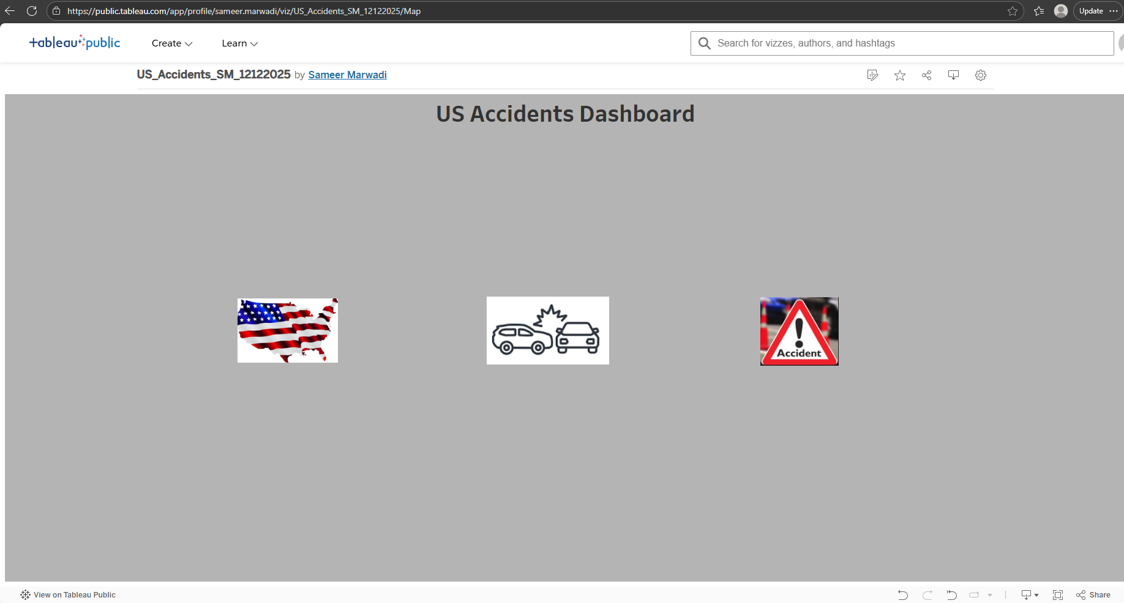
Landing Page
Main Dashboard Page with Navigable buttons

Slide 9
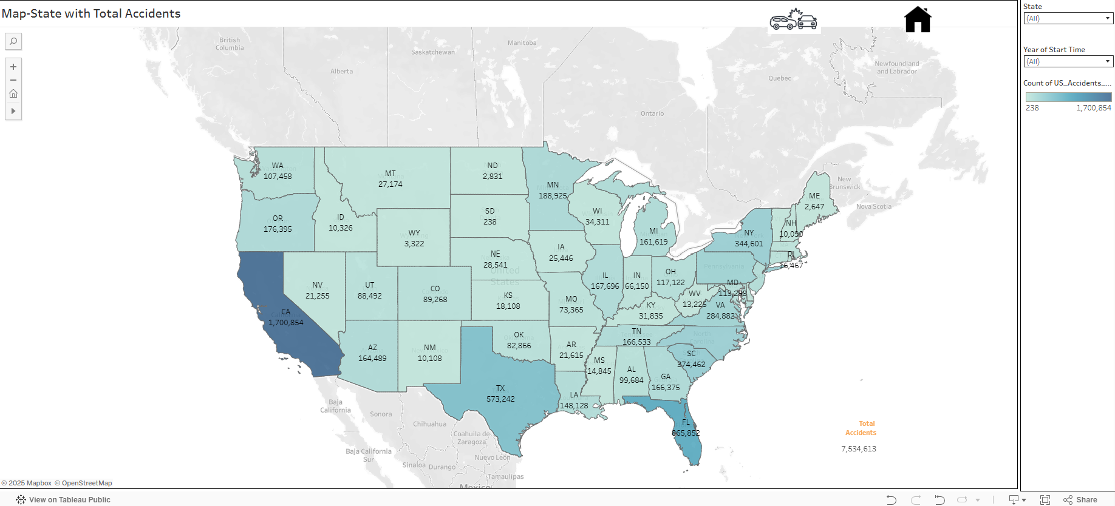
Insights- 1
US Map with Filters for State & Searching Accident Counts on a Yearly Basis

Slide 10
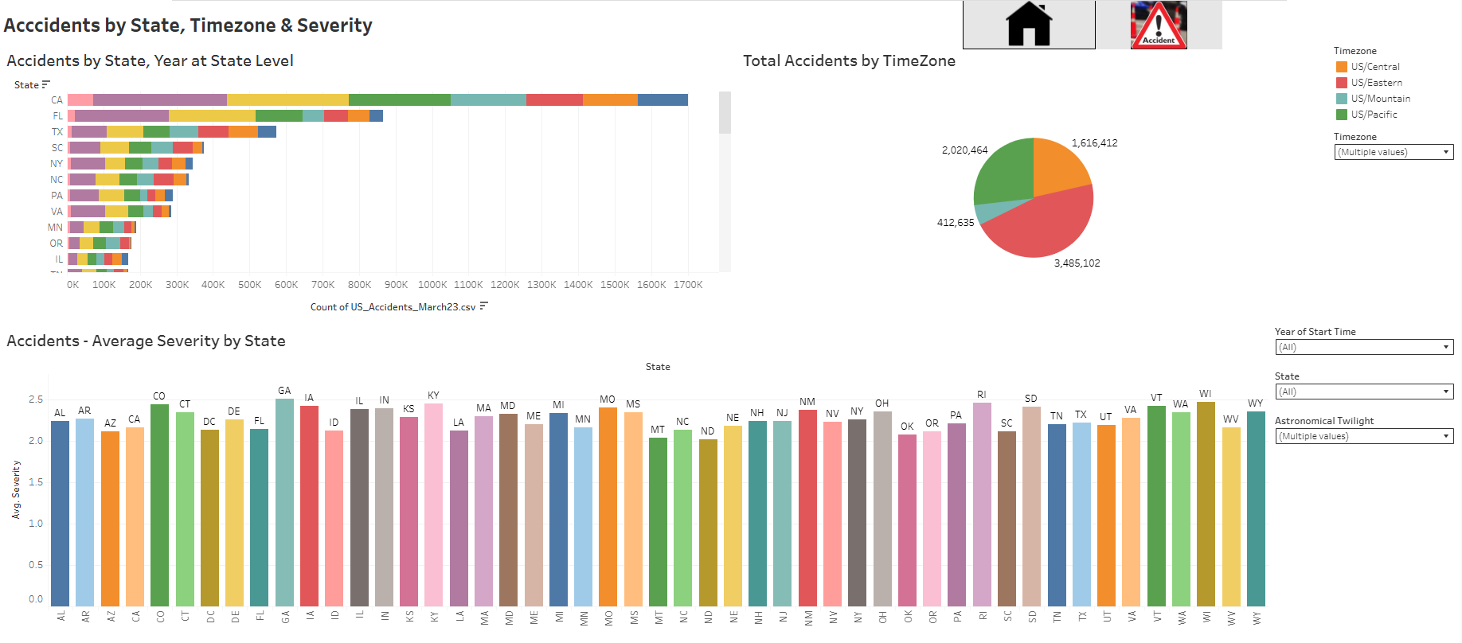
Insights- 2
Accidents Insights Filtered by State, Year, Time, Zone, Severity with Filter options for Year, State & Astronomical Twilight(Day/Night)

Slide 11
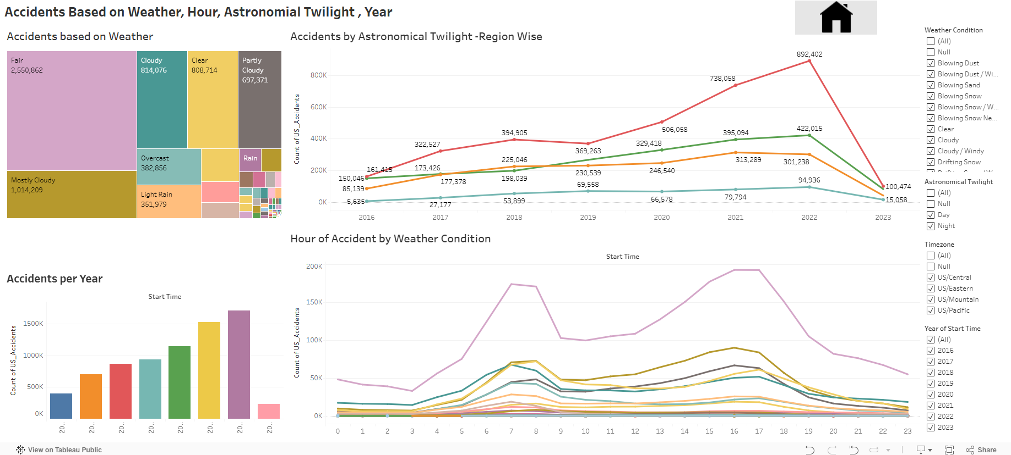
Insights- 3
Accidents Insights Based on Weather, Year, Astronomical Twilight, Hour with Filters for Weather condition Selection, TimeZone, year & Astronomical Twilight

Slide 12
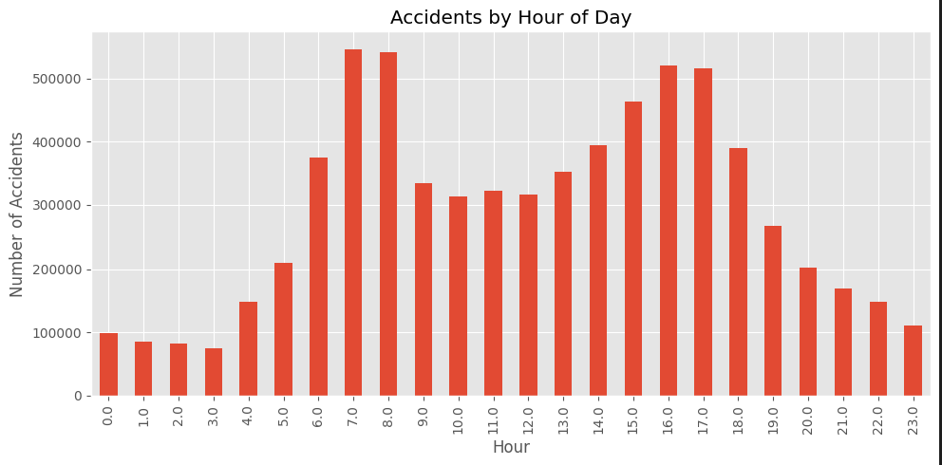
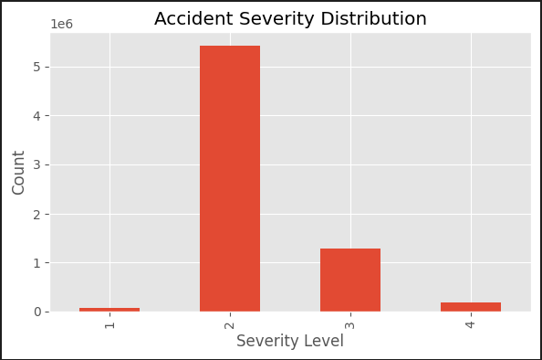
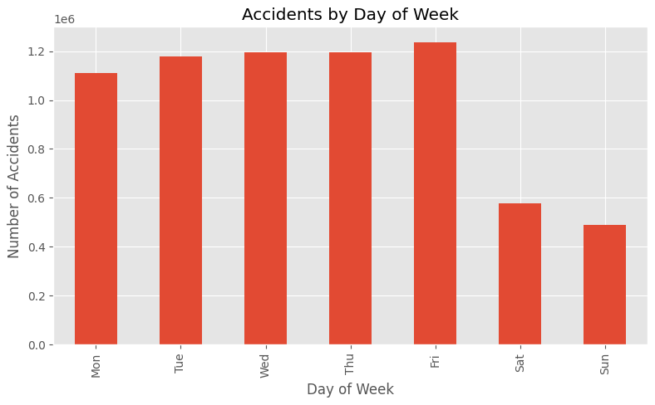
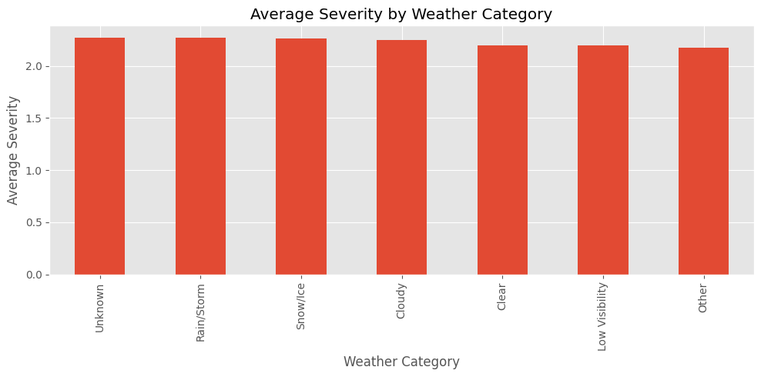
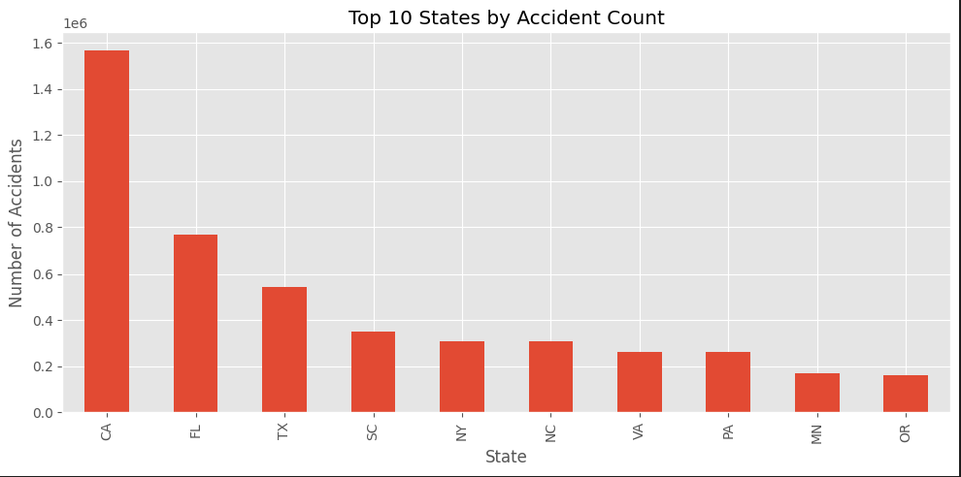
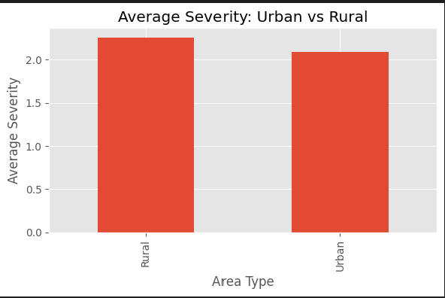
Insights- 4
Graph 1
Graph 4
Key Highlights:
Graph 1- Bar Chart Showing Accident distribution by Hour in a day with Hours 6, 7, 16, 17 showing Highest Accident rate
Graph 2 – Bar Chart showing Accidents by Day of week, Showing Friday as the Highest Accident and lower counts over the weekend
Graph 3- Shows Top 10 States by Accident Count
Graph 4- Shows Severity Distribution where Sev 2 shows the Highest Accident Count
Graph 5- Shows Severity distribution by Weather category with Avg Sev for ~ 2,2 for each Weather category
Graph 6- Shows Avg. Severity by Rural V Urban with Rural having more Accidents
Graph 2
Graph 5
Graph 3
Graph 6

Slide 13
Key Findings
Accidents Analysis
Hourly: Hour- 7, 8 & 16 & 17 Show Highest Accidents
Daily: Friday saw highest accidents with weekend being the lowest
State: CA, FA, TX, SC, NY are top 5 States with Accidents
1
Correlation by Severity & Weather
Urban V Rural
4 Times more accidents in Rural as compared to Urban with Rural Sev – 2.2 and Urban being at 2
Sev 2 had the Highest Accident
Average Severity was 2.3 across various Weather conditions like Rain/strorm, Snow/Ice, Cloudy, Clear, Low Visibility, other
5
2
The Five Drivers
Causation Analysis - Infrastructure
Accidents by Day Part & Severity Breakdown
4
3
Infrastructure impact on severity (mean severity
  Junction: present=2.322, absent=2.222
  Traffic Signal: present=2.091, absent=2.255
  Crossing: present=2.067, absent=2.250
  Stop: present=2.078, absent=2.234
Distribution of Accident by Severity Level.

Slide 14
Data Driven Recommendations
01
The peak accident hour is around 7.0:00 with ~546789 accidents in the dataset.
Recommendation: Evening rush hours and late-night periods may require targeted enforcement and campaigns.
Temporal Hotspot
Average severity on Clear conditions: 2.20
Average severity during Rain/Storm: 2.27 T-test p-value = 0.000000.
Recommendation: With p < 0.05, this suggests significantly higher severity in rain/storm, supporting investment in wet-weather driving campaigns, drainage, and roadway friction improvements.
02
Weather and Severity
03
Average severity in Urban-like areas: 2.09
Average severity in Rural-like areas: 2.25
Chi-square p-value (Severity x Urban_Rural) = 0.000000.
Recommendation: With severity is higher in rural areas, DOT might prioritize EMS response time improvements, lighting, and geometric design improvements on rural roadways.
Location

Slide 15
Thank You
Reference Links:
Dataset
US Accidents (2016 - 2023)
Dashboard
Tableau_Dashboad
GitHub
sameer-marwadi/AI_Capstone_1

