Slide 1
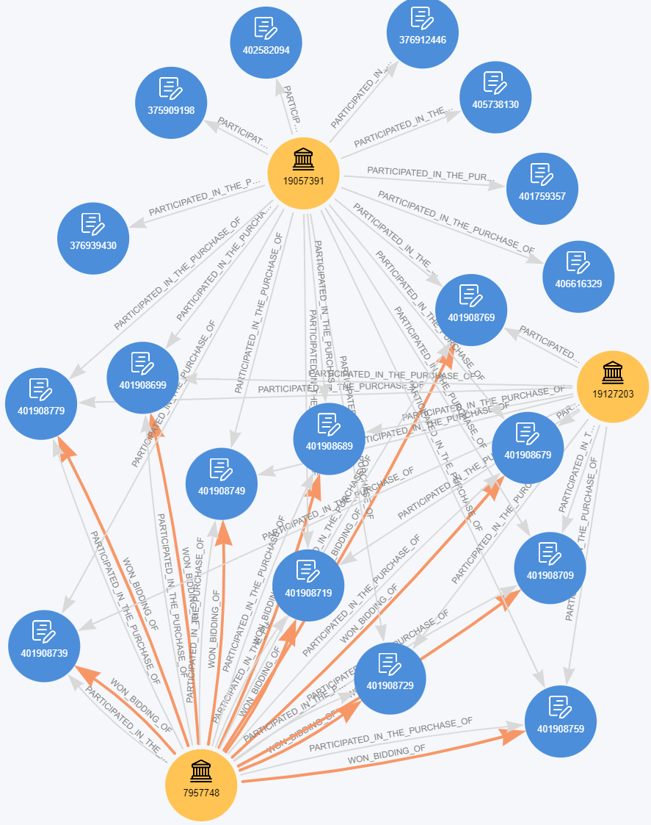
Unmasking Collusion: Detecting Insurance Fraud Rings
How Knowledge Graphs transform unstructured claims data into proactive network intelligence.
THE INSURANCE FRAUD CHALLENGE
Hidden Connections: Bad actors exploit data silos by staging accidents across different insurers, vehicles, and coverage policies.
The 'Mule' Disguise: Individual claims look completely legitimate when evaluated in isolation by traditional rules engines.
Coordinated Networks: Organized rings systematically drain payouts using shared links like identical body shops or medical clinics.
THE KNOWLEDGE GRAPH SOLUTION
Entity Resolution: Converts raw text (PDF reports, call logs, invoices) into interconnected Subject → Predicate → Object triples.
Unified Network Analysis: Automatically links distinct policyholders if they share a digital footprint, device ID, or location.
Pattern Recognition: Uncovers circular cash flows, phantom passengers, and recurring vendor relationships instantly.
[Claim 101] ──(Involves)──> [Policyholder A] ──(Uses Device)──> [HW_ID: 991X] <──(Uses Device)── [Policyholder B] ──(Involves)──> [Claim 102]
💡 Value Impact: By connecting separate claim attributes into a single unified mesh, insurers intercept rings instead of single claims.

