Slide 1
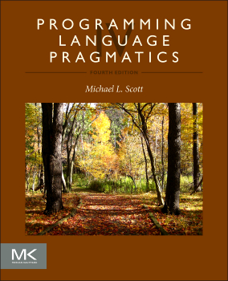

Chapter 3::
Names, Scopes, and Bindings
Programming Language Pragmatics, Fourth Edition
Michael L. Scott

Slide 2
Name, Scope, and Binding
A name is exactly what you think it is
  Most names are identifiers
  symbols (like '+') can also be names
A binding is an association between two things, such as a name and the thing it names
The scope of a binding is the part of the program (textually)in which the binding is active

Slide 3
Binding
Binding Time is the point at which a binding is created or, more generally, the point at which any implementation decision is made
  language design time
    program structure, possible type
  language implementation time
    I/O, arithmetic overflow, type equality (if unspecified in manual)

Slide 4
Binding
Implementation decisions (continued ):
  program writing time
    algorithms, names
  compile time
    plan for data layout
  link time
    layout of whole program in memory
  load time
    choice of physical addresses

Slide 5
Binding
Implementation decisions (continued):
  run time
    value/variable bindings, sizes of strings
    subsumes
      program start-up time
      module entry time
      elaboration time (point a which a declaration is first "seen")
      procedure entry time
      block entry time
      statement execution time

Slide 6
Binding
The terms STATIC and DYNAMIC are generally used to refer to things bound before run time and at run time, respectively
  “static” is a coarse term; so is "dynamic"
It is difficult to overstate the importance of Binding Times in programming languages

Slide 7
Binding
In general, early binding times are associated with greater efficiency
Later binding times are associated with greater flexibility
Compiled languages tend to have early binding times
Interpreted languages tend to have later binding times
Today we talk about the binding of identifiers to the variables they name

Slide 8
Binding
Scope Rules - control bindings
  Fundamental to all programming languages is the ability to name data, i.e., to refer to data using symbolic identifiers rather than addresses
  Not all data is named! For example, dynamic storage in C or Pascal is referenced by pointers, not names

Slide 9
Lifetime and Storage Management
Key events
  creation of objects
  creation of bindings
  references to variables (which use bindings)
  (temporary) deactivation of bindings
  reactivation of bindings
  destruction of bindings
  destruction of objects

Slide 10
Lifetime and Storage Management
The period of time from creation to destruction is called the LIFETIME of a binding
  If object outlives binding it's garbage
  If binding outlives object it's a dangling reference
The textual region of the program in which the binding is active is its scope
In addition to talking about the scope of a binding, we sometimes use the word scope as a noun all by itself, without an indirect object

Slide 11
Lifetime and Storage Management
Storage Allocation mechanisms
  Static
  Stack
  Heap
Static allocation for
  code
  globals
  static or own variables
  explicit constants (including strings, sets, etc)
  scalars may be stored in the instructions
Copyright © 2009 Elsevier

Slide 12
Lifetime and Storage Management
Central stack for
  parameters
  local variables
  temporaries
Why a stack?
  allocate space for recursive routines
  (not necessary in FORTRAN – no recursion)
  reuse space
  (in all programming languages)
Copyright © 2009 Elsevier

Slide 13
Lifetime and Storage Management
Contents of a stack frame (cf., Figure 3.1)
  arguments and returns
  local variables
  temporaries
  bookkeeping (saved registers, line number static link, etc.)
Local variables and arguments are assigned fixed OFFSETS from the stack pointer or frame pointer at compile time

Slide 14
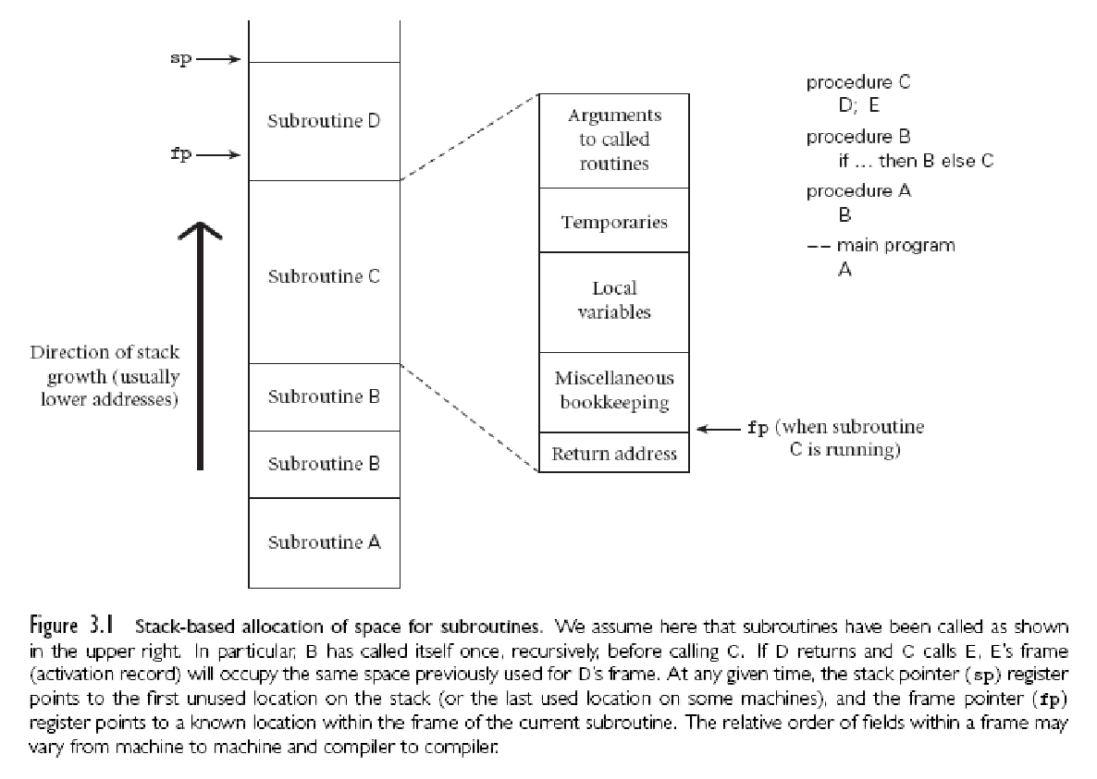
Lifetime and Storage Management

Slide 15
Lifetime and Storage Management
Maintenance of stack is responsibility of calling sequence and subroutine prologue and epilogue
  space is saved by putting as much in the prologue and epilogue as possible
  time may be saved by putting more in the body of the subroutine
    putting stuff in the caller instead
    or
    combining what's known in both places
    (interprocedural optimization)

Slide 16
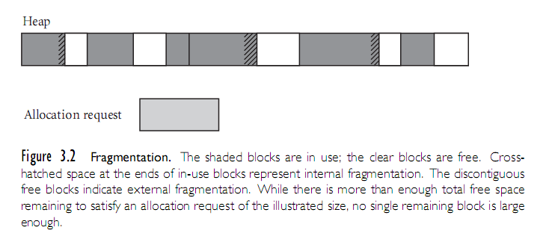
Lifetime and Storage Management
Heap for dynamic allocation

Slide 17
Scope Rules
A scope is a program section of maximal size in which no bindings change, or at least in which no re-declarations are permitted (see below)
In most languages with subroutines, we OPEN a new scope on subroutine entry:
  create bindings for new local variables,
  deactivate bindings for global variables that are re-declared (these variable are said to have a "hole" in their scope)
  make references to variables

Slide 18
Scope Rules
On subroutine exit:
  destroy bindings for local variables
  reactivate bindings for global variables that were deactivated
Algol 68:
  ELABORATION = process of creating bindings when entering a scope
Ada (re-popularized the term elaboration):
  storage may be allocated, tasks started, even exceptions propagated as a result of the elaboration of declarations

Slide 19
Scope Rules
With STATIC (LEXICAL) SCOPE RULES, a scope is defined in terms of the physical (lexical) structure of the program
  The determination of scopes can be made by the compiler
  All bindings for identifiers can be resolved by examining the program
  Typically, we choose the most recent, active binding made at compile time
  Most compiled languages, C and Pascal included, employ static scope rules

Slide 20
Scope Rules
The classical example of static scope rules is the most closely nested rule used in block structured languages such as Algol 60 and Pascal
  An identifier is known in the scope in which it is declared and in each enclosed scope, unless it is re-declared in an enclosed scope
  To resolve a reference to an identifier, we examine the local scope and statically enclosing scopes until a binding is found

Slide 21
Scope Rules
We will see classes - a relative of modules - later on, when discussing abstraction and object-oriented languages
  These have even more sophisticated (static) scope rules
Euclid is an example of a language with lexically-nested scopes in which all scopes are closed
  rules were designed to avoid ALIASES, which complicate optimization and correctness arguments

Slide 22
Scope Rules
Note that the bindings created in a subroutine are destroyed at subroutine exit
  The modules of Modula, Ada, etc., give you closed scopes without the limited lifetime
  Bindings to variables declared in a module are inactive outside the module, not destroyed
  The same sort of effect can be achieved in many languages with own (Algol term) or static (C term) variables (see Figure 3.5)

Slide 23
Scope Rules
Access to non-local variables STATIC LINKS
  Each frame points to the frame of the (correct instance of) the routine inside which it was declared
  In the absence of formal subroutines, correct means closest to the top of the stack
  You access a variable in a scope k levels out by following k static links and then using the known offset within the frame thus found

Slide 24
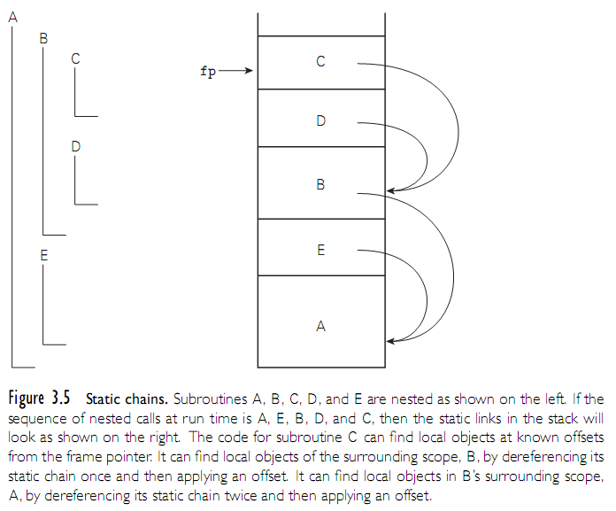
Scope Rules

Slide 25
Scope Rules
The key idea in static scope rules is that bindings are defined by the physical (lexical) structure of the program.
With dynamic scope rules, bindings depend on the current state of program execution
  They cannot always be resolved by examining the program because they are dependent on calling sequences
  To resolve a reference, we use the most recent, active binding made at run time

Slide 26
Scope Rules
Dynamic scope rules are usually encountered in interpreted languages
  early LISP dialects assumed dynamic scope rules.
Such languages do not normally have type checking at compile time because type determination isn't always possible when dynamic scope rules are in effect

Slide 27
Scope Rules
Example: Static vs. Dynamic
program scopes (input, output );
var a : integer;
procedure first;
begin a := 1; end;
procedure second;
var a : integer;
begin first; end;
begin
a := 2; second; write(a);
end.

Slide 28
Scope Rules
Example: Static vs. Dynamic
If static scope rules are in effect (as would be the case in Pascal), the program prints a 1
If dynamic scope rules are in effect, the program prints a 2
Why the difference? At issue is whether the assignment to the variable a in procedure first changes the variable a declared in the main program or the variable a declared in procedure second

Slide 29
Scope Rules
Example: Static vs. Dynamic
Static scope rules require that the reference resolve to the most recent, compile-time binding, namely the global variable a
Dynamic scope rules, on the other hand, require that we choose the most recent, active binding at run time
  Perhaps the most common use of dynamic scope rules is to provide implicit parameters to subroutines
  This is generally considered bad programming practice nowadays
    Alternative mechanisms exist
      static variables that can be modified by auxiliary routines
      default and optional parameters

Slide 30
Scope Rules
Example: Static vs. Dynamic
At run time we create a binding for a when we enter the main program.
Then we create another binding for a when we enter procedure second
  This is the most recent, active binding when procedure first is executed
  Thus, we modify the variable local to procedure second, not the global variable
  However, we write the global variable because the variable a local to procedure second is no longer active

Slide 31
The Meaning of Names within a Scope
Aliasing
  What are aliases good for? (consider uses of FORTRAN equivalence)
    space saving - modern data allocation methods are better
    multiple representations - unions are better
    linked data structures - legit
  Also, aliases arise in parameter passing as an unfortunate side effect
    Euclid scope rules are designed to prevent this

Slide 32
The Meaning of Names within a Scope
Overloading
  some overloading happens in almost all languages
    integer + vs. real +
    read and write in Pascal
    function return in Pascal
  some languages get into overloading in a big way
    Ada
    C++

Slide 33
The Meaning of Names within a Scope
It's worth distinguishing between some closely related concepts
  overloaded functions - two different things with the same name; in C++
    overload norm
    int norm (int a){return a>0 ? a : -a;)
    complex norm (complex c ) { // ...
  polymorphic functions -- one thing that works in more than one way
    in Modula-2: function min (A : array of integer); …
    in Smalltalk

Slide 34
The Meaning of Names within a Scope
It's worth distinguishing between some closely related concepts (2)
  generic functions (modules, etc.) - a syntactic template that can be instantiated in more than one way at compile time
    via macro processors in C++
    built-in in C++
    in Clu
    in Ada

Slide 35
Binding of Referencing Environments
Accessing variables with dynamic scope:
  (1) keep a stack (association list) of all active variables
    When you need to find a variable, hunt down from top of stack
    This is equivalent to searching the activation records on the dynamic chain

Slide 36
Binding of Referencing Environments
Accessing variables with dynamic scope:
  (2) keep a central table with one slot for every variable name
    If names cannot be created at run time, the table layout (and the location of every slot) can be fixed at compile time
    Otherwise, you'll need a hash function or something to do lookup
    Every subroutine changes the table entries for its locals at entry and exit.

Slide 37
Binding of Referencing Environments
(1) gives you slow access but fast calls
(2) gives you slow calls but fast access
In effect, variable lookup in a dynamically-scoped language corresponds to symbol table lookup in a statically-scoped language
Because static scope rules tend to be more complicated, however, the data structure and lookup algorithm also have to be more complicated

Slide 38
Binding of Referencing Environments
REFERENCING ENVIRONMENT of a statement at run time is the set of active bindings
A referencing environment corresponds to a collection of scopes that are examined (in order) to find a binding

Slide 39
Binding of Referencing Environments
SCOPE RULES determine that collection and its order
BINDING RULES determine which instance of a scope should be used to resolve references when calling a procedure that was passed as a parameter
  they govern the binding of referencing environments to formal procedures

Slide 40
Separate Compilation
Separately-compiled files in C provide a sort of poor man's modules:
  Rules for how variables work with separate compilation are messy
  Language has been jury-rigged to match the behavior of the linker
  static on a function or variable outside a function means it is usable only in the current source file
    This static is a different notion from the static variables inside a function

Slide 41
Separate Compilation
Separately-compiled files in C (continued)
  extern on a variable or function means that it is declared in another source file
  Functions headers without bodies are extern by default
  extern declarations are interpreted as forward declarations if a later declaration overrides them
  Variables or functions (with bodies) that don't say static or extern are either global or common (a Fortran term)

Slide 42
Conclusions
The morals of the story:
  language features can be surprisingly subtle
  designing languages to make life easier for the compiler writer can be a GOOD THING
  most of the languages that are easy to understand are easy to compile, and vice versa

Slide 43
Conclusions
A language that is easy to compile often leads to
  a language that is easy to understand
  more good compilers on more machines (compare Pascal and Ada!)
  better (faster) code
  fewer compiler bugs
  smaller, cheaper, faster compilers
  better diagnostics

