Slide 1
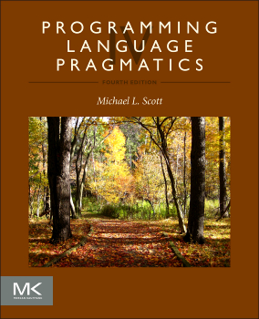

Chapter 4 :: Semantic Analysis
Programming Language Pragmatics, Fourth Edition
Michael L. Scott
Copyright © 2016 Elsevier

Slide 2
Role of Semantic Analysis
Following parsing, the next two phases of the "typical" compiler are
  semantic analysis
  (intermediate) code generation
The principal job of the semantic analyzer is to enforce static semantic rules
  constructs a syntax tree (usually first)
  information gathered is needed by the code generator

Slide 3
Role of Semantic Analysis
There is considerable variety in the extent to which parsing, semantic analysis, and intermediate code generation are interleaved
A common approach includes construction of a syntax tree with parsing, and then follows with separate, sequential phases for semantic analysis and code generation

Slide 4
Role of Semantic Analysis
The PL/0 compiler has no optimization to speak of (there's a tiny little trivial phase, which operates on the syntax tree)
Its code generator produces MIPs assembler, rather than a machine-independent intermediate form

Slide 5
Attribute Grammars
Both semantic analysis and (intermediate) code generation can be described in terms of annotation, or "decoration" of a parse or syntax tree
ATTRIBUTE GRAMMARS provide a formal framework for decorating such a tree
The notes below discuss attribute grammars and their ad-hoc cousins, ACTION ROUTINES

Slide 6
Attribute Grammars
We'll start with decoration of parse trees, then consider syntax trees
Consider the following LR (bottom-up) grammar for arithmetic expressions
made of constants, with precedence and associativity:

Slide 7
Attribute Grammars
E → E + T
E → E – T
E → T
T → T * F
T → T / F
T → F
F → - F
This says nothing about what the program MEANS

Slide 8
Attribute Grammars
We can turn this into an attribute grammar as follows
E → E + T E1.val = E2.val + T.val
E → E – T E1.val = E2.val - T.val
E → T E.val = T.val
T → T * F T1.val = T2.val * F.val
T → T / F T1.val = T2.val / F.val
T → F T.val = F.val
F → - F F1.val = - F2.val
F → (E) F.val = E.val
F → const F.val = C.val

Slide 9
Attribute Grammars
The attribute grammar serves to define the semantics of the input program
Attribute rules are best thought of as definitions, not assignments
They are not necessarily meant to be evaluated at any particular time, or in any particular order, though they do define their left-hand side in terms of the right-hand side

Slide 10
Evaluating Attributes
The process of evaluating attributes is called annotation, or DECORATION, of the parse tree [see Figure 4.2 for (1+3)*2]
  When a parse tree under this grammar is fully decorated, the value of the expression will be in the val attribute of the root
The code fragments for the rules are called SEMANTIC FUNCTIONS
  Strictly speaking, they should be cast as functions, e.g., E1.val = sum (E2.val, T.val), cf., Figure 4.1

Slide 11
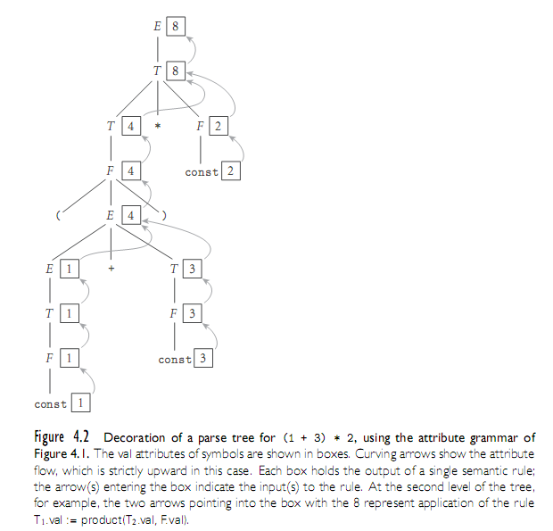
Evaluating Attributes
E → E + T E1.val = E2.val + T.val
E → E – T E1.val = E2.val - T.val
E → T E.val = T.val
T → T * F T1.val = T2.val * F.val
T → T / F T1.val = T2.val / F.val
T → F T.val = F.val
F → - F F1.val = - F2.val
F → (E) F.val = E.val
F → const F.val = C.val

Slide 12
Evaluating Attributes
This is a very simple attribute grammar:
  Each symbol has at most one
  attribute
    the punctuation marks have no attributes
These attributes are all so-called SYNTHESIZED attributes:
  They are calculated only from the attributes of things below them in the parse tree

Slide 13
Evaluating Attributes
In general, we are allowed both synthesized and INHERITED attributes:
  Inherited attributes may depend on things above or to the side of them in the parse tree
  Tokens have only synthesized attributes, initialized by the scanner (name of an identifier, value of a constant, etc.).
  Inherited attributes of the start symbol establish run-time parameters of the compiler

Slide 14
Evaluating Attributes
The grammar above is called S-ATTRIBUTED because it uses only
synthesized attributes
Its ATTRIBUTE FLOW (attribute dependence graph) is purely bottom-up
  It is SLR(1), but not LL(1)
An equivalent LL(1) grammar requires inherited attributes:

Slide 15
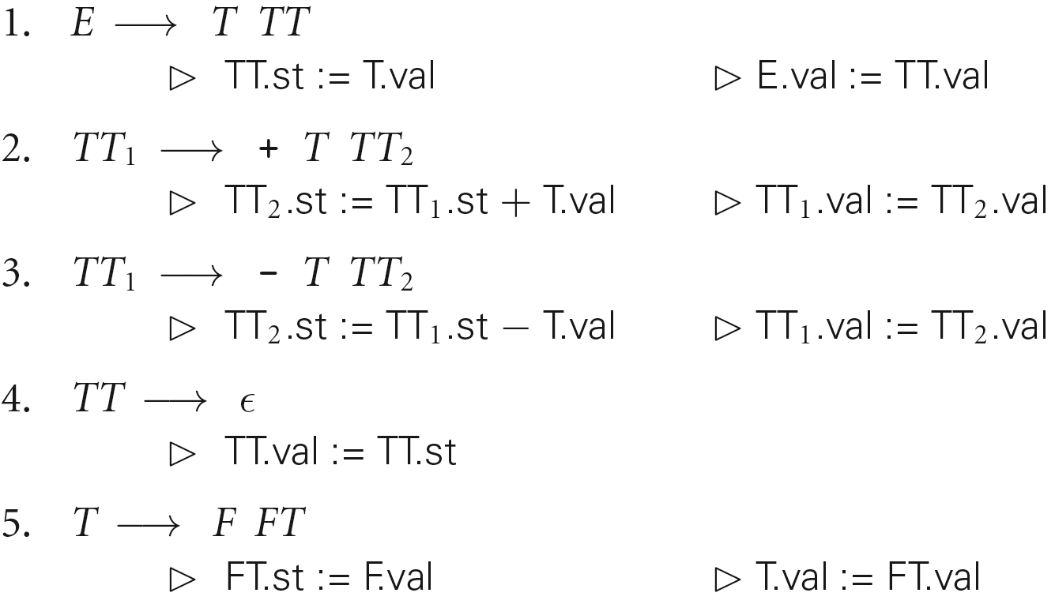
Evaluating Attributes – Example
Attribute grammar in Figure 4.3:

Slide 16
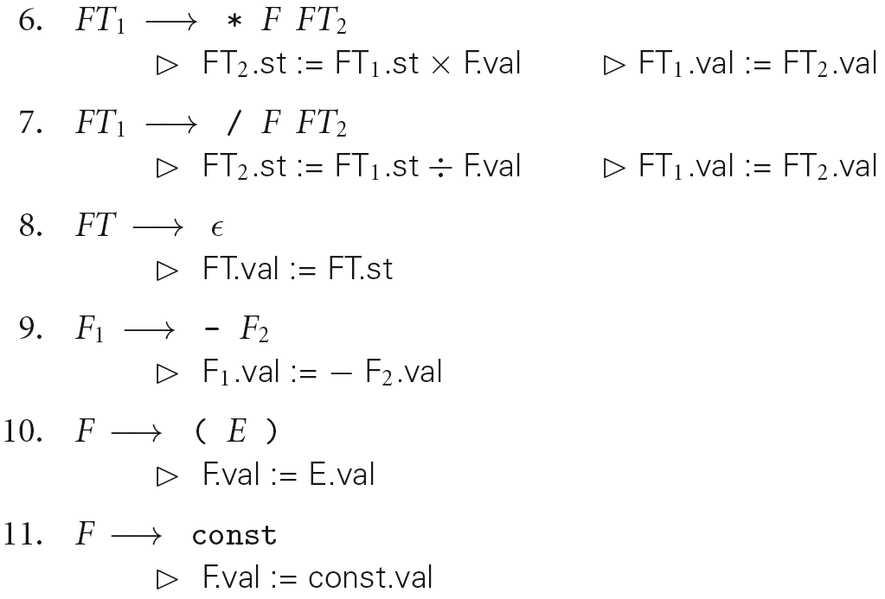
Evaluating Attributes– Example
Attribute grammar in Figure 4.3 (continued):

Slide 17
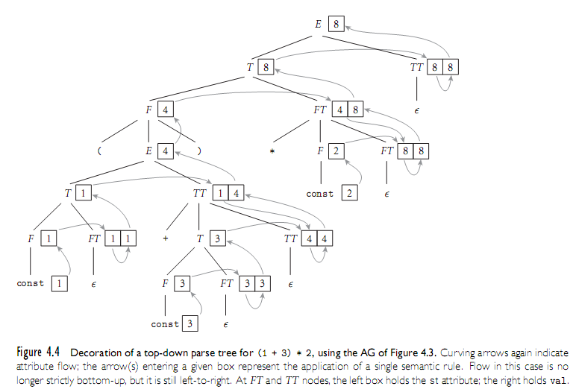
Evaluating Attributes– Example

Slide 18
Evaluating Attributes– Example
Attribute grammar in Figure 4.3:
  This attribute grammar is a good bit messier than the first one, but it is still L-ATTRIBUTED, which means that the attributes can be evaluated in a single left-to-right pass over the input.

Slide 19
Evaluating Attributes – Example
Attribute grammar in Figure 4.3:
  L-attributed grammars are the most general class of attribute grammars that can be evaluated during an LL parse

Slide 20
Evaluating Attributes
There are certain tasks, such as generation of code for short-circuit Boolean expression evaluation, that are easiest to express with non-L-attributed attribute grammars
Because of the potential cost of complex traversal schemes, however, most real-world compilers insist that the grammar be L-attributed

Slide 21
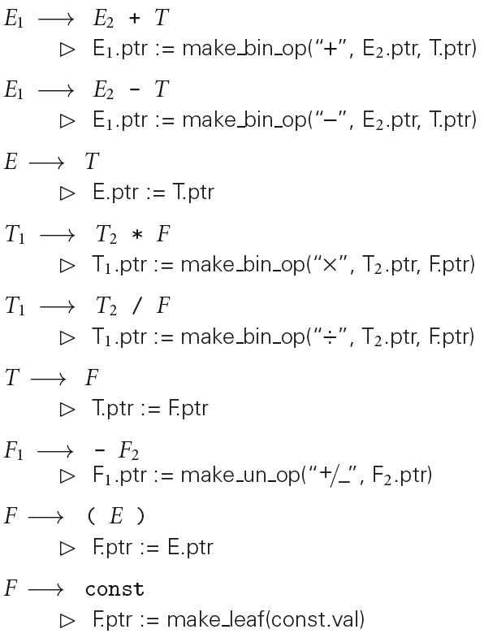
Evaluating Attributes – Syntax Trees

Slide 22
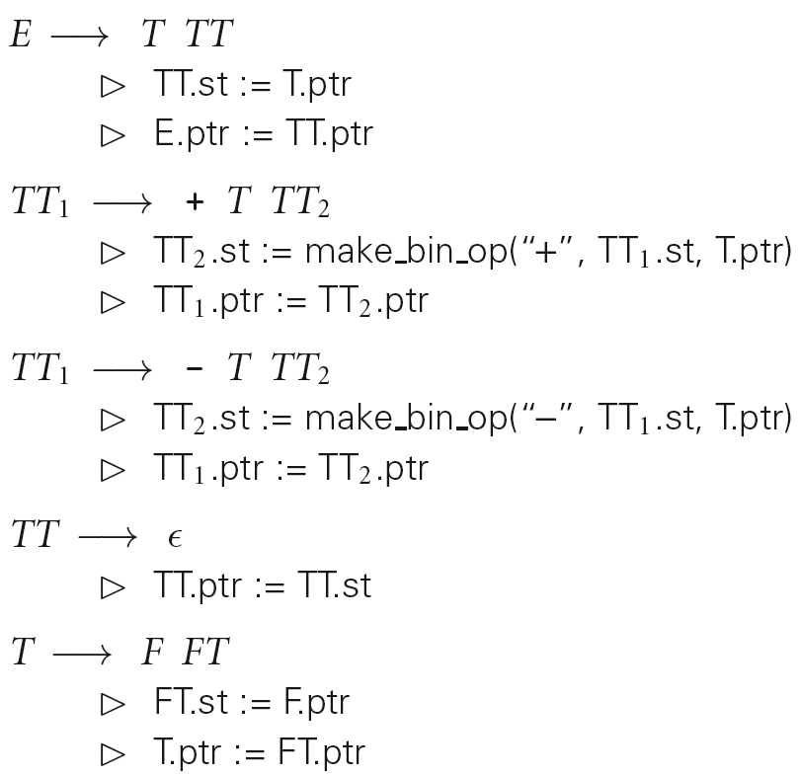
Evaluating Attributes – Syntax Trees

Slide 23
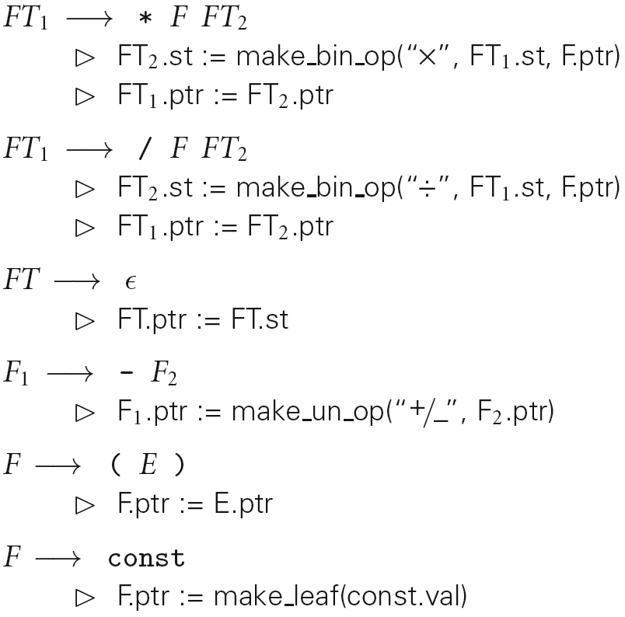
Evaluating Attributes – Syntax Trees

Slide 24
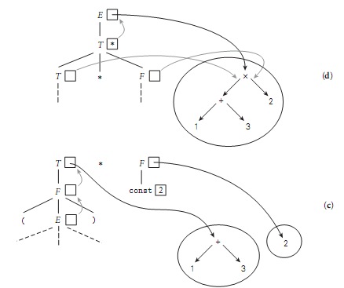
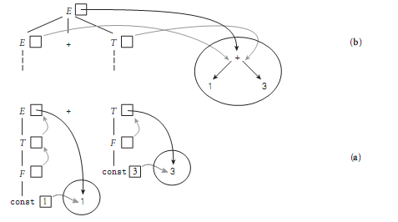
Evaluating Attributes – Syntax Trees
Figure 4.7 Construction of a syntax tree for (1 + 3) * 2 via decoration of a bottom-up parse tree, using the grammar of Figure 4.5. This ﬁgure reads from bottom to top. In diagram (a), the values of the constants 1 and 3 have been placed in new syntax tree leaves. Pointer s to these leaves propagate up into the attributes of E and T. In (b), the pointer s to these leaves become child pointer s of a new internal + node. In (c) the pointer to this node propagates up into the attributes of T, and a new leaf is created for 2 . Finally, in (d), the pointer s from T and F become child pointer s of a new internal × node, and a pointer to this node propagates up into the attributes of E .

Slide 25
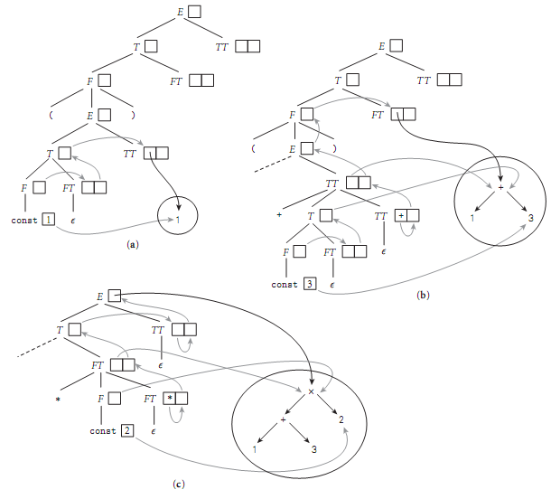
Evaluating Attributes – Syntax Trees
Figure 4.8 Construction of a syntax tree via decoration of a top-down parse tree, using the grammar of Figure 4.6. In the top diagram, (a), the value of the constant 1 has been placed in a new syntax tree leaf. A pointer to this leaf then propagates to the st attribute of TT. In (b), a second leaf has been created to hold the constant 3 . Pointer s to the two leaves then become child pointer s of a new internal + node, a pointer to which propagates from the st attribute of the bottom-most TT, where it was created, all the way up and over to the st attribute of the top-most FT. In (c), a third leaf has been created for the constant 2 . Pointer s to this leaf and to the + node then become the children of a new ×node, a pointer to which propagates from the st of the lower FT, where it was created, all the way to the root of the tree

Slide 26
Action Routines
We can tie this discussion back into the earlier issue of separated phases v. on-the-fly semantic analysis and/or code generation
If semantic analysis and/or code generation are interleaved with parsing, then the TRANSLATION SCHEME we use to evaluate attributes MUST be L-attributed

Slide 27
Action Routines
If we break semantic analysis and code generation out into separate phase(s), then the code that builds the parse/syntax tree must still use a left-to-right (L-attributed) translation scheme
However, the later phases are free to use a fancier translation scheme if they want

Slide 28
Action Routines
There are automatic tools that generate translation schemes for context-free grammars or tree grammars (which describe the possible structure of a syntax tree)
  These tools are heavily used in syntax-based editors and incremental compilers
  Most ordinary compilers, however, use ad-hoc (created or done for a particular purpose as necessary) techniques.

Slide 29
Action Routines
An ad-hoc translation scheme that is interleaved with parsing takes the
form of a set of ACTION ROUTINES:
  An action routine is a semantic function that we tell the compiler to execute at a particular point in the parse
If semantic analysis and code generation are interleaved with parsing, then action routines can be used to perform semantic checks and generate code

Slide 30
Action Routines
If semantic analysis and code generation are broken out as separate phases, then action routines can be used to build a syntax tree

Slide 31
Action Routines
Later compilation phases can then consist of ad-hoc tree traversal(s), or can use an automatic tool to generate a translation scheme
  The PL/0 compiler uses ad-hoc traversals that are almost (but not quite) left-to-right
For our LL(1) attribute grammar, we could put in clear action routines as follows:

Slide 32
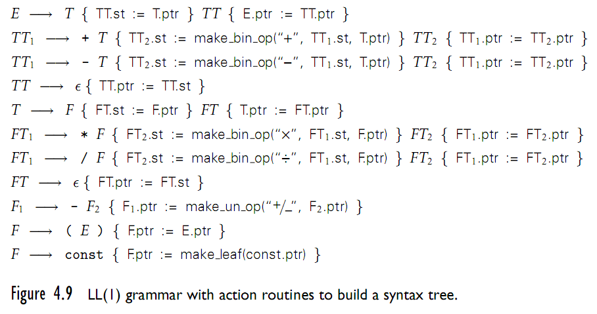
Action Routines - Example
Action routines (Figure 4.9)

Slide 33
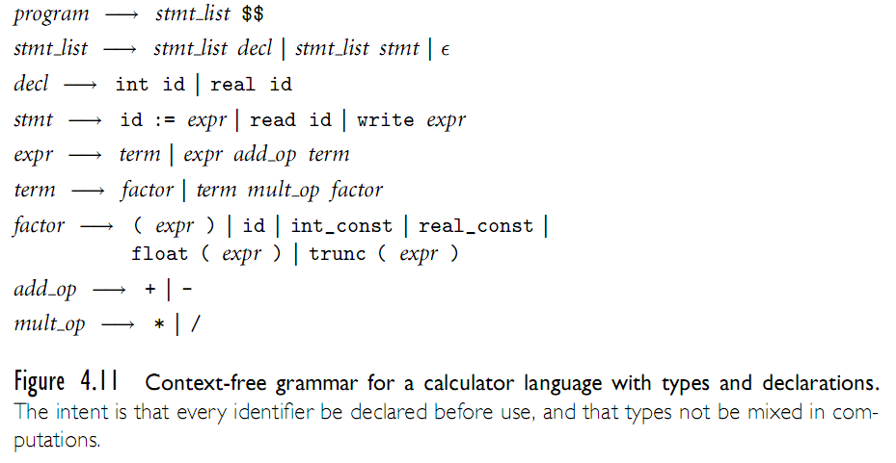
Space Management for Attributes
Entries in the attributes stack are pushed and popped automatically

Slide 34
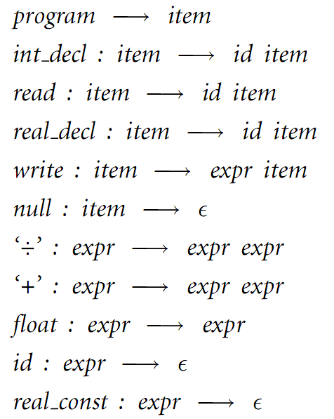
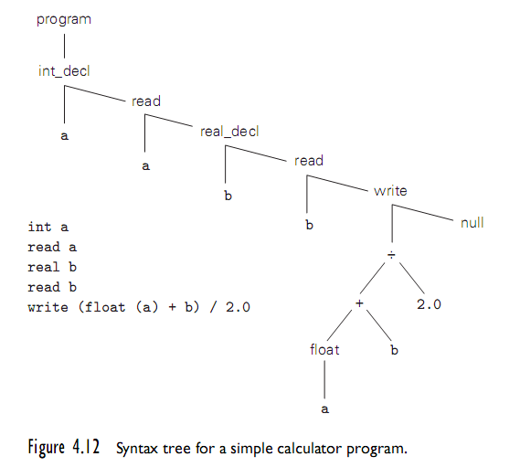
Decorating a Syntax Tree
Syntax tree for a simple program to print an average of an integer and a real

Slide 35
Decorating a Syntax Tree
Tree grammar representing structure of syntax tree in Figure 4.12

Slide 36
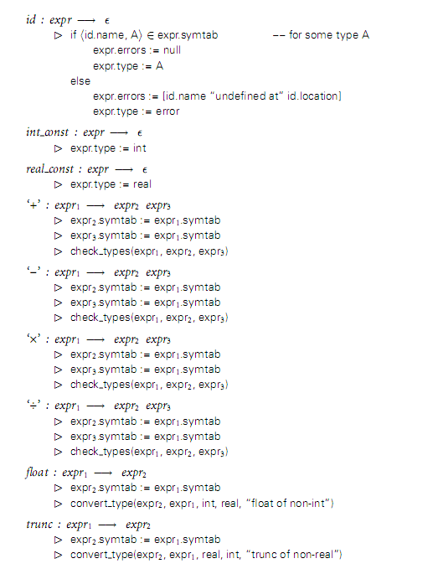
Decorating a Syntax Tree
Sample of complete tree grammar representing structure of syntax tree in Figure 4.12

