Slide 1

Riphah e-Gaming Club
1
Casual gaming, e-sports and much more!

Slide 2
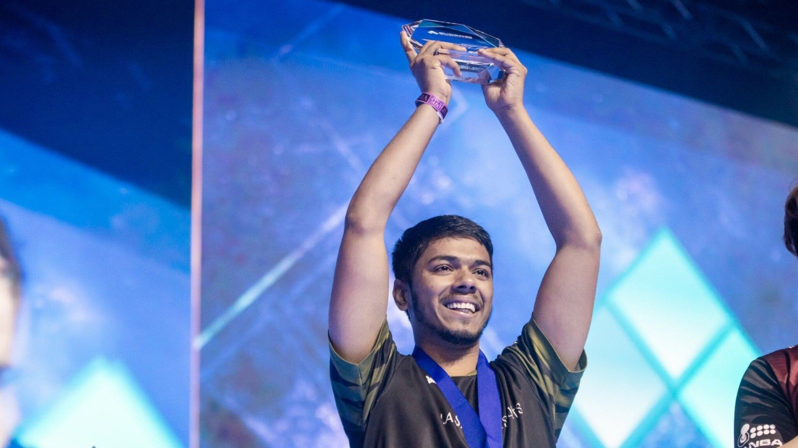
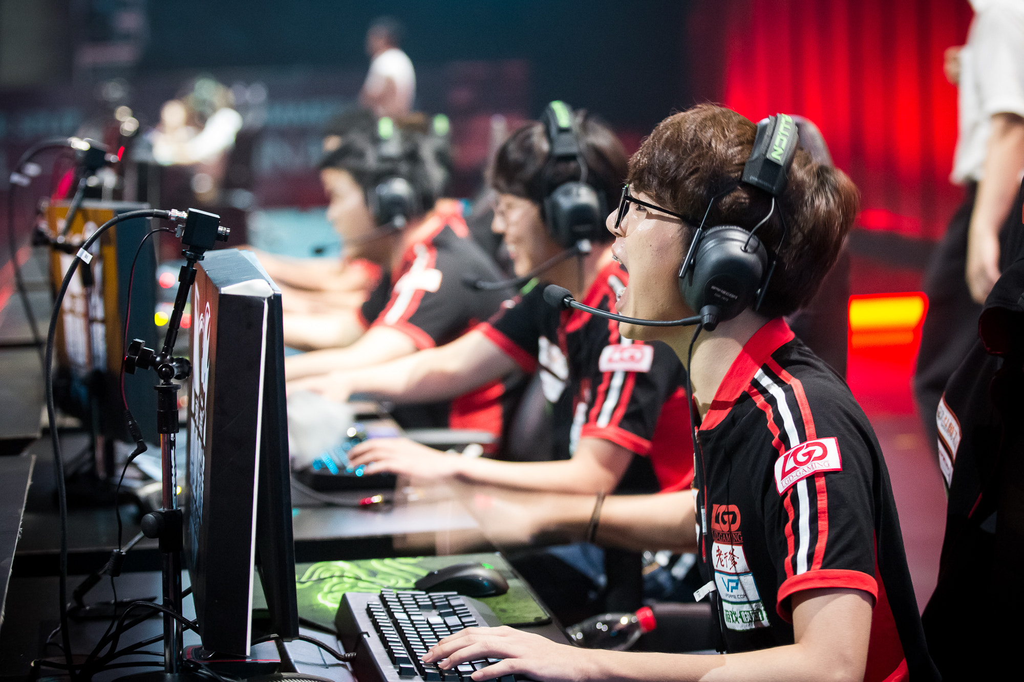
Outline
2
Speed Programming
Logic Programming
Quiz competition
Among Us
PUBG M
COD Mobile(To be decided)
Ludo Star
Valorant(To be Decided)

Slide 3
Speed Programming
3
The key rule is that the person who takes the least amount of time to finish the given task(writing an algorithm) will be considered the winner.
No internet allowed
Any kind of cheating will not be tolerated

Slide 4
Logic Programming
4
The person with the most efficient code out of all participants will be announced as the winner
Time does not matter in this competition
No internet usage allowed
Any kind of cheating will not be tolerated

Slide 5
Quiz competition

Slide 6
Among Us Rules and Config.
5
Among Us is a competition between individuals in which the game randomly assigns each player to crewmates and impostors, to address the randomness we have devised a points based system. It is much harder to win a round in which you’re an imposter, so they get five points for a win, while crewmates get four points for a win. Imposters also get one point per kill, while crewmates get two points when they vote to execute an imposter, and lose one point when they mistakenly vote for another crewmate.
The point system is as follows:
Crewmates:
Vote out impostor: 2 points
Wrong vote: -1 point
Skip: 0 points
Win: 4 points

Slide 7
Among Us Rules and Config.
4
Impostors:
Kill: 1 point
Win: 5 points
There will be 3 rounds of game play with each round lasting 30 minutes and scores reported in between rounds.
Players individual scores will be added together to form their team score with each players score counting every vote counts.
If there is a tie at the end of the round the game will continue until there is a 1st, 2nd & 3rd place winner.

Slide 8
PUBG M Rules
5
FFA Battle Royale SQUADS ONLY
For both Girls and Boys
2 Matches (Livik) simultaneously
TPP
Top 30 from both matches will face off in a third final match in livik (TPP)
Squads caught teaming up with other squads or players will be disqualified instantly
Any exploitation or cheats are not allowed
Emulator players will be disqualified instantly
The Heads and reserve the right to change the rules anytime.

Slide 9
Ludo Star Rules and Config.
6
Only Female participants allowed
Max 16 entries only
4 matches will be conducted (1v3) simultaneously
One winner from each match will face off each other in a final 1v3
The heads reserve the rights to change the rules anytime
Any kind of cheats or exploits will result in disqualification.

Slide 10
Valorant Rules and Config.
7
Only 20 Entries allowed (4 Teams)
Two matches will be conducted between two teams
The winning teams will face off each other in a final match
Maps will be decided on the spot.
The heads reserve the rights to change the rules anytime
Any kind of cheats or exploits will result in disqualification

Slide 11
8
Summary:
The games added in the outline will be conducted according to their appropriate times and each match/game will be having fixed times so that everything goes smoothly.
We will try our best to execute our plan accordingly.
Regards,
Husnain Momin (Head e-Gaming Club)
end

