Slide 1
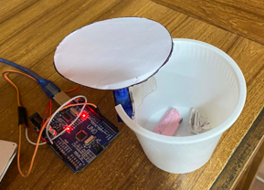
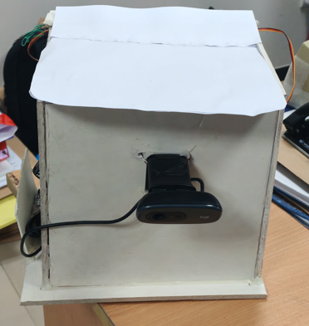
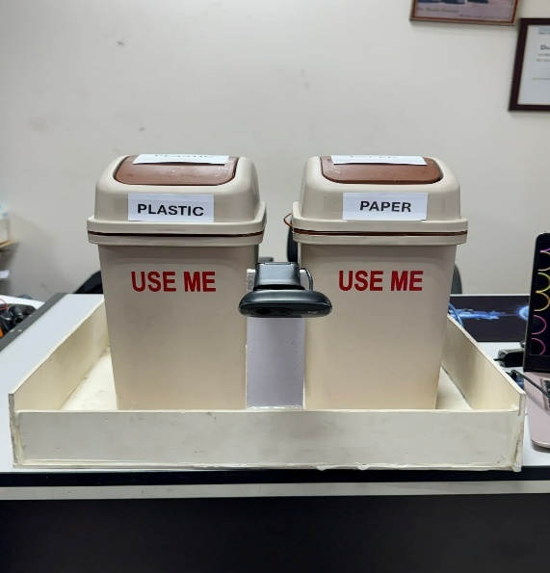
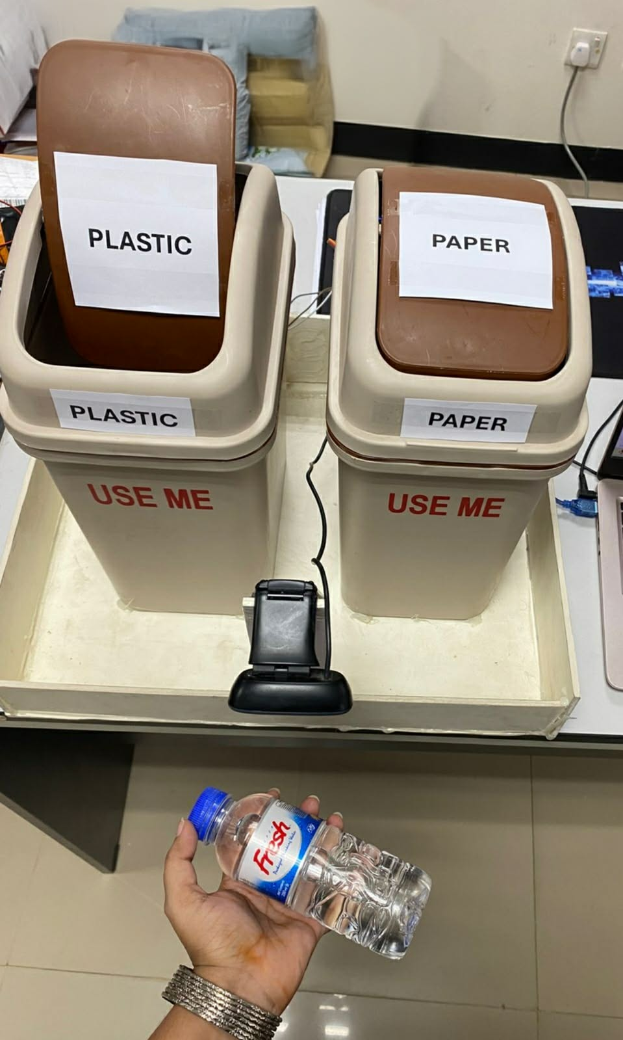
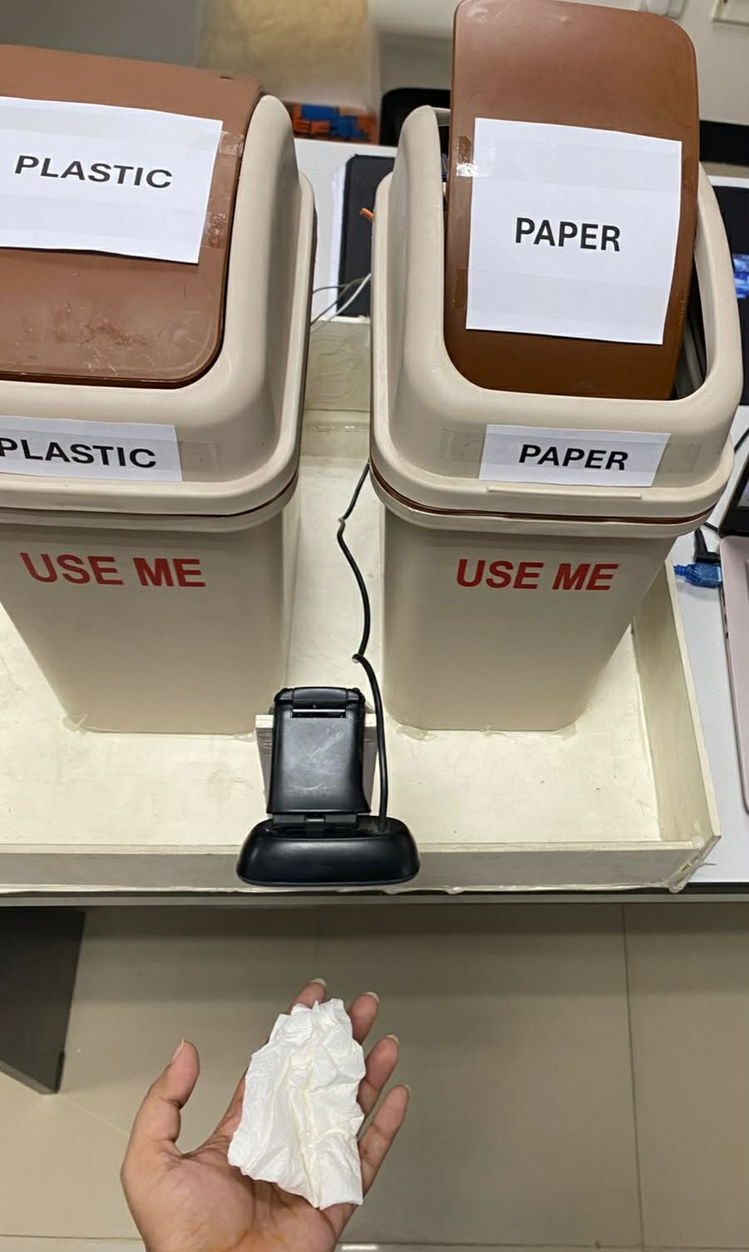
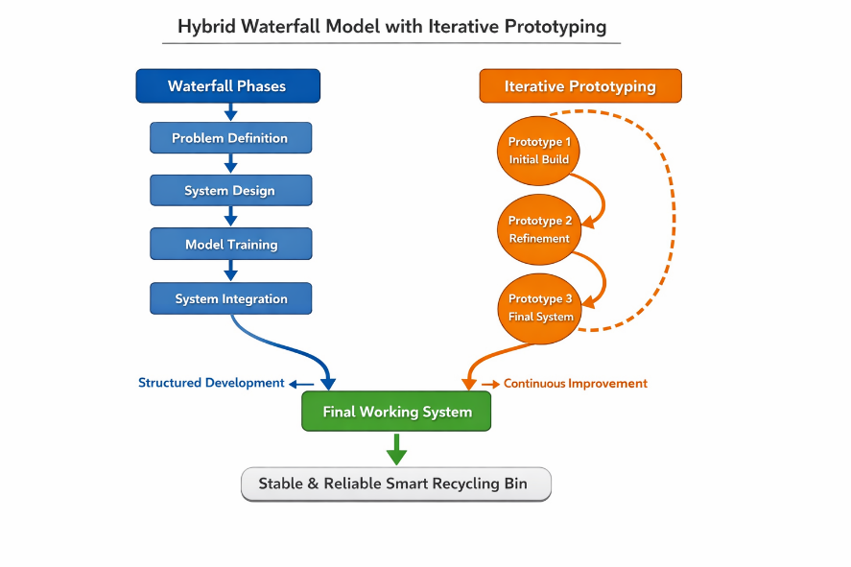

Vision Based Smart Bin
Sharifuzzaman Mazumder, Farhana Rahman Munira, Faria Zaman Titly, Tonmoy Das
Department of Computer Science & Engineering, East West University
Abstract
Prototype Models & Result Analysis
The project proposes the design and development of a vision-based smart bin, whose functionality lies in automatically correct waste detection via object detection. Incorrect waste segregation continues being an issue, leading to pollution of the environment and low levels of recycling efficiency. To deal with this problem, a smart dual-bin system is developed and tested. This system utilizes a lightweight YOLOv8n object detection model, which distinguishes recyclables among the incoming waste (paper and plastic) via a camera. This object detection algorithm is run on a computer that connects to an Arduino Uno R3 device to activate the dual bins according to the detected classes. Thus, if recyclables are found, the relevant servo motors open the corresponding bins. For objects not classified, the servo motors remain idle, thereby allowing other types of waste to be placed into a special compartment. During the training process, the model attained the best results of 72.5% mAP50-95. At the same time, class-specific precisions were 99% whereas recalls equaled 95%. The experiments showed acceptable detection capabilities together with coordinated operation of the hardware and software parts of the project.
Figure 02:
1st Prototype
Single dustbin with one SG90 servo motor connected to Arduino Uno
Basic lid actuation successfully tested, validating the feasibility of automated bin opening and closing.
Figure 03:
2nd Prototype
Dual dustbins with two synchronized SG90 servo motors per bin.
Arduino Uno programmed for synchronized lid movement to ensure smooth operation.
Implemented Camera
Figure04:
3rd Prototype
Two bin system setup for real-world use.
YOLOv8n-model deployed on a computer for real-time detection.
The system accurately detects waste and automatically opens the corresponding bin
Background
As global population growth and industrialization continue, waste management is environmental challenge. Improper segregation of recyclable materials such as plastic and paper increases landfill usage, pollution, and resource loss. Manual waste sorting is inefficient, time-consuming, and prone to human error in household and industrial environments. To address issues, automated waste classification systems using computer vision and machine learning have gained attention. Traditional image processing methods were initially used for waste identification; however, they showed limited robustness in real-world conditions due to variations in lighting, background, and object appearance [1]. With deep learning advancements, CNN-based approaches improve accuracy. For instance, WasteNet achieved strong performance in multi-class waste classification and demonstrated suitability for edge deployment [2]. Additionally, lightweight models such as EfficientNet provide high accuracy with low computational cost suitable for real-time embedded applications [3]. Despite these advancements, most systems focus mainly on software-level classification and lack physical actuation integration. This gap motivates development of an integrated system combining real-time detection with embedded hardware for automated waste segregation. of this project is to design a low-cost scalable solution that detects plastic and paper waste in real time and improves recycling efficiency.
Model Name | Precision | MAP@50:95 | Weight
YOLO v8n | 0.8861 | 0.7251 | 5.94 MB
YOLO v8m | 0.8864 | 0.7259 | 49.6 MB
Discussion
Machine Learning Model Selection: The Comparative evaluation of YOLOv8n, YOLOv8m highlights YOLOv8n as the most practical choice for lightweight and resource constrained deployment.
Servo Synchronization: Proper implementation of Arduino control logic ensures synchronized rotation of dual servo motors. This synchronization is essential for stable and reliable dual-bin lid operation.
Hardware Stability:The system shows stable performance during continuous operation. The use of a modular wiring setup (breadboard and connecting wires) allows easy maintenance and future upgrades.
Real-time Software–Hardware Integration:The YOLOv8n model output is successfully transmitted to Arduino, enabling real-time actuation of the corresponding bin lid based on detection results.
Proposed Methodology
Data Preparation Plastic and paper images were collected in YOLO format and augmented to improve performance under different conditions.
Model Training A YOLOv8n model was trained to detect two classes: plastic and paper, providing class labels with confidence scores.
Detection and Decision The webcam captures images, and the model detects objects. Plastic and paper trigger respective bins, while low-confidence detections are treated as “others.
Hardware ActuationDetection results are sent to Arduino, which controls servo motors to open the correct bin lid and then close it automatically .
Methodology Model
Figure 06: Detecting plastic
Figure 07: Detecting Paper
Conclusions
This project successfully establishes a functional and affordable vision-based smart recycling system through the integration of machine learning, computer vision, and embedded hardware. Overall, this work contributes toward efficient, low-cost, and intelligent waste management systems that can be applied in homes, educational institutions, and small-scale environments, supporting sustainability and environmental protection.
Figure 01:Hybrid Model
References
Redmon, J., Divvala, S., Girshick, R. and Farhadi, A., 2016. You only look once: Unified, real-time object detection. In Proceedings of the IEEE conference on computer vision and pattern recognition (pp. 779-788). cit
Lu, W. and Chen, J., 2022. Computer vision for solid waste sorting: A critical review of academic research. Waste Management, 142, pp.29-43.
White, G., Cabrera, C., Palade, A., Li, F. and Clarke, S., 2020. WasteNet: Waste classification at the edge for smart bins. arXiv preprint arXiv:2006.05873.

