Slide 1
GIT Overview

Slide 2
What is GIT
Git is a mature, actively maintained open source project originally developed in 2005 by Linus Torvalds, the famous creator of the Linux operating system kernel. A staggering number of software projects rely on Git for version control, including commercial projects as well as open source. Developers who have worked with Git are well represented in the pool of available software development talent and it works well on a wide range of operating systems and IDEs (Integrated Development Environments).
Git easily solves mainly two problems: managing project versions and sharing code among developers.

Slide 3
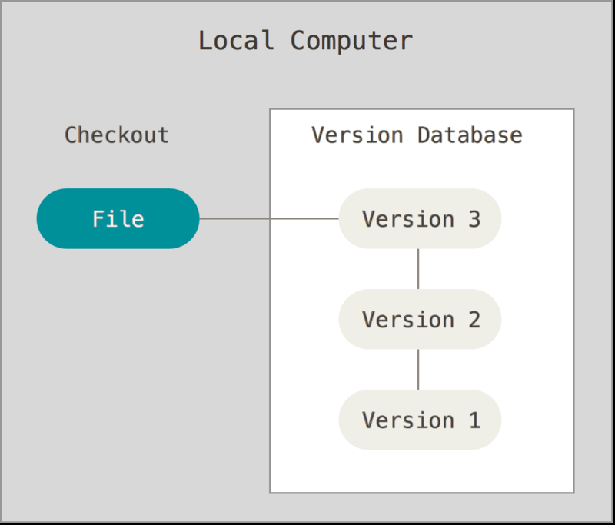
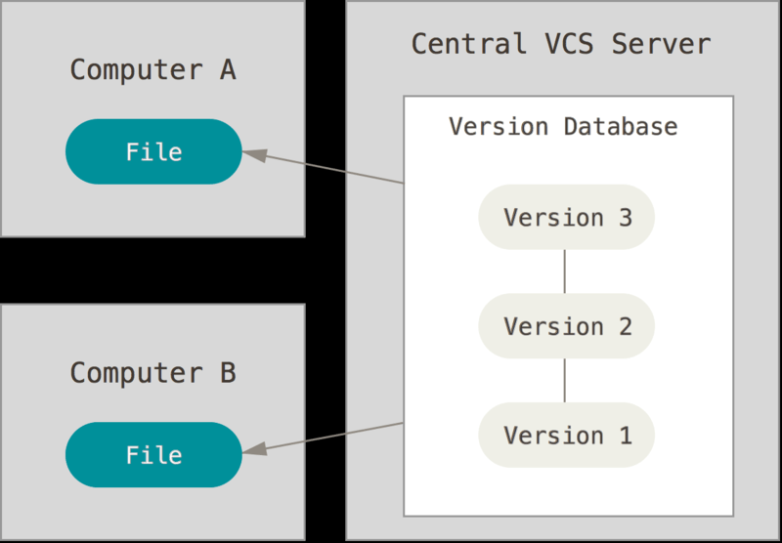
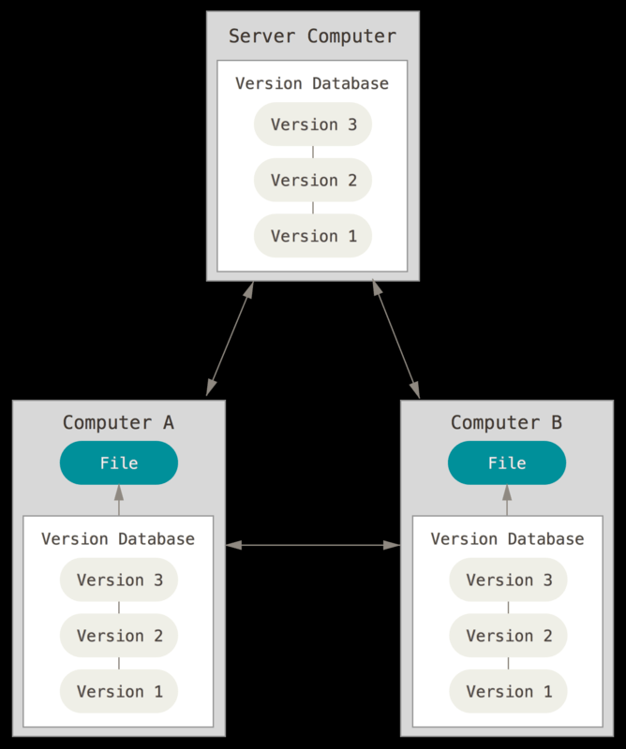
Version control & Types
Version control is a system that records changes to a file or set of files over time so that you can recall specific versions later.
Local Central VCS Distributed VCS

Slide 4
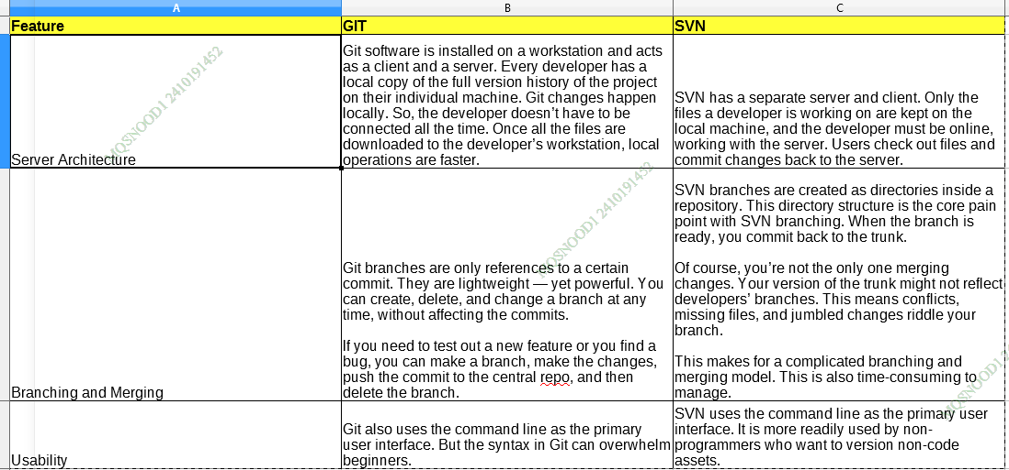
Comparison – GIT Vs SVN
Git vs. SVN: Feature Comparison

Slide 5
Why GIT
Goals for GIT is to achieve :-
Speed
Simple design
Strong support for non-linear development (thousands of parallel branches)
Fully distributed
Able to handle large projects efficiently (speed and data size)
Since its birth in 2005, Git has evolved and matured to be easy to use and yet retain these initial qualities. It’s amazingly fast, it’s very efficient with large projects, and it has an incredible branching system for non-linear development

Slide 6
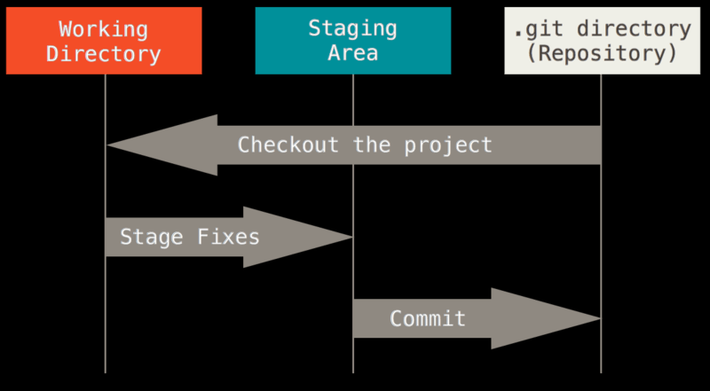
GIT – 3 States of file
Git has three main states that your files can reside in: modified, staged, and committed:
Modified means that you have changed the file but have not committed it to your database yet.
Staged means that you have marked a modified file in its current version to go into your next commit snapshot.
Committed means that the data is safely stored in your local database.

Slide 7
GIT - Installation
Installing on Linux
For manual Installation, https://git-scm.com/download/linux
Installing on Windows
For manual Installation, https://git-scm.com/download/win
For developers working on latest Eclipse , the Git plugin (named EGit) is pre-bundled with the installation package. No extra efforts needed for installation :) .

Slide 8
GIT – Getting a Repository (Cont..)
Initializing a Repository in an Existing Directory
cd /c/user/my_project
git init
Cloning an Existing Repository
git clone <repository path>

Slide 9
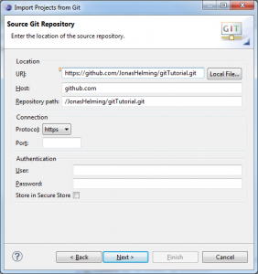
GIT – Getting a Repository (Cont..)
Cloning an existing repository in Eclipse (Enter repo url)

Slide 10
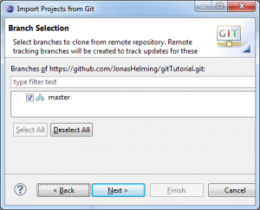
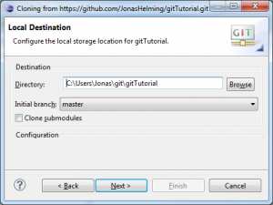
GIT – Getting a Repository (Cont..)
Cloning an existing repository in Eclipse (Branch selection, local destination selection)

Slide 11
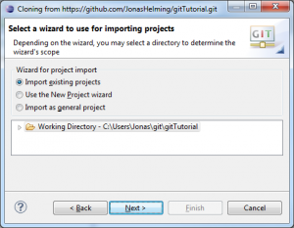
GIT – Getting a Repository (Cont..)
Cloning an existing repository in Eclipse (Import projects)

Slide 12
GIT - Different actions
Creating Local Repositories
Commit
Adding/Removing Files
Reverting Changes
Revert via Compare
Revert via Reset
Cloning Repositories
Creating Branches
Resolving Conflicts
Fetch and Pull
Push
Synchronize
History View

Slide 13
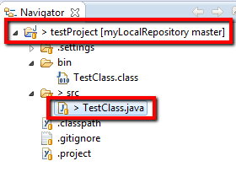
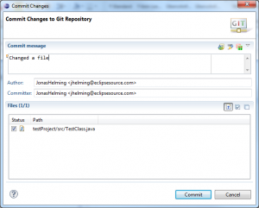
GIT - Different actions - Commit
Commit

Slide 14
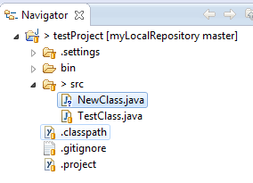
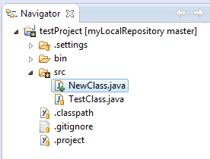
GIT - Different actions - Adding Files
Adding Files – Right click → Team → Add

Slide 15
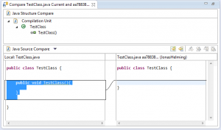
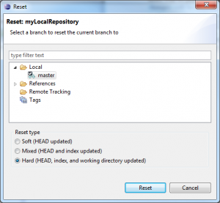
GIT - Different actions - Reverting Changes
Revert via compare Revert via Reset

Slide 16
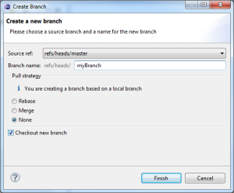
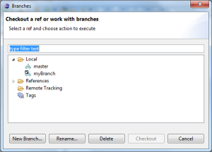
GIT - Different actions - Creating Branches
To create a new branch in your repository, right click a shared project and navigate to Team => Switch to => New Branch…
The new branch should appear in the branch selection window. If you would like to checkout the newly created branch, select it and click Checkout.

Slide 17
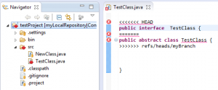
GIT - Different actions -Resolving Conflicts
If your merge resulted in conflicts (note the red symbols on the file icons), you will have to resolve these manually. Open the conflicting files and scroll to the conflicting changes marked with “<<<<<<<”.
After you are finished the manual part of the merge, you will have to tell Git that the conflicts are resolved. To do so, Add the files and Commit to complete your merge.

Slide 18
GIT - Different actions -Fetch and Pull
The operation Pull combines Fetch and Merge.
To perform a Fetch, select Team => Fetch From… from the project’s context menu.
Enter the repository you want to fetch branches from. (If you cloned this repository, the remote branch will be selected as default.)
In the following window you will have to select what you want to fetch. As default, all branches are selected.
The result of the Fetch-operation will be shown in a final confirmation window. Follow the same steps to apply a Pull.

Slide 19
GIT - Different actions -Push
First, right click the project node and navigate to Team=> Push… .
Enter the repository you want to push your branches to (the default for this will be the same as the Fetch default if you didn’t configure a Push default) and hit Next.
Choose the branches you want to push or click Add all branches spec if you want to push all branches. You can also select branches you want to delete from the remote repository.
If you are done hit Finish. A final window will show the results of the Push.

Slide 20
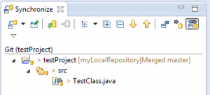
GIT - Different actions -Synchronize
Synchronize

Slide 21
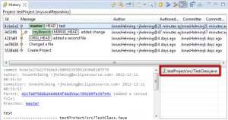
GIT - Different actions - History View
History of changes in files

Slide 22
GIT - Commands
Here are the Git commands which are frequently used:
git config git reset git branch
git init git status git checkout
git clone git rm git merge
git add git log git remote
git commit git show git push
git diff git tag git pull
git stash
Details of commands can be found from :- https://dzone.com/articles/top-20-git-commands-with-examples

Slide 23
GIT – Additional Info
Detailed information can be explored from
https://eclipsesource.com/blogs/tutorials/egit-tutorial/
https://git-scm.com/book/en/v2/
The benefits of moving to GIT over SVN can be explored from below links
https://www.perforce.com/blog/vcs/git-vs-svn-what-difference
https://backlog.com/blog/git-vs-svn-version-control-system/

