Slide 1
Dayananda Sagar College of Engineering
( Shavige Malleshwara Hills, Kumaraswamy Layout, Bengaluru – 560 078 )
Department of
Electronics and Communication Engineering
DSDV Mini-Project
TOPIC: Implementation of Galois field arithmetic
NAME
Vishvendra Singh
Saurabh Singh
Sameer Gautam
USN
1DS18EC156
1DS18EC144
1DS18EC143
Faculty In-charge
Dr. A. Rajagopal

Slide 2
CONTENTS
INTRODUCTION
GALOIS FIELD
REPRESENTATION OF THE ELEMENTS OF GF(2⁴)
ADDITION OF GALOIS FIELD ELEMENTS
MULTIPLICATION OF GALOIS FIELD ELEMENTS
(15, 7) BCH DECODER
SYNDROME CALCULATION
SIMULATION AND RESULTS

Slide 3
INTRODUCTION
In mathematics, a finite field also known as a Galois field (named in honor of Évariste Galois) is a field that contains a finite number of elements. It is a set on which the operations of multiplication, addition, subtraction and division are defined and satisfy certain basic rules.
Arithmetic in a finite field is different from standard integer arithmetic. There are a limited number of elements in the finite field; all operations performed in the finite field result in an element within that field.
Finite fields are used in a variety of applications, such as classical coding theory in linear block codes for example BCH codes and Reed Solomon error correction.

Slide 4
GALOIS FIELD
It is a type of finite field on which the operations of multiplication, addition, subtraction and division are defined.
Consider the equation, P(x) = x⁴ + x + 1
A Galois Field defined by GF(2^{m} ) does not have both 0 and 1 as their roots.
From the above equation, it is clear that, neither 0 nor 1 is the root of the equation. So, we can say that the 4th order root of above equation lies outside of the GF (2⁴ ) field.
By assuming ‘α’ as one of the root of the equation,
Set P(α)=0,
P (α) = α⁴ + α + 1 = 0
ECE, DSCE 4

Slide 5
Rearranging the above equation gives,
α⁴= α + 1
But multiplying α to the above equation gives,
α⁴ = α + 1
α⁵ = α⁴ . α = α² + α
α⁶ = α⁵ . α = α³ + α²
α⁷ = α⁶ . α = α⁴ + α³ . . .
The higher order field elements can be generated similarly by multiplying α to its previous power.
The fifteenth power of α can be calculate as below: α¹⁵= α¹⁴. α = 1. Here, the simplification of the fifteenth order gives 1,
which is an existing element so; further powers of α will always give the existing elements.
Therefore, the field GF (2⁴) has the following 16 elements:
0, 1, α, α² , α³, α⁴, α⁵ , α⁶ , α⁷ , α⁸, α⁹ , α¹⁰, α¹¹, α¹², α¹³, α¹⁴
ECE, DSCE 5

Slide 6
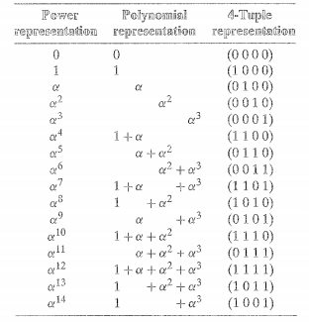
Representation of the elements of GF(2⁴)
For the primitive polynomial,
Set, P(α)=0,
We can construct GF(2⁴) from this
Equation,
P(x) = x⁴ + x + 1
P (α) = α⁴ + α + 1 = 0
α⁵ = α .α⁴= α(1+ α)= α+ α²
α⁶ = α .α⁵= α(α + α²)= α²+ α³
ECE, DSCE 6

Slide 7
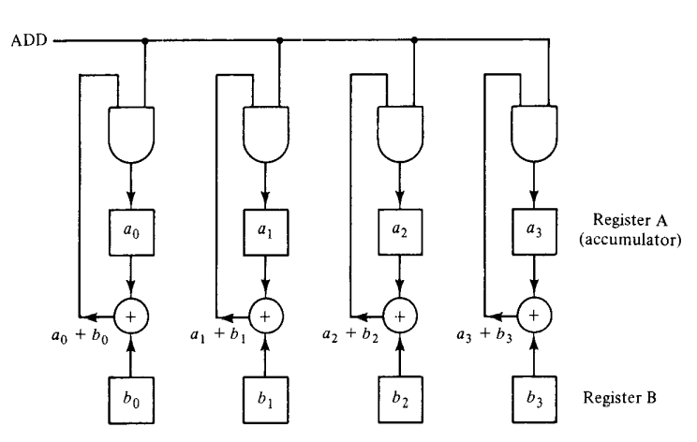
ADDITION OF GALOIS FIELD
In GF(2^{m}), to add two fields elements, we simply add their vector representation (XOR operation).
The resultant vector is then the vector representation of the sum of the two field elements.
For example, α⁷ and α¹³ in GF(2⁴),
In vector representation we can write:
α⁷ => 1101
α¹³ => 1011
So, α⁷ + α¹³ will be,
1101 + 1011 = 0110,
which is the vector representation
of α⁵
( Galois Field Adder )
ECE, DSCE 7

Slide 8
Flowchart for Galois field addition
Control Signals:
INPUT CLK
INPUT powerA
INPUT powerB
OUTPUT out
Two reg variables:
4-bit “alphaA”
4-bit “alphaB”
Case Statements:
clk
powerA
powerB
powerA
powerB
alphaA
alphaB
XOR operation
alphaA alphaB
Output as Sum of two
Galois Field element
ECE, DSCE 8

Slide 9
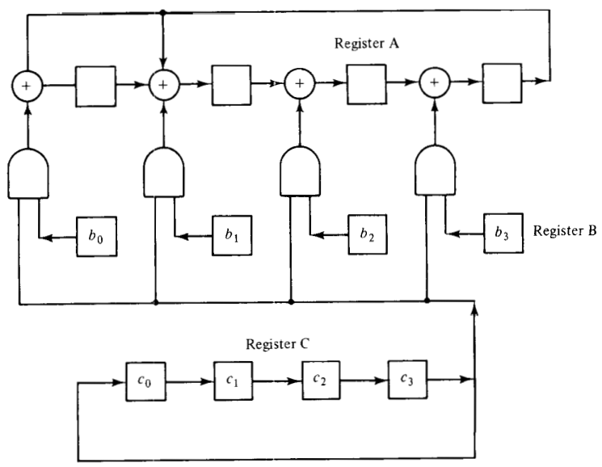
MULTIPLICATION OF GALOIS FIELD
In GF(2⁴), to multiply two arbitrary field elements. Let β and γ be two elements in GF (2⁴).
Express these two elements in polynomial form:
β = b₀ + b₁α + b₂α² + b₃α³ γ = c₀ + c₁α + c₂α² + c₃α³
Then the product βγ can be expressed in the following form:
βγ = (((c₃β)α + c₂β)α + c₁β)α + c₀β
This product can be carried out with
the following steps:
1. Multiply c₃β by α and add the
product to c₂β.
2. Multiply (c₃β)α + c₂β by α and
add the product to c₁β.
3. Multiply ((c₃β)α + c₂β)α + c₁β
by α and add the product to c₀β.
( Galois Field Multiplier )
ECE, DSCE 9

Slide 10
Flowchart for Galois field multiplication
clk
Control Signals:
INPUT CLK
INPUT powerA
INPUT powerB
OUTPUT out
reg variable:
5-bit “p”
p= powerA + powerB
powerA
powerB
p > 14
If True
If False
p = p - 15
p
Case Statement:
p
out
Output as product of two
Galois Field elements
ECE, DSCE 10

Slide 11
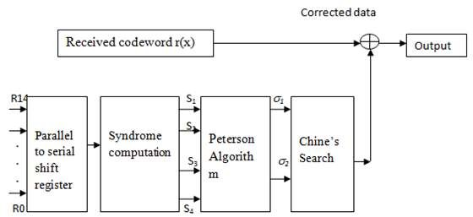
(15,7) BCH Decoder
The decoding algorithm for BCH codes consists of three major steps :-
Calculate the syndrome value S_{i} , i=1,2,….,2t from the received word, r(x).
Determine the error location polynomial s(x)
Find the roots of s(x) and then correct the errors
( Block diagram for (15, 7) BCH Decoder )
ECE, DSCE 11

Slide 12
Flowchart for Syndrome calculation
clk
Rx
[100000001000000]
Control Signals:
INPUT CLK
INPUT 15-bit “rx”
OUTPUT 4-bit “s1,s2,s3,s4”
Integer “i”
reg variables:
4-bit “pxA”, “pxB”
First, check the index of value of “1 bit” in
“rx” polynomial using while and if – conditions
pxA = 0
pxB = 8
Assign the respective index of value “1” bit
to “pxA” and for next index assign to “pxB”
s1=add(pxA, pxB)
s1= 0010= α²
To calculate syndrome, [s1,s2, s3, s4]
We will use “pxA” and “pxB”
s2=add(pxA, 2*pxB)
Function ADD:
s2= 1100= α⁴
s3=add(pxA, 3*pxB)
add=alpha XOR alphaB
s3= 1101= α⁷
s4=add(pxA, 4*pxB)
s4= 1010= α⁸
Output as Syndrome
ECE, DSCE 12

Slide 13
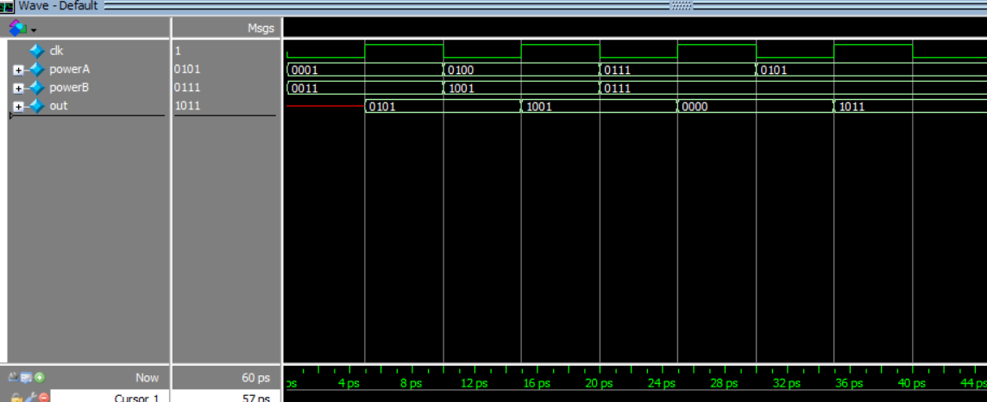
Simulation and Results
ADDITION OF GALOIS FIELD
ECE, DSCE 13

Slide 14
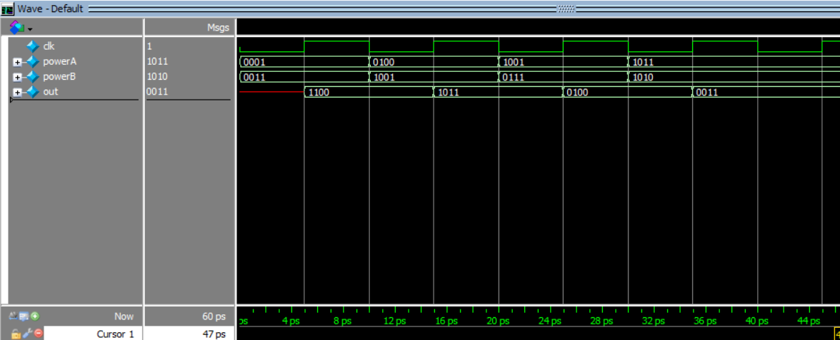
Multiplication OF GALOIS FIELD
ECE, DSCE 14

Slide 15
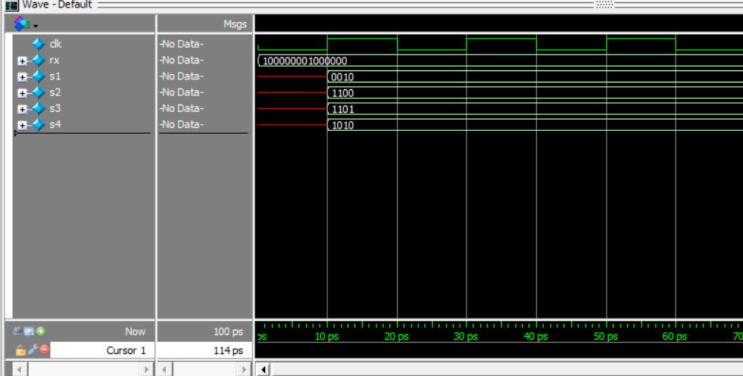
Syndrome calculation
ECE, DSCE 15

Slide 16
THANK YOU!

