Slide 1
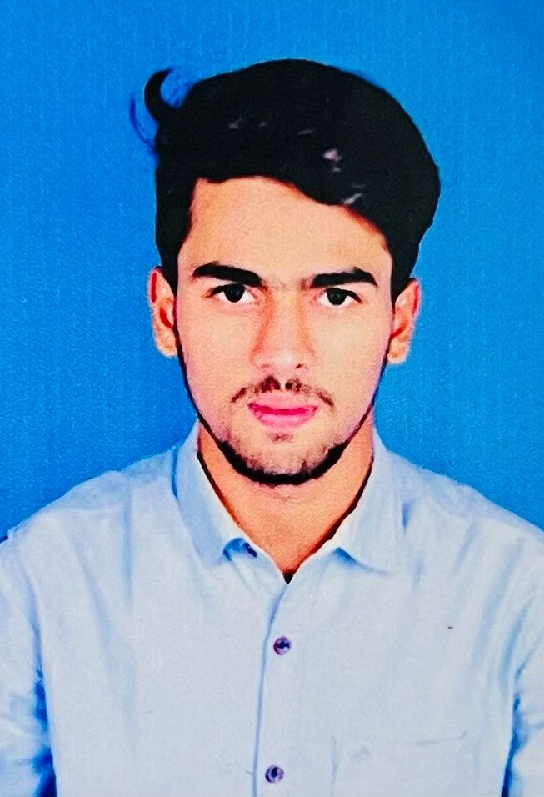
STUDENT DETAILS
Name: shaik sameer
Email id: sameershaik2602@gmail.com
College name: Annamacharya Institute of technology & Science
College state: Andhra Pradesh
Internship domain : Frontend developer
Internship start and end date: 05/06/2023-08/07/2023(5 weeks)

Slide 2
PROJECT TITLE/Problem Statement
Project Title: Front-end developer portfolio
Problem Statement:
To create a visually appealing and functional website that showcases the developer's skills, projects, and experience. The portfolio should effectively communicate the developer's expertise in front-end development and highlight their ability to create engaging user interfaces.
The portfolio should feature a selection of the developer's best projects, providing details about each project's objectives, technologies used, and the developer's specific contributions. The projects should showcase a range of front-end development techniques and highlight the developer's problem-solving abilities.

Slide 3
Agenda
The main agenda of this presentation is expertise my project
Portfolio website it includes the project overview, who are
the end users , modeling, results, links.
As a front end developer portfolio site there must been the content of his Introduction, about me, skills and expertise, projects showcase, contact Information.

Slide 4
Project Overview
The project is to create a personalized web developer portfolio website to showcase skills, experience, and projects. The portfolio website will serve as a representation of work and expertise in web development, providing potential clients or employers with an In-depth understanding of capabilities.
Key features and components:
1)Home
2)About me
3)Skills and expertise
4)Project showcase
5)Contact Information

Slide 5
Who are the end users
Potential clients: the primary end users of a web developer portfolio website are potential clients who are looking to hire a web developer for their projects. These could be individuals, small businesses, startups, or even larger organizations. They visit the portfolio website to evaluate the web developer's skills, expertise, and previous work to determine if they are a good fit for their project requirements.
Freelance opportunities: some web developers may be interested in securing freelance opportunities or collaborations. In this case, other web developers or agencies seeking to partner with or outsource work to a skilled developer could be the end users. They would assess the portfolio website to gauge the developer's capabilities and determine If they would be a valuable addition to their projects.
Employers: web developer portfolio websites can also be relevant for employers who are seeking to hire a web developer for their company or organization. Employers may Include recruiters, HR professionals, or decision-makers within companies who review portfolios to assess a candidate's qualifications and suitability for available job positions.

Slide 6
Solution and its value proposition
Responsive design: Our portfolio website ensures a seamless experience across various devices and screen sizes. It is fully responsive and optimized for desktops, laptops, tablets, and smartphones. This responsiveness enables potential clients or employers to access your portfolio from any device, increasing your reach and engagement.
User-friendly interface: Our solution focuses on creating a user-friendly interface that allows visitors to navigate your portfolio website with ease. A well-organized layout and Intuitive design help visitors quickly find the information they are seeking, resulting in a positive user experience.
Accessibility and performance: Our portfolio website adheres to web accessibility standards, ensuring that Individuals with disabilities can access and navigate your content. Additionally, we prioritize performance optimization, resulting In fast loading times and efficient resource utilization.

Slide 7
Customize the project and make it your own?
Code optimization: As a web developer, I optimized the website's code by following best practices and implementing techniques to improve performance. This included minimizing file sizes, compressing images, and optimizing loading times, resulting in a faster and more efficient website.
Responsive design: I made sure that the portfolio website was fully responsive and adapted seamlessly to different devices and screen sizes. By testing the website on various devices and making necessary adjustments, I ensured an optimal user experience regardless of the device being used.
Visual design: I carefully selected a color scheme and typography that resonated with my personal brand and style. I chose fonts that reflected professionalism and readability, and colors that conveyed a sense of creativity and modernity. By Incorporating my preferred design elements, I gave the portfolio website a unique visual Identity.

Slide 8
Modelling
In this project I have been included some techniques they are:
Html (hypertext markup language) to structure and organize the content of web pages.
CSS (cascading style sheets) to customize the visual appearance and layout of the website.
Bootstrap framework for a responsive and mobile-friendly design, utilizing its grid system and UI components.
Animations (CSS or JavaScript-based) to add engaging and Interactive elements to the website.
Favicons, small icons, used to visually identify the website in browser tabs or bookmark bars.
Google fonts, a collection of free and open-source fonts, to enhance the typography and visual appeal of the website.
Responsive design, ensuring the website adapts and displays well across different devices and screen sizes.

Slide 9
Results
A web developer portfolio website yields tangible results in terms of increased job prospects, client inquiries, networking opportunities, and the ability to showcase technical abilities. It serves as a powerful marketing tool that highlights your skills, expertise, and professionalism, ultimately propelling career forward In the field of web development.

Slide 10
Links
GitHub repository link:
https://github.com/sameer5072/sameer.git
Project host link:
https://drive.google.com/file/d/1dS6BBrqi4ut8zWgxS1nLC0G27g3PNZd2/view?usp=sharing
References:
Skills build Edunet portfolio demo video
W3 schools

Slide 11
THANK YOU

