Slide 1
VibeTrack On the path to your best self.

Slide 2
agenda
INTRODUCTION
Literature Survey
Objective
Modules
Architecture and Design _________________________________ References

Slide 3
INTRODUCTION

Slide 4
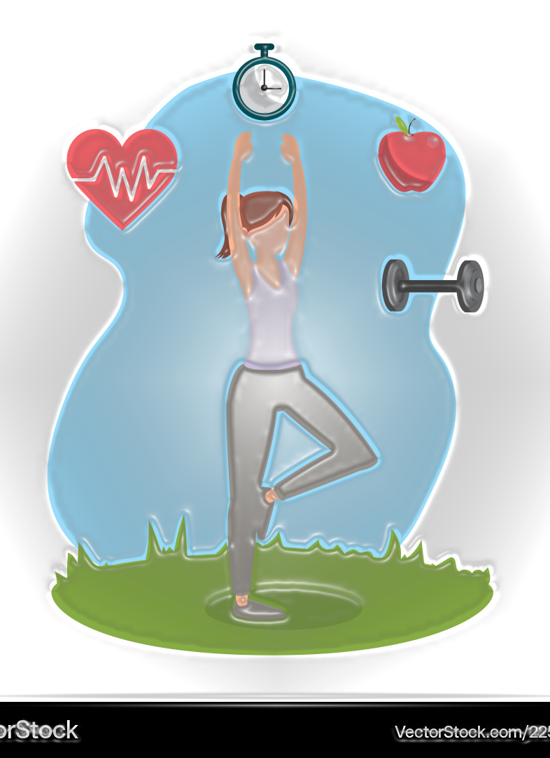
The “VibeTrack” website is an innovative platform designed to help users achieve their health and wellness goals. By providing personalized fitness programs and dietary plans, our website caters to individual needs and promotes a healthier lifestyle. Key features include dedicated courses for women and men, a comprehensive food diet module, and additional wellness courses to support users in their fitness journey

Slide 5
Literature Survey

Slide 6
Current Fitness Trackers:
Numerous fitness tracking solutions are available in the market, including popular apps like MyFitnessPal, Fitbit, and Strava. These platforms offer various features such as exercise tracking, dietary logging, and progress monitoring. Despite their widespread use, many of these solutions lack personalized recommendations and integration across different aspects of fitness and diet.
Identified Gaps: While existing solutions provide valuable features, they often fall short in offering integrated, personalized plans that cater to different user needs. Our Vibe Track aims to fill this gap by offering specialized courses for men and women, a detailed food diet module, and additional wellness resources, all in one cohesive platform.

Slide 7
OBJECTIVE

Slide 8
Project Goals:
The primary goal of the “VibeTrack” is to offer users a holistic approach to managing their fitness and dietary needs. This includes:
Providing customized workout plans for both men and women.
Offering a comprehensive food diet module with personalized meal plans and nutritional advice.
Enhancing user engagement with additional wellness courses and tracking features.
Target Audience:
Our platform is designed for individuals seeking to improve their health through better fitness and diet management. This includes people of various fitness levels, from beginners to advanced users, who are looking for a structured approach to achieving their health goals.

Slide 9
MODULES

Slide 10
Women’s Course:
The Women’s Course module provides tailored fitness programs designed to address the unique fitness needs and goals of women. This includes workout routines, exercise tutorials, and progress tracking features to help users stay motivated and achieve their fitness objectives.
Men’s Course:
The Men’s Course module offers specialized fitness plans for men, focusing on strength training, endurance, and overall fitness improvement. It includes personalized exercise recommendations and tracking tools to support users in reaching their fitness goals.

Slide 11
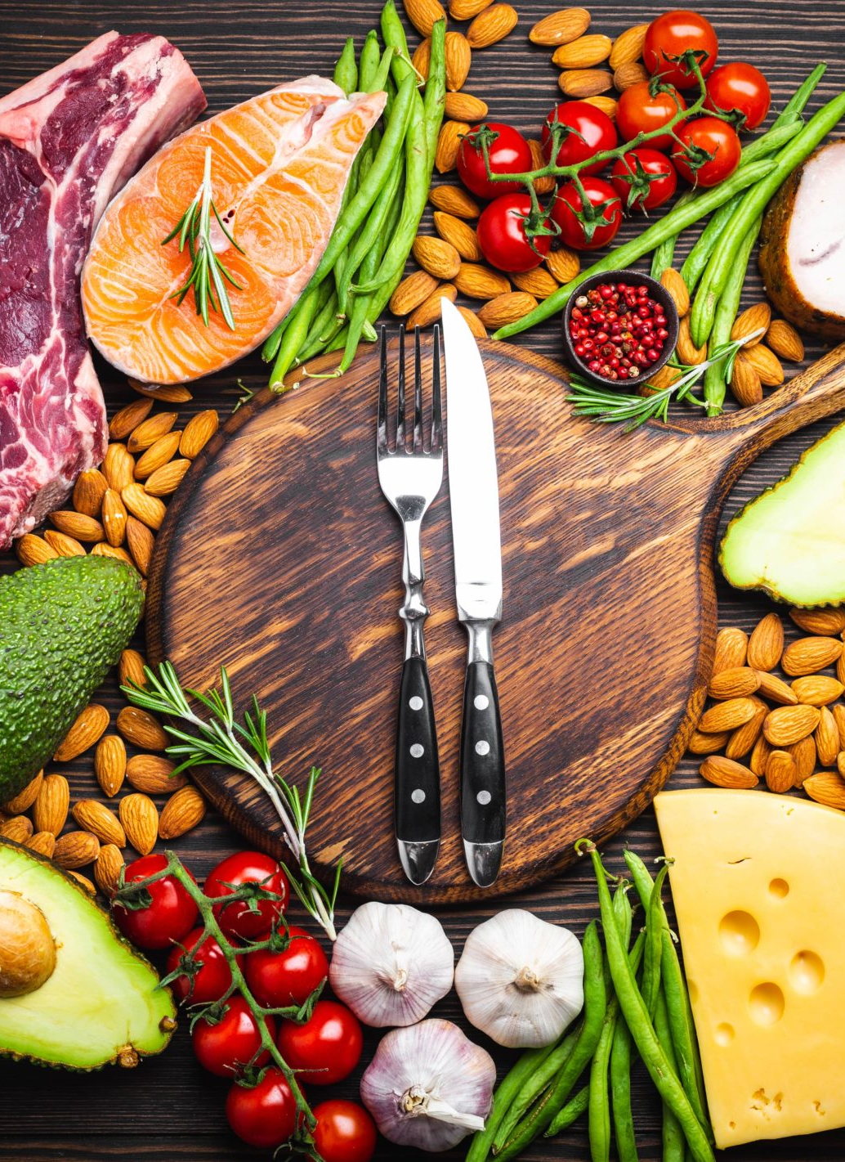
The Food Diet module is a comprehensive tool for managing dietary intake. It includes meal planning features, nutritional information, and personalized dietary recommendations based on user goals and preferences. This module aims to help users make informed food choices and maintain a balanced diet.
Food Diet:

Slide 12
Architecture and Design

Slide 13
The “VibeTrack” website is designed with a straightforward architecture that focuses on delivering a seamless user experience. The architecture can be divided into the following components: Frontend: HTML: Structures the content and layout of the website. CSS: Styles the visual elements, ensuring a responsive and aesthetically pleasing design. JavaScript: Adds interactivity and dynamic features, such as user interactions, form validations, and content updates without reloading the page. Backend: Not included in this project: For future iterations, the backend could handle user authentication, data storage, and server-side logic. Database: Not included in this project: For future expansion, a database could store user data, workout plans, diet information, and progress tracking.

Slide 14
REFERENCES

Slide 15
Dr Workout. (n.d.). Retrieved from https://www.drworkout.fitness
This Is Why I'm Fit. (n.d.). Retrieved from ThisIsWhyImFit.com
Healthline Nutrition. (n.d.). Retrieved from https://www.healthline.com/nutrition
Verywell Fit. (n.d.). Your Guide to a Healthy Diet and Workout. Retrieved from https://www.verywellfit.com
Men's Health. (n.d.). Fitness and Nutrition Tips for Men. Retrieved from https://www.menshealth.com

Slide 16
thank you

