Slide 1
Capstone Project
Hotel Booking Analysis
By:

Slide 2
Points for Discussion
Data Summary
Status of Reservation and the Repeated Guest
Country Name from where most of the Guests are coming
Month Wise Bookings
Bookings by Various Sources
Monthly Cancellations
Cancellations by Type of Customer
Duration of Stay of People
Comparison of Duration of Stay in both types of Hotel

Slide 3
Data Summary
This data set contains booking information for a city hotel and a resort hotel, and includes information such as when the booking was made, length of stay, the number of adults, children, and/or babies, and the number of available parking spaces, among other things.
Following steps were taken to start the Analysis of the Data.
Data Cleaning: Checking for missing or null values in any of the columns.
Separating and generating distinct datasets for the two categories of hotels. (i.e., Resort and City Hotel)
Analysis

Slide 4
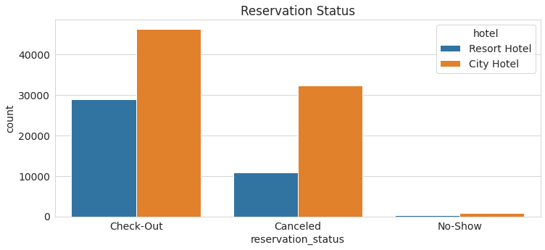
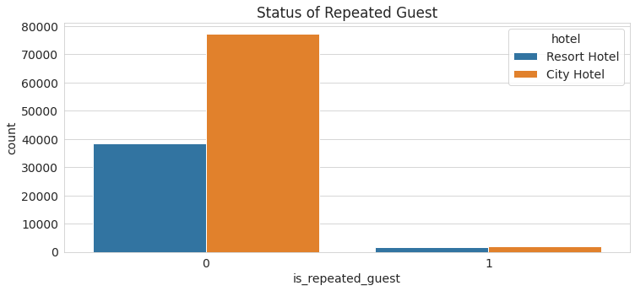
Status of Reservation and the Repeated Guest
It helps the company to get the detail about the Check-out and Cancel Reservation Status.

Slide 5
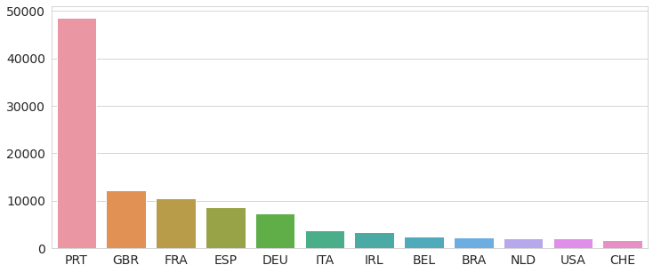
Country Name from where most of the Guests are coming
This Analysis helps company to make a custom or attractive packages for the country from where less guests are coming.

Slide 6
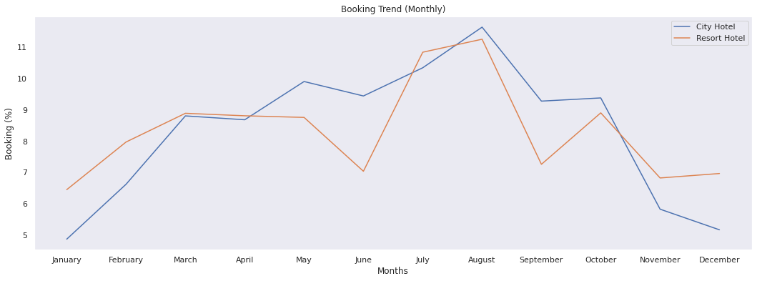
Month Wise Bookings
By this Analysis Company can figure Out which month have less no. of bookings, and provide some offers in that months to increase the sales.

Slide 7
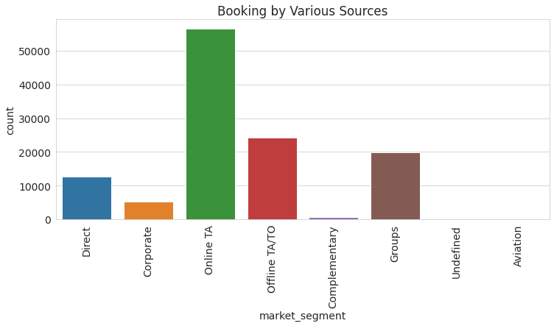
Bookings by Various Sources
By this, Company can get the sources of Booking and get the Idea on which platfom they have to focus.

Slide 8
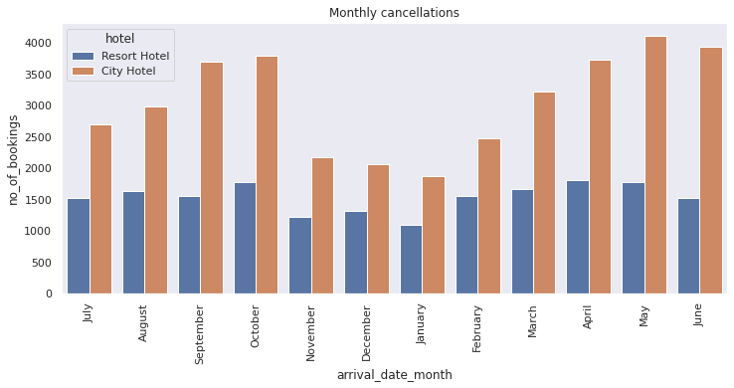
Monthly Cancellations
By this Analysis Company can figure Out which month have max. number of cancellations so that they can have the Idea of Reason for Cancellation like month containing less holidays etc.

Slide 9
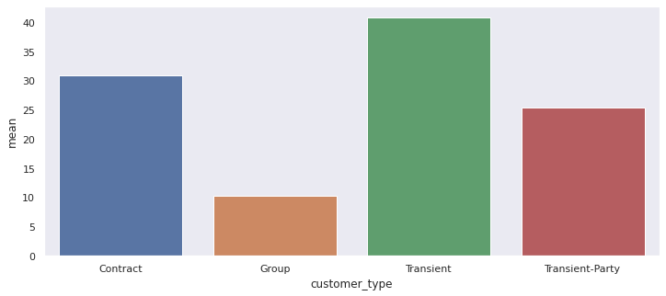
Cancellations by Type of Customer
By this Insight, Company can easily focus on the type of Customers who cancel their Visit / Stay

Slide 10
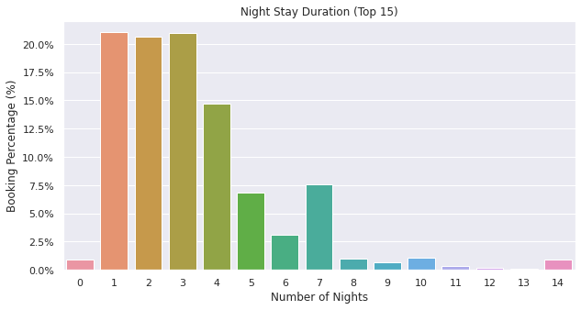
Duration of Stay of People
This is just for Information of the Duration of Stay

Slide 11
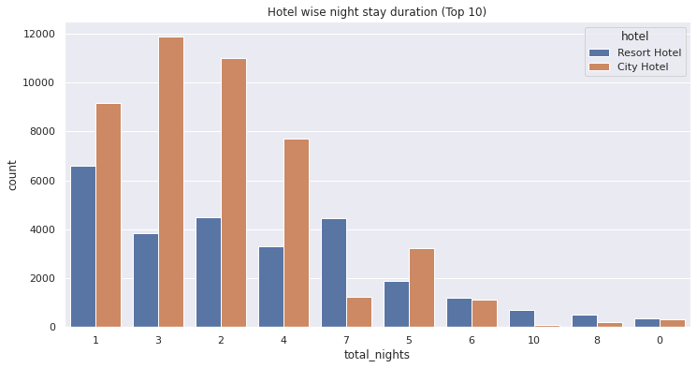
Comparison of Duration of Stay in both types of Hotel
This Analysis provide the comparison by which company get to know that in which type of hotel, people like to stay more.

Slide 12
Conclusion

Slide 13
THANK YOU

