Slide 1

Gender Recognition by Voice
N.S.C.Sameer
http://aiclub.world

Slide 2
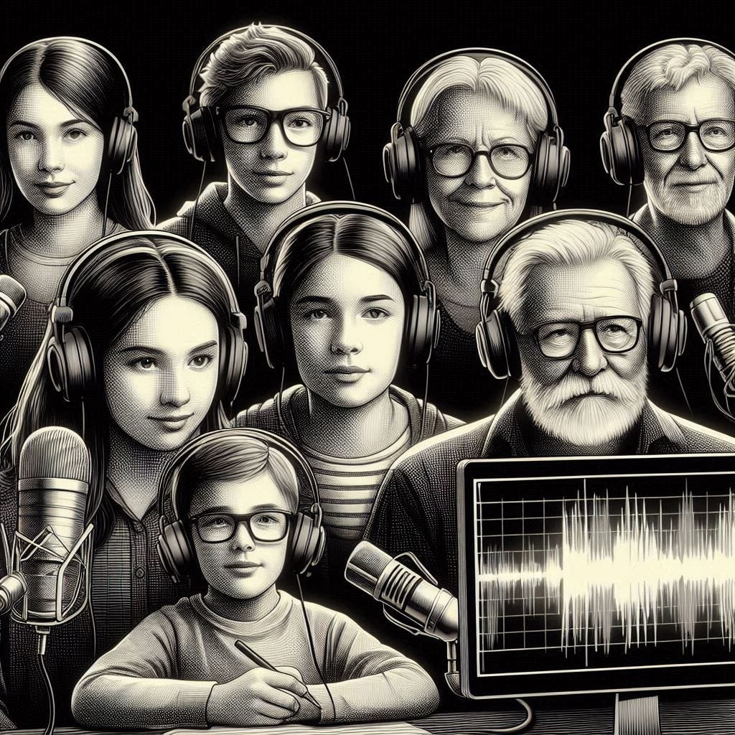
Gender Recognition By Voice
It predicts the gender by the Voice from the given input

Slide 3

Dataset
Number of samples: 3,186
Number of features: 1
Problem type: Classification

Slide 4
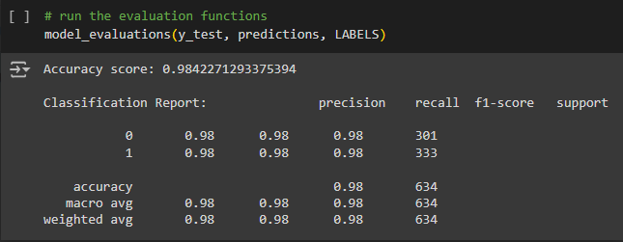
Metrics
How well did your AI do?
98.42% Accuracy

Slide 5
Algorithms (Advanced Classes Only)
KNN
RandomForest
LogisticRegression

Slide 6
Demo

